Slide 1


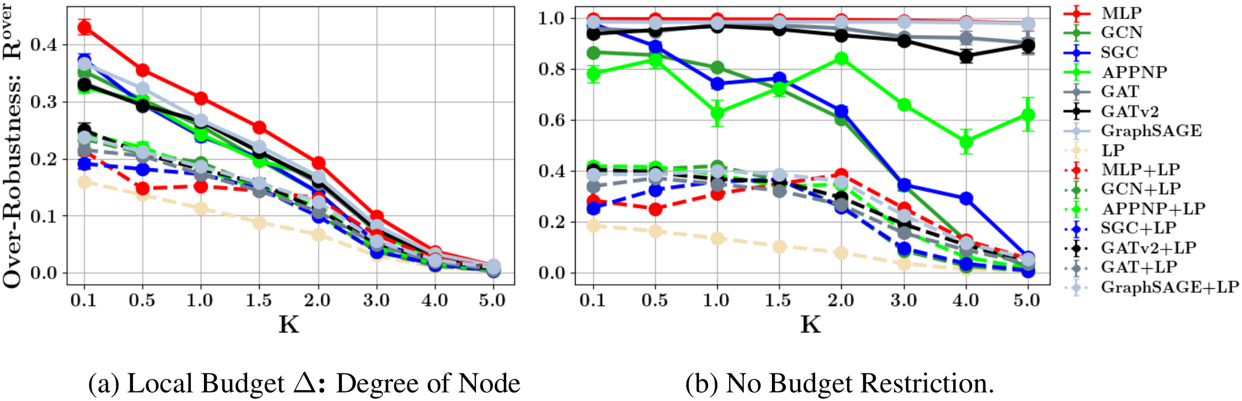

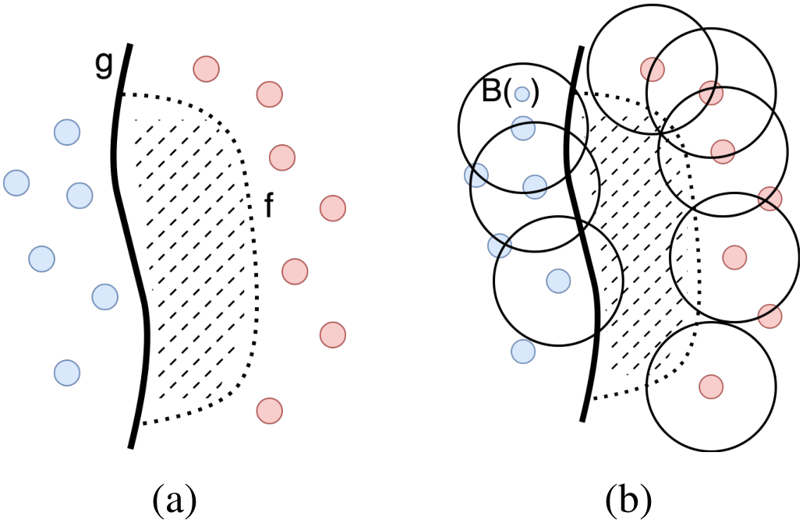
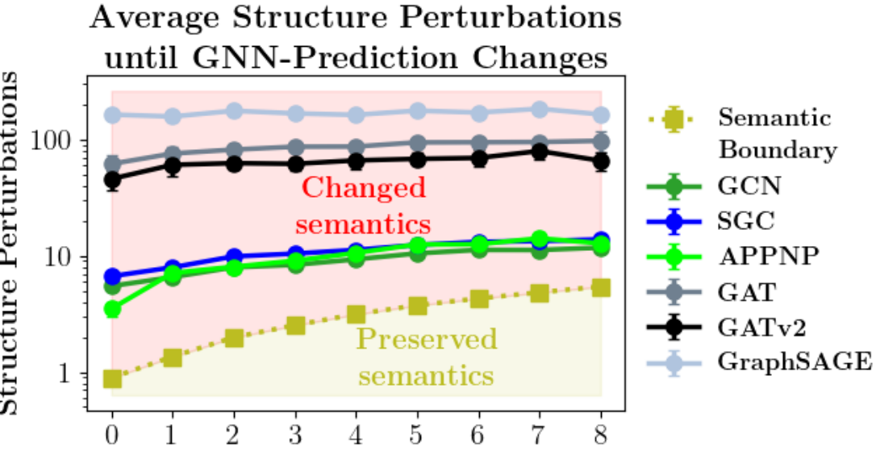
Revisiting Robustness in Graph Machine Learning
Lukas Gosch · Daniel Sturm · Simon Geisler · Stephan Günnemann
Dept. of Computer Science & Munich Data Science Institute, Technical University of Munich
PROBLEM
METHOD
KEY RESULTS
It is unclear whether the small, low-budget structure perturbations used to attack GNNs actually preserve a node’s semantic content — the core assumption behind any adversarial example — and for graphs it has stayed largely unverified, so a “small” attack may already be a relabeling.
On Contextual Stochastic Block Models the Bayes-optimal classifier g is derived exactly and used as a trusted reference for the true semantics.
An over-robust example at node v: f and g agree on the clean graph, the perturbation flips g (semantics change), yet f keeps its original prediction.
Graphs can’t be eyeballed like images, so a small ℓ₀ edge budget may silently change a node’s true label rather than merely perturb the input.
Over-robustness R_{over} vs. signal K — LP variants (dashed) sit far below GNN counterparts.
MOTIVATION
HEADLINE NUMBERS
Most real graph nodes have low degree, so a small ℓ₀ budget can erase a node’s entire original neighbourhood.
R(f,g): semantics-aware robustness vs. reference g · R(f)=R(f,y): conventional degree-corrected robustness
99.4%
43%
over-robust max-robust ref
of target nodes admit a semantics-changing perturbation
20.9%
GCN+LP R_{over} (K=0.5)
Unnoticeability heuristics (degree, homophily) never check the ground-truth label — semantics can shift undetected.
11.4%
GCN R_{over}, Nettack
Common K = 1.0, B_{deg+2} threat model; every GNN then over-robust, not just fragile
19.2%
MLP R_{over}, Nettack (K=2)
Measured on CSBMs; confirmed on Cora-ML.
TAKEAWAY
GNNs are not simply fragile — they are over-robust: much measured robustness persists after a node’s true meaning has changed. Feeding the training graph’s labels back via label propagation reduces it at no cost to accuracy or adversarial robustness. With a semantics-aware definition, classifying a newly added node carries no robustness–accuracy tradeoff — reframing how graph adversarial robustness should be measured — robustness the semantics no longer justify.
Over- vs. adversarial robustness: f (dotted) follows base classifier g except across the boundary; finite perturbation sets B(·) cross it from one side.
All GNNs stay robust far beyond the semantic boundary (CSBM graphs).

