Slide 1





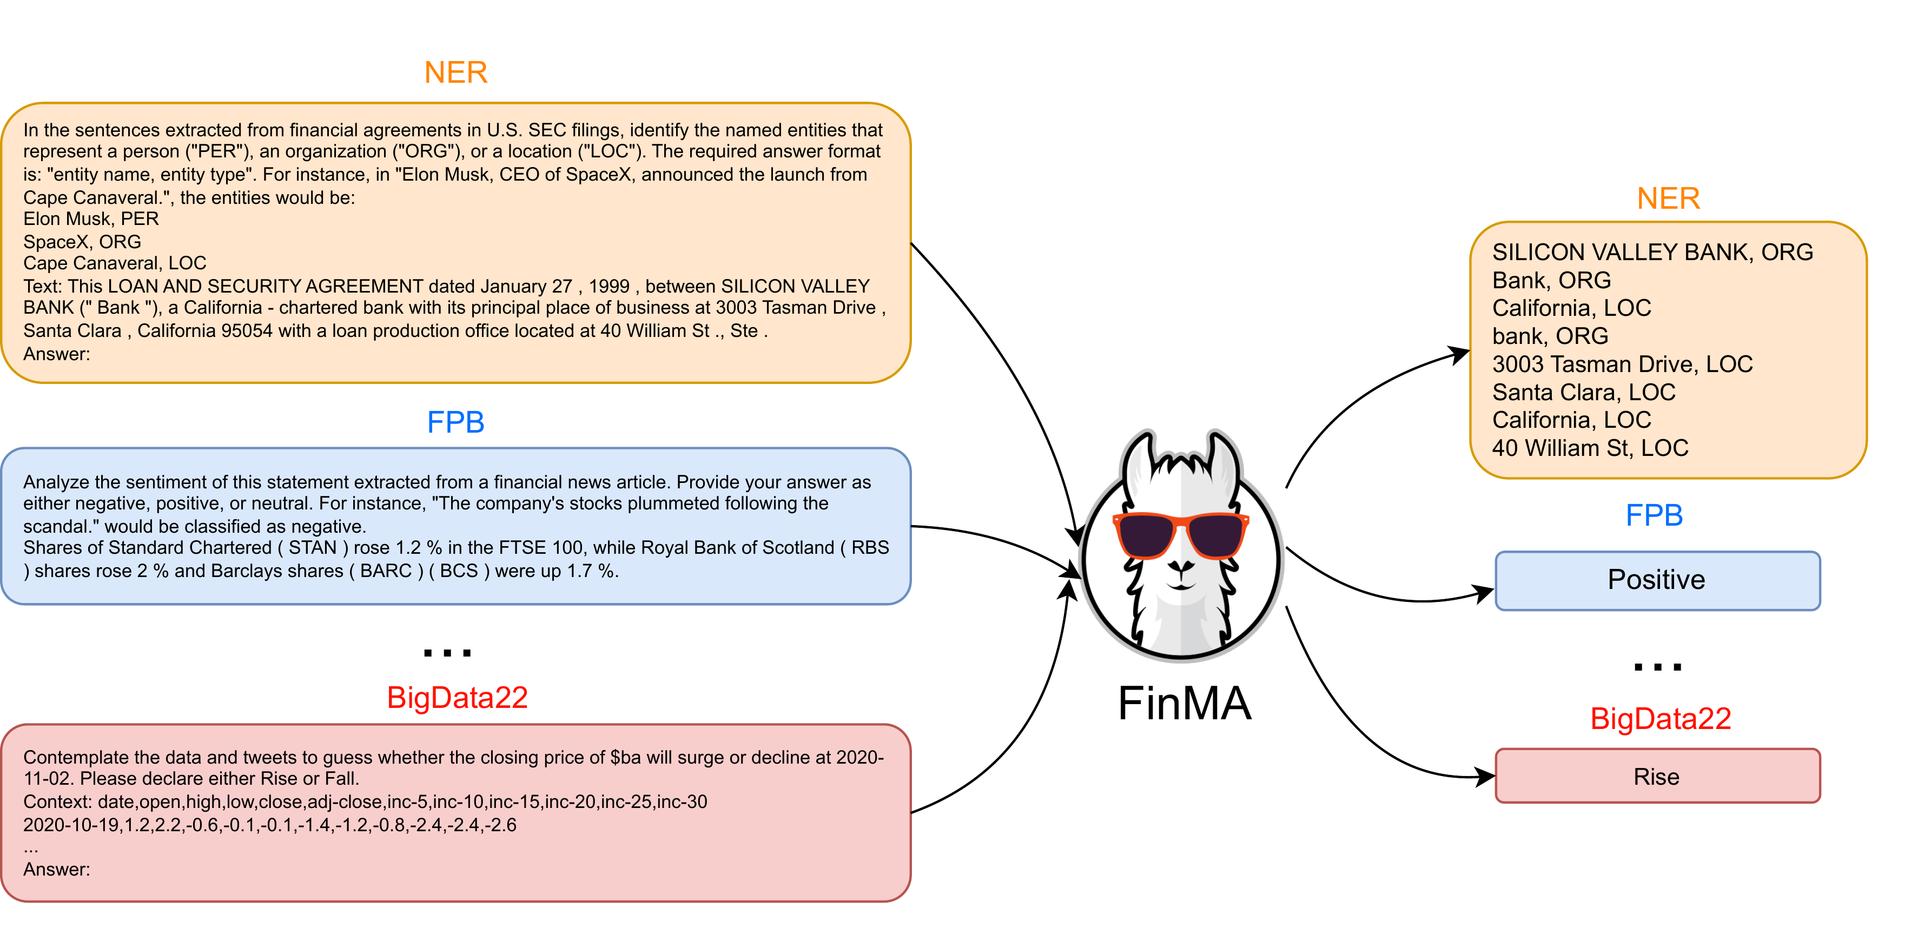


PIXIU: An Open Large Language Model, Instruction
Dataset & Evaluation Benchmark for Finance
Qianqian Xie¹, Weiguang Han¹, Xiao Zhang², Yanzhao Lai³, Min Peng¹, Alejandro Lopez-Lira⁴, Jimin Huang⁵
¹Wuhan University ²Sun Yat-Sen University ³Southwest Jiaotong University ⁴University of Florida ⁵ChanceFocus AMC
PROBLEM
METHOD
DATASET / BENCHMARK
HEADLINE NUMBERS
Financial NLP advances fast, but the
technical nature of financial text
demands domain-specific models — and
almost nothing is open.
136K
+10%
F1 vs GPT-4
(FPB)
1
Collect open data across 5 financial tasks —
sentiment, headline classification, NER, question
answering, and stock-movement prediction.
FIT: 136,609 samples across 5 tasks, 9 datasets
(text, tables, time series).
instruction samples in
FIT
+37%
F1 vs
BloombergGPT
FLARE: 6 NLP + 3 prediction datasets, each with
its standard metric.
first open financial instruction
dataset
7B/30B
open LLaMA
Financial PLMs (finBERT, FLANG) are
tiny (<1B params); no open financial
instruction data or benchmarks
exist.
2
Wrap each sample with domain-expert task
instructions to build FIT, spanning text, report
tables, and stock-price time series.
FPB
FiQA-SA
Headline
NER
FinQA
CONTRIBUTION
ConvFinQA
FIT — first multi-modal financial instruction
dataset (136K).
BloombergGPT (50B), the one large
financial model, is proprietary — no
weights, no data, not instruction-
tuned.
3
Fine-tune LLaMA (7B / 30B) with multi-task
instruction tuning → the FinMA family, then
evaluate on FLARE.
KEY RESULTS
FinMA — first open instruction-tuned financial
LLM.
FPB sentiment
F1
Acc
BloombergGPT
0.51
—
FLARE — first NLP + prediction financial
benchmark.
GPT-4
0.78
0.78
MOTIVATION
FinMA-30B
0.88
0.87
+10% F1 over GPT-4 · +37% F1 over
BloombergGPT
TAKEAWAY
Instruction tuning is essential for
zero-shot financial tasks — yet no
financial instruction data exists to
enable it.
A 30B open model on the right data beats
GPT-4 — the recipe is data, not size.
SO WHAT → SOTA on 3 NLP + 1 prediction task; QA stays hard (weak math).
PIXIU gives financial AI its first fully open triad:
FinMA (model), FIT (data), and FLARE
(benchmark) — proving domain instruction tuning
beats far larger general models.
Real finance needs prediction. Prior
benchmarks (FLUE, BBT-CFLEB)
cover only NLP and ignore stock-
movement prediction aligned with real
trading.
Multi-task, multi-modal instruction tuning of FinMA across
diverse financial tasks (NER, FPB sentiment, BigData22
stock prediction).
ABLATION STUDY
Scale ≠ gain. FinMA-30B ≈ FinMA-7B on most
tasks — data quality & diversity beat size.
Multi-modal inputs: reports, news, tweets, and
SEC filings, plus tabular financial reports and
historical stock-price time series.
SCAN TO READ
Finance demands both language
understanding and time-series
prediction — PIXIU is the first to cover
both, in the open.
CONVFINQA
EM ACC
arxiv.org/abs/2306.05443 ·
github.com/chancefocus/PIXIU
FinMA-7B
0.25
Model family: FinMA-7B and FinMA-30B for
NLP; FinMA-7B-full also handles stock prediction.
FinMA-30B
0.40
GPT-4
0.76
Paper
Code

