Slide 1





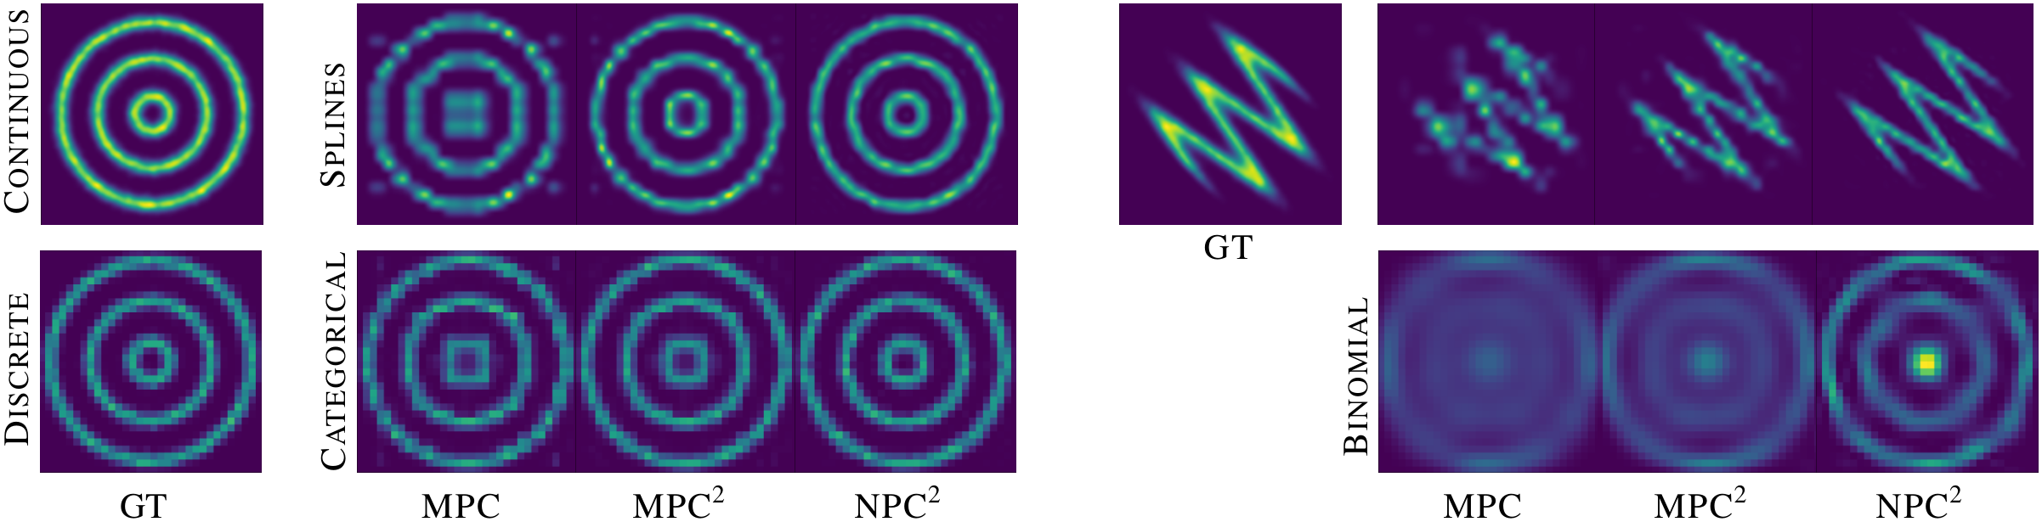
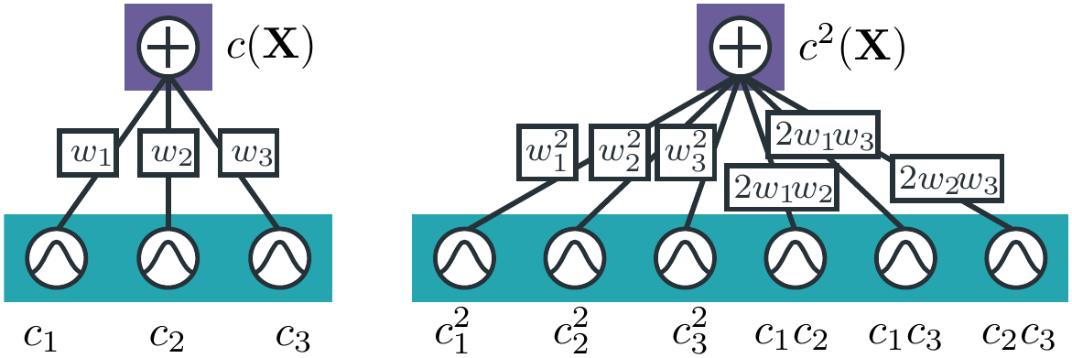
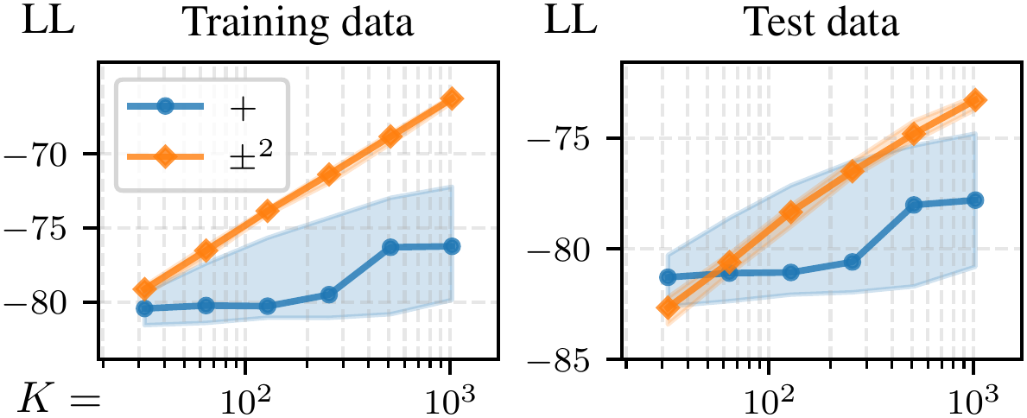
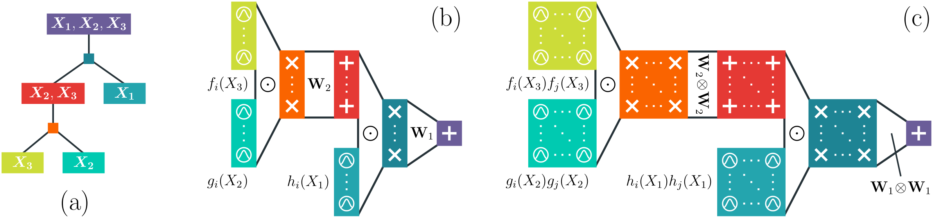
Subtractive Mixture Models via Squaring:
Representation & Learning
Lorenzo Loconte¹, Aleksanteri M. Sladek², Stefan Mengel³, Martin Trapp², Arno Solin², Nicolas Gillis⁴, Antonio
Vergari¹
¹ University of Edinburgh ² Aalto University ³ University of Artois, CNRS, CRIL ⁴ Université de Mons
Problem
Method
Key Results
Classical mixture models can only add non-negative
components, so approximating distributions with holes or
sharp structure needs a large, wasteful number of
components.
Take a mixture with unconstrained real weights and square it: expanding
gives a product-of-experts sum over all component pairs whose normalizer
Z stays closed-form.
TRACTABLE MODEL
POWER
GAS
HEPMASS
EiNet-LRS (MPC)
0.36
4.79
−22.46
TTDE
0.46
8.93
−21.34
Go deep by recursively squaring each layer of a tensorized structured-
decomposable circuit — squared non-monotonic PCs (NPC²) stay
tractable for marginalization and inference.
NPC² (ours)
0.62
10.98
−20.41
Letting components subtract mass can slash that count —
but a naively negative mixture can dip below zero and stop
being a valid distribution, making it hard to learn.
Carving a “hole” in a density with only additive parts
wastes an enormous number of components.
weights w_{i} ∈ ℝ are unconstrained — squaring forces c²(X) ≥ 0 while the normalizer Z stays computable in closed form
On 2D ring densities (continuous, above; discrete, below), only NPC²
sharply recovers the ground-truth holes.
Motivation
SO WHAT → Negative parameters — not squaring alone — carve the holes that monotonic PCs blur.
A subtractive mixture that can cancel mass models
complex distributions with far fewer components.
But naively negative weights can make the density negative
— and prior fixes (energy-based exponentiation) lose
tractable normalization.
Headline Numbers
Subtraction cancels probability mass — capturing “holey”
densities with far fewer components than additive mixtures.
K²
0.62
Power test LL
pairwise components from K
parameters
10.98
Gas test LL
Shallow view: squaring a K=3 subtractive mixture yields more, parameter-sharing
components while staying a valid density.
exponentially more compact than any monotonic PC
−20.41
Hepmass test LL
Takeaway
Squaring turns subtractive mixtures into valid, tractable
probabilistic circuits needing exponentially fewer
components than additive mixtures.
Payoff: distilling data sampled from GPT2, squared non-
monotonic circuits (±²) reach higher log-likelihood than
monotonic PCs (+) as size K grows.
Deep view: recursively squaring each layer of a tensorized circuit; squared layers hold
a quadratic number of units but still output vectors.
Squaring makes subtraction valid and tractable — far
fewer components than adding.

