Slide 1


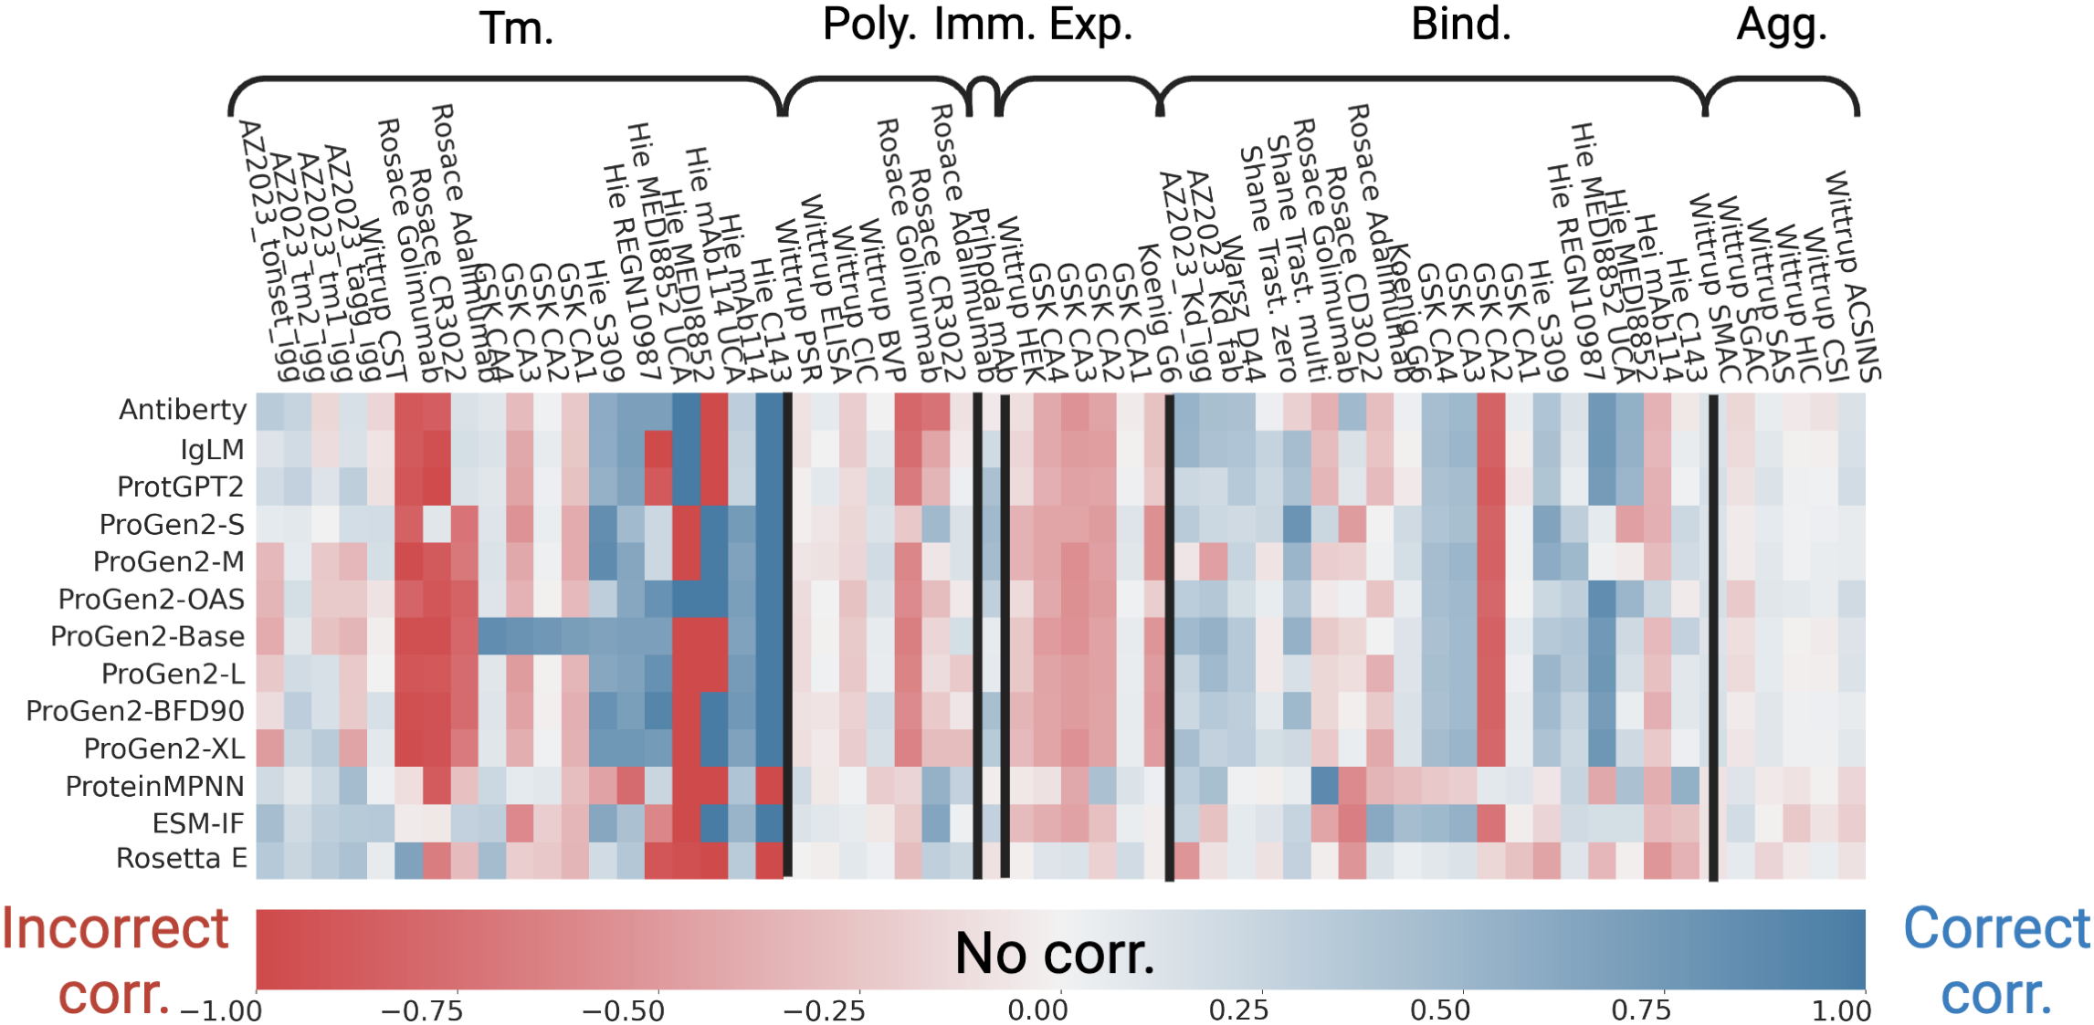
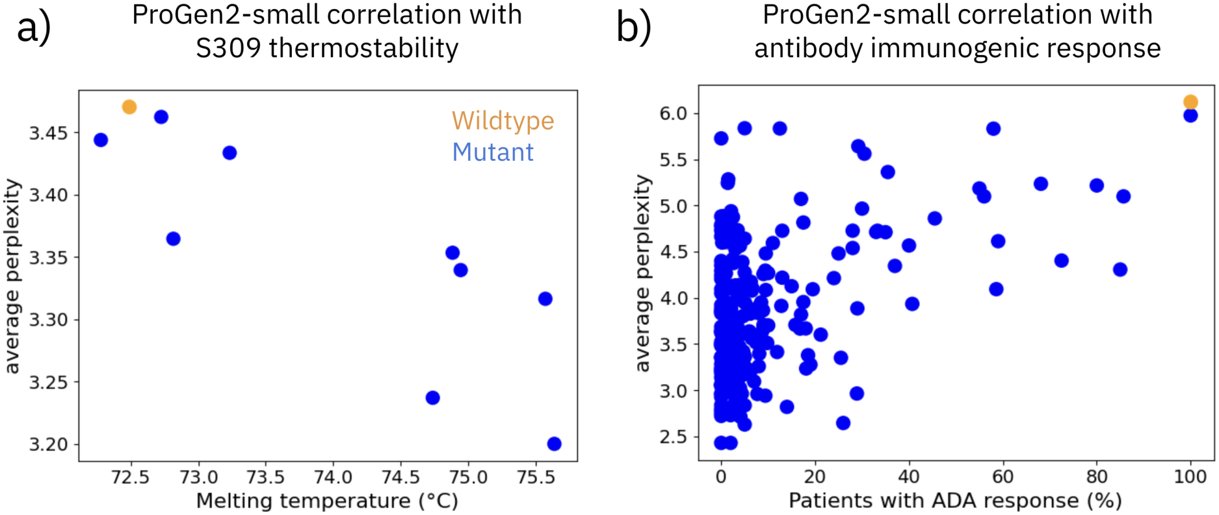


FLAb: Benchmarking Deep Learning Methods for Antibody Fitness Prediction
Michael Chungyoun¹, Jeffrey Ruffolo¹, Jeffrey Gray¹
¹ Johns Hopkins University
PROBLEM
METHOD
ABLATION STUDY
Major protein fitness benchmarks (CAFA, TAPE, FLIP) exclude antibody data or use very little of it, leaving no systematic way to test how well deep learning models capture therapeutic antibody fitness. As new methods proliferate, there is no shared yardstick to compare them.
Each antibody is scored by a model's (pseudo-)perplexity (low = high confidence) and correlated with measured fitness; six pretrained models are benchmarked with no fine-tuning against physics-based Rosetta.
Parameter size beats architecture (AntiBERTy ≈ IgLM).
Scaling ProGen2 151M → 6.4B helped only two properties.
SO WHAT → Evolutionary bias misranks golimumab; Rosetta wins.
Antibody methods are still judged by weak proxies like native sequence recovery.
HEADLINE NUMBERS
13,384
17
mutational landscapes
MOTIVATION
experimental fitness measurements
6
developability properties
A therapeutic antibody must jointly satisfy six developability properties with intricate trade-offs — improving one often hurts another.
8
source studies
TAKEAWAY
No deep learning model reliably predicts antibody fitness across all six properties — much work remains before models can filter candidates.
Reliable model scoring could filter candidates far faster than slow, costly wet-lab screening.
Perplexity correlation with six properties across all model–dataset pairs (blue = useful).
KEY RESULTS
DATASET / BENCHMARK
Path forward: add structure and physics-based priors.
No model correlates well with all six developability properties, and accuracy swings from one dataset to the next within a single property.
17 mutational landscapes from 8 studies, totaling 13,384 fitness measurements.
Each property has its own experimental unit — T_{m}, % ADA, µg/mL, and K_{D} binding affinity.
SCAN TO READ
Sequence-based models beat structure-based ones across every landscape; ProGen2-Small is the most frequent winner, top on 7 of 17 datasets.
Code & Data
github.com/Graylab/FLAb
Perplexity vs. fitness: correct on thermostability (r = −0.84), wrong on immunogenicity (r = 0.48).
Expression
Thermostability
Immunogenicity
Preprint
biorxiv.org/10.1101/2024.01.13.575504
Aggregation
Polyreactivity
Binding
Code
Project

