Slide 1



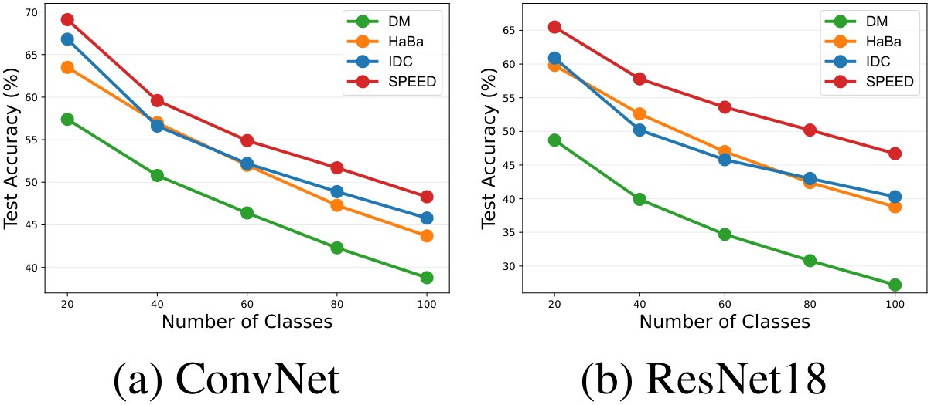
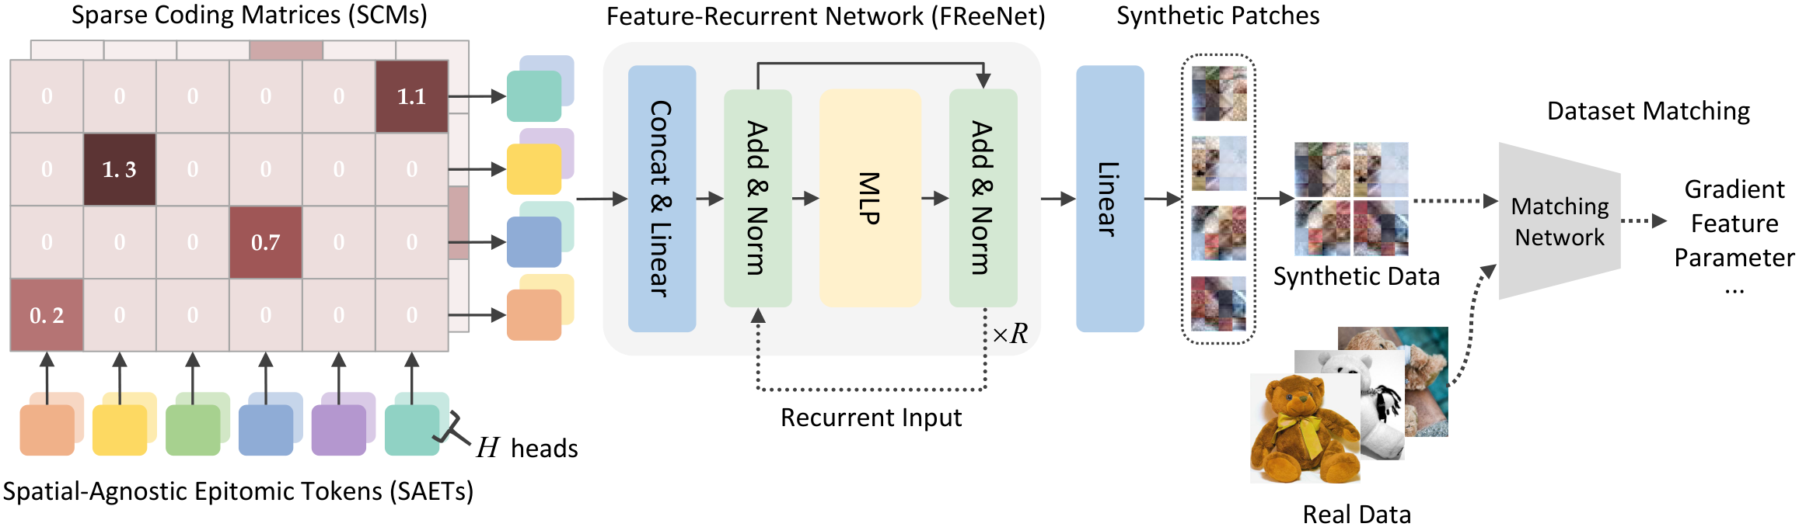
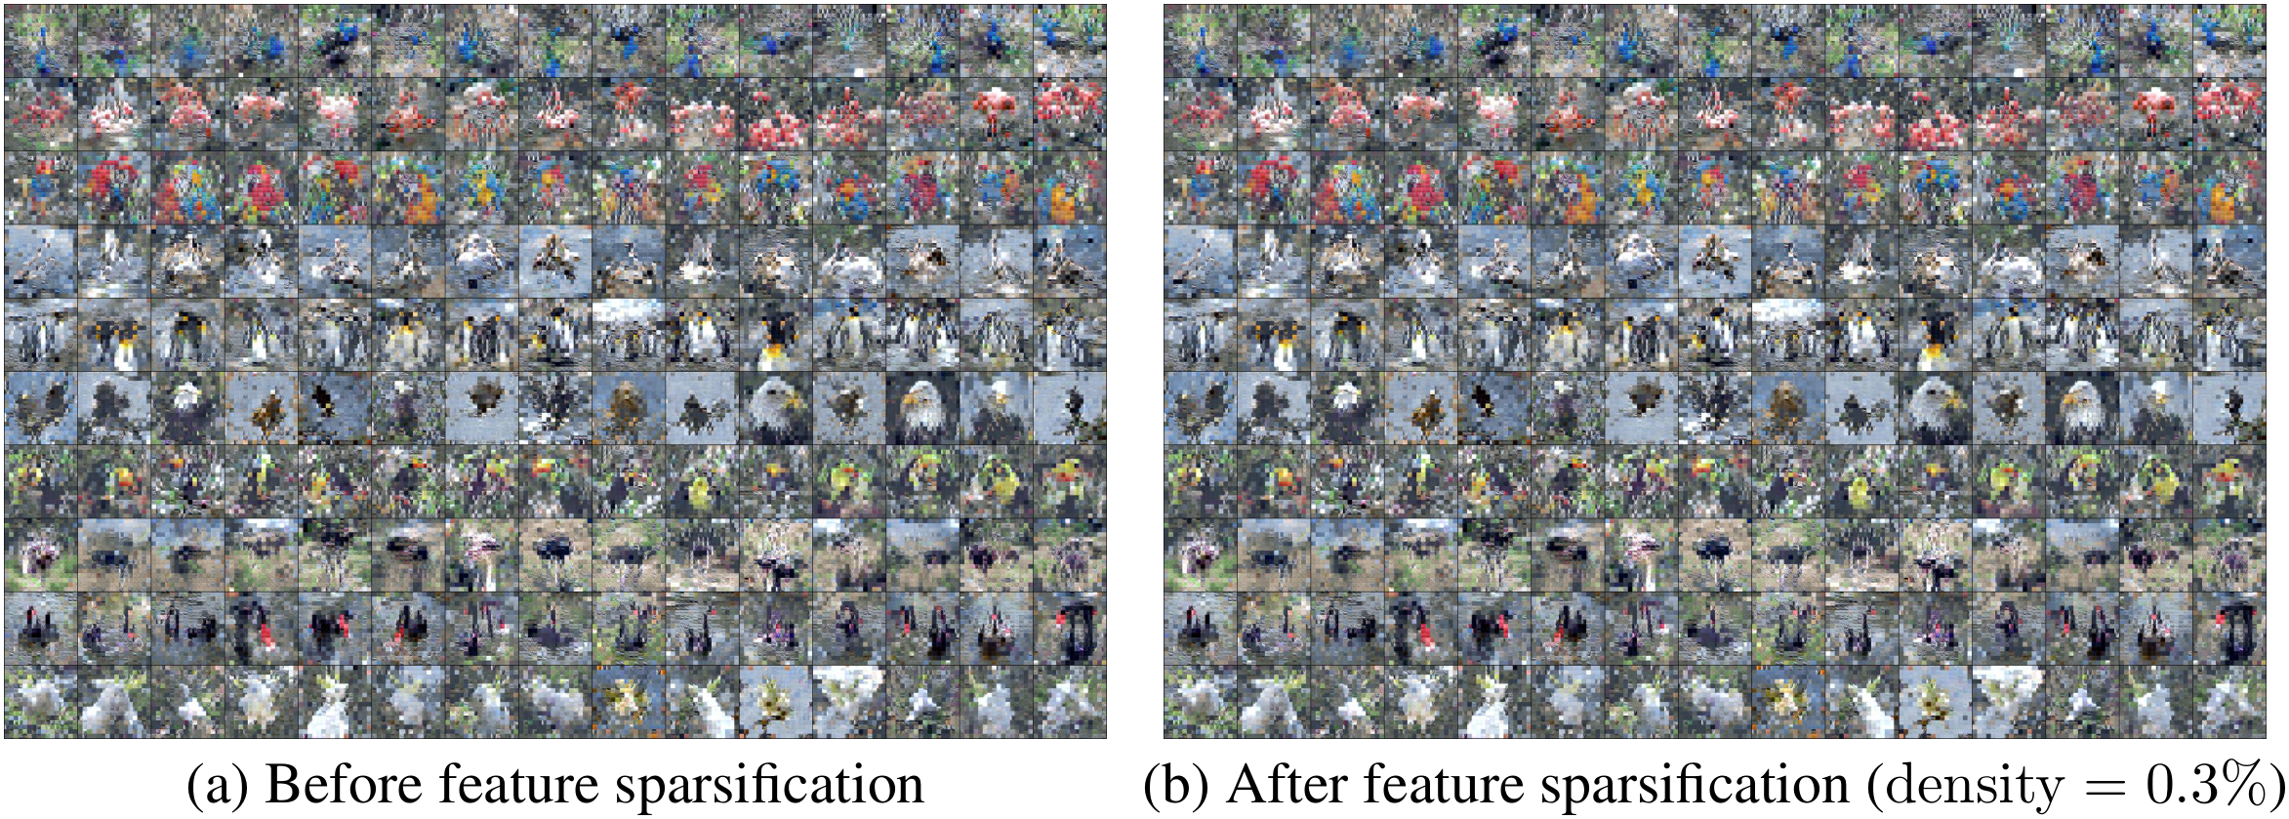
Sparse Parameterization for Epitomic Dataset
Distillation
Xing Wei¹, Anjia Cao¹, Funing Yang¹, Zhiheng Ma²
¹ School of Software Engineering, Xi'an Jiaotong University ² Shenzhen Institute of Advanced Technology, CAS
Problem
Method
Key Results
Dataset distillation compresses a large dataset into a small
synthetic set, but prior work pours effort into the matching
objective while parameterizing each synthetic image
independently — a naive scheme that ignores the heavy spatial
redundancy within and across images.
Epitomic tokens (SAETs). A shared multi-head dictionary E of
spatial-agnostic tokens reused by every synthetic image patch.
IPC 1 · test acc (%)
Prior SOTA
SPEED
CIFAR-100
34.0
40.0
Sparse coding (SCMs). Each image keeps a sparse matrix A_{i}
that selects only its significant tokens; an ℓ₁ penalty then prunes
each SCM to its top-k non-zero entries.
TinyImageNet
16.0
26.9
Wasted redundancy caps the informative data that fits the tiny
budget — worst at high resolution.
FReeNet synthesis. A recurrent transformer-style network Φ_{φ}
(shared across R blocks) assembles tokens into hierarchical
image patches.
Motivation
Images are redundant. Patches, textures, and structures recur
within and across images — exactly what dictionary learning and
sparse coding were built to exploit.
Factorize each image into shared tokens E + a sparse code A_{i} (top-k, uint8).
Continual learning: SPEED (red) leads at every step.
Spend the budget wisely. A compact shared dictionary plus
sparse per-image codes packs far more informative synthetic
images than one-image-per-parameter.
Headline Numbers
Spatially agnostic. Prior methods exploit cross-image relations,
but none remove redundancy regardless of a feature's location
— SPEED's shared tokens do.
+11.2%
40.0%
CIFAR-100 IPC 1 (+6.0)
avg gain across 6 ImageNet
subsets
26.9%
TinyImageNet IPC 1 (+10.9)
new state-of-the-art
307K
params (k=48) vs 15M full
SPEED overview: shared tokens + sparse codes drive recurrent synthesis.
Dataset / Benchmark
Takeaway
Equal-storage comparison (params/class) at IPC 1/10/50; ConvNet
+ trajectory matching by default:
How you parameterize the synthetic dataset matters as
much as the matching objective.
CIFAR-10
CIFAR-100
TinyImageNet
ImageNette
ImageWoof
A shared epitomic-token dictionary with sparse per-image codes
and a recurrent synthesizer removes spatial redundancy —
delivering SOTA distillation at a fraction of the storage, especially
on high-resolution data.
ImageFruit
ImageMeow
ImageSquawk
ImageYellow
Synthetic ImageSquawk samples from a compact shared dictionary.
CIFAR-100-C

