Slide 1


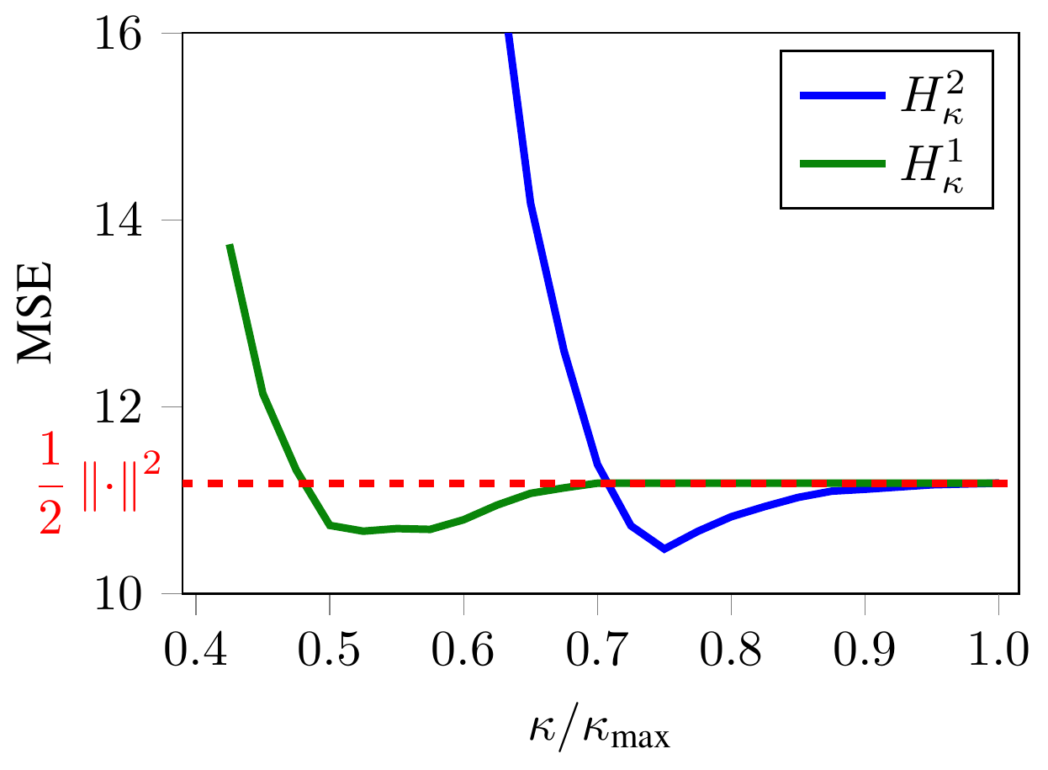
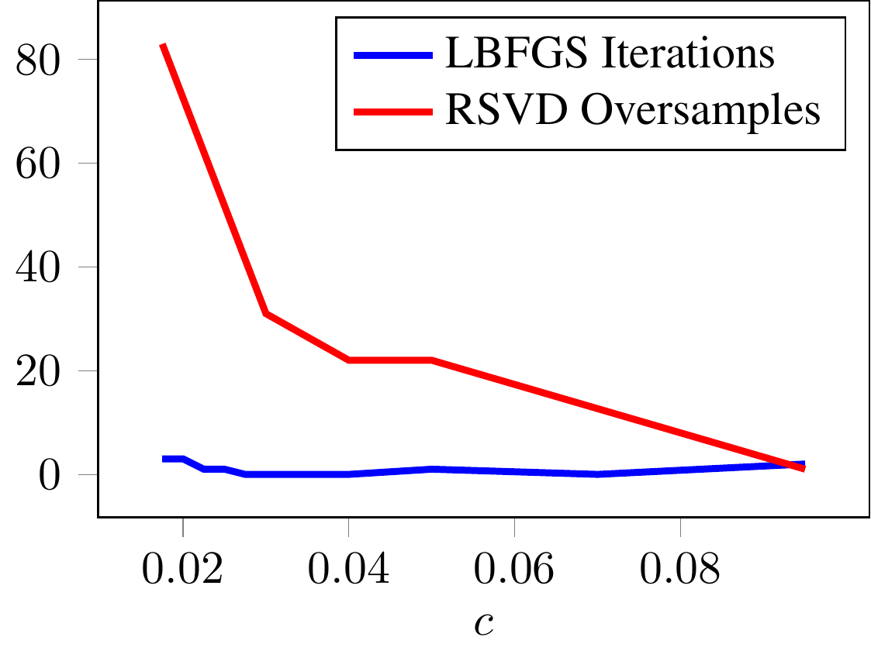
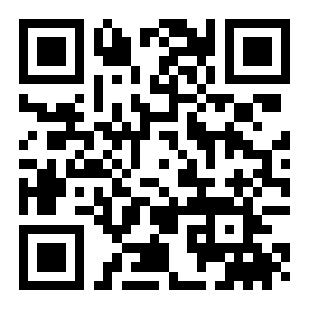
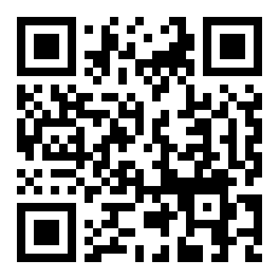
Extending Kernel PCA through Dualization:
Sparsity, Robustness & Fast Algorithms
Francesco Tonin · Alex Lambert · Panagiotis Patrinos · Johan A.K. Suykens
ESAT-STADIUS, KU Leuven
Motivation
Problem
Key Results
Headline Numbers
Kernel PCA is naturally a variance-
maximization problem under
orthonormality — a difference-of-
convex (DC) program.
Classical Kernel PCA solves an n×n singular value decomposition of
the Gram matrix — an O(n³) operation that is prohibitively slow and
blocks large-scale use.
DATASET (N)
FULL SVD
L-BFGS SPEEDUP
≥3×
faster than
RSVD on
every task
Synth 1 (7k)
baseline
≥3× vs RSVD
9.17×
Protein (14.9k)
slow
≥3× vs RSVD
speedup over
randomized SVD
on CIFAR-10
(n=60k)
O(s³)
per-iter
SVD,
replaces
O(n³)
Every robust or sparse KPCA variant has meant a new ad-hoc
reformulation — no unifying framework.
RCV1 (20.2k)
>30 min
≥3× vs RSVD
But earlier DC treatments handled
only linear PCA, or just the first
component where the orthogonality
constraints vanish.
CIFAR-10 (60k)
>30 min
9.17× vs RSVD
full SVD could not finish
within a 30-min cap
6.83
Huber MSE
vs 7.59
squared
Method
At δ=10⁻², L-BFGS beats full SVD,
Lanczos & RSVD on every task — at least
3× over randomized SVD.
Separately, infimal convolution is
known to design robust & sparse
losses cleanly, and behaves
especially well in dual formulations.
Cast KPCA as inf g(W) − f(ΓW) over the Stiefel manifold of
orthonormal frames — a difference of convex functions.
Takeaway
A general dualization turns the (possibly infinite-dimensional)
primal into a finite n×s dual matrix H, ideal for gradient descent.
One dualization of KPCA as a
difference of convex functions →
SVD-free (up to 9× faster than
RSVD), robust, and sparse — all
controlled by the choice of
Moreau-envelope objective. The
dual variable stays finite-
dimensional, so even infinite-
dimensional feature maps are
handled.
Bringing these together: one dual
framework can unify robust and
sparse extensions for the
nonlinear, multi-component kernel
case.
Standard KPCA → L-BFGS; robust / sparse variants add a Moreau-
envelope term Ψ⋆(H) and use a DC algorithm with closed-form
Huber / ε-insensitive prox.
The Stiefel indicator becomes the nuclear-norm term π(H); its gradient needs only a small s×s SVD, never the n×n one.
Fast
Robust
Sparse
Sparsity & Robustness
SVD-free,
up to 9×
over RSVD
Huber Moreau-
envelope losses
ε-insensitive
dual solutions
Robustness on contaminated Iris. Huber losses
H²κ, H¹κ drive MSE below the plain squared loss
(dashed red).
ε-insensitive Moreau-envelope losses yield sparse dual solutions;
reconstruction error grows only mildly with sparsity.
SO WHAT → The solver is nearly insensitive to G’s eigenspectrum decay — the regime where randomized SVD needs sharply more oversamples. Only s×s SVDs are ever computed, so the cost is set by the number of components, not the dataset size.
Scan to Read
Sweeping the Huber κ lowers MSE vs the squared loss across
contaminated Iris.
Eigenspectrum decay. As the spectrum
of G decays slower (small c), randomized
SVD needs far more oversamples (red); L-
BFGS iterations stay flat (blue).
≤1.5×
rec.-error ratio even at high sparsity
Paper
Code

