Slide 1



ICML 2023 · ESAT-STADIUS, KU LEUVEN
Extending Kernel PCA
through Dualization
Sparsity, Robustness & Fast Algorithms
Francesco Tonin · Alex Lambert · Panagiotis Patrinos · Johan A.K. Suykens
Paper
Code
The Premise
The Move
Kernel Principal Component Analysis, seen
Reformulate Kernel PCA as a difference
through the lens of convex duality.
of convex functions — then dualize it.
KU Leuven · presented at ICML 2023.
One reformulation, unlocked in the dual.
One Move, Three Wins
Why It Matters
SVD-free gradient solvers · robust & sparse
The right optimization viewpoint extends
via Moreau envelopes · real speedups.
a classical method in several directions.
Three extensions from a single viewpoint.
A clean, simultaneous extension.
Extending Kernel PCA through Dualization — Tonin, Lambert, Patrinos, Suykens · ICML 2023
01 / 10

Slide 2
02 · PROBLEM
02 / 10
The scaling wall of Kernel PCA
A workhorse with a weakness
Kernel PCA is one of the most widely used tools in unsupervised learning —
but it carries a stubborn scaling problem that blocks large-scale use.
The cubic cost
The standard recipe takes the SVD of the n×n Gram matrix — an O(n³) operation
that becomes painfully slow even for moderately sized datasets.
A scattered toolbox
Each robust or sparse variant needed its own ad-hoc formulation or weighting
heuristic — a scattered collection of problems rather than one coherent method.
Extending Kernel PCA through Dualization — ICML 2023

Slide 3
03 · MOTIVATION
03 / 10
Two ideas waiting to meet
KPCA is a difference-of-convex problem
Kernel PCA is variance maximization under orthonormality constraints — squarely
in the well-understood family of difference-of-convex (DC) problems.
But prior DC work stopped short
Earlier DC treatments of PCA covered only the linear case, and often only the
first component — where the orthogonality constraints conveniently vanish.
A second thread: infimal convolution
A separate line showed infimal convolution builds robust or sparse losses cleanly —
and that these constructions behave especially nicely in dual formulations.
The opening
Bringing these two observations together — DC structure and dual-friendly losses —
is exactly the opening this paper exploits.
Extending Kernel PCA through Dualization — ICML 2023

Slide 4
04 · CONTRIBUTION
04 / 10
One dual formulation, two payoffs
A general dual-based formulation
The core contribution is a general dual formulation of Kernel PCA, built on the
dualization of a difference of convex functions. It does two things at once.
Payoff 1 · SVD-free
Payoff 2 · Modular
A finite-dimensional dual matrix,
The objective becomes modular:
solvable by efficient gradient
choosing objectives expressible as
methods, that avoids the expensive
Moreau envelopes promotes
SVD — even when the feature space
robustness or sparsity — all without
is infinite-dimensional.
leaving the dual picture.
Backed by theory and algorithms
The paper supplies the dualization theory, concrete L-BFGS and difference-of-convex
algorithms, and closed-form proximal operators that make the robust and sparse
cases practical.
Extending Kernel PCA through Dualization — ICML 2023

Slide 5
05 · METHOD
05 / 10
Dualizing a difference of convex functions
1 · Cast as a DC problem
2 · Dualize to finite dimensions
Write Kernel PCA as minimizing a difference
A dualization proposition sends the primal —
of two convex functions over the Stiefel
possibly infinite-dimensional — to a dual
manifold of orthonormal frames.
whose variable H is a finite n×s matrix,
ideal for gradient descent.
3 · Only a small s×s SVD
4 · Robust & sparse via DCA
The Stiefel indicator becomes a nuclear-norm
For robustness or sparsity, add a Moreau-
term π(H) = Tr√(HᵀGH). Its gradient needs
envelope term and run a difference-of-convex
only an s×s SVD — never the full n×n Gram
algorithm with closed-form prox operators for
SVD. That is the source of the speedup.
the Huber and ε-insensitive losses.
THE DUAL OBJECTIVE
Standard: inf over H ∈ ℝⁿˣˢ ½·Tr(HᵀH) − π(H), with π(H) = Tr √(HᵀG H)
Robust / sparse: inf over H ½‖H‖²_F + Ψ⋆(H) − π(H), Hκ = ½‖·‖²_F □ κ‖·‖
Extending Kernel PCA through Dualization — ICML 2023

Slide 6
06 · DATASET / BENCHMARK
06 / 10
How the method is evaluated
Synthetic and real-world data
The experiments span both synthetic and real-world datasets, covering efficiency,
robustness, and sparsity in a single evaluation.
Efficiency · four datasets, up to 60k points
Synth 1 (n = 7 000) · Protein (n ≈ 15 000) · RCV1 (n ≈ 20 000) · CIFAR-10 (n = 60 000)
Laplace kernel for the timing study; a Gaussian kernel for the robustness study.
Robustness & sparsity probes
Robustness: the Iris dataset contaminated with multiplicative Gaussian outliers.
Sparsity: reconstruction error under ε-insensitive losses.
A fair, shared stopping rule
All solvers stop on a shared relative dual-cost residual at δ = 10⁻² and δ = 10⁻⁴,
with timing results averaged over five runs.
Extending Kernel PCA through Dualization — ICML 2023

Slide 7
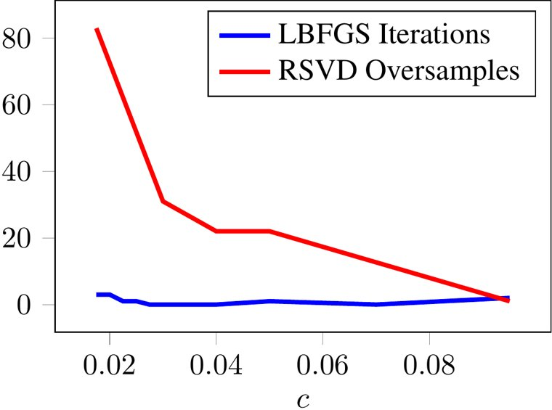
07 · KEY RESULT
07 / 10
Faster than every baseline
Wins across the board
FIGURE 1 · VARYING EIGENSPECTRUM
On the efficiency benchmarks, the proposed
solver is the fastest on every single task.
Full SVD, Lanczos and randomized SVD all trail it.
≥ 3× faster, up to 9.17×
At δ = 10⁻² it beats full SVD, Lanczos and RSVD
on every task — at least 3× faster than RSVD,
peaking at 9.17× on CIFAR-10 (n = 60 000),
where full SVD could not finish within 30 min.
Robust to slow spectral decay
As the Gram eigenspectrum decays more slowly,
RSVD needs many more oversamples — while the
Extra compute as the spectrum of G decays faster.
solver's iteration count barely changes.
Blue: our L-BFGS solver. Red: randomized SVD.
Larger c ⟶ faster spectral decay.
Extending Kernel PCA through Dualization — ICML 2023

Slide 8
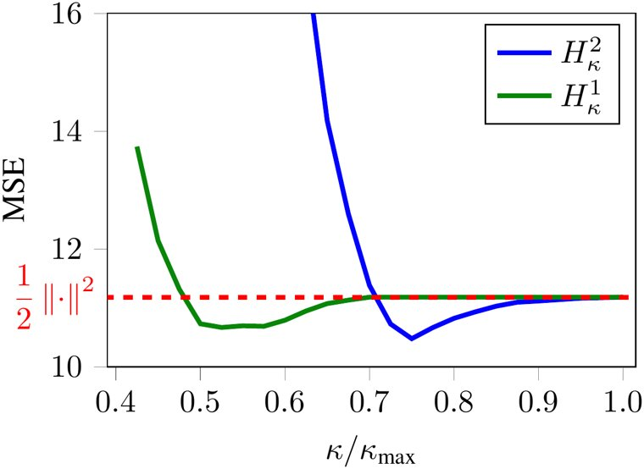
08 · ABLATION STUDY
08 / 10
What drives the behavior
Three controlled studies
FIGURE 3 · ROBUSTNESS
Several controlled studies dissect exactly where
the method's behavior comes from.
Huber κ ⟶ lower MSE
Sweeping the Huber κ, both variants cut MSE on
contaminated Iris versus the plain squared loss.
Speed holds as s grows
L-BFGS keeps its edge over RSVD across a wide
range of components s; only very large s bites.
Reconstruction error vs the Huber parameter κ
Why it scales
for the H²κ and H¹κ losses on contaminated Iris.
As the spectrum decays slowly, RSVD oversamples
Both Huber losses stay below the squared loss.
climb while the solver's iterations stay flat.
Extending Kernel PCA through Dualization — ICML 2023

Slide 9
09 · HEADLINE NUMBERS
09 / 10
The numbers that matter
SPEEDUP · CIFAR-10
PER-ITERATION COST
9.17×
O(s³)
Faster than randomized SVD
Replaces the classical O(n³)
And ≥ 3× faster than RSVD on every efficiency
Each iteration factorizes only a small s×s
task at tolerance δ = 10⁻².
matrix, never the full n×n Gram SVD.
ROBUSTNESS · CONTAMINATED IRIS
LARGEST BENCHMARK
6.83 vs 7.59
n = 60 000
Huber MSE vs squared loss
Where full SVD gives up
H²κ against the plain squared loss at corruption
Full SVD exceeded a 30-minute cap on both
level τ = 10 — lower is better.
RCV1 and CIFAR-10; the solver finishes.
Extending Kernel PCA through Dualization — ICML 2023

Slide 10
10 · TAKEAWAY
10 / 10
One viewpoint, three directions
A single change of viewpoint pays off in three directions at once.
The lasting message
Recast a classical method through the right optimization lens, and one move extends
it in three directions simultaneously.
Faster, robust, and sparse — together
Writing KPCA as a difference of convex functions and moving to the dual gives a solver
that avoids the expensive SVD and runs up to 9× faster than RSVD — while a Moreau-
envelope objective supplies modular robustness or sparsity on demand.
And it reaches where classical KPCA cannot
Because the dual variable is always finite-dimensional, the framework even handles
infinite-dimensional feature maps that classical Kernel PCA simply cannot.
Extending Kernel PCA through Dualization — Tonin, Lambert, Patrinos, Suykens · ICML 2023

