Slide 1



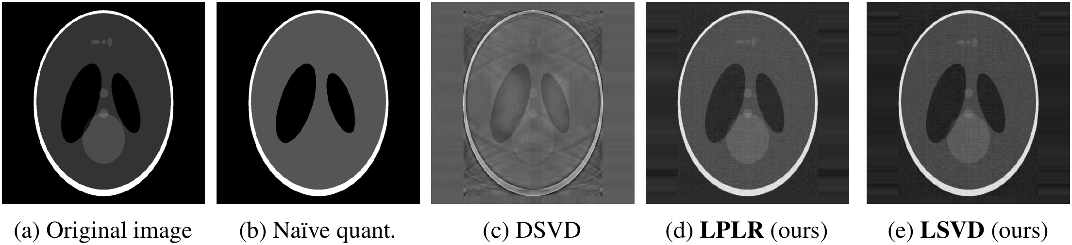
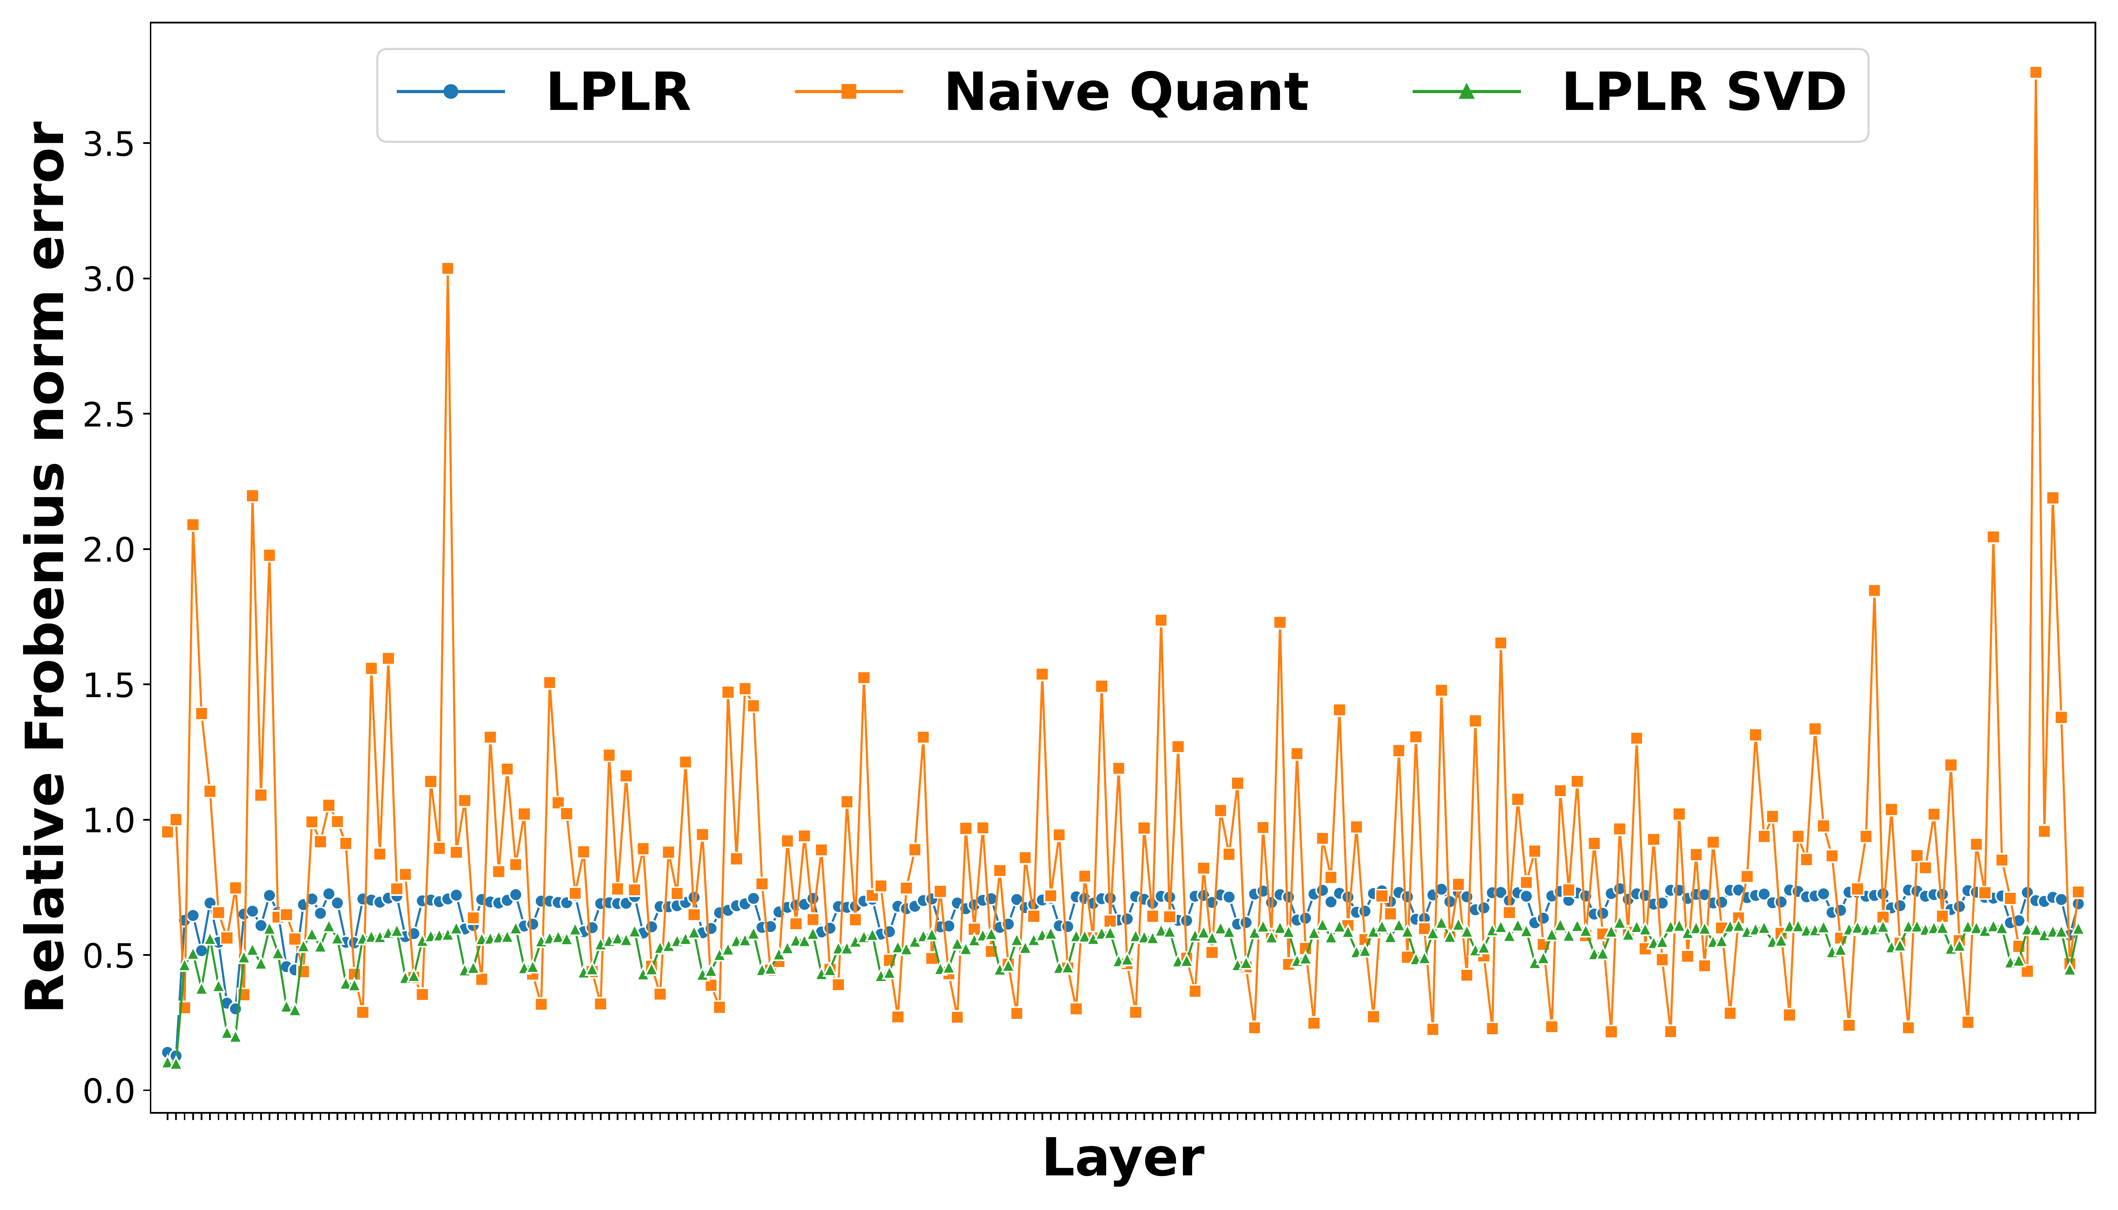
Matrix Compression via Randomized Low Rank and Low Precision
Factorization
NeurIPS
2023
POSTER
Rajarshi Saha¹, Varun Srivastava¹, Mert Pilanci¹
Paper
Code
¹ Stanford University
Problem
Method
Ablation Study
Modern matrices can hold billions of
entries, so storing and processing them
strains memory and compute — yet they
are frequently approximately low rank.
B_{nq}
LPLR Acc
Naïve Acc
error
1 bit
79%
~1%
Sketch. Multiply A by a Gaussian matrix S to approximate its column space, then quantize the basis: L = Q(AS).
2 bit
80%
1.7%
Low-rank approximation or low-
precision quantization alone each
leaves compression on the table — the
two structures are rarely exploited
jointly, with error guarantees.
Project. Solve the least-squares fit of A onto that basis for W⋆, then quantize: R = Q′(W⋆).
4 bit
79%
75%
Equalization. Gaussian JL embeddings keep the quantization error O(1), not O(d) — so LPLR holds up even at
1-bit precision.
SO WHAT → Sweeping B_{nq} at fixed compression: LPLR's edge is largest at aggressive budgets; naïve quant. only catches up at 4 bits.
Motivation
Headline Numbers
A low-rank matrix factorizes into a tall
and a wide factor with far fewer entries;
storing those in low precision multiplies
the savings.
~1 bit
92%
CIFAR-10 acc
@ 1-bit
per matrix
coordinate, task
performance kept
79%
CIFAR-100 acc
@ 1-bit
Shepp-Logan at ~2 bits/pixel: LPLR / LSVD (ours) preserve detail lost by naïve quant. and DSVD.
0.537
Done crudely at low bit budgets this
degrades fast, and the exact SVD route
costs O(nd²) — prohibitive at scale.
Results · LLaMa-7b
Key Results
vs 11% accuracy for naïve
quant. on CIFAR-10
LLaMa Frob
err (LSVD)
Method · 1-bit
CIFAR-10 Acc
CIFAR-100 Acc
Takeaway
Needed: a fast, randomized way to get
low-rank and low-precision factors
together, with small, analyzable error.
Naïve quant.
11%
~1%
LPLR (ours)
92%
79%
By jointly exploiting low rank and low
precision, LPLR compresses matrices to
~1 bit per entry with provable error
bounds, matching or beating standard
compression at a fraction of an SVD's cost.
Unquantized
91%
76%
Payoff: compression to ~1 bit per
coordinate whose error provably tracks
the best rank-k approximation.
LPLR matches unquantized accuracy at ~1 bit/coord, exactly where
naïve quant. collapses.
LLaMa-7b per-layer relative Frobenius
error, ordered by layer.
Low rank and low precision are
complementary — jointly exploited, they
compound.
SO WHAT → Low rank + low precision keeps the task accuracy that plain quantization destroys — on CIFAR-100 at a single bit, LPLR holds 79% where naïve quant. falls to ~1%.
Sketch → project → quantize:
extreme compression with error
guarantees.
Lower error, far less variance
than naïve quant.

