Slide 1



PAPER · DEEP READ · NeurIPS 2023 · arXiv:2310.11028
Matrix Compression via Randomized
Low Rank & Low Precision
A ≈ L · R, EACH FACTOR QUANTIZED
≈ 1 bit / entry
LPLR — one algorithm that is both low-rank and low-precision
Rajarshi Saha · Varun Srivastava · Mert Pilanci
A
≈
L
·
R
Stanford University
r × d
THE SETTING
n × d
n × r
Billions of entries, but nearly low rank
Modern matrices strain memory and compute, yet carry
far less information than their size suggests.
EXTREME COMPRESSION · ACCURACY PRESERVED
≈ 1 bit / coord · images · embeddings · LlaMa-7b
THE METHOD · LPLR
Low-rank and low-precision in one step
A randomized factorization into two low-rank factors,
AFFILIATION · VENUE
quantized down to about one bit per coordinate.
Code
GitHub
pilancilab
01 / 10

Slide 2
Big matrices, one open gap
PROBLEM · WHY MATRIX COMPRESSION IS STILL HARD
01
THE STRAIN
Modern matrices hold billions of elements
The workhorse of science and ML, but at scale, storing and processing them strains memory and compute.
02
THE OPPORTUNITY
Many are approximately low rank
Real-world matrices carry far less information than their size suggests — room to compress aggressively.
03
THE OPEN QUESTION
Combine both — with provable error control
Prior methods used low-rank structure or low-precision alone; fusing both into one factorization stayed open.
02 / 10

Slide 3
Cheap in theory, tricky in practice
MOTIVATION · WHY A FAST RANDOMIZED ROUTE IS NEEDED
THE IDEA · TWO SAVINGS AT ONCE
THE CATCH
Fewer entries, then fewer bits
Crude quantization & costly SVD
At very low bit budgets, naive quantization degrades
accuracy fast. And the exact route through a singular
value decomposition costs
A
=
L
·
R
O(n d²)
prohibitive at scale.
wide
n × d dense
tall
THE GOAL
+ store L, R in low precision
A fast, randomized factorization
A low-rank matrix splits into a tall factor times a
Obtain the low-rank and low-precision factors together,
wide one — far fewer entries. Store those entries in
without a full SVD — while keeping the approximation
low precision and the savings compound.
error small and, crucially, analyzable.
Small, analyzable error — by design.
03 / 10

Slide 4
What LPLR contributes
CONTRIBUTION · ONE ALGORITHM, PROVABLE BOUNDS, A TUNABLE KNOB
THE ALGORITHM · LPLR
Low-Precision Low-Rank factorization
A single randomized algorithm that simultaneously exploits low-rank structure and quantizes the
resulting factors to low precision — both savings captured in one pass.
PROVABLE GUARANTEES
A VARIANT · AND BROAD VALIDATION
Rigorous error bounds
LPLR-SVD, validated widely
Upper bounds on the approximation error, in terms of
An SVD-based variant, LPLR-SVD, complements the
the target rank and the quantization bit budget.
randomized method. Both are validated across:
A TUNABLE KNOB
IMG
3-NN
7B
A clean compression-vs-accuracy tradeoff to dial in.
Images
Embeddings
LlaMa-7b
Error depends on rank and bits — so practitioners can
reconstruction
classification
weights
trade compression for accuracy predictably.
04 / 10

Slide 5
How LPLR works
METHOD · SKETCH → PROJECT → QUANTIZE, WITH AN EQUALIZATION GUARANTEE
LPLR runs in a few steps — a randomized rangefinder, a least-squares projection, and two quantizers.
STEP 1 · RANDOMIZED RANGEFINDER
STEP 2 · PROJECT & QUANTIZE
Sketch, then quantize the basis
Solve for W*, return L and R
A·S → Q(A·S) = L
→
W* = argmin ‖Q(A·S)W − A‖F
Draw a Gaussian sketch S; the product A·S is a
Least-squares-project A's columns onto Q(A·S),
randomized rangefinder for A's column space.
solve for W* (closed form or conjugate gradients),
Quantize it to the low-precision basis Q(A·S).
quantize it, and return L = Q(A·S), R = Q(W*).
THE KEY INSIGHT · WHY IT STAYS ACCURATE
Gaussian sketches equalize the quantization error
Gaussian sketches are Johnson-Lindenstrauss embeddings with an equalization property, so the
reconstruction's quantization error stays order one and does not grow with the matrix dimension.
Consequence: LPLR remains accurate even at one bit per coordinate — the equalization is exactly why.
05 / 10

Slide 6
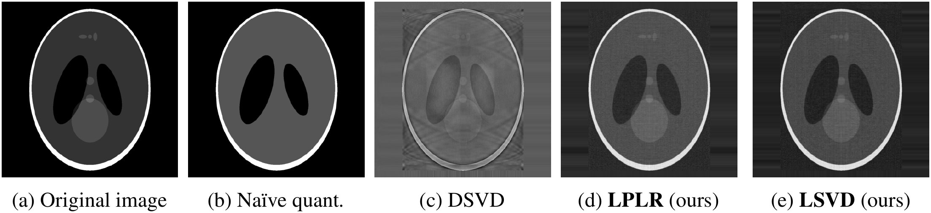
Tested on a diverse zoo of matrices
DATASETS & BENCHMARK · IMAGES, EMBEDDINGS, AND LLM WEIGHTS
Experiments span a deliberately diverse set of matrices — from medical images to language-model weights.
DOMAIN 1 · IMAGES
DOMAIN 2 · EMBEDDINGS
DOMAIN 3 · LLM WEIGHTS
Image reconstruction
3-NN classification
LlaMa-7b compression
7B params
IMAGE · MobileNetV3
CIFAR-10 · CIFAR-100
Weight matrices compressed layer by
layer across the whole network.
TEXT · BERT
Shepp-Logan phantom, reconstructed
IMDB · Emotion
FAIR-PARITY PROTOCOL
Every method gets the same total
Shepp-Logan phantom (medical test)
bit budget — no free lunch.
Scored by a three-nearest-neighbor
Hubble image of Jupiter
classifier on accuracy and weighted F1.
MR brain scan
Reported alongside task metrics:
Both vision and language embeddings,
relative Frobenius error
Standard reconstruction targets across
quantized to as little as one bit.
medical and astronomical imaging.
06 / 10

Slide 7
One bit, accuracy intact
KEY RESULT · EXTREME COMPRESSION WITHOUT LOSING PERFORMANCE
VISUAL PROOF · SHEPP-LOGAN PHANTOM
CIFAR-10 EMBEDDINGS · 1 BIT
Extreme compression, detail preserved
92% LPLR accuracy
11%
Matches the unquantized 91% —
naive quant.
while naive quant. collapses to
CIFAR-100 EMBEDDINGS · 1 BIT
79% LPLR accuracy
≈1%
Same bit budget: naive quant. and DSVD blur; LPLR / LSVD keep the anatomy.
An even starker gap on the harder
naive quant.
LPLR delivers extreme compression — down to roughly
100-class task, where naive quant. is
one bit per matrix coordinate — while preserving
performance. On the phantom, it keeps the fine
anatomical details that competing methods wash out.
LlaMa-7b WEIGHTS · REL. FROBENIUS ERROR
0.54 LPLR-SVD
0.84
≈ 1 bit / coordinate — performance held
Lower error and lower variance across layers.
naive quant.
07 / 10

Slide 8
Pulling the two levers apart
ABLATION · LOW-RANK STRUCTURE VERSUS QUANTIZATION PRECISION
THE DESIGN OF THE ABLATIONS
Two effects, separated: low-rank structure vs. quantization precision
Each swept independently.
TABLE 3 · BIT-BUDGET SWEEP, FIXED COMPRESSION
EMBEDDINGS · QUANT. BUDGET Bnq: 1 → 4 BITS
Shift budget to the reference → less error
Biggest edge where compression bites
high
LPLR
mid
LPLR
naive
low
naive
budget on
budget on
factors
reference
1 bit — LPLR wins big
4 bits — near parity
Frobenius error falls for both LPLR and LPLR-SVD.
LPLR's advantage is largest at the most aggressive budgets.
08 / 10

Slide 9
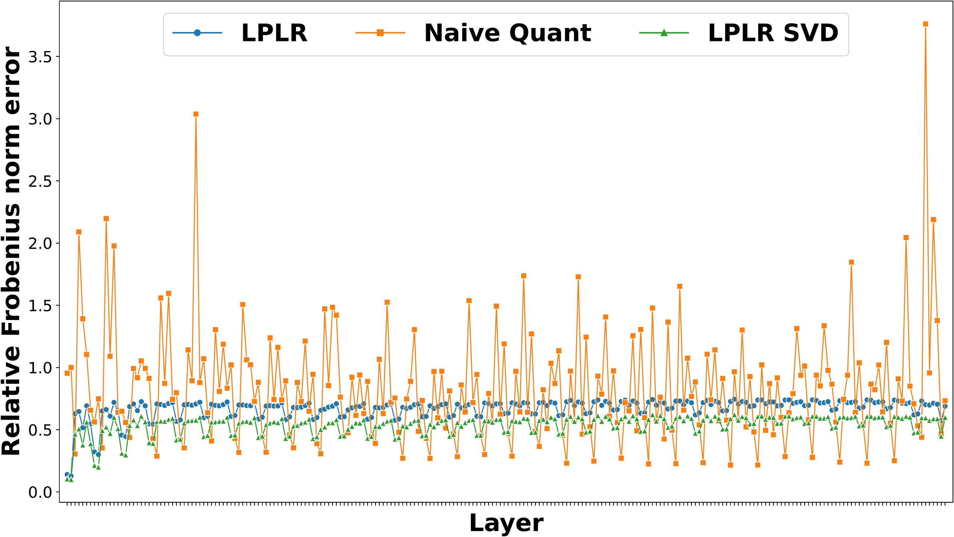
The headline numbers
RESULTS AT A GLANCE · ACCURACY, ERROR, AND COST
COMPRESSION
CIFAR-10 EMBEDDINGS · 1-BIT ACCURACY
≈ 1 bit
92%
LPLR accuracy at a single bit,
matching the unquantized 91%.
per matrix coordinate
The regime where LPLR shines.
91%
unquantized baseline
11%
naive quantization at 1 bit
CIFAR-100: 79% vs ≈1% · LlaMa-7b PER-LAYER ERROR
COMPUTE COST
O(n d m)
LPLR runtime
Far cheaper than a full SVD
A large saving over the
O(n d²)
cost of exact SVD.
LlaMa-7b weights: LPLR-SVD 0.54 vs naive 0.84 — lower and steadier per layer.
09 / 10

Slide 10
TAKEAWAY · LOW RANK MEETS LOW PRECISION
THE BIG IDEA
Low rank and low precision are complementary
Exploiting both together — not just one — is what unlocks extreme compression without losing accuracy.
That fusion is the paper's core message.
WHAT LPLR DELIVERS
WHY IT SCALES
Sketch, quantize, compress — with bounds
No expensive SVD
Sketch a matrix with a Gaussian random projection and quantize the resulting
factors — and compression reaches about one bit per coordinate.
O(n d m)
ACCURACY PRESERVED
PROVABLE BOUNDS
≈ 1 BIT / COORD
Avoiding the exact singular value
images · embeddings · LLMs
error controlled by rank & bits
extreme compression
decomposition makes LPLR a practical
option for the very largest matrices —
One randomized pass gives both low-rank and low-precision factors, with
exactly where exact methods do not fit.
upper bounds on the approximation error the whole way down.
Practical at billion-entry scale.
Saha, Srivastava, Pilanci · Stanford University · NeurIPS 2023 · arXiv:2310.11028
10 / 10

