Slide 1






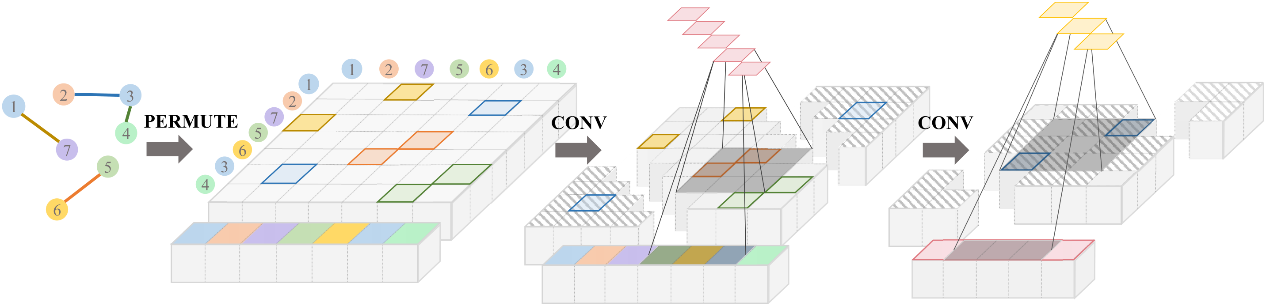
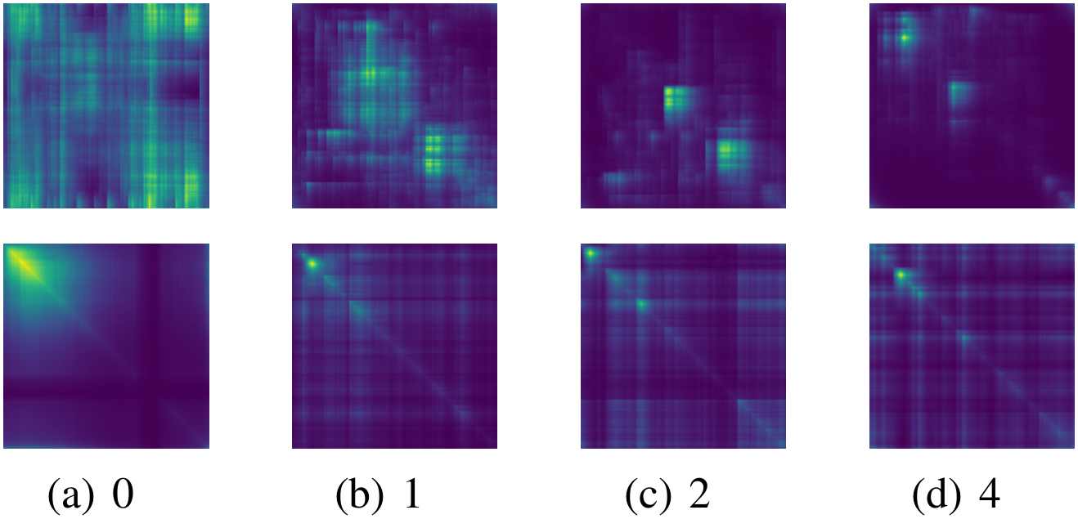
All in a Row: Compressed Convolution Networks for
Graphs
Junshu Sun^{1,2}, Shuhui Wang^{1,3†}, Xinzhe Han^{1,2}, Zhe Xue⁴, Qingming Huang^{1,2,3}
¹ Key Lab of Intelligent Information Processing, ICT, CAS ² UCAS ³ Peng Cheng Laboratory ⁴ Beijing Key Lab of Intelligent Telecom Software &
Multimedia, BUPT
Problem
Method
Key Results
Convolutional GNNs built on graph polynomials are weakly
expressive under a small parameter budget, and cannot learn
hierarchical representations on their own: they need bolt-on
node clustering or node-drop pooling.
Permutation generation regresses each node position with a
Laplacian-smoothed MLP, then converts positions into a relaxed,
differentiable permutation matrix.
BENCHMARK
TASK
COCN
Squirrel
Node
72.95%
Cornell
Node
86.22%
Diagonal convolution slides one kernel along the diagonal of
the permuted node- and edge-feature matrices; compressed
pooling and transposed convolution build and then invert the
multi-scale hierarchy.
COLLAB
Graph
86.15%
Euclidean CNNs escape both limits through local feature
learning and global parameter sharing, but their convolution
cannot run on irregular, non-grid graphs.
+11.1 pts on Squirrel over LINKX, best average rank 1.83, and wins on
five of six graph datasets.
Motivation
Headline Numbers
Convolution is order-sensitive, yet GNNs must be
permutation-invariant, and prior graph regularizers are
decoupled from the convolution, so they cannot be optimized for
each downstream task.
1.83
72.95%
Squirrel accuracy
One kernel reads structure Â and features X̂ along the diagonal.
Avg rank · 6 node-classification
datasets
86.15%
COLLAB accuracy
Best of all baselines
O(n²)
perm. cost, was O(n!)
Prior orderings are chosen independent of the task; CoCN
learns the permutation end-to-end, differentiable and invariant.
On Squirrel, CoCN gains +11.1 points over LINKX, the strongest prior
baseline model.
CoCN pipeline: permute nodes into a row, then convolve diagonally.
Ablation Study
More permutations help. Accuracy rises steadily with the
number of learnable permutations.
Dataset / Benchmark
Graph classification: six TU datasets, evaluated under 10-fold
cross-validation.
Bigger kernels help. Larger kernels and receptive fields boost
accuracy without degradation.
Node classification: six heterophilic sets, plus three large-scale
graphs (questions, amazon-ratings, genius) for mini-batch
scalability tests.
Takeaway
Graphs, all in a row, can be convolved just like images.
MUTAG
PROTEINS
NCI1
COLLAB
IMDB-B
IMDB-M
One differentiable permutation brings standard CNN machinery to
graphs, reaching state-of-the-art at O(n²) cost.
Learned permutations cluster connected / similar nodes into adjacent
positions (varying smoothness t).
Chameleon
Squirrel
Cornell
Texas
Wisconsin
Actor

