Slide 1
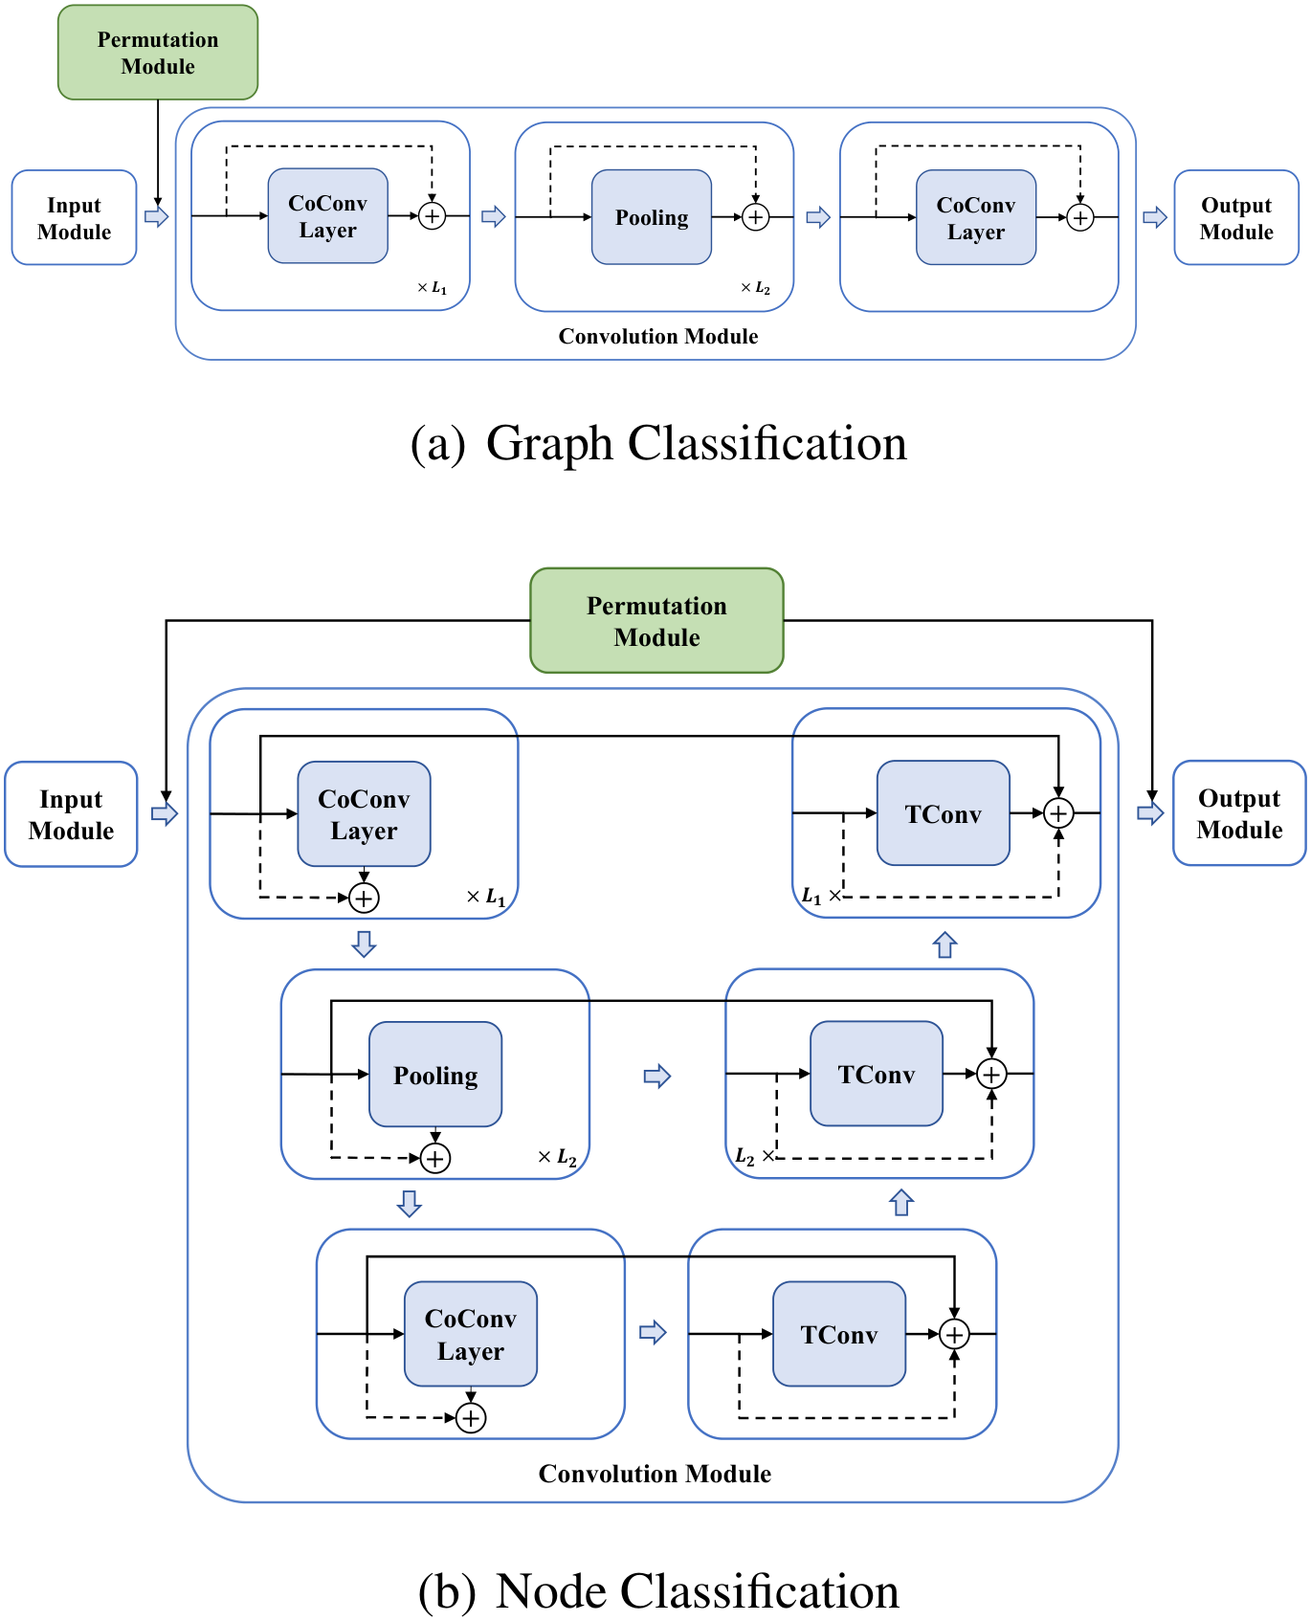




PAPER · DEEP READ · ICML 2023
All in a Row
Compressed Convolution Networks for Graphs
Junshu Sun · Shuhui Wang · Xinzhe Han · Zhe Xue · Qingming Huang
Institute of Computing Technology, Chinese Academy of Sciences · UCAS · Peng Cheng Laboratory
THE QUESTION
Euclidean convolution — directly on graphs?
Can we run standard, CNN-style convolution on irregular graph data?
THE IDEA
Learn a differentiable permutation
Line all nodes up in a single row, then slide a convolution kernel across them.
Compressed Convolution Network — diagonal convolution over permuted nodes
THE RESULT
CoCN — state of the art on node & graph classification
Code
Learned end to end, from a provably convergent permutation.
github.com/
sunjss/CoCN
01 / 10

Slide 2
Convolutional GNNs have two stubborn weaknesses
THE PROBLEM · WHY GRAPH CONVOLUTION LAGS ORDINARY CNNs
Weak on a small budget
No hierarchy on their own
1
2
Their filters are built from graph polynomials,
They cannot learn hierarchical, multi-scale
so expressiveness stays low when the
features alone — needing bolt-on tricks like
parameter budget is small.
node clustering or node dropping.
IMAGE CNNs — NO SUCH PROBLEM
THE CATCH
Local learning + shared filters
Euclidean convolution needs a grid
Ordinary CNNs naturally capture diverse,
It assumes regular grid data — and simply does
multi-scale patterns from images.
not fit the irregular structure of a graph.
The gap:
GNNs are expressive-limited and flat; CNNs are powerful but grid-bound. Can we get the best of both?
Local feature learning · shared filters · multi-scale hierarchy — the CNN toolkit graphs are missing.
02 / 10

Slide 3
A fundamental tension: order vs invariance
MOTIVATION · WHY BORROWING CONVOLUTION IS HARD
THE QUESTION
So why not just borrow Euclidean convolution for graphs?
THE CLASH
PRIOR ATTEMPTS FELL SHORT
Order-sensitive vs invariant
Ordering chosen in isolation
Convolution is sensitive to spatial order — it
Earlier methods picked a node ordering
cares how inputs are arranged. But graph
independently of the convolution — untunable
networks must be permutation invariant.
for the task, and often throwing away information.
THE MISSING PIECE
An ordering that is differentiable — and learned end to end
Tune the node arrangement for the actual task, jointly with the convolution that follows.
03 / 10

Slide 4
Two contributions: a regularization and a model
CONTRIBUTION · WHAT THE PAPER DELIVERS
This paper makes two core contributions.
1
DIFFERENTIABLE REGULARIZATION
2
THE MODEL
A learnable permutation
Compressed Convolution Network
Constrains all nodes into a single row while
Built on top of the permutation, CoCN follows
preserving permutation invariance —
the same local-feature-learning and global
so Euclidean convolution can finally be
parameter-sharing principles as image CNNs.
applied to graph data.
CoCN
END TO END
Learns node features and structure features — trained fully end to end
Outperforms competitive convolutional GNNs and graph pooling models.
04 / 10

Slide 5
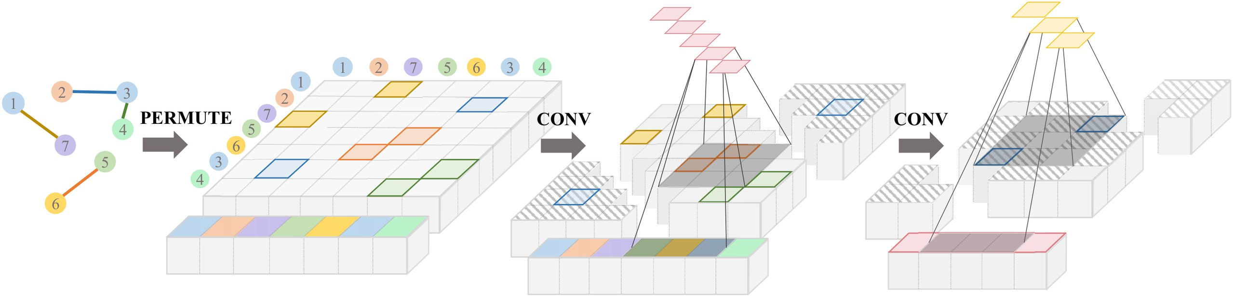
How CoCN works: permute, then convolve on the diagonal
METHOD · FOUR MODULES — INPUT · PERMUTATION · CONVOLUTION · OUTPUT
Figure 1 · CoCN pipeline — permute the node and edge feature matrices, then apply diagonal convolution.
01
02
03
04
PERMUTATION GENERATION
RELAXED PERMUTATION
DIAGONAL CONVOLUTION
POOLING + SCALE
Regress a position
A differentiable
Slide along the
Hierarchy, then
per node
matrix
diagonal
up-sample
An MLP on node features
Positions become a relaxed
With nodes in a row, the
Compressed pooling builds
smoothed by the graph
permutation matrix — a
kernel slides along the
a hierarchy; transposed
Laplacian gives each node
differentiable relaxation
diagonal of the permuted
convolution up-samples for
an absolute position, so
set by a factor τ that
edge and node matrices —
node predictions.
similar or connected
provably converges to a
extracting node features
Cost: n! → n²
nodes land nearby.
true permutation as τ grows.
and structure together.
— it scales to large graphs.
05 / 10

Slide 6
A broad evaluation: 12 datasets, plus leakage & scale checks
DATASETS & BENCHMARKS · GRAPH AND NODE CLASSIFICATION
The evaluation is deliberately broad — spanning graph and node classification.
GRAPH CLASSIFICATION · 6 DATASETS
NODE CLASSIFICATION · 6 HETEROPHILIC
Biochemical + social graphs
Heterophilic benchmarks
MUTAG
PROTEINS
NCI1
COLLAB
Chameleon
Squirrel
Cornell
Texas
IMDB-Binary
IMDB-Multi
Wisconsin
Actor
Evaluated under ten-fold cross-validation.
Where neighbors often carry different labels.
RIGOR · LEAKAGE + SCALE
No leakage: filtered Chameleon & Squirrel remove duplicate nodes
Scale: mini-batch experiments on questions, amazon-ratings, and genius —
three graphs with hundreds of thousands of nodes.
06 / 10

Slide 7
State of the art on node and graph classification
KEY RESULT · ACCURACY % (HIGHER IS BETTER)
Top scores on node classification
HEADLINE
86.2
Results are strong across the board.
CoCN accuracy (%)
Avg. rank 1.83 — best
79.2
73.0
GRAPH CLASSIFICATION
5 / 6
Wins five
of six
datasets won
Including COLLAB (86.15%) and IMDB-Multi (56.3%);
competitive on the sixth.
NO DATA LEAKAGE
Filtered
#1
datasets
of 18 models
Chameleon
Squirrel
Cornell
On cleaned Chameleon & Squirrel (duplicates
Best average rank (1.83) across six heterophilic benchmarks.
removed), CoCN still ranks first — the edge is real.
07 / 10

Slide 8
Ablations: why each design choice pays off
ABLATION STUDY · THREE DISSECTIONS OF CoCN
Several ablations dissect exactly why CoCN works.
1
PERMUTATION HEADS
2
KERNEL SIZE
3
INFORMATION LOSS
More heads help
Bigger receptive field
Essentially lossless
Allowing more permutations
Larger diagonal-convolution
An autoencoder reconstructs
raises accuracy consistently on
kernels give a bigger receptive
graphs from the permuted
MUTAG, Chameleon, Cornell,
field and better performance —
features — the relaxed,
and Wisconsin.
without the over-smoothing you
approximate permutations
might fear.
preserve almost all information.
accuracy
≈ 0
more heads →
↑ acc.
information lost —
k=1
k=3
k=5
the regularization is
1 head
lossless.
08 / 10

Slide 9
The numbers that capture the impact
HEADLINE NUMBERS · AT A GLANCE
NODE CLASSIFICATION
SQUIRREL
1.83
73%
+11 pts
Best average rank
Over 11 points ahead
Across six node datasets — the best of any method tested.
Above the strongest prior model on Squirrel.
GRAPH CLASSIFICATION · COLLAB
SCALABILITY
86%
n!
n²
→
Top result on COLLAB
Permutation cost slashed
86.15% — the best score on the COLLAB dataset.
From intractable n factorial down to n squared.
09 / 10

Slide 10
TAKEAWAY
The takeaway is elegant
THE IDEA
THE MODEL
Line the nodes up in a single row
CoCN
Learn a differentiable permutation that arranges a graph's
Does exactly this — with a
nodes into a single row — and all the machinery of ordinary
permutation that is provably
image convolution becomes available for graphs.
convergent and invariant,
reaching state-of-the-art
Sliding kernels · pooling · hierarchical feature learning.
results on node & graph tasks.
IN SHORT
RESOURCES
Graphs, all in a row, can be convolved just like images.
Paper · ICML 2023
Code
One permutation turns the entire CNN toolkit loose on graph data.
sunjss/CoCN
All in a Row: Compressed Convolution Networks for Graphs · Sun et al., ICML 2023
10 / 10

