Slide 1




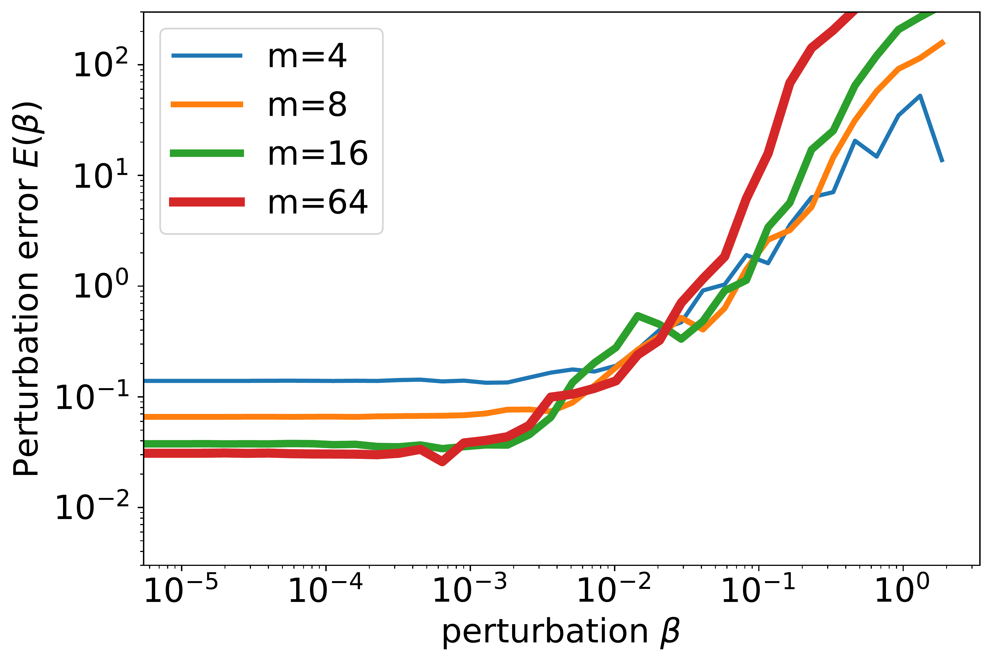

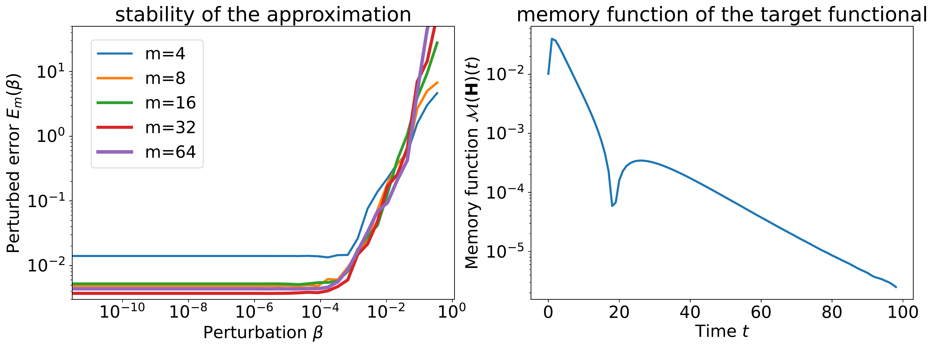
Inverse Approximation Theory for Nonlinear
Recurrent Neural Networks
Zhong Li¹, Shida Wang², Qianxiao Li^{2,3}
¹ Microsoft Research Asia ² National University of Singapore ³ Institute for Functional Intelligent Materials
Problem
Method
Key Results
Recurrent neural networks (RNNs) fail to learn sequence
relationships with long-term memory. Is that an optimization
failure, or a fundamental limit of the RNN class?
THEOREM
1
Memory function. Over Heaviside step inputs, measure how
strongly the output at time t still depends on the input — a task-
independent, numerically queryable notion of memory.
Stable nonlinear-RNN approximation forces exponentially
decaying memory: the first Bernstein-type inverse result.
Prior inverse guarantees covered only linear RNNs — the
nonlinear case was open.
2
Stable approximation. The worst-case perturbation error
under a weight ball of radius β must stay continuous up to some
positive β₀ — exactly what gradient training needs.
Motivation
Most ML approximation results are forward (Jackson-type): they
bound achievable error given a regular target.
3
Stable reparameterization. Replace the recurrent weight with
a map into stable, negative-real-part matrices (exp / softplus) to
escape the limit.
The reverse, inverse (Bernstein-type) question — what a target
must look like to be efficiently and stably learnable — exposes
architectural limits far more directly.
An earlier Bernstein result forced linear-RNN-approximable
targets to decay exponentially, but only for linear RNNs.
Stable approximation forces — the memory must decay exponentially.
Ablation: Reparameterization
Vary only how the recurrent weight is parameterized on MNIST (10
epochs, 3 repeats); initialization held fixed:
Fig 2 · Nonlinear functional with polynomial memory: intersections shift left
as m grows — no stability radius survives.
SO WHAT → Polynomial-memory targets have no stability radius; stability-filtered teachers are all exponential-memory.
MNIST · recurrent param.
Test acc.
Direct g(M)=M (unstable)
68.47%
Exp reparameterization
70.55%
Takeaway
Inverse reparameterization
70.77%
Fig 3 · Filtering random RNN teachers (m=256) by stable approximability
leaves only those with exponentially decaying memory functions (right).
Softplus reparameterization
71.36%
Nonlinear RNNs stably learn only targets with exponentially
decaying memory, so their long-term-dependency struggle is a
fundamental architectural limit, not an optimizer artifact.
SO WHAT → All three stable maps beat the direct baseline at unchanged capacity, a pure stability gain. On synthetic polynomial-decay targets, exp and softplus reparameterization also restore the continuous limiting perturbation curve.
SO WHAT → Proof sketch: stability drives hidden-state derivatives toward zero, and the Hartman–Grobman theorem then bounds the recurrent eigenvalues — forcing exponential decay. The framework extends toward GRU and LSTM.
A principled stable reparameterization relaxes the curse of
memory: faster training, higher accuracy.

