Slide 1



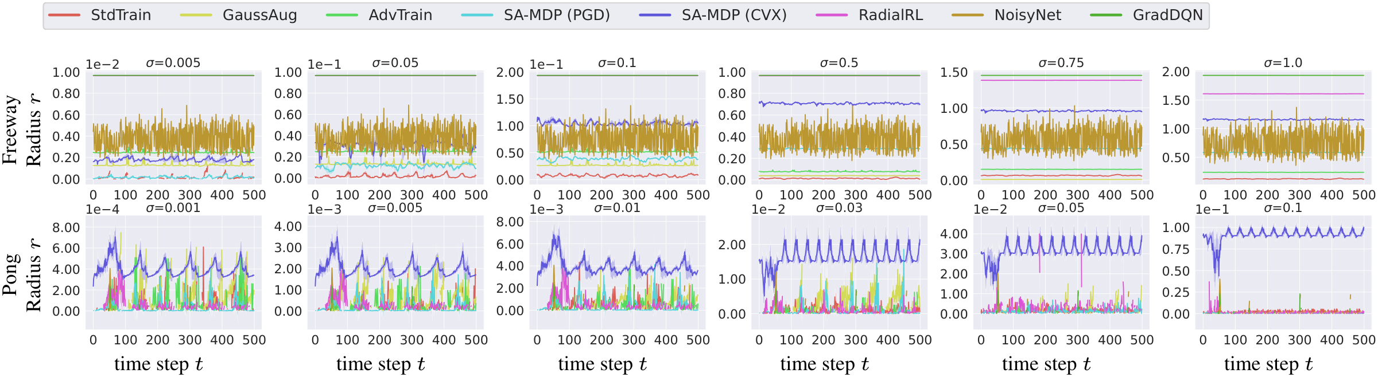
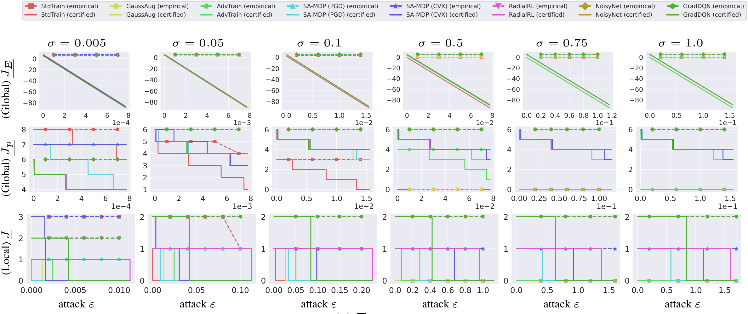


CROP: Certifying Robust Policies for Reinforcement
Learning through Functional Smoothing
Fan Wu¹, Linyi Li¹, Zijian Huang¹, Yevgeniy Vorobeychik², Ding Zhao³, Bo Li¹
¹ University of Illinois at Urbana-Champaign ² Washington University in St. Louis ³ Carnegie Mellon University
PROBLEM
METHOD
HEADLINE NUMBERS
RL agents now drive safety-critical
systems (autonomous cars, trading), yet
tiny adversarial perturbations of their input
states can quietly steer them toward
disaster.
Functional smoothing. Average the Q-network over Gaussian state noise → a smoothed, Lipschitz value
function.
1st
9
RL methods
CROP-LoAct. Local smoothing certifies a radius r within which the action cannot change.
4
environments
CROP-GRe / CROP-LoRe. Global smoothing bounds the reward; a tree search certifies a tight absolute lower
bound.
unified certification
framework for RL
3
algorithms
Defenses improve robustness
empirically — but almost none can
certify it.
ABLATION STUDY
ENV
BEST Σ
TREND
Freeway
up to 1.0
rises with σ
MOTIVATION
Pong
0.01–0.03
moderate best
The core issue is trust: if you cannot prove
a policy is robust, passing today's attacks
says little about tomorrow's.
SO WHAT → Percentile J_{p} beats the loose J_{E}; absolute J shows a zero gap to PGD.
A policy that resists known attacks may
still fail against a stronger, unseen
adversary — safety-critical RL needs
provable certificates.
TAKEAWAY
Certificates are often tight — robust
RL you can measure on a
leaderboard.
Per-state certified radius r over time for nine RL methods; each column is a smoothing variance σ (top: Freeway, bottom: Pong).
Randomized smoothing certifies image
classifiers, but Q-learning breaks its
assumptions: values are unbounded
and are not probabilities.
Functional smoothing gives RL policies
provable robustness at both the action and
reward levels.
KEY RESULTS
ENVIRONMENT
MOST CERTIFIABLY
ROBUST
CERTIFIED
RADIUS R
CLASSIFICATION
SMOOTHING
vs.
RL CERTIFICATION
Freeway
RadialRL
up to ~2.0
SCAN TO
READ
Output in [0,1],
behaves like a
probability, one
decision.
Unbounded Q-
values; reward
accrues over a
whole trajectory.
Pong
SA-MDP (CVX)
highest at all σ
Baselines
StdTrain / GaussAug
near 0
Leaderboard
crop-leaderboard.githu
b.io
Certified reward. Bounds on Freeway vs. attack ε; solid =
certified, dashed = empirical PGD — tight.
SO WHAT → Certified rankings match empirical robustness — the certificates are trustworthy.
Paper
arxiv.org/abs/2106.092
92
Paper
Project

