Slide 1


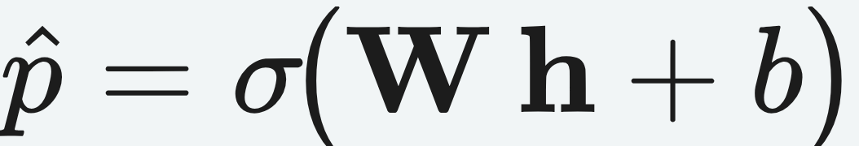
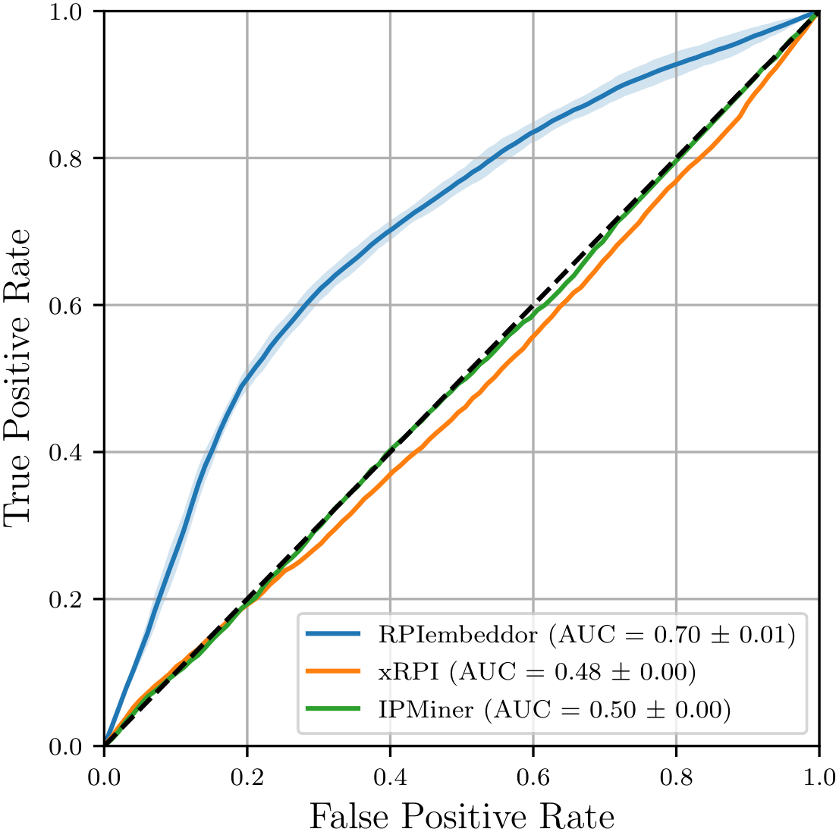
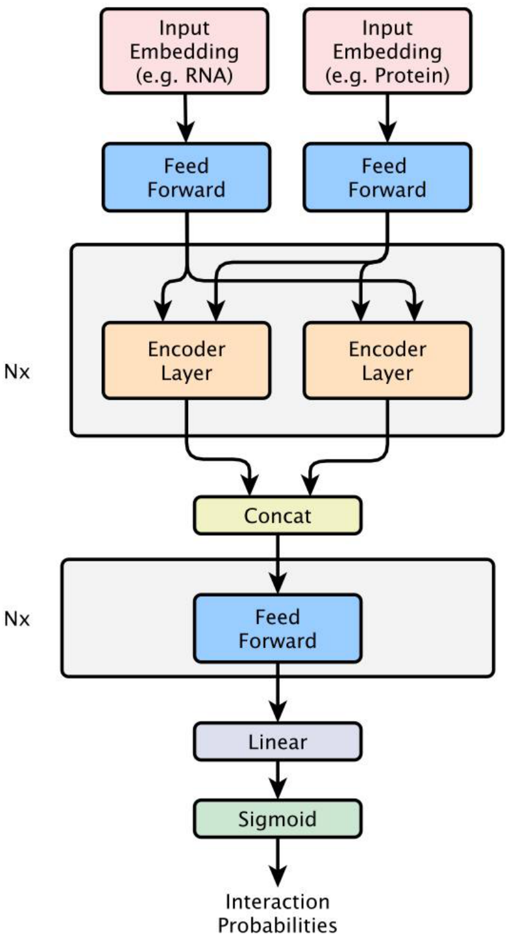


RNA-Protein Interaction Classification via Sequence
Embeddings
Dominika Matus¹, Frederic Runge¹, Jörg K.H. Franke¹, Lars Gerne¹, Michael Uhl¹, Frank Hutter^{1,2}, Rolf Backofen¹
¹ University of Freiburg ² ELLIS Institute Tübingen
Method
Problem
Key Results
Headline Numbers
Predicting whether an ncRNA and protein interact from
sequence alone is largely unsolved: most methods
are protein-specific and need a dataset per protein.
0.70
0.586
F1 on TSfam
RNA-FM + ESM-2 embeddings → symmetric encoders → sigmoid over latent h
ROC AUC on unseen
RNA families
122K
interactions
Datasets exist for only a few hundred of the ~2,000
human RNA-binding proteins.
vs 0.48–0.50 (chance)
baselines
1.4M
model params
Motivation
Takeaway
A sequence-only classifier across diverse RNA and
protein types unlocks the vast interaction space
without per-protein data.
Feeding RNA + protein foundation-
model embeddings into a compact
attention classifier yields the first
strong sequence-only predictor that
generalizes across unseen RNA
families.
Foundation models trained on massive unlabeled
corpora inject structural and functional priors that
are otherwise unavailable for RNAs at scale.
Meta-learning across interaction types remains
largely unexplored.
FIRST
A general, sequence-only ncRNA-
protein interaction predictor that needs
no per-protein training data.
Dataset / Benchmark
ROC on held-out TSfam: AUC 0.70 vs 0.48 (XRPI) and 0.50
(IPMiner), which sit at chance. RPIembeddor generalizes to
unseen RNA families.
The released RNAInterAct dataset, split to
remove homology bias, gives the
community a fair benchmark for further
progress.
From RNAInter (>47M interactions); sequences
recovered via NCBI, UniProt and Ensembl and
annotated with Rfam and Pfam.
Ablation Study
122,217 interactions (1:2 pos:neg) with realistic
negatives, split by RNA family so no family is
shared between train and test.
EMBEDDINGS
F1
ACC
Random RNA-FM
0.0
0.624
Scan to Read
Random ESM-2
0.0
0.624
Splits by family: TRinter 109,214 · TSfam 13,003 ·
external RPI2825.
Full (RNA-FM + ESM-2)
0.605
0.678
RPIembeddor architecture — dual embeddings
→ encoders → sigmoid. 1.4M parameters.
SO WHAT → Replace either embedding and the model collapses to a negative-only classifier — both are essential.
RNAInter
NCBI
UniProt
Ensembl
Rfam
Pfam
Paper
Dataset

