Slide 1

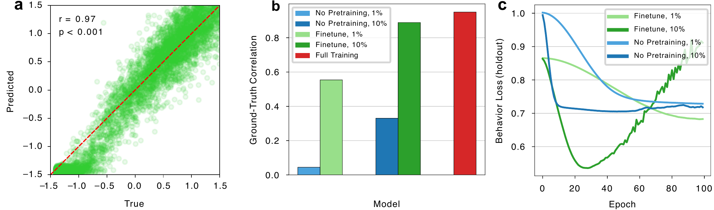
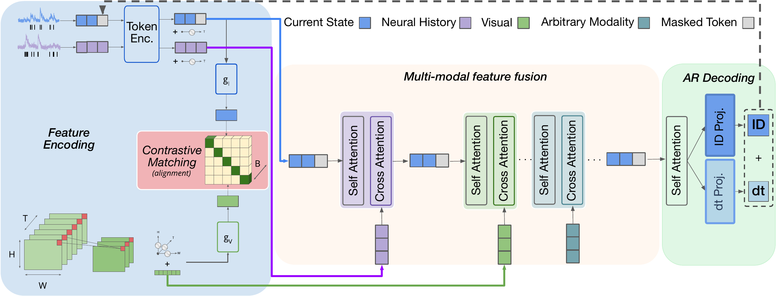
Neuroformer: Multimodal & Multitask Generative Pretraining for Brain Data
Antonis Antoniades¹, Yiyi Yu¹, Joseph Canzano¹, William Wang¹, Spencer LaVere Smith¹
¹ University of California, Santa Barbara
Problem
Method
Key Results
Modern experiments yield large-scale, multimodal spiking data whose scale and heterogeneity outstrip the classical tools built for small, single-modality recordings.
Spike analysis reframed as autoregressive spatiotemporal generation, trained self-supervised:
Behavior decoding
cond. 1
cond. 2
Lasso regression
0.62
0.73
A widening gap: data richness has outrun the methods to make sense of it.
1
Tokenize spikes into Current & Past State windows; encode video (3D-conv patches) and behavior as feature streams.
Neuroformer
0.95
0.97
+0.24 Pearson r over Lasso on mouse-speed decoding (0.97 vs 0.73)
Motivation
2
Align neural, visual & behavioral tokens with a multimodal contrastive objective.
Pretrained transformers reshaped vision and language via self-supervised learning from raw data. Can the same generative recipe unlock scalable, transferable neural-spike analysis?
3
Fuse via cascading cross-attention — cost O(T_{c}·T_{f}), linear in features.
One general model, not many bespoke ones: multimodal, linear-scaling, transferable.
4
Decode autoregressively: predict which neuron fires and its sub-interval time bin.
Dataset / Benchmark
Fig 5. (a) Predicted vs. true speed, r = 0.97. (b) A pretrained model fine-tuned on 1% of data beats a non-pretrained one trained on 10%. (c) Pretrained models (green) converge faster to lower behavior loss.
Two validation levels: a simulated network with ground-truth connectivity, and real two-photon imaging of mouse cortex (386 neurons, V1 & AL).
Joint loss: contrastive alignment + neuron-ID + time-bin cross-entropy
SO WHAT → Attention recovers directed circuitry that correlation cannot; pretraining transfers to behavior with few-shot fine-tuning.
Simulated SNN
2-photon V1
2-photon AL
Visnav (speed)
Headline Numbers
Takeaway
Treating neural spikes as an autoregressive, multimodal generation problem lets one self-supervised transformer recover circuit connectivity and decode behavior from few examples.
0.97
p=.02
beats GLM, pop. response
Pearson r · behavior decoding
1%
few-shot beats 10% data
vs 0.73 for Lasso, same split
~100M
params, largest model
The pretraining paradigm that reshaped vision and language now works for the brain — a path to scalable neuroscience foundation models.
SO WHAT → Pretrained few-shot models decode behavior with a fraction of the labels.
Fig 1. Neuroformer architecture: contrastive matching aligns modalities; cascading self- & cross-attention fuse neural history, visual, and arbitrary modalities; the decoder reads out spike (neuron ID + Δt) tokens.

