Slide 1

ICLR 2024
Neuroformer
Multimodal & Multitask Generative Pretraining
for Brain Data
Scan for code
Antonis Antoniades · Yiyi Yu · Joseph Canzano · William Wang · Spencer LaVere Smith
WHAT IT IS
KEY IDEA
WHAT IT DOES
Generative pretrained
Spikes as a generation
✓ Recovers circuit connectivity
transformer for the brain
problem
✓ Decodes mouse behavior
cellular-resolution spikes
from only a few examples,
Multimodal · multitask ·
→ autoregressive spatiotemporal
fully self-supervised
via few-shot fine-tuning
Neuroformer · ICLR 2024
01 / 10
Notes:
Neuroformer is a multimodal, multitask generative pretrained transformer for brain data, built at UC Santa Barbara. It reframes cellular-resolution spike analysis as autoregressive spatiotemporal generation, borrowing the recipe behind large language and vision models. Trained self-supervised, it recovers circuit connectivity and decodes mouse behavior.

Slide 2
02 · PROBLEM
Rich data outpaces the tools
A BIG-DATA ERA
THE ANALYSIS GAP
Experiments now co-record three
Classical tools were built for
modalities at once
smaller, single-modality data
Neural activity
large · multimodal
N
thousands of neurons, cellular resolution
widening gap
V
Visual stimuli
gratings and naturalistic videos
single-modality
B
Behavior
eye position, running speed, movement
Data richness
Classical tools
Neuroformer · ICLR 2024
02 / 10
Notes:
Modern neuroscience records thousands of neurons at cellular resolution, alongside visual stimuli and behavior. These datasets are large, multimodal, and messy, yet the field's traditional statistical tools were built for far smaller, single-modality recordings, leaving a widening data-analysis gap.

Slide 3
03 · MOTIVATION
Borrow the pretraining playbook
WHAT WORKED IN VISION & LANGUAGE
THE QUESTION FOR THE BRAIN
Reframe spike analysis as a
1
Learn from raw data
generative prediction problem?
no task labels — self-supervised prediction
of the next token
If yes, one self-supervised model could:
→
2
General representations
Scale to large, high-neuron recordings
powerful features emerge directly from data
Transfer with few labels
Fuse an arbitrary number of modalities
3
adapt to many downstream tasks cheaply
Transfer to behavior decoding
A general-purpose recipe, proven at scale.
Neuroformer · ICLR 2024
03 / 10
Notes:
Large pretrained models in vision and language point a way forward: they learn general representations self-supervised from raw data, then transfer with little labeling. The authors ask whether reframing spike analysis as generative prediction can likewise scale, fuse modalities, and transfer to behavior decoding.

Slide 4
04 · CONTRIBUTION
Four contributions
1
Spikes as generation
2
Linear-scaling fusion
Reframes spike analysis as autoregressive
Cross-attention design scales
spatiotemporal generation —
linearly with feature size
trained fully self-supervised, no labels.
and fuses an arbitrary number of modalities.
3
Recovers connectivity
4
Transfers to behavior
On a network with known ground truth,
Once pretrained on neural responses,
attention maps recover the directed circuit,
decodes mouse behavior with few-shot
including hub neurons correlation misses.
fine-tuning
— no explicit supervision.
Neuroformer · ICLR 2024
04 / 10
Notes:
Neuroformer makes four contributions. It reframes spike analysis as self-supervised autoregressive generation, needing no labels. Its cross-attention scales linearly with feature size and fuses many modalities. On simulated data, its attention maps recover directed connectivity, including hub neurons correlation misses. Pretrained, it decodes behavior with few-shot fine-tuning.

Slide 5
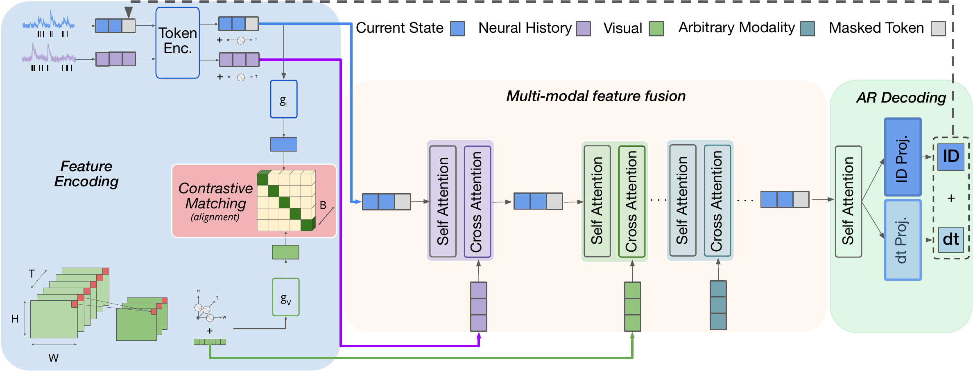
05 · METHOD
Tokenize · align · fuse · decode
STEP 1 · TOKENIZE
ARCHITECTURE (FIG. 1)
Each spike is a token
activity split into Current + Past State windows
STEP 2 · ENCODE + ALIGN
3D-conv video patches · behavior stream
contrastive module aligns the three modalities
STEP 3 · FUSE
Cross-attention: Current State × features
attention cost quadratic → linear
JOINT OBJECTIVE
STEP 4 · DECODE
ℒ = γ·ℒ_vnc + μ·ℒ_ce(I) + (1−γ−μ)·ℒ_ce(dt)
Causally masked transformer decoder
one contrastive loss + two spike cross-entropy losses,
predicts which neuron fires + its time bin
optimized jointly end-to-end.
Neuroformer · ICLR 2024
05 / 10
Notes:
Neuroformer treats each spike as a token, splitting activity into Current and Past States. Video becomes patches via a 3D-convolutional encoder; behavior forms a separate stream. A contrastive module aligns neural, visual, and behavioral features. Cross-attention fuses the Current State with larger feature arrays, cutting attention cost from quadratic to linear. A causally masked decoder predicts which neuron fires and its time bin.

Slide 6
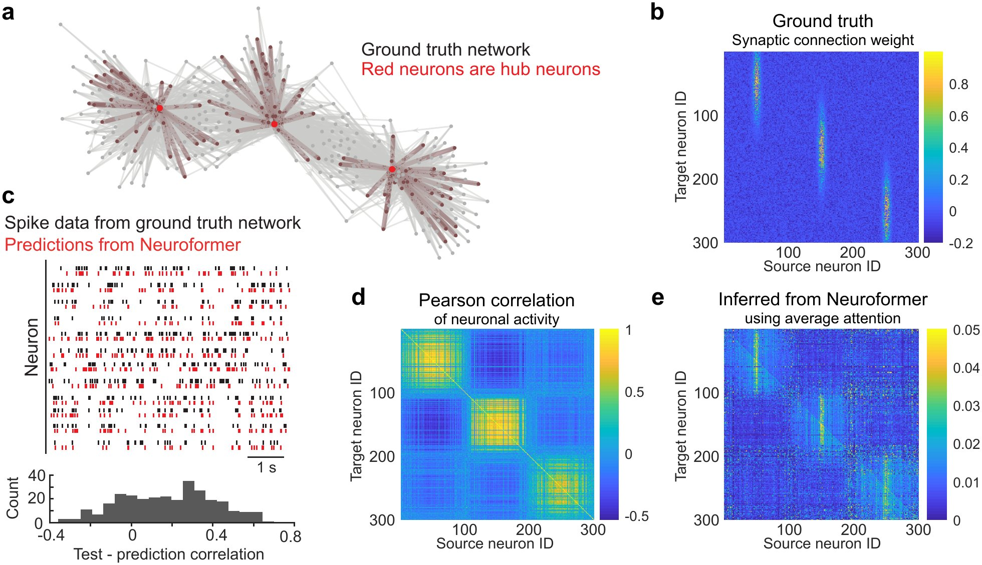
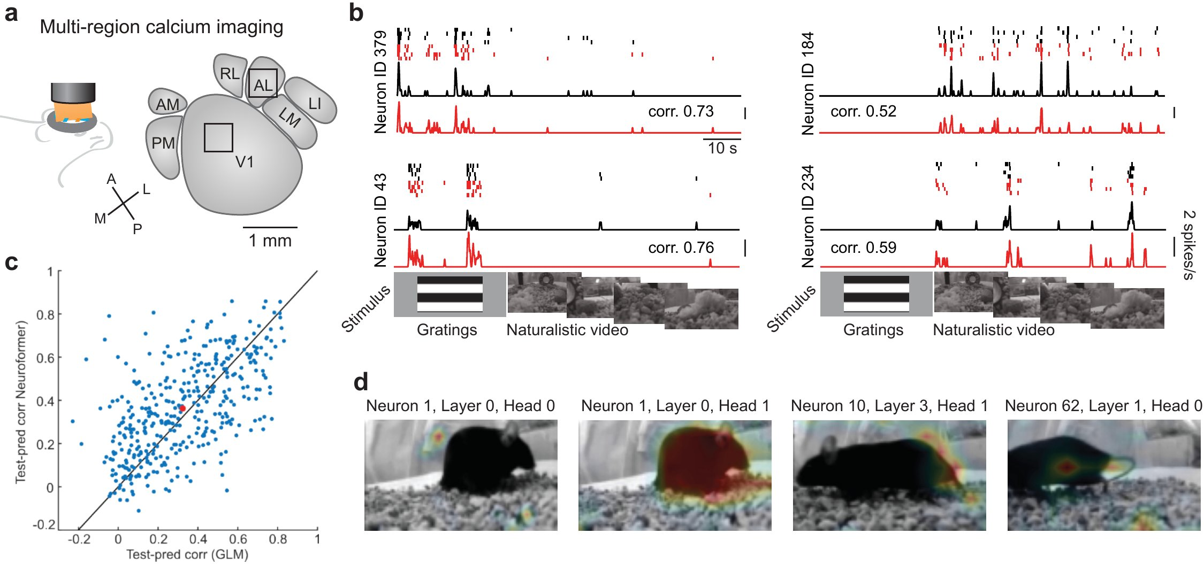
06 · DATASET / BENCHMARK
Validated at two levels
Validation spans two levels: ground-truth simulation and real mouse cortex.
LEVEL 1 · GROUND-TRUTH SIMULATION
LEVEL 2 · REAL MOUSE CORTEX
386
V1 + AL
+ Visnav
3 strongly connected hub neurons
reliable neurons
visual areas
speed / behavior
give a known connectivity matrix to check against
gratings & naturalistic videos · models ~40–100M params
Neuroformer · ICLR 2024
06 / 10
Notes:
Validation spans two levels. First, a simulated spiking network with three hub neurons gives a ground-truth connectivity matrix. Second, two-photon calcium imaging of mouse visual cortex records 386 neurons across V1 and AL viewing gratings and natural videos, plus a virtual-navigation dataset pairing activity with running speed.

Slide 7
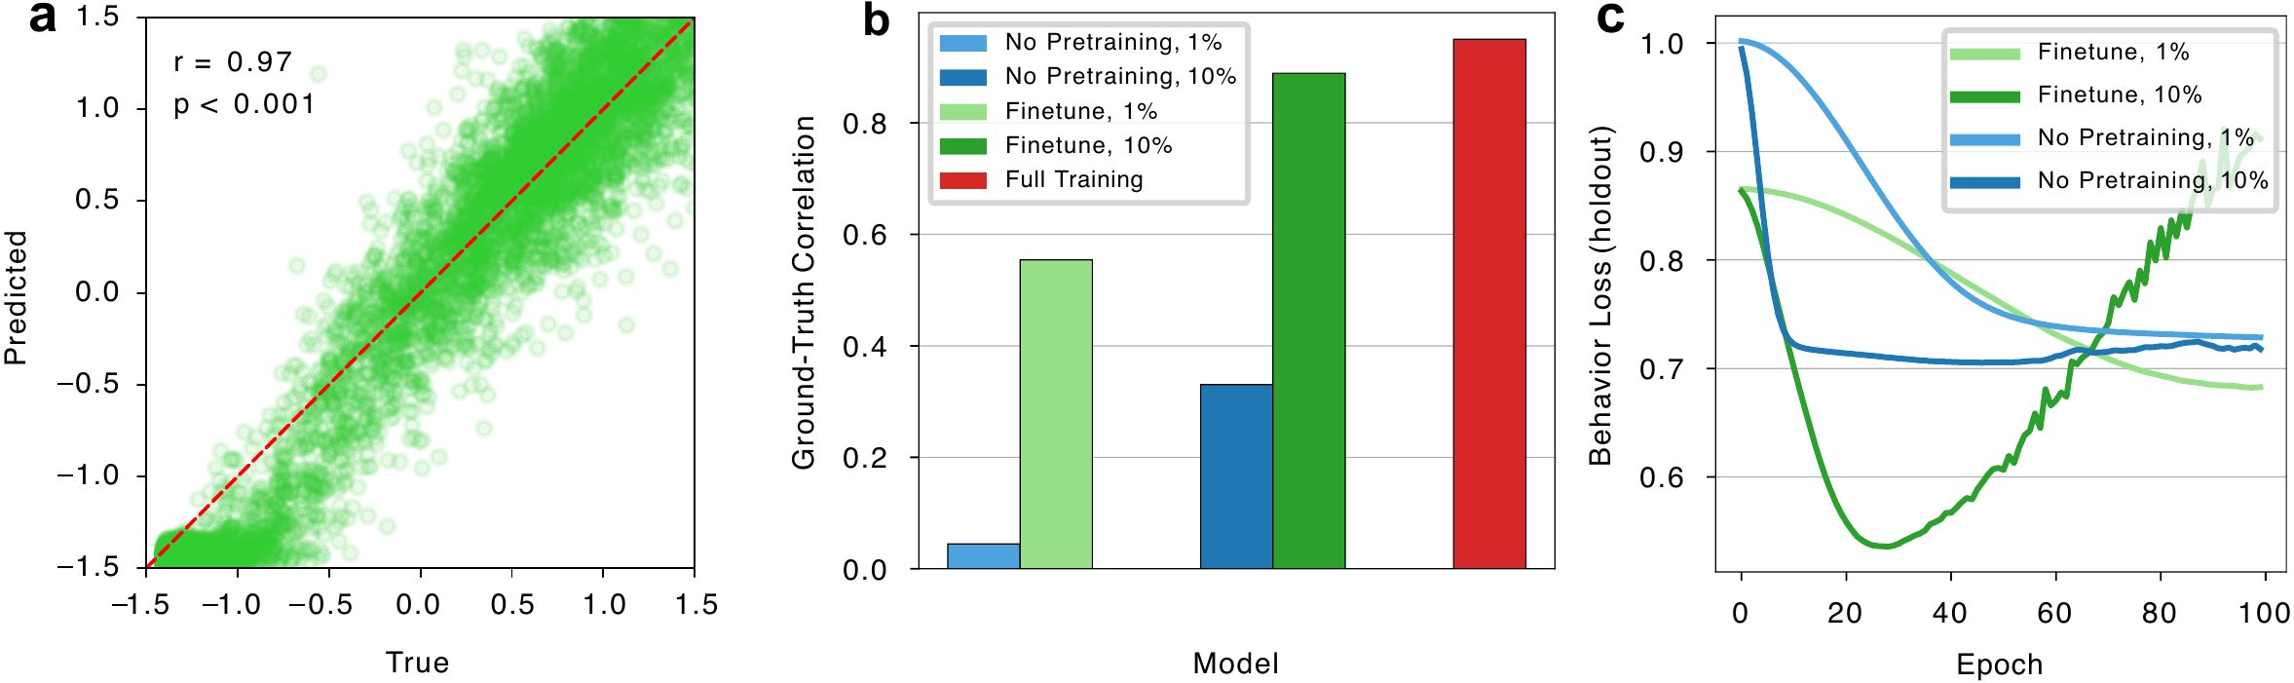
07 · KEY RESULT
Connectivity recovered, behavior decoded
SIMULATED NETWORK
REAL CORTEX
Attention reveals directed
Reproduces responses to
connectivity + hub neurons
gratings & natural videos
Plain Pearson correlation cannot —
Population predictions beat a GLM,
it has no sense of direction.
significantly (p ≈ 0.02).
FINE-TUNED TO DECODE RUNNING BEHAVIOR
0.97
peak Pearson r
predicted vs. true running speed
Neuroformer · ICLR 2024
07 / 10
Notes:
On the simulated network, Neuroformer's attention reveals directed connectivity and identifies the hub neurons, which plain correlation misses for lack of directionality. On real cortex, it reproduces responses to gratings and natural videos, with population predictions significantly beating a GLM, p around 0.02. Fine-tuned to decode running, it reaches Pearson correlations up to 0.97.

Slide 8
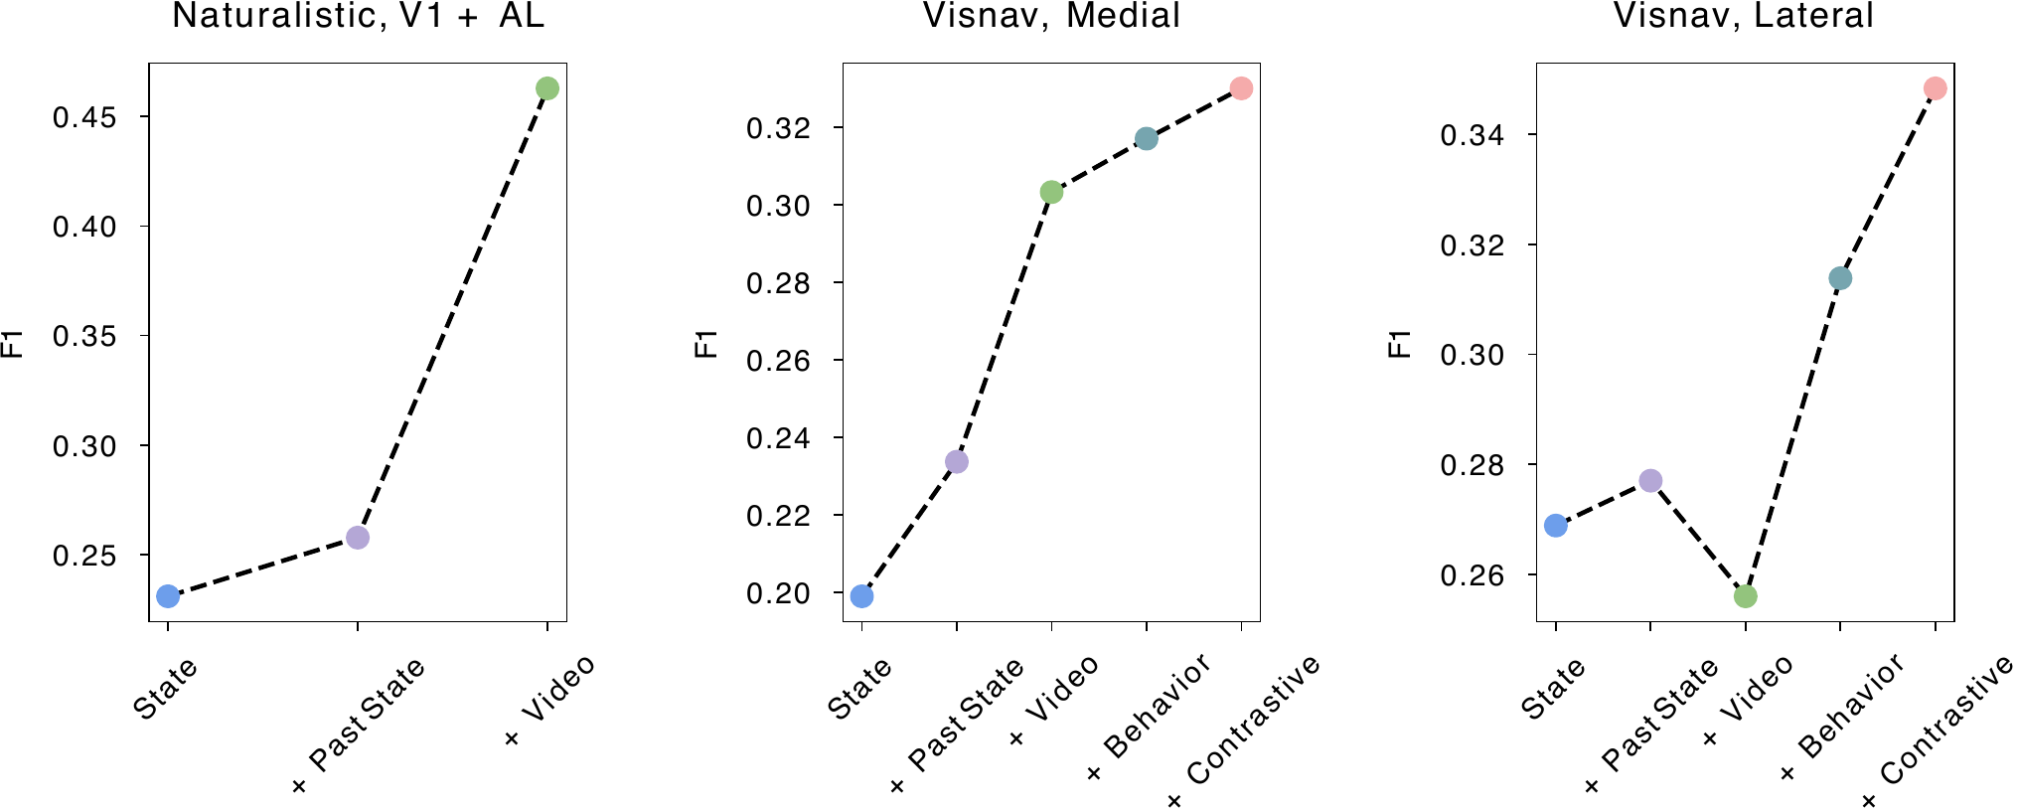
08 · ABLATION STUDY
Every component pulls its weight
REMOVE COMPONENTS ONE AT A TIME (FIG. 6)
Two findings stand out
FINDING 1 · JOINT TRAINING
Neural + behavior together
beats either signal alone
the model links neural and behavioral
representations without supervision
FINDING 2 · CONTRASTIVE OBJECTIVE
Each part adds measurable predictive power:
Helps most when data is
scarce
Current St.
Past St.
Video
Behavior
Contrastive
guards against over-fitting to noisy,
variable neural signals
Neuroformer · ICLR 2024
08 / 10
Notes:
An ablation removes components one at a time: the Current State, Past State, video stream, behavior stream, and contrastive objective each add measurable predictive power. Two findings stand out. Jointly training on neural responses and behavior beats either alone, and the contrastive objective helps most when data is scarce.

Slide 9
09 · HEADLINE NUMBERS
By the numbers
BEHAVIOR PREDICTION · PEAK PEARSON r
FEW-SHOT TRANSFER · LESS DATA, HIGHER r
0.97
Pretrained · fine-tuned on 1% data
0.51
0.73
learns transferable structure first
beats ↓ (10× more data)
Non-pretrained · given 10% data
0.33
trained from scratch
Neuroformer
Lasso
~100M
parameters in the largest models
p ≈ 0.02
scales linearly with feature size
population responses beat a GLM
Neuroformer · ICLR 2024
09 / 10
Notes:
For behavior prediction, Neuroformer reaches Pearson correlation up to 0.97, versus about 0.73 for Lasso. Few-shot, a model pretrained and fine-tuned on just 1% of behavior data hits 0.51, beating a non-pretrained model given 10%, which reaches only 0.33. Its largest models scale to roughly 100 million parameters.

Slide 10

10 · TAKEAWAY
Pretraining, now for the brain
The pretraining paradigm that reshaped vision and
language can also work for the brain.
one self-supervised, multimodal, generative recipe
ONE FORMULATION
TWO OUTCOMES
WHERE IT POINTS
Spikes as autoregressive,
Recovers directed
Scalable neuroscience
multimodal generation
connectivity + decodes
foundation models
a single self-supervised transformer
behavior from few examples
and a future link to LLMs
Code
Paper
github.com/a-antoniades/Neuroformer
arxiv.org/abs/2311.00136 · ICLR 2024
10 / 10
Notes:
The takeaway: the pretraining paradigm that reshaped vision and language can also work for the brain. Treating spikes as autoregressive multimodal generation, one self-supervised transformer recovers a circuit's directed connectivity and decodes behavior from few examples, pointing toward scalable neuroscience foundation models.

