Slide 1



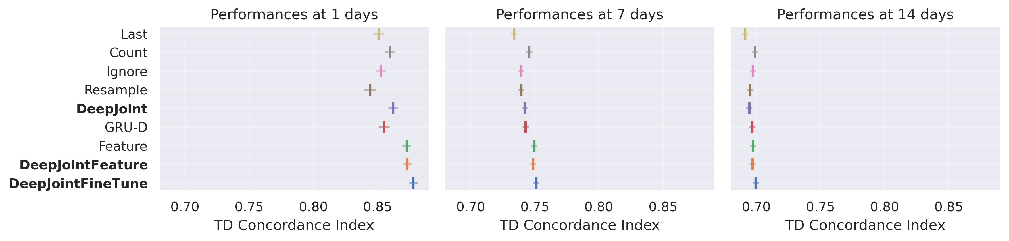

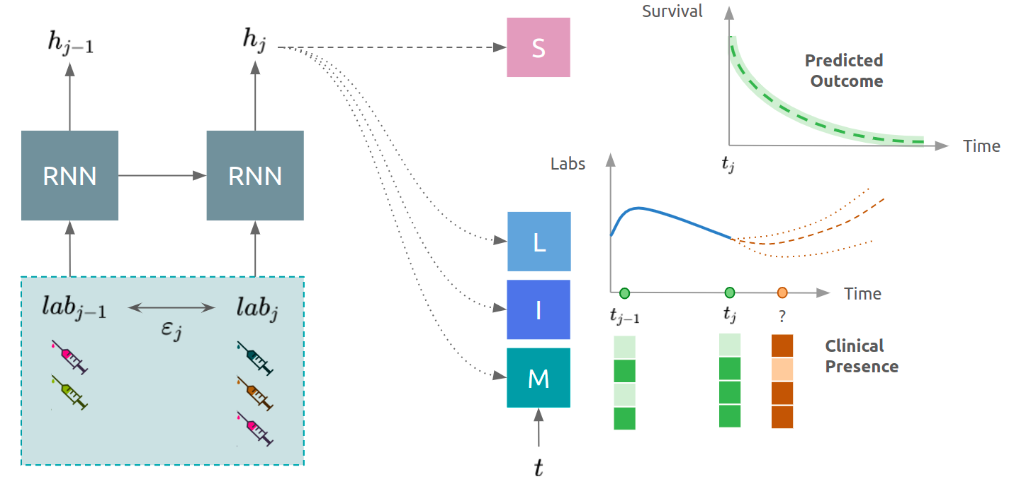
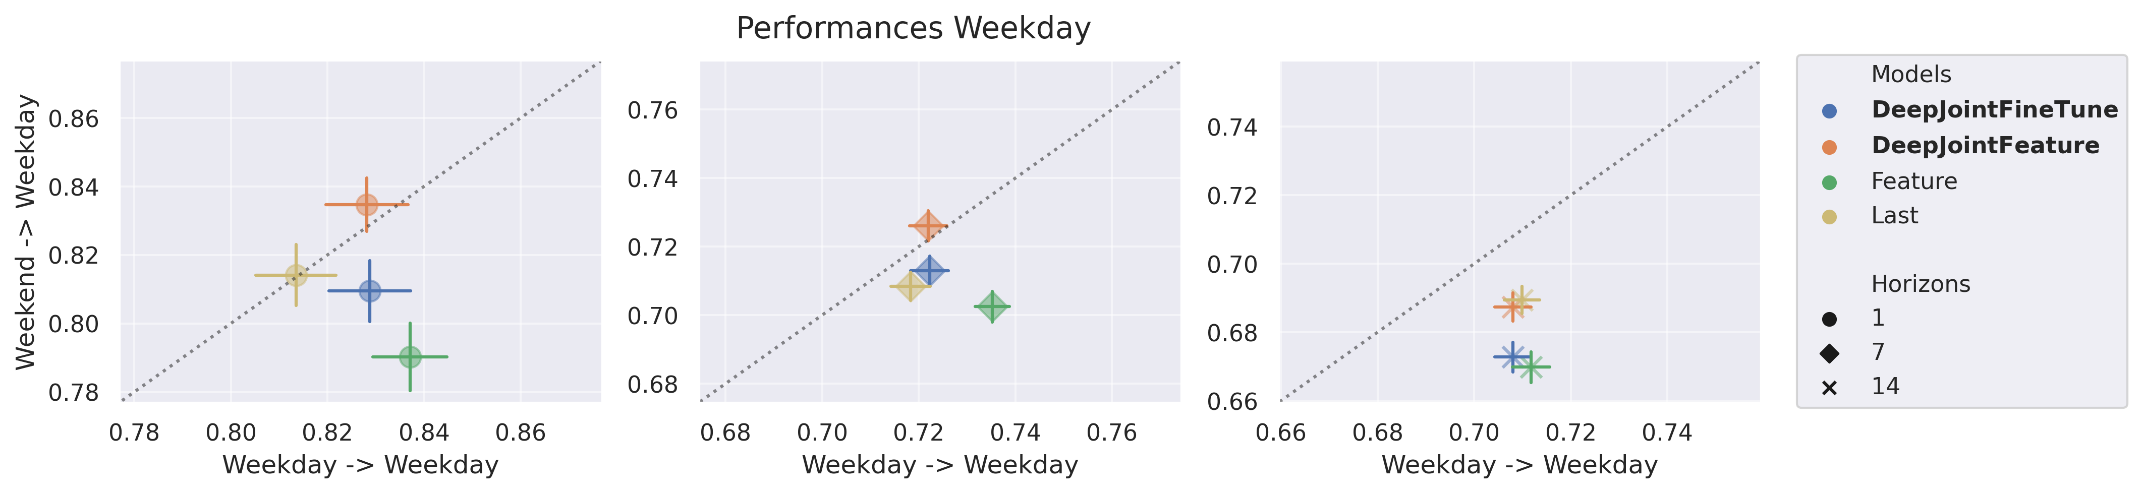
DeepJoint: Robust Survival Modelling Under
Clinical Presence Shift
Vincent Jeanselme¹, Glen Martin², Niels Peek², Matthew Sperrin², Brian Tom¹, Jessica Barrett¹
¹ University of Cambridge (MRC Biostatistics Unit) ² University of Manchester (Health e-Research Centre)
Problem
Method
Key Results
Clinical data arise from an informative sampling process, when,
which, and how often tests are ordered, yet survival models treat
this clinical presence as noise, hurting both accuracy and
transportability when practice evolves, discarding the very signal
that should inform prediction.
An LSTM encodes each patient's irregular ICU test sequence
into a shared embedding h; three heads then model clinical
presence, longitudinal values (Gaussian), missingness
(Bernoulli) and timing (cumulative intensity), while a DeepSurv
Cox head models survival, all trained jointly.
Even lab-only DeepJoint beats GRU-D and the “Ignore”
LSTM.
Motivation
The same patients present differently under different observation
processes; a model overfit to one regime fails when practice
shifts.
Joint loss: survival term ℓ_{S} plus dynamically-weighted clinical-presence tasks; α balances the two.
Time-dependent C-Index at 1 / 7 / 14-day horizons (higher is better).
Proposed models (bold) lead at short horizons.
The weekend effect, differing test intensity and mortality for
weekend vs weekday admissions, offers a controllable shift to
stress-test robustness.
SO WHAT → The edge fades at longer horizons as presence signals short-term instability.
Data & Cohort
Prior work uses missingness or timing in isolation, not the full
observation process jointly with survival.
MIMIC-III ICU laboratory tests, 38,597 patients at Beth Israel
Deaconess (2001–12).
Clinical presence is signal to model, not noise to ignore.
Filtered to 30,834 patients surviving the first 24 h post-
admission.
Robustness to Shift
30,834
90/10
1·7·14
patients
train / test split
day horizons
Deep Joint Model: an LSTM embedding h drives the longitudinal (L), inter-
observation (I), missingness (M) and survival (S) networks.
Takeaway
Explicitly modelling how clinical data are observed, not just their
values, yields survival models that are both more accurate and far
more transportable when clinical practice shifts. Clinical presence
is signal, not noise, and building it into the model is what makes
medical predictions transfer across settings, and even flags when
the observation process itself has changed.
Transferred (y-axis) vs oracle (x-axis) discrimination under the
weekday↔weekend shift, at 1 / 7 / 14-day horizons. Closer to the diagonal
= more robust.
Headline Numbers
DeepJointFeature stays closest to the diagonal, most robust to the
shift; the fine-tuned variant overfits and Feature alone is shift-
sensitive.
0.878
30,834
ICU patients
C-Index · 1-day horizon · MIMIC-III
3
presence processes
State-of-the-art vs input-matched models
1/7/14
day horizons

