Slide 1
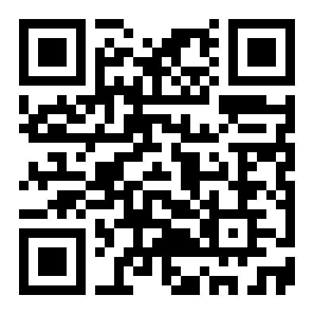
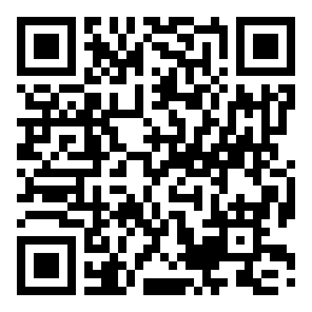


NEURIPS 2022 · arXiv 2205.13481
DeepJoint
CLINICAL PRESENCE
When and which tests get ordered
is itself informative — it reflects
how clinicians treat each patient.
Robust Survival Modelling Under
Clinical Presence Shift
Patterns shift across settings
V. Jeanselme, G. Martin, N. Peek, M. Sperrin, B. Tom, J. Barrett
— and standard prediction models degrade.
University of Cambridge, MRC Biostatistics Unit · University of Manchester
How clinical data are observed is itself informative
ONE EMBEDDING, FOUR HEADS
— model it, and survival predictions get both more accurate
and more transportable.
L · next values
h
I · timing
embedding
LSTM sequence
M · missingness
S · survival
Paper
Code
Notes:
DeepJoint is a robust survival model for clinical data. In medicine, when and which tests get ordered is itself informative — a phenomenon the authors call clinical presence. When these patterns shift, standard prediction models degrade. DeepJoint is a multi-task recurrent network that models three clinical-presence processes jointly with survival.

Slide 2
THE PROBLEM
The observation process is informative
01
02
03
Patient × system
Timing carries signal
The common blind spot
Observational medical data
When a clinician orders a
Most models ignore this —
arise from the interaction
test, its timing and its
they assume the sampling
between patients and the
existence carry information
process is non-informative.
healthcare system.
about the patient.
Ignoring clinical presence yields sub-optimal, non-transportable models.
→
Modelling it explicitly is the fix.
02 / 10
DeepJoint · NeurIPS 2022
Notes:
Observational medical data arise from the interaction between patients and the healthcare system. A test's timing and its existence carry information about the patient. Most models ignore this, assuming sampling is non-informative — which yields sub-optimal, non-transportable models.

Slide 3
MOTIVATION
Clinical presence shifts — and models break
Heterogeneity is the key challenge
A gap in the literature
The same patient population can look
ML has studied covariate and label shift.
very different depending on the observation
Shift in the observation process itself
process — it shifts across countries, over
remains under-explored.
time, and between weekdays and weekends.
OBSERVATION DENSITY, SAME COHORT
DEEPJOINT'S QUESTION
Does explicitly modelling
clinical presence make survival
models robust to this shift?
Weekday
Weekend
03 / 10
DeepJoint · NeurIPS 2022
Notes:
The same patient population appears differently under different observation processes, and that process shifts across countries, over time, and between weekdays and weekends. ML has studied covariate and label shift, but shift in the observation process itself is under-explored.

Slide 4
CONTRIBUTION
A joint model of clinical presence + survival
Multi-task learning
One shared embedding → four heads
Treat clinical presence as
multi-task learning — the
h
→
L
I
M
S
observation processes are
shared recurrent
longitudinal
timing
missingness
survival
learned together with survival.
Combined likelihood · dynamic weighting · optimised end-to-end
THE RESULT
A representation that encodes the observation process —
a predictive edge and robustness when practice changes.
04 / 10
DeepJoint · NeurIPS 2022
Notes:
The paper contributes a deep joint model that treats clinical presence as multi-task learning. A shared recurrent embedding feeds four heads — longitudinal, inter-observation timing, missingness, and survival — trained together with dynamic weighting. The result encodes the observation process, giving a predictive edge and robustness.

Slide 5
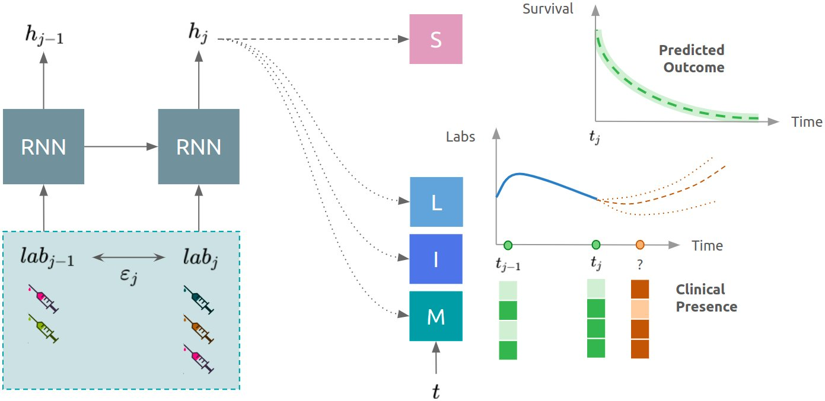
METHOD
Architecture: one embedding, four heads
LSTM encoder
Encodes each patient's irregular lab-test
sequence into a single embedding h.
Three clinical-presence heads
L — next test values (Gaussian)
M — which tests appear (Bernoulli)
I — inter-observation intensity (timing)
DeepSurv head (S)
Models survival under Cox proportional hazards.
Fig 1 · DeepJoint — LSTM embedding h feeding heads L, I, M (clinical presence) and S (survival)
TRAINING OBJECTIVE — DYNAMIC WEIGHTING
ℓ(e) = (1 − α) · ℓ_S + α · Σ w_task(e) · ℓ_task(e) task ∈ {L, I, M}
Four losses combined, balanced by the hyperparameter α, and optimised end-to-end.
05 / 10
DeepJoint · NeurIPS 2022
Notes:
An LSTM encodes each patient's irregular lab-test sequence into an embedding h. Three clinical-presence heads model next values (Gaussian), which tests appear (Bernoulli), and inter-observation timing. A DeepSurv head models survival under Cox proportional hazards. The four losses are combined by dynamic weighting, balanced by alpha, optimised end-to-end.

Slide 6
DATASET / BENCHMARK
MIMIC-III ICU laboratory tests
MIMIC-III
STUDY COHORT
Evaluation protocol
An intensive-care database
30,834
Predict in-hospital survival
from Beth Israel Deaconess,
from the embedding at the last
2001–2012, with anonymised
observation in day 1.
laboratory tests for over
patients · survived the first 24 hours
38,000 patients.
Time-dependent C-index and
Brier score at 1 / 7 / 14 days.
17
90 / 10 patient split.
laboratory tests
06 / 10
DeepJoint · NeurIPS 2022
Notes:
Experiments use MIMIC-III, an intensive-care database of anonymised lab tests for over 38,000 patients. Restricting to those surviving the first 24 hours leaves 30,834 patients. Models predict in-hospital survival from the embedding at the last day-1 observation, scored by time-dependent C-index and Brier at 1 / 7 / 14 days.

Slide 7
KEY RESULT
Presence lifts short-horizon discrimination
1-day C-index · same-input models
Why it matters
Random population split — three proposed methods are competitive-to-best.
DeepJoint sees only lab
0.853
values, yet beats Ignore-LSTM
Ignore-LSTM
and GRU-D — which takes
missingness as an input.
GRU-D
0.855
DeepJoint
0.862
Modelling the observation
labs only
process — even without
DeepJointFineTune
0.878
feeding it in — yields a
BEST
more predictive embedding.
0.84
0.88
1-day time-dependent C-index — higher is better (axis starts at 0.84)
07 / 10
DeepJoint · NeurIPS 2022
Notes:
On a random population split, the three proposed methods deliver competitive-to-best discrimination against same-input models. DeepJoint, seeing only lab values, already outperforms Ignore-LSTM and GRU-D. Modelling the observation process — even without feeding it in — yields a more predictive embedding. Fine-tuning reaches a 1-day C-index of 0.878.

Slide 8
ABLATION STUDY
Variants × baselines: discrimination and robustness
3 variants vs 6 baselines
Robustness — closeness to the diagonal
Variants: DeepJoint · DeepJointFeature · DeepJointFineTune
Transferred vs internal (oracle) C-index · y = x means perfect transfer
Baselines: Last · Count · Ignore · Resample · Feature · GRU-D
Same inputs, compared on discrimination and transfer.
transferred ↑
y = x
DeepJointFeature improves
Adding clinical-presence features to the joint model
DeepJointFeature
closest to diagonal → best transfer
beats plain DeepJoint and matches the strong
Feature baseline.
DeepJointFineTune
DeepJointFineTune overfits
baselines
Highest population-level discrimination internally,
but degrades when the observation process shifts —
strong discrimination does not guarantee transfer.
internal (oracle) C-index →
08 / 10
DeepJoint · NeurIPS 2022
Notes:
The approach decomposes into three variants against six baselines. DeepJointFeature improves over plain DeepJoint and matches a strong feature baseline. The fine-tuned variant reaches the highest discrimination but overfits under shift. Across the robustness experiment, DeepJointFeature sits closest to the diagonal, transferring most reliably.

Slide 9
HEADLINE NUMBERS
DeepJoint at a glance
BEST 1-DAY C-INDEX
STUDY COHORT
0.878
30,834
time-dependent concordance index at the one-day horizon
MIMIC-III patients surviving the first 24 hours
CLINICAL-PRESENCE DIMENSIONS
PREDICTION HORIZONS
3
1 / 7 / 14
longitudinal · timing · missingness — modelled jointly with survival
days — evaluated by C-index and Brier score
09 / 10
DeepJoint · NeurIPS 2022
Notes:
The headline numbers: a concordance index of 0.878 at the one-day horizon, on a cohort of 30,834 MIMIC-III patients. DeepJoint jointly captures three dimensions of clinical presence — longitudinal, timing, and missingness — alongside survival, across horizons of one, seven, and fourteen days.

Slide 10
TAKEAWAY
Clinical presence is signal, not noise
THE TAKEAWAY
The way clinical data are sampled is itself informative. Jointly modelling the
observation process with survival gives predictions that are both more accurate
and markedly more robust when clinical practice changes.
Model clinical presence →
transportable medical predictions.
Signal, not noise: it improves both discrimination and robustness under shift.
PAPER · CODE
arXiv 2205.13481
github.com/Jeanselme/ClinicalPresence
Paper
Code
10 / 10
DeepJoint · NeurIPS 2022
Notes:
The takeaway: the way clinical data are sampled is itself informative, and jointly modelling that observation process with survival produces predictions that are both more accurate and markedly more robust when clinical practice changes. Clinical presence is signal, not noise.

