Slide 1







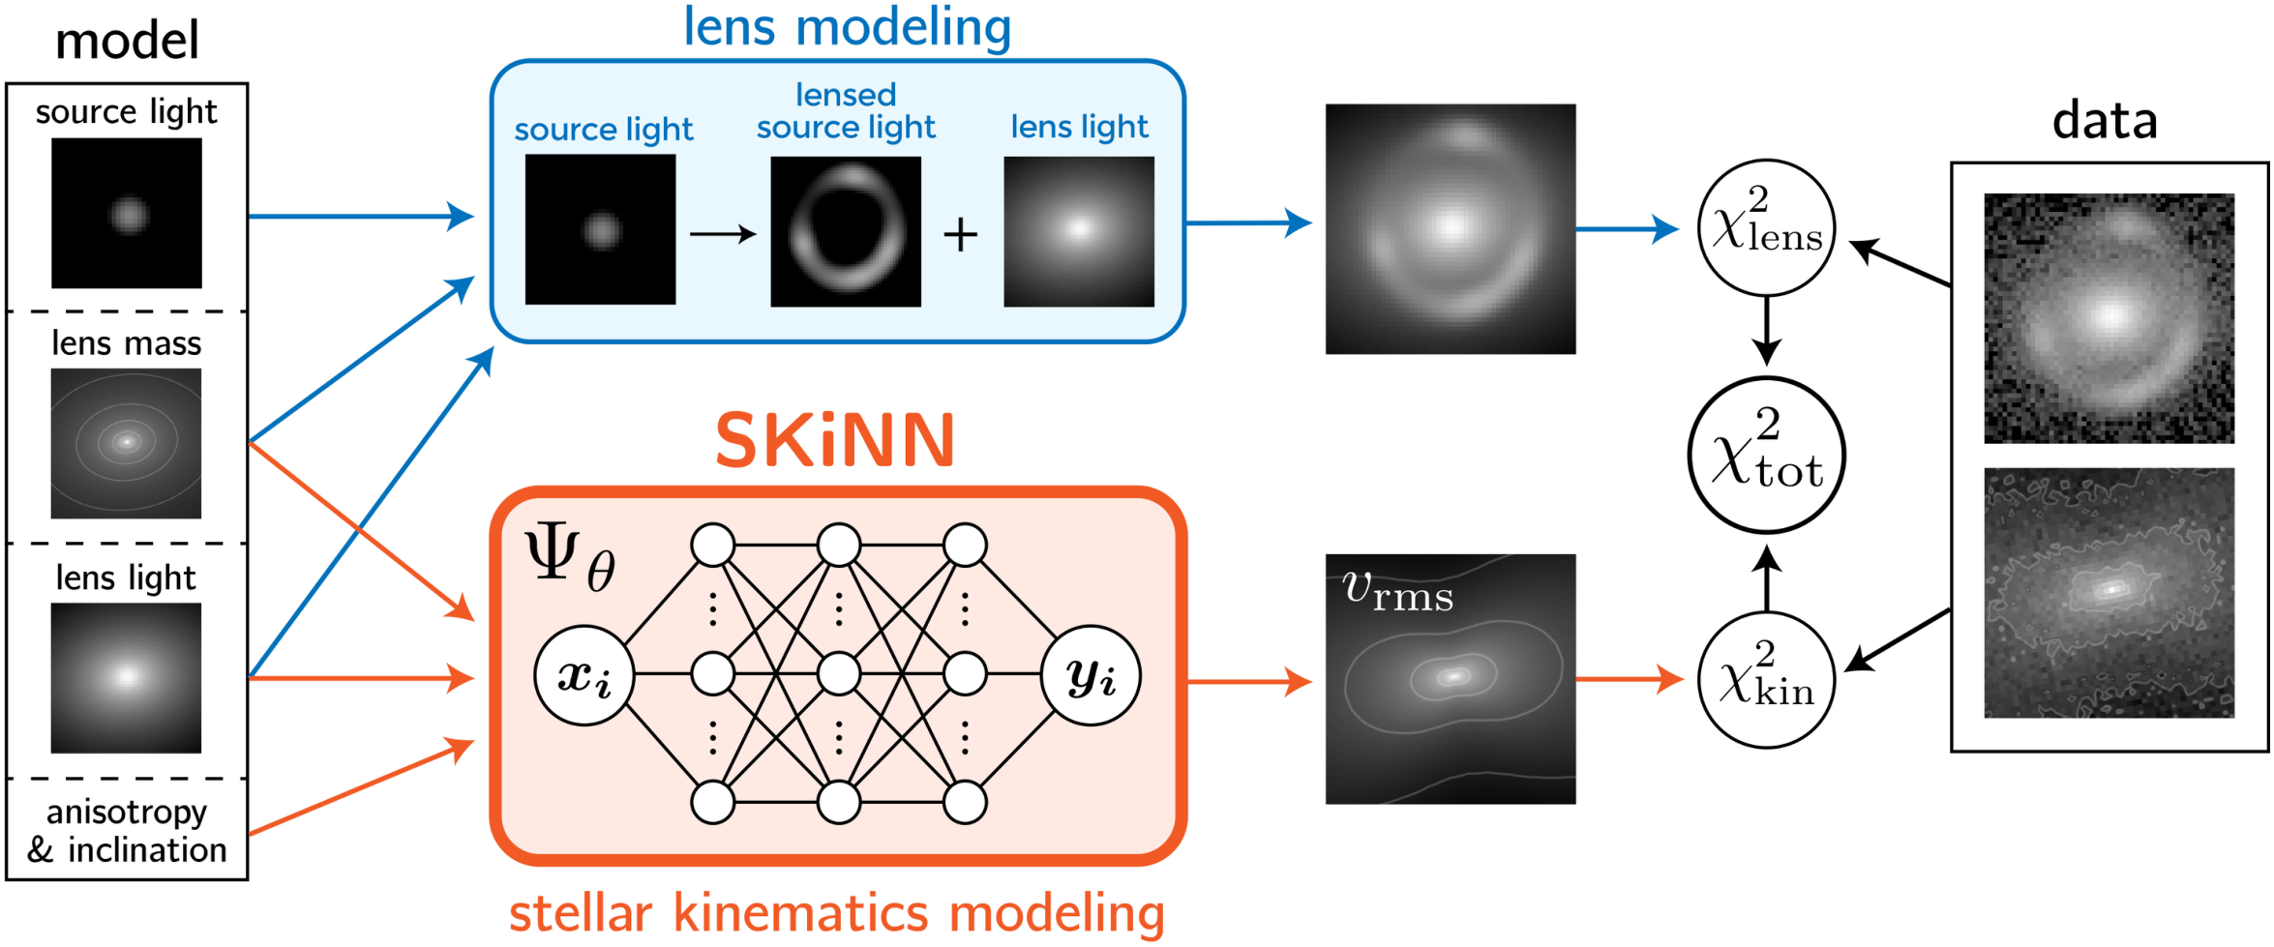
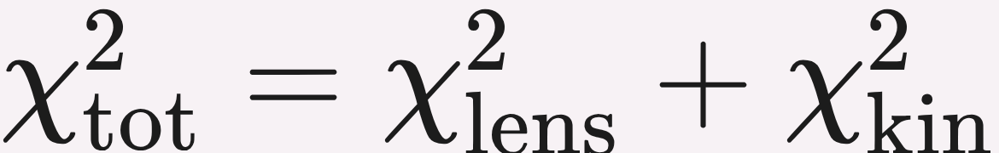


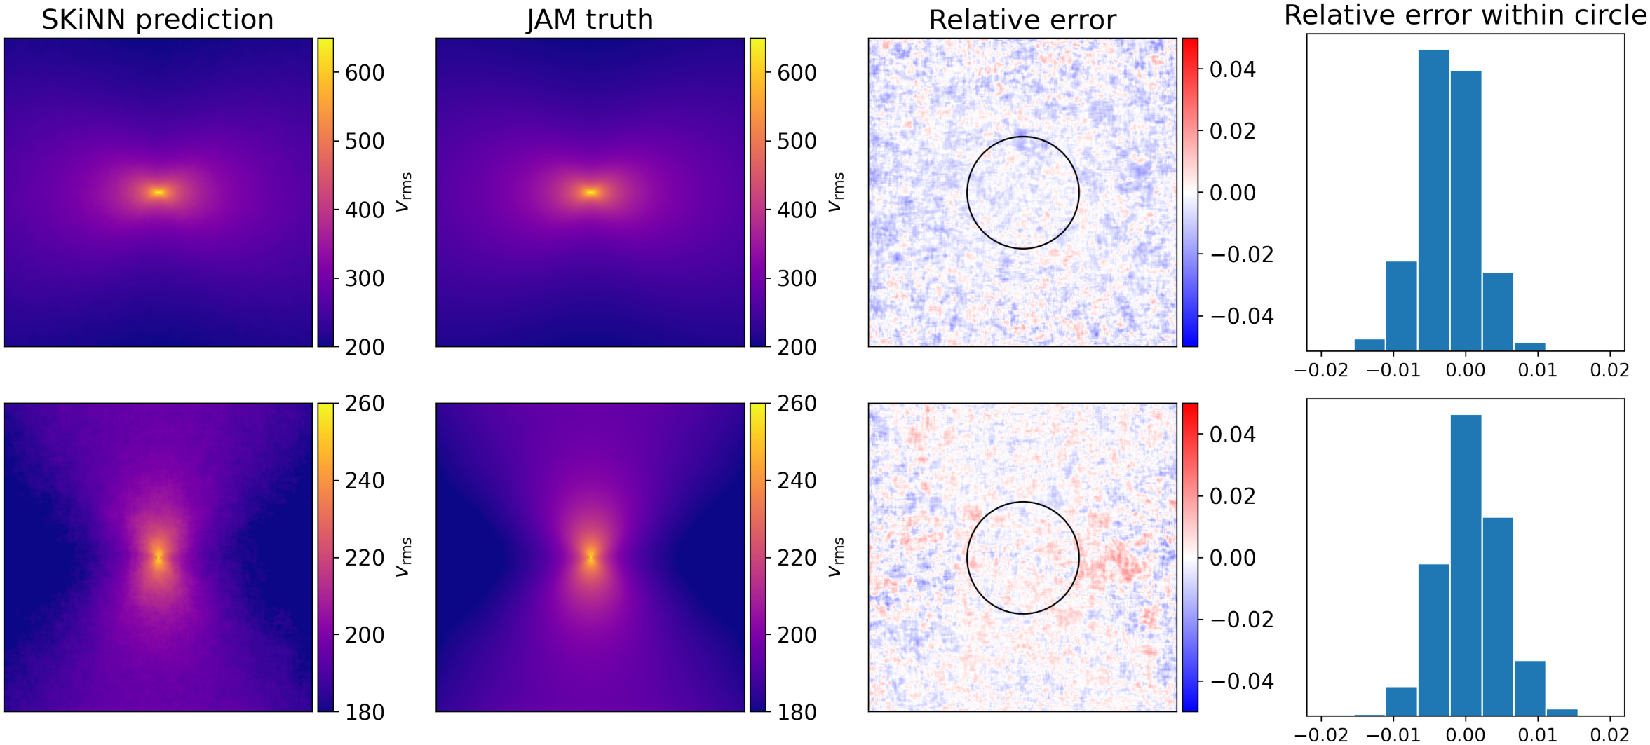

Fast Kinematics Modeling for Conjunction with Lens Image Modeling
Matthew R. Gomer¹, Luca Biggio², Sebastian Ertl^{3,4}, Han Wang^{3,4}, Aymeric Galan⁵, Lyne Van de Vyvere¹, Dominique Sluse¹, Georgios Vernardos⁵, Sherry Suyu^{3,4,6}
¹ Université de Liège ² ETH Zürich ³ Max-Planck-Institut für Astrophysik ⁴ Technische Universität München ⁵ EPFL ⁶ ASIAA
PROBLEM
METHOD
HEADLINE NUMBERS
Galaxy-kinematics modeling is the computational bottleneck in joint lensing + kinematics modeling: the physics code JAM must be re-run for every likelihood evaluation inside an MCMC.
SKiNN is a CNN Ψ_{θ} mapping an 8-D galaxy-parameter vector (PEMD mass + elliptical Sérsic light, inclination i, anisotropy β) to a d×d velocity-dispersion (v_{rms}) image.
~300×
<1%
error, inner 2″
5 conv blocks (upsampling + ReLU), ~7.07M params, trained with MSE against JAM-generated data (via GLEE) to mimic the JAM procedure.
Faster than JAM per v_{rms} image
0.47%
median abs. error
≈50 ms vs ~15 s
~7.07M
parameters
WHY IT MATTERS
SPEED &
COMPUTE
Kinematics break lensing mass-sheet degeneracies for a precise H₀ — but re-running JAM every MCMC step makes joint sampling prohibitive.
~15 s
~50 ms
~10×
JAM / img
SKiNN / img
GPU vs CPU
An O(10²–10³)× speedup at just ~7.07M parameters.
MOTIVATION
Spatially resolved kinematics from JWST are now available, but spherical Jeans models are too crude for elliptical lens mass models.
ERROR ANALYSIS
SKiNN (orange) emulates the stellar-kinematics branch; its χ² joins the lens branch (blue) in a single joint χ²_{tot}.
REGION / METRIC
REL. ERROR
EMULATION QUALITY
JOINT OBJECTIVE
Inner 2″ (constrained)
<1%
Self-consistent axisymmetric modeling with JAM is the right tool, yet far too slow for joint sampling — prior frameworks fit lens and kinematics separately.
Median, full image
~0.47%
SKiNN supplies the kinematics term from its predicted image; the lens term is unchanged.
TAKEAWAY
SKiNN is trained by MSE against JAM ground-truth images.
A neural network emulates slow galaxy-kinematics physics (JAM) at ~300× speed and sub-percent accuracy — making joint lensing + kinematics modeling feasible for precise H₀.
Existing joint pipelines targeted galaxy structure rather than H₀, or stayed too slow for full parameter exploration.
Because Ψ_{θ} is fast and differentiable, the kinematics term can be evaluated at every MCMC step — enabling joint lens + resolved-kinematics inference that JAM’s cost made intractable, and the same swap-a-component recipe transfers to other expensive model pieces.
Keep JAM’s physics, remove its cost — emulate the slow component with a neural network.
Swap an expensive-but-calculable component for a trained network, keep the rest of the physics.
SKiNN vs JAM ground truth: error stays <1% inside the 2″ region.

