Slide 1




NEURIPS 2022 · ML4PS WORKSHOP
SKiNN
Stellar Kinematics Neural Network
SCAN
Code &
Fast kinematics modeling for conjunction with lens
paper
image modeling — toward a precise Hubble constant.
M. R. Gomer, L. Biggio, S. Ertl, H. Wang, A. Galan, L. Van de Vyvere,
D. Sluse, G. Vernardos, S. Suyu
Uni Liège · ETH Zürich · MPA · TU München · EPFL · ASIAA
github.com/mattgomer/SKiNN
THE BOTTLENECK
THE IDEA
ACCURACY
SPEED
Kinematics is slow
Emulate the physics
±1%
~300×
JAM recomputed at every
A neural network replaces
error in the innermost
faster — joint modeling
MCMC likelihood step.
the JAM kinematics code.
two-arcsecond region.
now becomes feasible.
SKiNN · Stellar Kinematics Neural Network
01 / 10
Notes:
Galaxy kinematics modeling is the computational bottleneck when astronomers try to jointly model gravitational lensing and kinematics to measure the Hubble constant. This paper introduces SKiNN, the Stellar Kinematics Neural Network, a proof-of-concept emulator that reproduces slow physics-based kinematics calculations at a fraction of the cost. After a one-time training phase, SKiNN generates velocity dispersion images that are accurate to within about one percent in the scientifically important region, while running two to three orders of magnitude faster than existing methods. This speedup finally makes it feasible to model spatially resolved kinematic data jointly with lensing data, addressing the largest source of uncertainty in Hubble constant measurements.

Slide 2
02
PROBLEM
Kinematics is the speed bottleneck
LENSING → H₀
DEGENERACIES
Time delays constrain the mass
Kinematics breaks the tie
Time delays between the multiple images of a
Many different mass distributions reproduce the
distant source are compared to a model of the
same lensed image, so independent kinematic
lens galaxy's mass to infer the Hubble constant.
constraints are required to break the degeneracy.
THE COST
THE CONSEQUENCE
JAM must run every step
Joint sampling is prohibitive
Modeling kinematics with a physics code like
Exploring the full lensing and kinematics
JAM is slow — and it is recomputed for every
parameter space together is too costly, forcing
single likelihood evaluation inside the MCMC.
modelers to fit the two components separately.
SKiNN · Stellar Kinematics Neural Network
02 / 10
Notes:
Gravitational lensing measures the Hubble constant by comparing time delays between multiple images of a distant source to a model of the lens galaxy's mass. But lensing degeneracies allow many different mass distributions to reproduce the same image, so independent kinematic constraints are needed to break them. The trouble is speed. Modeling galaxy kinematics with a physics code like JAM is slow, and it must be recomputed for every single likelihood evaluation inside a Markov Chain Monte Carlo sampling. This makes jointly exploring the full lensing and kinematics parameter space computationally prohibitive, forcing modelers to cut corners by fitting the two components separately.

Slide 3
03
MOTIVATION
Richer data needs axisymmetric physics
New data
Old models fail
JAM — but slow
Spatially resolved kinematics
Simple spherical Jeans models
Axisymmetric modeling with
of lensing galaxies are now
are too crude for this richer
software such as JAM is the
available from instruments
data and are not self-consistent
natural next step, yet it stays
like the James Webb Space
with the elliptical mass models
far too expensive for full joint
Telescope.
used in lensing.
parameter exploration.
KEY INSIGHT
Emulate JAM's slow physics with a neural network.
Keep the physics of the overall model intact — just remove the computational bottleneck that
makes joint lensing-plus-kinematics modeling impractical.
SKiNN · Stellar Kinematics Neural Network
03 / 10
Notes:
Recently, spatially resolved kinematics of lensing galaxies became available through instruments like the James Webb Space Telescope. Traditional spherical Jeans models are too simplistic for this richer data, and they lack self-consistency with the elliptical mass models used in lensing. The natural next step is axisymmetric modeling with software such as JAM, but JAM is expensive. Existing frameworks that combine it with lens modeling either fit the two separately or remain far too slow for full joint parameter exploration. The key insight of this work is that JAM's slow physics can be emulated by a neural network, keeping the physics of the overall model while removing the computational bottleneck.

Slide 4
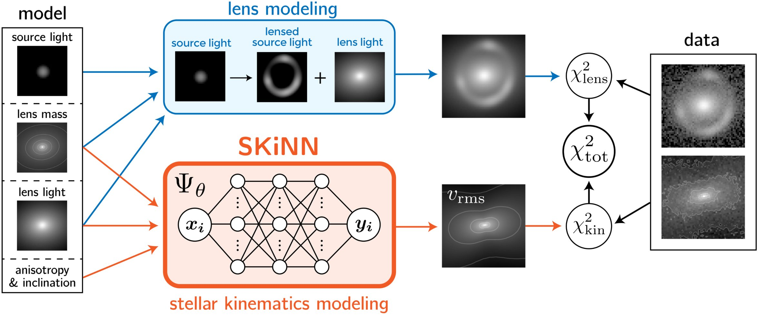
04
CONTRIBUTION
A neural emulator inside lens modeling
What SKiNN is
The Stellar Kinematics Neural Network — a
learned emulator of the JAM calculation.
A first
First application of NN emulation to the
kinematics piece of a lens-modeling framework.
Emulate JAM only
Figure 1 — SKiNN (orange) slots into the joint lens-modeling framework;
the combined χ²ₜₒₜ is minimized to jointly optimize the model.
It emulates the JAM physics, not the
~300×
speedup at sub-percent accuracy
observations — so the model's physics stays intact.
makes joint lensing + kinematics modeling
computationally feasible.
SKiNN · Stellar Kinematics Neural Network
04 / 10
Notes:
The core contribution is SKiNN, the Stellar Kinematics Neural Network. It is the first time the strategy of replacing an expensive model component with a neural network has been applied to the kinematic-modeling aspect of gravitational lens modeling. Crucially, SKiNN emulates only the JAM physics calculation rather than being applied directly to observations. This design choice keeps the physics of the overall model intact while exploiting the speed and versatility of neural networks. The result is a roughly 300-fold speedup at sub-percent accuracy, which finally makes joint lensing plus kinematics modeling computationally feasible.

Slide 5
05
METHOD
A convolutional emulator of JAM
MAPPING
THE 8 INPUTS
ARCHITECTURE
TRAINING
Input → output
Galaxy parameters
5 conv blocks
MSE + Adam
Ψθ : ℝ⁸ → d×d
Power-law elliptical mass +
Each block: two 2-D conv
Minimize a mean-squared-
An 8-D galaxy-parameter
elliptical Sérsic light (6 shape
layers → upsampling → ReLU.
error loss with the Adam
vector maps to a d×d image
params), plus inclination i
~7.07M
parameters
optimizer, on JAM data
of v_rms.
and anisotropy β.
generated via GLEE.
THE EMULATION PIPELINE
x ∈ ℝ⁸
Ψθ — convolutional network
v_rms
8 galaxy
d×d velocity
parameters
image
5 blocks × (2 conv → upsample → ReLU)
SKiNN · Stellar Kinematics Neural Network
05 / 10
Notes:
SKiNN precalculates JAM for use in lensing applications. Formally, it is a function that maps an eight-dimensional vector of galaxy parameters into a d by d image of vrms, the quadratic sum of velocity dispersion and rotational velocity. The eight inputs describe a power-law elliptical mass distribution and an elliptical Sérsic light profile, plus the galaxy inclination and orbital anisotropy. The architecture consists of five blocks, each with two two-dimensional convolutional layers followed by an upsampling layer and a ReLU nonlinearity, for about seven million trainable parameters. It is trained by minimizing a standard mean-squared-error loss with the Adam optimizer, using a dataset generated by JAM through the GLEE software so the network learns to mimic the JAM procedure.

Slide 6
06
DATASET & BENCHMARK
5000 JAM images to learn from
GROUND TRUTH
DATA SPLIT
Built entirely from JAM
5000
input–output pairs
The training set is generated entirely by JAM —
the very physics code SKiNN is meant to imitate.
Parameter ranges are physically motivated.
4000 train
500 val
500 test
500 test images are held out for evaluation.
IMAGE SIZE
TRAINING SETUP
551 × 551 px
PyTorch Lightning
Each v_rms image is rendered at higher resolution
Implemented in PyTorch with PyTorch Lightning.
than real data. A single JAM image takes about
5 × Tesla P100
15 seconds to create — hence the case for emulation.
16 GB each, trained over roughly one day.
SKiNN · Stellar Kinematics Neural Network
06 / 10
Notes:
The training set is constructed entirely with JAM, the physics code SKiNN is meant to imitate. The authors created five thousand input-output pairs, using four thousand for training, five hundred for validation, and five hundred held out for testing. Each velocity image is 551 by 551 pixels, generated at higher resolution than real data. Creating a single image with JAM takes about fifteen seconds, which underscores why emulation is worthwhile. The network is implemented in PyTorch with PyTorch Lightning and trained on five Tesla P100 GPUs, each with sixteen gigabytes of memory, over roughly one day.

Slide 7
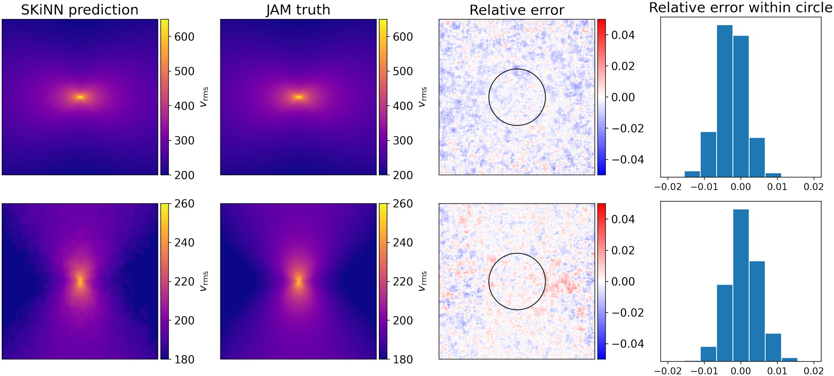
07
KEY RESULT
Within ±1% where the data constrains
~50 ms
per image on a GPU —
about 300× faster than JAM.
500 test images
Accuracy is assessed by the
relative error at each pixel.
±1% inside 2″
Outer regions reach a few %,
but the constrained core holds.
median 0.47% · p90 1.1%
Figure 2 — SKiNN prediction vs JAM truth, the relative error, and its histogram
Both are well below the typical
inside the black 2″ circle where real data is most constraining.
≥2% systematic uncertainty.
SKiNN · Stellar Kinematics Neural Network
07 / 10
Notes:
Once trained, SKiNN produces a velocity image from an input parameter vector in about fifty milliseconds on a single GPU, which is roughly three hundred times faster than JAM. Accuracy is assessed on the five hundred held-out test images by computing the relative error at each pixel. While some outer regions can show errors of a few percent, the important innermost region, where real data actually constrains the model, is matched to within plus or minus one percent for almost all pixels. Averaged over entire images, the median absolute error is about 0.47 percent and the ninetieth percentile is about 1.1 percent. Both are comfortably below the typical two-percent-or-greater systematic uncertainty in real velocity measurements.

Slide 8
08
ABLATION / ANALYSIS
Characterized by its error distribution
i
No formal ablation
PER-PIXEL ERROR
WHERE IT HOLDS
Error distribution
Core vs outskirts
This is a proof-of-concept
The innermost two-arcsecond
workshop paper, so it does
region stays within 1%; outer
not present a formal ablation
parts relax to a few %, where
table.
data barely constrains anyway.
Instead, performance is
reported through the behavior
−1%
0
+1%
GPU vs CPU inference:
of the emulation error itself.
Across the 500 test images:
~10×
faster on GPU
median 0.47%
90th percentile ≈ 1.1%
than the same forward pass on CPU.
SKiNN · Stellar Kinematics Neural Network
08 / 10
Notes:
As a proof-of-concept workshop paper, this work does not present a formal ablation study. Instead, performance is characterized by the distribution of per-pixel errors across the five hundred test images, and by comparing inference on GPU versus CPU, where the GPU is about ten times faster. The analysis also distinguishes the innermost two-arcsecond region, where errors stay within one percent, from the outer parts of the image, where errors can rise to a few percent but the data provides little constraint anyway.

Slide 9
09
HEADLINE NUMBERS
The numbers at a glance
SPEED
ACCURACY
MODEL
TRAINING
~300×
< 1%
8 → d×d
5000
faster than JAM
within inner 2″
params → image
samples (4000/500/500)
≈ 50 ms per image on GPU
median 0.47%
~7.07M
~1 day
vs ≈ 15 s for JAM
90th percentile ≈ 1.1%
trainable parameters
on 5 × Tesla P100
TIME PER v_rms IMAGE (log-scale intuition)
SKiNN
≈ 50 ms
JAM
≈ 15 s
SKiNN · Stellar Kinematics Neural Network
09 / 10
Notes:
Here are the headline numbers. SKiNN runs about three hundred times faster than JAM, taking roughly fifty milliseconds per image on a GPU compared to about fifteen seconds for JAM. Its error is under one percent within the innermost two-arcsecond region, with a median absolute error around 0.47 percent and a ninetieth percentile of about 1.1 percent across five hundred test images. The network maps an eight-dimensional parameter vector to a velocity image and has about seven million trainable parameters. It was trained on five thousand samples, split four thousand for training and five hundred each for validation and testing, over roughly one day on five Tesla P100 GPUs.

Slide 10
10
TAKEAWAY
Swap slow physics for a fast emulator
THE TAKEAWAY
Train a neural network to emulate JAM's slow kinematics physics.
SKiNN achieves a ~300× speedup at sub-percent accuracy in the region that matters.
THE RESULT
WHY IT MATTERS
THE BROADER LESSON
Fast and accurate
Joint modeling for H₀
A transferable recipe
A neural network emulates the
Removing the main bottleneck
Swap an expensive-but-
slow JAM physics at roughly
makes joint lensing + spatially
calculable model piece for a
300× speed and sub-percent
resolved kinematics feasible —
trained neural network, keep
accuracy where it matters.
correcting the largest source of
the surrounding physics — a
uncertainty in measuring H₀.
recipe that likely transfers
to many modeling problems.
SKiNN · Stellar Kinematics Neural Network · github.com/mattgomer/SKiNN
10 / 10
Notes:
The takeaway is simple. By training a neural network to emulate the slow kinematics physics of JAM, SKiNN achieves roughly a three-hundred-fold speedup at sub-percent accuracy in the region that matters. This removes the main computational bottleneck and makes it feasible to jointly model gravitational lensing together with spatially resolved kinematics, which corrects for the largest source of uncertainty in measuring the Hubble constant. More broadly, the strategy of swapping an expensive but calculable model piece for a trained neural network, while keeping the surrounding physics intact, likely transfers to many other scientific modeling problems.

