Slide 1









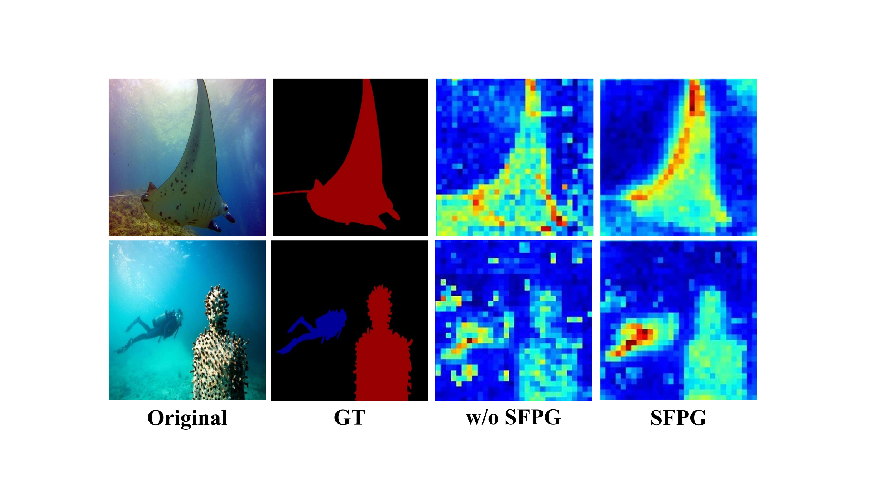
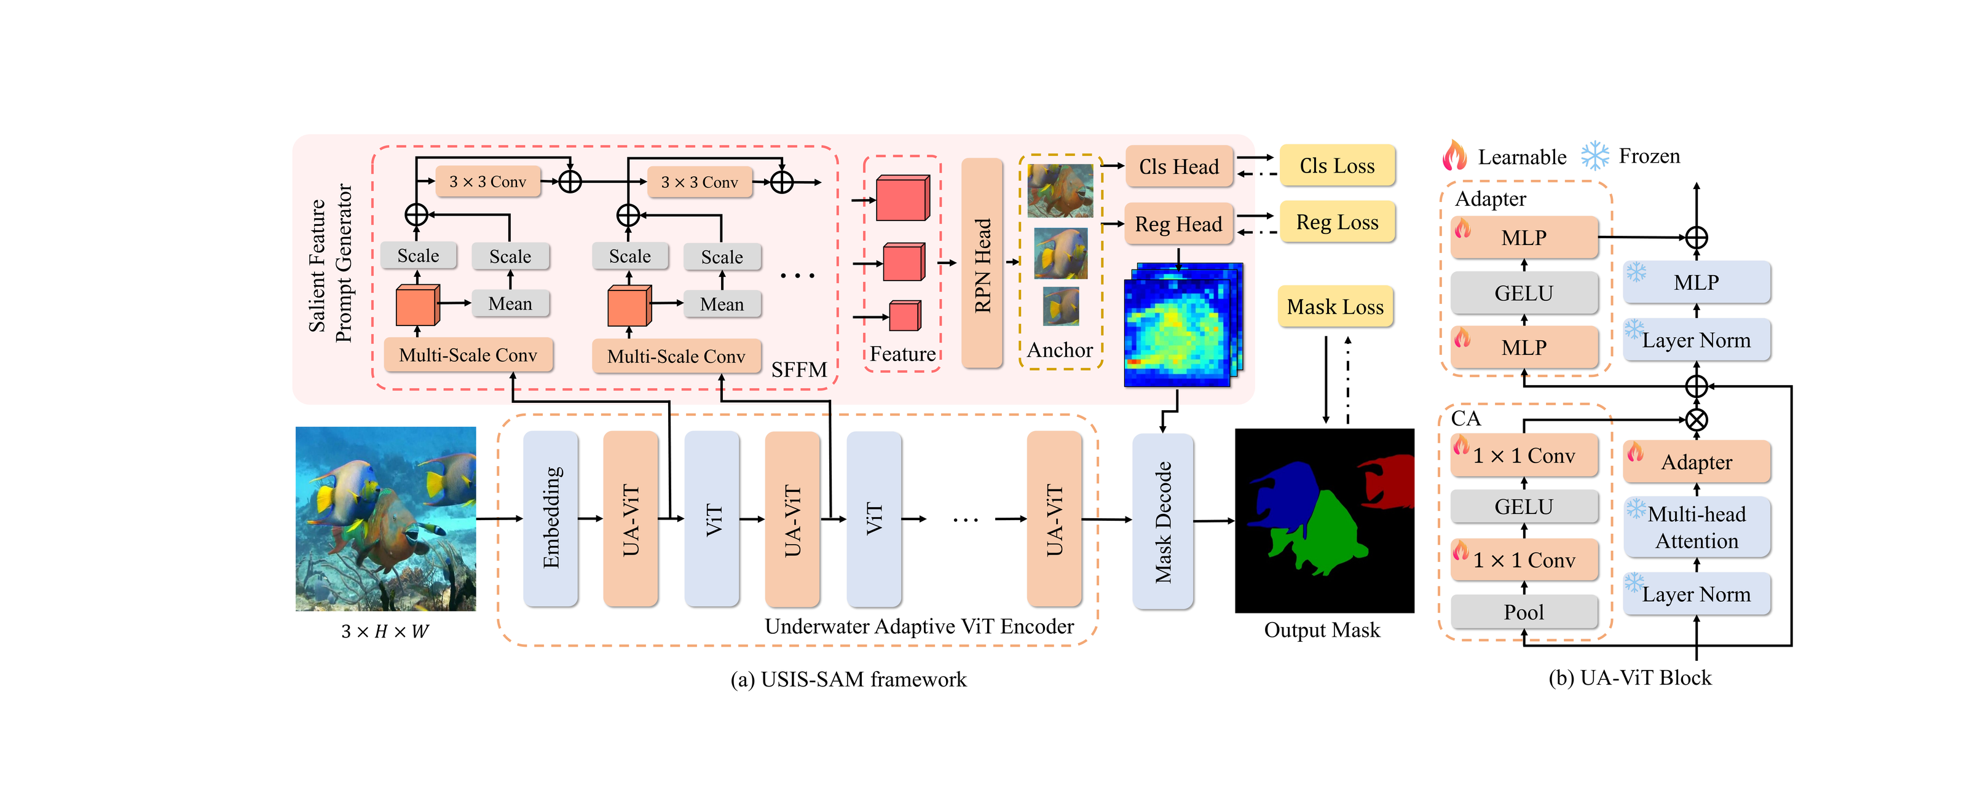
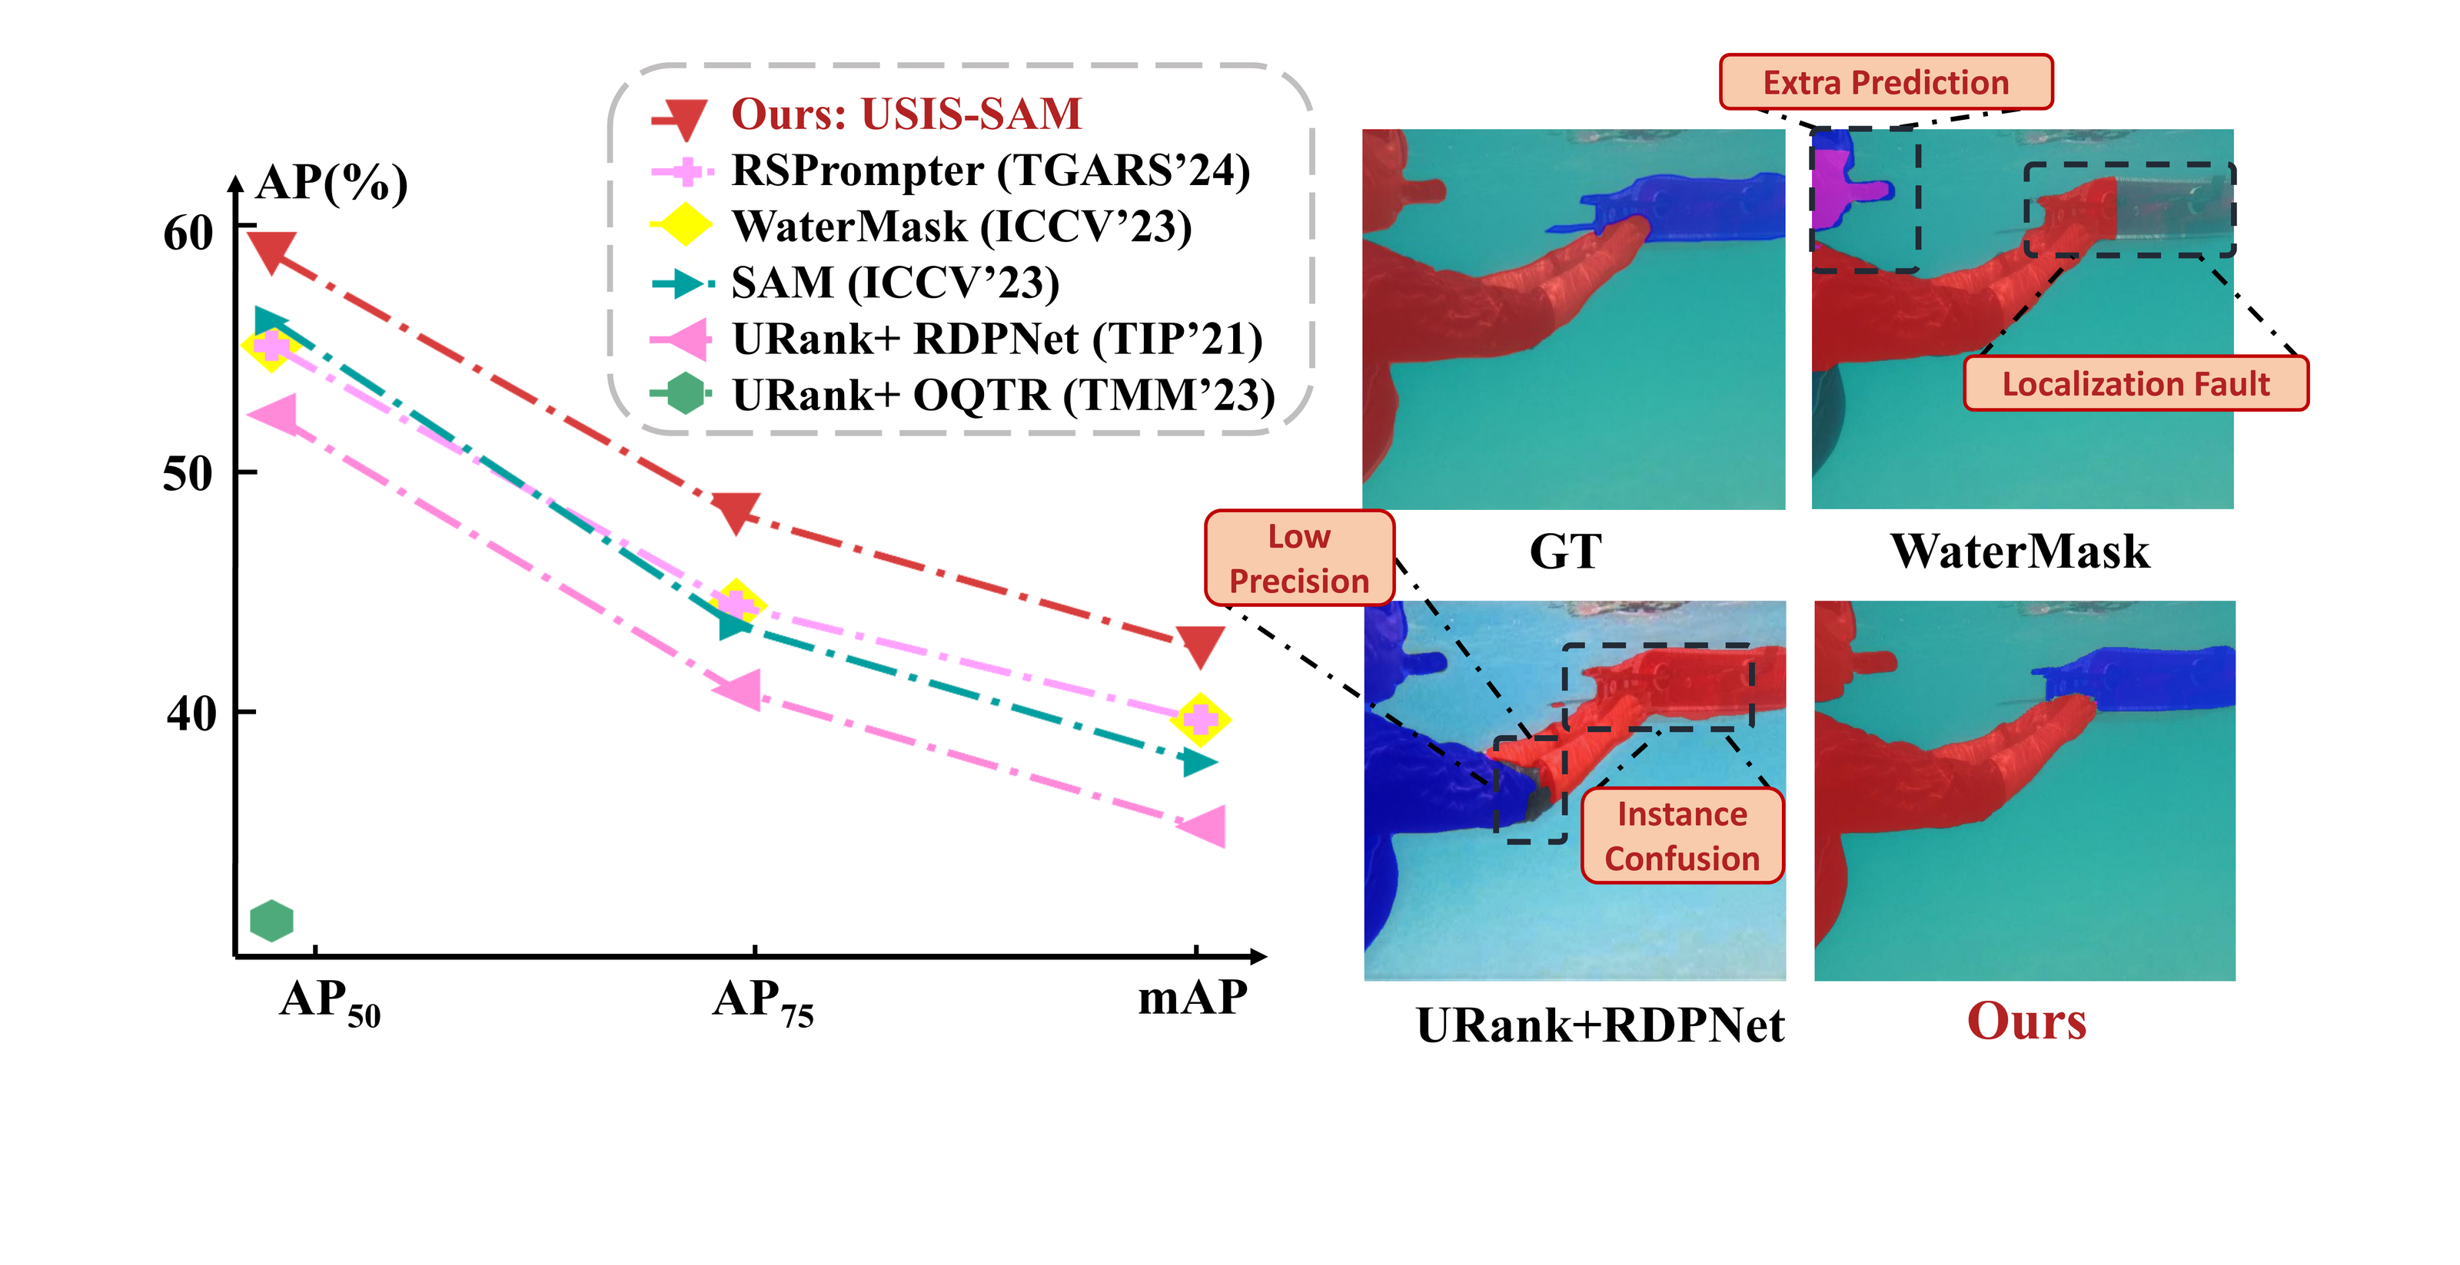
Diving into Underwater: Segment Anything Model Guided Underwater Salient Instance
Segmentation and A Large-Scale Dataset
Shijie Lian¹, Ziyi Zhang², Hua Li^{1,3,†}, Wenjie Li¹, Laurence Tianruo Yang^{1,4,5}, Sam Kwong⁶, Runmin Cong^{7,8}
¹ Hainan University ² HKUST (Guangzhou) ³ Southeast University ⁴ Huazhong Univ. of Science & Technology ⁵ St. Francis Xavier University ⁶ Lingnan University ⁷ Shandong University ⁸ MoE Key Lab of Machine Intelligence & System Control
Problem
Method
Key Results
Finding and masking a scene's most salient objects underwater is
hard: conditions distort images, and no large-scale pixel-level
salient dataset exists.
UA-ViT injects underwater prompts into a frozen SAM via a
channel adapter + multi-scale convolutions; SFPG auto-
generates salient prompts, replacing SAM's manual ones.
Method
Class-agnostic mAP
Multi-class mAP
WaterMask (ICCV'23)
59.0
38.7
USIS-SAM (Ours)
59.7
43.1
GAP
New SOTA: +1.5 mAP class-agnostic, +5.1 multi-class.
SAM generalizes poorly underwater and needs manual
prompts to segment.
Motivation
Multi-scale, channel-adapted features (λ = 0.8).
SAM segments strongly, but without underwater adaptation and
salient data it fails in murky scenes.
Unlocking SAM underwater needs a large-scale dataset and
self-prompting adaptation.
USIS-SAM: frozen SAM + Underwater Adaptive ViT encoder + Salient
Feature Prompt Generator; (b) UA-ViT block.
SFPG concentrates features on salient instances vs. without SFPG.
Dataset / Benchmark
Takeaway
USIS10K: 10,632 images, pixel-level, 7 categories — the first &
largest underwater salient-instance dataset, with class-agnostic
& multi-class labels.
USIS10K plus a SAM that sees underwater and prompts itself sets
a new state of the art for salient instance segmentation underwater.
Dataset and code are publicly released.
USIS-SAM vs. prior methods on USIS10K: baselines show extra
predictions, localization faults, instance confusion.
Fish
Reefs
Aquatic plants
Wrecks/ruins
Human divers
Adapt the foundation model, give it the right data, and let it
prompt itself.
Robots
Sea-floor

