Slide 1
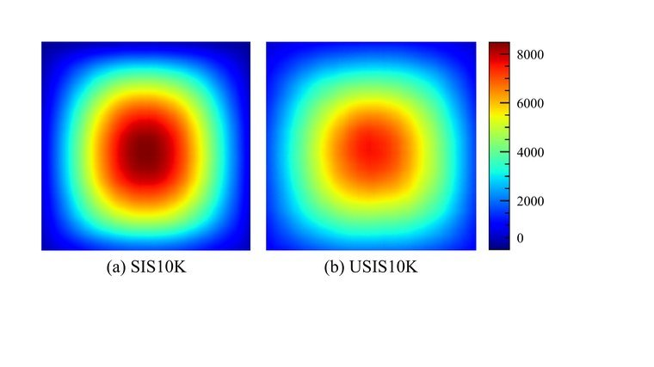

ICML 2024
Underwater Salient Instance Segmentation
Diving into Underwater
SAM-Guided Salient Instance Segmentation
and a Large-scale Underwater Dataset
Shijie Lian · Ziyi Zhang · Hua Li · Wenjie Li
Laurence T. Yang · Sam Kwong · Runmin Cong
Hainan Univ. · HKUST (GZ) · Southeast · HUST · St. Francis Xavier · Lingnan · Shandong
USIS10K salient-region statistics compared with the prior SIS10K benchmark.
USIS10K
USIS-SAM
First large-scale underwater
SAM adapted to underwater:
salient dataset — 10,632 images
visual prompts + self-prompting
Code & Data released
pixel-level · 7 categories
new state of the art
github.com/LiamLian0727/USIS10K
arXiv:2406.06039
USIS-SAM · Underwater Salient Instance Segmentation
01 / 10

Slide 2
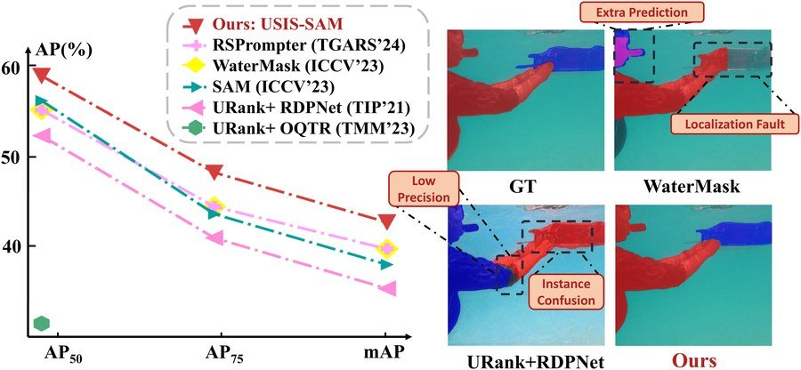
02 / 10
The Problem
THE TASK
Find and separate the most visually important
objects underwater — a foundation for marine
exploration and underwater robotics.
Degraded
No data
SAM gap
Light scattering,
No large-scale
Foundation models
color distortion
dataset with
like SAM are
and marine snow
pixel-level salient
trained on natural
Fig. 1: prior methods lose accuracy on degraded underwater scenes.
degrade images, so
annotations —
images and
Different colors mark distinct salient instances.
top methods fail.
progress stalled.
struggle underwater.
USIS-SAM · Underwater Salient Instance Segmentation
02 / 10

Slide 3
03 / 10
Motivation
SAM has spread across computer vision — but underwater it falls short.
WHY SAM FALLS SHORT
UNLOCKING SAM NEEDS TWO THINGS AT ONCE
Its features do not adapt to the murky,
1 · Data
low-contrast marine environment.
A large-scale dataset that
captures underwater saliency.
It needs manual foreground prompts —
which defeat the purpose of automatic
2 · Architecture
USIS-SAM
salient segmentation.
Teach SAM to see underwater
dataset + model
and to prompt itself.
Adapting SAM to this domain is not free.
Prior salient datasets are small and class-agnostic —
This paper delivers both.
limiting both training and multi-class study.
USIS-SAM · Underwater Salient Instance Segmentation
03 / 10

Slide 4
04 / 10
Contributions
Three contributions
01
02
03
USIS10K Dataset
USIS-SAM Model
State of the Art
The first large-scale underwater
An architecture built on SAM for
Extensive experiments show
salient instance segmentation
the underwater domain.
USIS-SAM outperforms prior
dataset.
state-of-the-art methods.
Underwater Adaptive ViT encoder
10,632
injects underwater visual prompts
59.7 / 43.1
pixel-level annotated images
mAP — class-agnostic / multi-class
7
Salient Feature Prompt Generator
categories, diverse scenes
out-of-the-box prompting —
Data & code released
removes the need for manual prompts
github.com/LiamLian0727/USIS10K
USIS-SAM · Underwater Salient Instance Segmentation
04 / 10

Slide 5
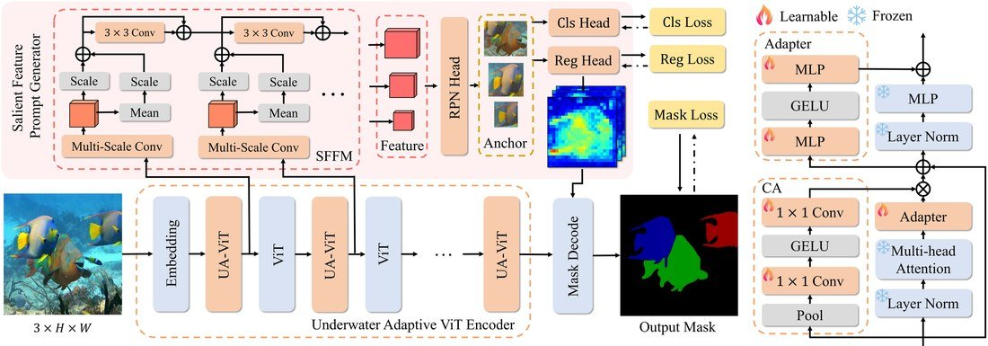
05 / 10
Method — USIS-SAM
FROZEN SAM BACKBONE ❄
USIS-SAM FRAMEWORK
Keep SAM's pretrained backbone frozen,
then add two lightweight, targeted modules.
1 · Underwater Adaptive ViT encoder
Injects underwater domain knowledge via adapters:
Channel adapter recalibrates features
Multi-scale conv 3×3 / 5×5 / 7×7 capture structure
Average residuals dampen underwater noise
Fig. 6: SAM extended with the UA-ViT encoder and the Salient Feature
Prompt Generator; the pretrained backbone stays frozen.
2 · Salient Feature Prompt Generator
Replaces SAM's manual point/box prompts.
END-TO-END TRAINING
A Salient Feature Fusion Module aggregates features
L = L_rpn + Σ ( L_cls + L_reg + L_seg )
from each UA-ViT block and produces salient prompt
Region proposal, classification, box regression, and mask segmentation.
embeddings automatically → fed to SAM's mask decoder.
USIS-SAM · Underwater Salient Instance Segmentation
05 / 10

Slide 6
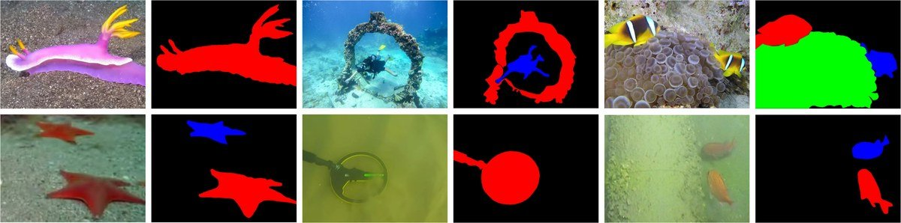
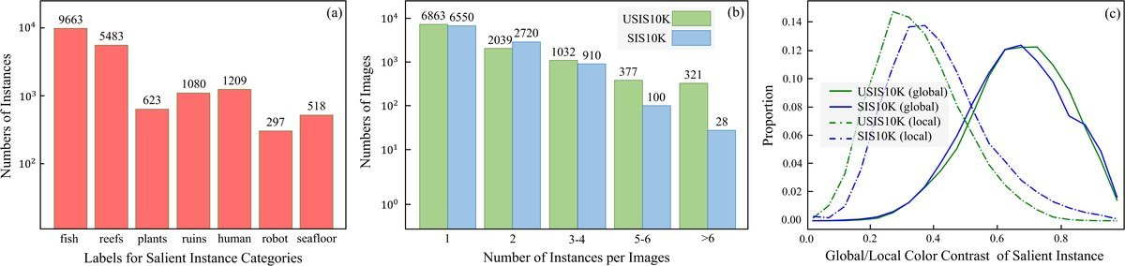
06 / 10
USIS10K Dataset
BREAKING THE DATA BOTTLENECK
ANNOTATION EXAMPLES — image / salient mask
The first large-scale underwater salient
instance segmentation dataset.
10,632
7
pixel-level
underwater
salient
instance
images
categories
annotations
DATASET CHARACTERISTICS
A FOUNDATION FOR THE COMMUNITY
Beyond training USIS-SAM, USIS10K gives
the whole community a foundation to develop
underwater salient segmentation methods.
Avg. salient instance ≈ 34,336 px · diverse underwater scenes.
(a) instances per category (b) instances per image (c) color contrast vs SIS10K
Underwater imagery poses distinct low-contrast challenges.
USIS-SAM · Underwater Salient Instance Segmentation
06 / 10

Slide 7
07 / 10
Results — New State of the Art
USIS-SAM leads on both USIS10K tasks
Class-agnostic · mAP
Multi-class · mAP
localize & mask salient objects regardless of category (axis from 50)
the harder setting: classify each salient instance (axis from 35)
OQTR
56.6
RSPrompter
38.0
RSPrompter
58.2
WaterMask
38.7
WaterMask
59.0
USIS-SAM
43.1
USIS-SAM
59.7
+3.1 over OQTR · +0.7 over WaterMask
+4.4 over WaterMask
+1.5 over SAM-based RSPrompter
+5.1 over RSPrompter
IT ALSO GENERALIZES
Retrained on the land-based SIS10K dataset, USIS-SAM still outperforms prior
approaches — the design is not narrowly overfit to underwater imagery.
USIS-SAM · Underwater Salient Instance Segmentation
07 / 10

Slide 8
08 / 10
Ablation Study
Ablations isolate each component — removing either module lowers multi-class mAP.
Multi-class mAP (axis from 40)
Underwater Adaptive ViT · −1.6 mAP
43.1
Reverting UA-ViT to the original ViT block drops
performance by 1.6 mAP — injecting underwater
42.2
information through adapters materially helps the
frozen backbone handle complex marine scenes.
41.5
Salient Feature Prompt Generator · −0.9 mAP
Replacing the SFPG with a generic Multi-scale
Feature Enhancer costs 0.9 mAP — the SFPG does
Full model
− UA-ViT
− SFPG
more than fuse features: it focuses the network's
−1.6
−0.9
attention on salient regions.
FURTHER ABLATIONS
Encoder freezing & multi-scale conv design — each choice matters.
USIS-SAM · Underwater Salient Instance Segmentation
08 / 10

Slide 9
09 / 10
Headline Numbers
DATASET — USIS10K
class-agnostic
AP @ 50%
AP @ 75%
multi-class
10,632
59.7
81.6
67.7
43.1
annotated underwater images
mAP · SOTA
AP50
AP75
mAP · SOTA
7 categories · pixel-level
UA-ViT ENCODER
SFPG
TRAINING SETUP
+1.6
+0.9
24
6×
ViT-H
mAP contribution
mAP contribution
epochs
NVIDIA 3090
backbone
injects underwater knowledge
self-prompting + attention
USIS-SAM · Underwater Salient Instance Segmentation
09 / 10

Slide 10
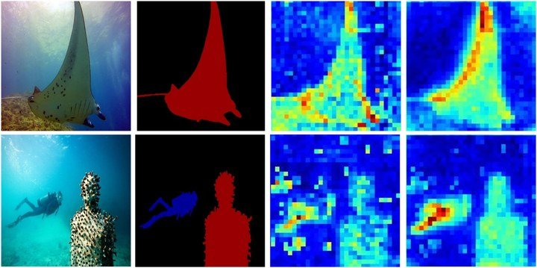
10 / 10
Takeaway
The takeaway is simple.
Adapting a foundation model to a hard new domain
A new state of the art
works best when you also give it the right data
USIS10K + teaching SAM to see underwater and
and let it prompt itself.
generate its own salient prompts.
Right data · USIS10K
Self-prompting · USIS-SAM
DATASET & CODE RELEASED
A practical foundation for the next
wave of underwater vision research.
Fig. 7: the SFPG aggregates features onto salient instances.
github.com/LiamLian0727/USIS10K
59.7 / 43.1 mAP — SOTA on USIS10K
arXiv:2406.06039 · ICML 2024
USIS-SAM · Underwater Salient Instance Segmentation
10 / 10

