Slide 1




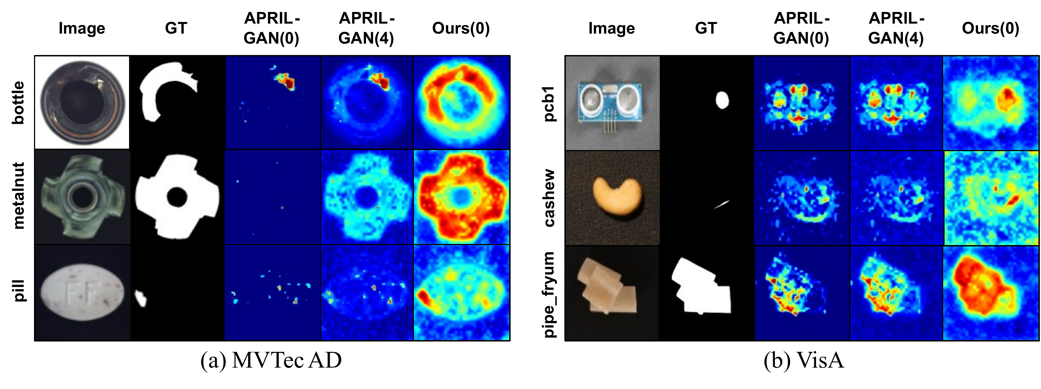
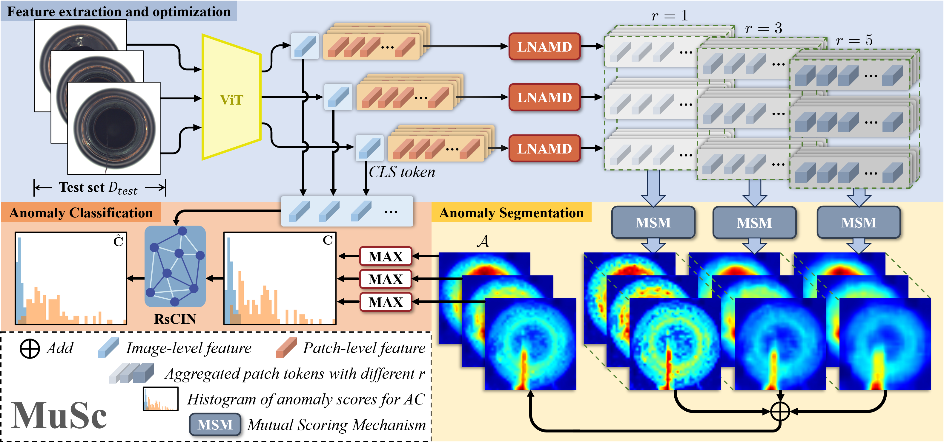
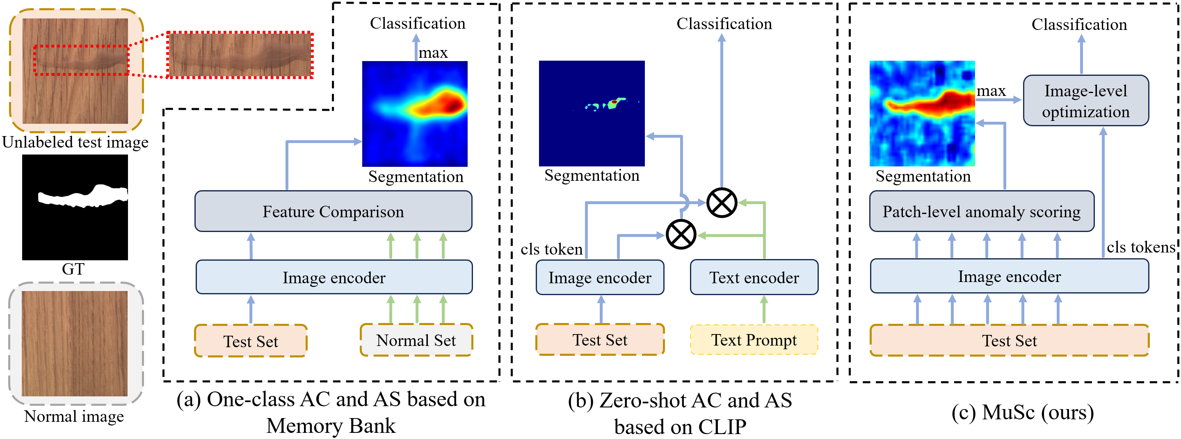
MuSc: Zero-Shot Industrial Anomaly Classification
& Segmentation with Mutual Scoring of the
Unlabeled Images
Xurui Li¹, Ziming Huang¹, Feng Xue³, Yu Zhou^{1,2}
¹ Huazhong University of Science and Technology ² Wuhan JingCe Electronic Group ³ University of Trento
Problem
Method
Key Results
Industrial anomaly classification (AC) and segmentation (AS)
usually need many normal reference images (one-class methods)
or hand-crafted text prompts (CLIP-based zero-shot methods) —
both limit real-world deployment.
LNAMD aggregates frozen ViT patch tokens at multiple degrees
r for multi-size anomalies.
0-shot method
AC AUROC
AS AUROC
MSM mutually scores patches across test images; RsCIN
refines the image-level decision.
WinCLIP
91.8
85.1
MuSc (ours)
97.8
97.3
A true zero-shot setting has no training data, no text prompts,
and no normal reference images, yet defects must still be
flagged per-image and localized per-pixel.
MSM score: mean nearest-patch distance over the K most-similar test images.
Motivation
Prior methods ignore the abundant normal and abnormal cues
already sitting inside the unlabeled test images themselves.
Fig. 6 · Zero-shot segmentation on MVTec AD & VisA.
Those cues alone are enough to determine anomalies with no
labels, prompts, or normal references.
Headline Numbers
A normal patch finds many similar patches across the other
unlabeled images; an abnormal patch finds only a few — a
discriminative, training-free signal.
97.8%
97.3%
pixel-AUROC (MVTec AD)
92.8%
image-AUROC (VisA)
Fig. 2 · MuSc architecture: LNAMD → MSM (segmentation) → RsCIN
(classification).
image-AUROC, MVTec AD (0-shot)
+21.1
PRO gain vs 2nd-best
new zero-shot SOTA — no training or prompts
Takeaway
Ablation Study
All three degrees r∈{1,3,5} in LNAMD give the best combined
AC/AS: small r for tiny defects, large r for big ones.
The lasting idea: a batch of unlabeled test images can supervise
itself. Letting the images score one another yields state-of-the-art
zero-shot classification and segmentation with no training,
prompts, or reference images — even rivalling few-shot and full-
shot methods that use the entire normal set, all with no data
collection or annotation.
Averaging the minimum 30% interval in MSM reaches 97.8% AC
vs 83.8% for a max strategy; RsCIN lifts VisA AC from 90.0% to
92.8%.
Fig. 1 · Prior paradigms need normal reference images (a) or text prompts
(b); MuSc (c) leverages only the unlabeled test images.

