Slide 1




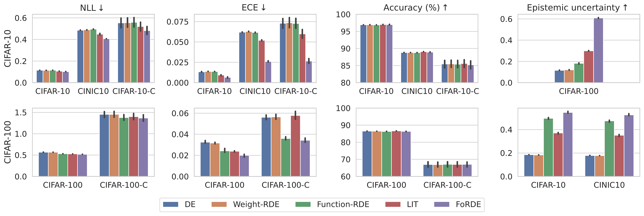
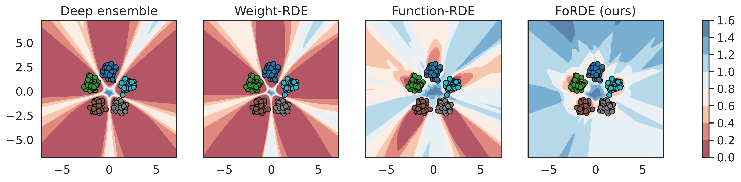
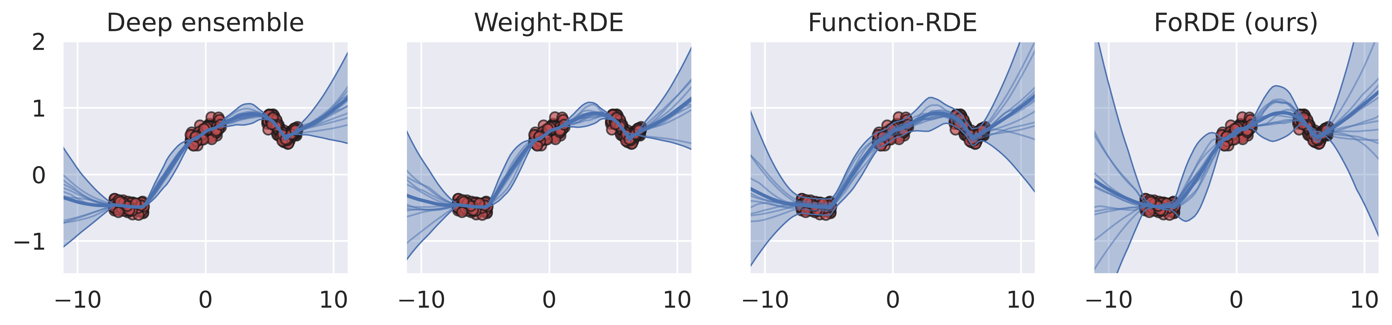
Input-Gradient Space Particle Inference for Neural Network Ensembles
Trung Trinh¹ Markus Heinonen¹ Luigi Acerbi² Samuel Kaski^{1,3}
¹ Aalto University · ² University of Helsinki · ³ University of Manchester
Problem
Method
Key Results
Deep ensembles gain accuracy and calibration from functional
diversity, but existing repulsive schemes fail to produce it: weight-
space repulsion is wasteful under over-parameterization (many
weights encode the same function), while function-space repulsion
needs an intractable function kernel and, in practice, underfits.
FoRDE runs Wasserstein gradient descent: each network is a
particle whose update sums a driving force toward the Bayesian
posterior and a repulsion force from a kernel.
Corrupted set
Metric
FoRDE vs 2nd-best
CIFAR-10-C
Accuracy ↑
+2.4%
CIFAR-100-C
Accuracy ↑
+1.3%
The kernel compares members' normalized true-label input
gradients with an RBF on the unit sphere, using PCA
lengthscales so repulsion targets high-variance directions; cost
stays linear in samples.
Neither weight-space nor function-space repulsion has
meaningfully beaten a plain deep ensemble.
Motivation
FoRDE (purple) beats every baseline on NLL, ECE, accuracy and OOD
uncertainty.
A function can be represented up to a translation by its first-
order input gradients — the derivatives of the output with
respect to each input dimension.
Driving force toward the posterior + kernel repulsion. Kernel compares normalized input gradients with an RBF on the unit sphere, using PCA-derived lengthscales.
Input gradients are the size of the input, far smaller than the
weight vector, so a kernel compares them cheaply — and
repelling them forces members to rely on complementary input
features, boosting robustness under perturbations.
Input-gradient repulsion pushes each model's gradient arrows apart on a
unit sphere, growing functional diversity over training (left → right).
2D classification: FoRDE (right) stays far more uncertain outside the
training data.
Third view of a network: not its weights, not its outputs — its
input gradients.
Dataset / Benchmark
Headline Numbers
Image classification on CIFAR-10 / CIFAR-100 / TinyImageNet;
10-member ensembles (ResNet18 / PreActResNet18).
+2.4%
+1.3%
Acc. on CIFAR-100-C
Robustness on the -C corrupted sets: 19 types × 5 severities.
Metrics: accuracy, NLL, ECE.
Accuracy on CIFAR-10-C over the
second-best method
10 =
30
members match a 30-
member DE
Largest robustness gain among all baselines
19×5
corruptions × severities
CIFAR-10
CIFAR-100
TinyImageNet
CIFAR-10-C
CIFAR-100-C
Diversity in the compact input-gradient space: where you
repel matters as much as how much.
FoRDE captures higher predictive uncertainty than deep-ensemble and
repulsive baselines in 1D regression.
TinyImageNet-C

