Slide 1



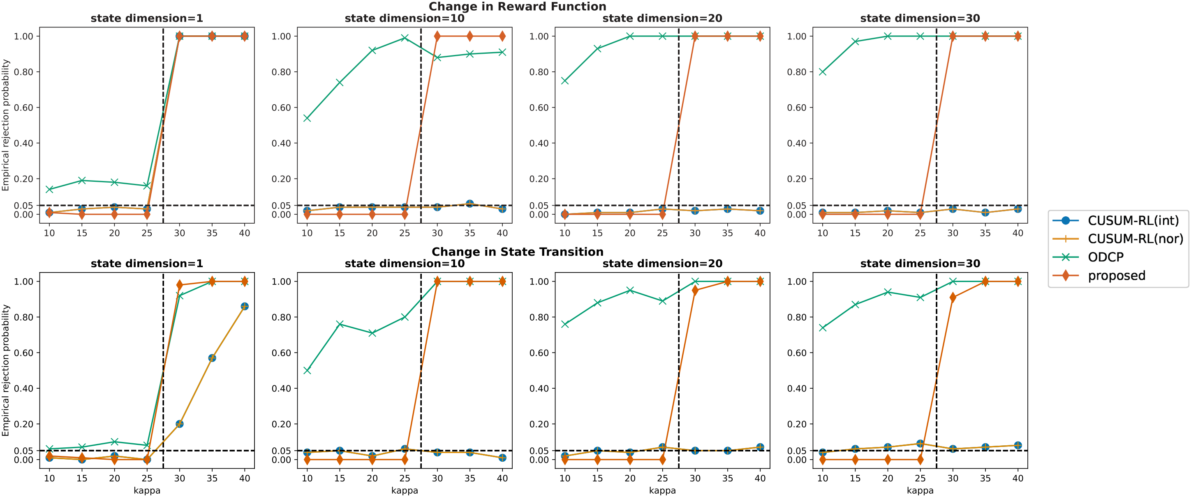
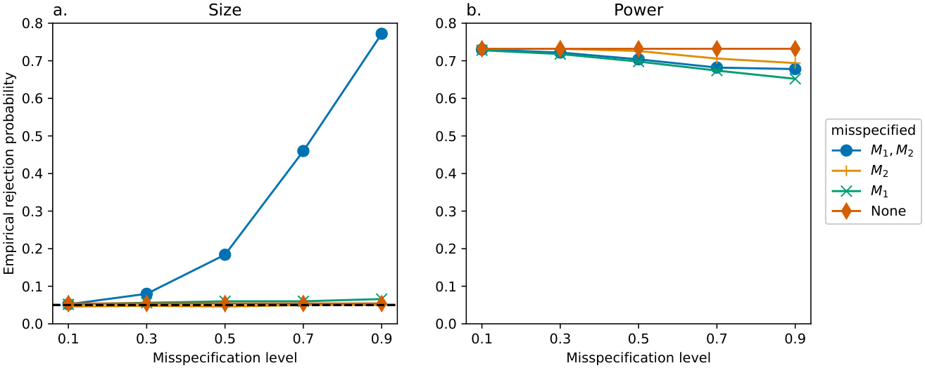
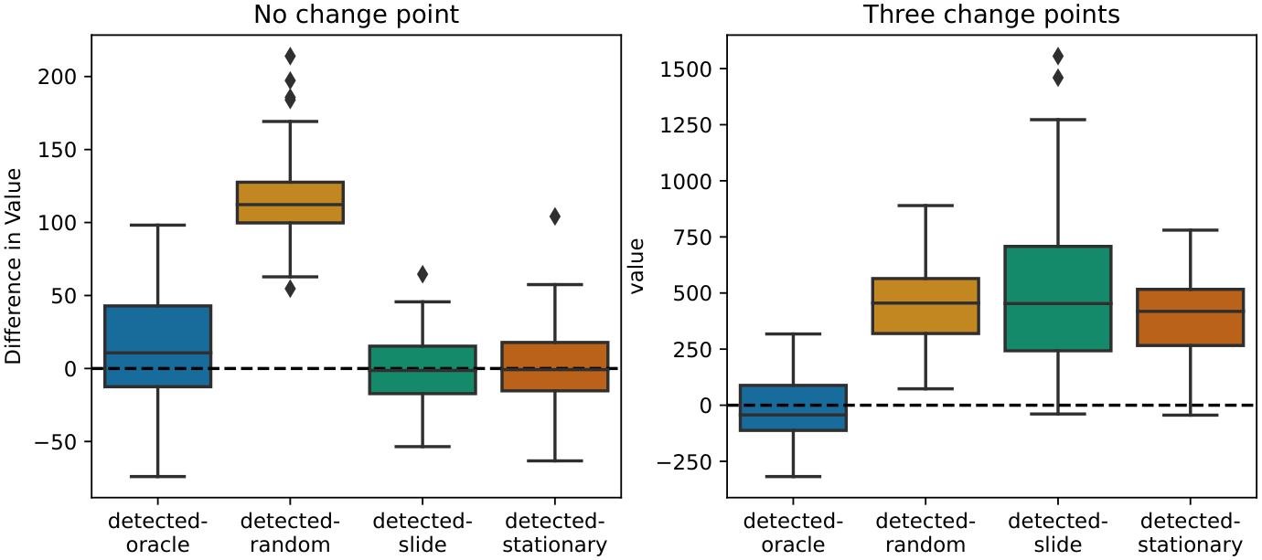
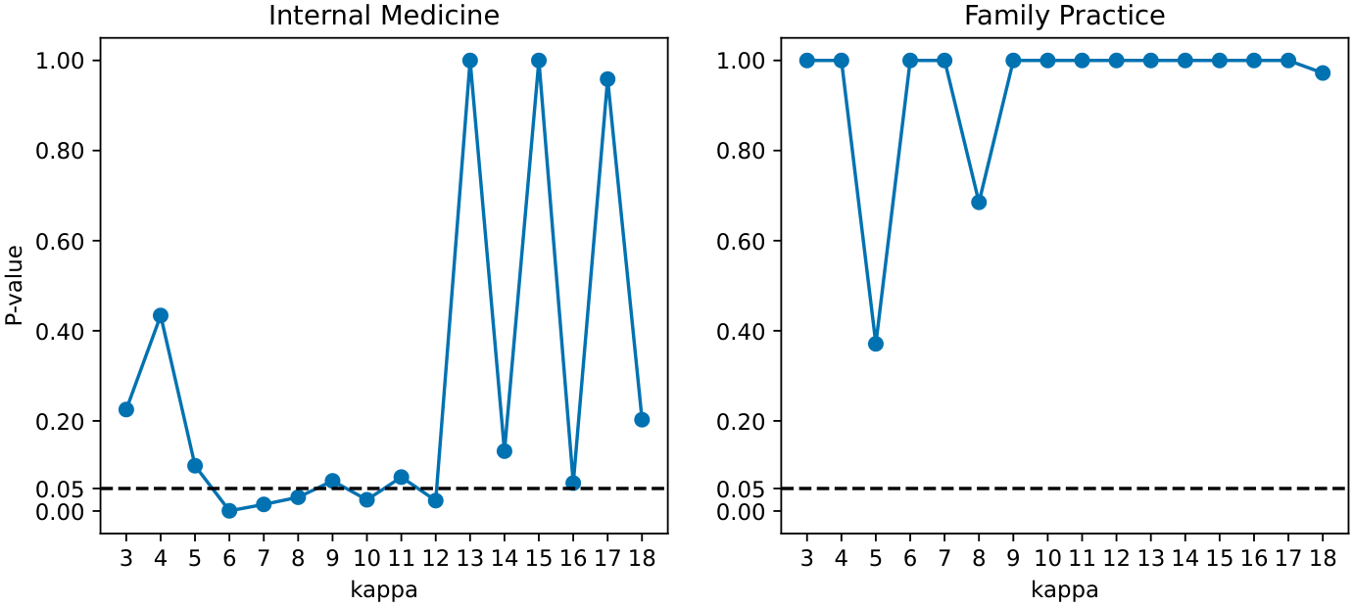
A Robust Test for the Stationarity Assumption in
Sequential Decision Making
Jitao Wang¹, Chengchun Shi², Zhenke Wu¹
¹ Department of Biostatistics, University of Michigan, Ann Arbor ² Department of Statistics, London School of Economics and Political Science
Problem
Method
Key Results
Most RL algorithms assume a stationary MDP with time-invariant transition and reward functions. Real offline systems drift over time, so a policy learned as if the world were frozen becomes suboptimal, sometimes harmful.
1
At each candidate change point t, compare pooled transition dynamics before vs. after via a CUSUM-type statistic.
Test
Max d_{S} detected
Type-I control
CUSUM-RL
1
✓ low-dim only
2
A mean-zero augmentation makes it doubly robust (neural nets / RF / lasso estimate the nuisances); sample-split + cross-fit, then a Gaussian multiplier bootstrap gives the p-value.
Proposed
30
✓ all settings
Before trusting any learned policy, we must ask: is the environment actually stationary — and if not, where did it change?
Motivation
Doubly robust ψ with E[ψ]=0 under H₀ (stationarity); valid if either M₁ or M₂ is correct.
Non-stationarity is pervasive in mobile health, traffic control, and robotics — e.g. waning push-notification effects in the Intern Health Study erode long-term reward.
Prior tests need a known MDP model, rely on linear approximation that fails in high dimensions, or waste samples learning a policy per time step.
High-dim: the proposed test (orange) detects the change point at all d_{S}=1–30; baselines collapse as dimension grows.
Double robustness in action: empirical size (left) stays at the nominal 0.05 whenever at least one nuisance model M₁ or M₂ is correct; power (right) stays high.
Headline Numbers
30
0.05
type-I level held
Max state dim · correct detection
wk 16
IHS change point
Policy value: acting on the detected change point matches the oracle, beating random / sliding / stationary updates.
30× the CUSUM-RL limit (d_{S}=1) — robust in high dimensions
5000
bootstrap samples
Real IHS data: p-values across κ flag a change point for Internal Medicine interns (around week 16); none for Family Practice.
SO WHAT → Nominal α=0.05 held across all four simulations and both IHS specialties; power stays high even under heavy model misspecification.
SO WHAT → Type-I error is controlled in every setting, and detecting the change point lets each policy relearn on its stationary segment — recovering reward that drift would erode.
Mobile health
Traffic control
Robotics
Intern Health Study

