Slide 1
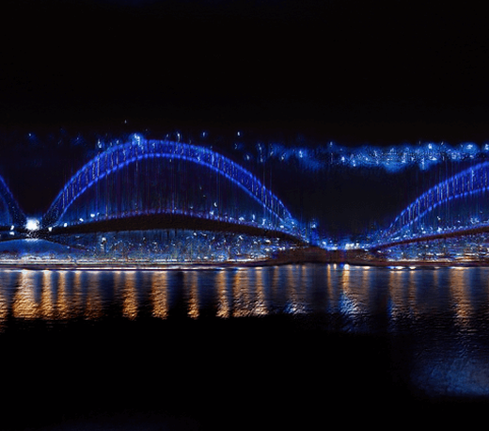





PAPER · DEEP READ · ICLR 2022 · arXiv:2104.03963
InfinityGAN
Towards Infinite-Pixel Image Synthesis
Chieh Hubert Lin · Hsin-Ying Lee · Yen-Chi Cheng · Sergey Tulyakov · Ming-Hsuan Yang
UC Merced · Snap Inc. · Carnegie Mellon University · Yonsei University · Google Research
THE QUESTION
Images of arbitrary, even infinite size
while training only on small patches, on a single consumer GPU.
THE WALL
Existing high-resolution GANs fail
compute, memory, and training data all scale with output resolution.
Synthesis at extended size — globally consistent landscape
THE IDEA
Disentangle global appearance · local structure · texture
Code
generate any region patch-by-patch from continuous coordinates — seamless, unbounded.
github.com/
hubert0527
01 / 10

Slide 2
Every gain in resolution comes at a cost
THE PROBLEM · GENERATION IS LOCKED TO A FIXED OUTPUT RESOLUTION
Progress keeps getting more expensive
1
Modern generative models keep improving in resolution and detail — but every gain costs more
training time, a bigger model, and large field-of-view images that are hard to collect.
Locked to one resolution
Push larger — it explodes
2
Existing generators are tied to the
3
Compute and memory explode
exact resolution they trained at.
quadratically; global structure falls apart.
THE GOAL
Escape the coupling entirely — synthesize arbitrary, even infinite images
from finite-sized training data, on modest hardware.
02 / 10

Slide 3
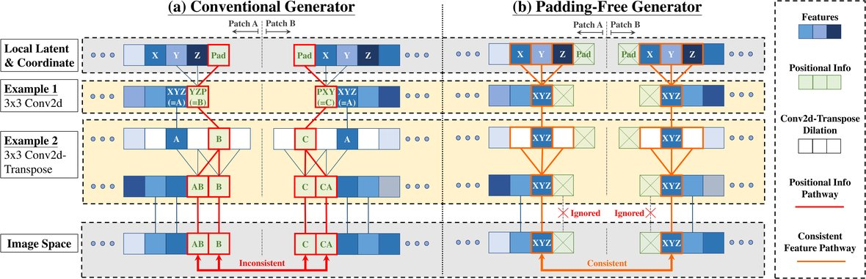
The hidden culprit: zero-padding encodes position
MOTIVATION · WHY EXISTING GENERATORS BREAK WHEN ASKED TO GROW
Fig. 1 · Conventional padding produces inconsistent pixels; a padding-free design keeps neighbouring patches consistent.
THE INSIGHT
DURING TRAINING
Padding secretly encodes position
The pattern gets memorized
Generators like StyleGAN2 rely on zero-padding
The padding pattern is fixed throughout
at the image borders to encode where each
training, so the network memorizes it as
feature sits in the frame.
its only cue to position.
WHAT BREAKS
THE REQUIREMENT
Grow it and the center falls apart
Position that never runs out
A larger image changes the feature size, so the
Truly infinite synthesis needs positional
padding-derived position shifts — the center no
information valid infinitely far from any border,
longer gets sensible position, giving broken content.
plus patches that combine seamlessly.
03 / 10

Slide 4
Four building blocks for infinite synthesis
CONTRIBUTIONS · WHAT INFINITYGAN INTRODUCES
1
Disentangled formulation
2
Structure synthesizer
Reframe image generation as disentangling a
A neural implicit function driven by continuous
global holistic appearance, local structure, and
coordinates, so any sub-region of the image can
fine texture — each with a dedicated component.
be queried directly.
3
Padding-free generator
4
Scale-invariant FID
Remove all zero-padding, letting patches
A new metric to evaluate synthesis at sizes for
synthesize independently yet combine
which no real reference images exist.
seamlessly into one image.
AND FINALLY · APPLICATIONS THE DESIGN UNLOCKS
Spatial style fusion · multi-modal outpainting · arbitrary-length inbetweening
One framework, many capabilities that fixed-resolution generators simply cannot offer.
04 / 10

Slide 5
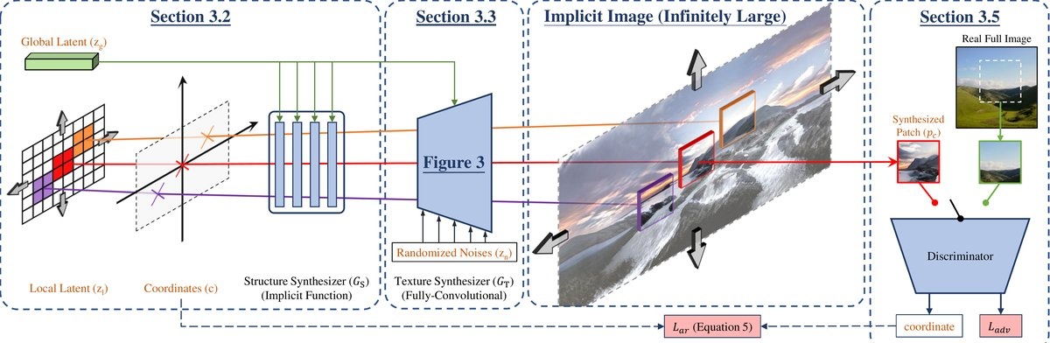
Two modules: structure synthesizer + padding-free texture
METHOD · GENERATOR ARCHITECTURE
Overview · a structure synthesizer (neural implicit function) feeds a fully-convolutional, padding-free texture synthesizer.
STRUCTURE SYNTHESIZER
COORDINATE ENCODING
A neural implicit function
Queryable infinitely far
Takes a global latent for scene appearance, a local
Sine-cosine horizontally exploits landscape
latent tensor for variation, and a continuous
self-similarity; a tanh vertically captures the
coordinate grid — outputs a structural latent for
ground-to-sky gradient — so it can be queried
any requested region.
infinitely far from the origin.
TEXTURE SYNTHESIZER
WHY IT TILES
Padding-free StyleGAN2
Consistent by construction
A fully-convolutional StyleGAN2 with all
With no padding, the same coordinate always
zero-padding removed — turns the structural
yields identical pixels — so independently
latent, global style, and noise into a patch.
generated patches tile seamlessly into an
Losses: adversarial · R1 · path-length · diversity · coord-regression
arbitrarily large image, at constant memory.
05 / 10

Slide 6
Big benchmarks, tiny training patches
DATASETS & BENCHMARK · TRAINED ON ONE CONSUMER GPU
NEW DATASET
FOR OUTPAINTING
THE REMARKABLE PART
Flickr-Landscape
Scenery subsets
Trained on tiny patches
450K
62,500
101×101
Places365 scenery images
high-quality landscape images
pixel patches (from 197px images)
~54,000
Crawled from Flickr to evaluate
Flickr-Scenery images
Training and inference at ANY size
synthesis at extended output sizes,
run on a single GTX TITAN X GPU —
far beyond the training resolution.
Paired with In&Out for outpainting.
one consumer card, any resolution.
THE HEADLINE SETUP
Train small, synthesize huge — the same patch model scales to any output size.
06 / 10

Slide 7
Quality holds as the image grows
KEY RESULT · FLICKR-LANDSCAPE, SCALE-INVARIANT FID (LOWER IS BETTER)
Scale-invariant FID vs extension
STEADY SLOPE
InfinityGAN
StyleGAN2 (NCI)
Graceful, not catastrophic
On Flickr-Landscape, InfinityGAN holds a steady
189
quality slope as output grows — while baselines
drift far from realistic global structure.
CONSTANT MEMORY
121
Memory never grows
Memory stays constant regardless of output size,
79.8
while StyleGAN2 runs out of memory at the
61.4
16× setting.
USER STUDY
> 90%
of 50 CV-literate
4× extension
8× extension
participants preferred
human preference
it over every method.
Beyond 4× extension, InfinityGAN surpasses the strongest baseline.
07 / 10

Slide 8
Isolating where position comes from
ABLATION · PADDING VERSUS IMPLICIT STRUCTURE
THE QUESTION
The central ablation isolates exactly where positional information comes from.
1
Strip the padding
2
It falls apart
3
Add structure back
Start from StyleGAN2 with
As predicted, the model fails to
Add the structure synthesizer,
non-constant input, then remove
generate reasonable structure
and position is now supplied
all zero-padding.
and degrades sharply across
through the coordinate-driven
›
every FID setting.
›
structural latent.
The result: a padding-free
variant with no positional
This confirms the generator
Generation quality returns —
cues at all.
leaned entirely on padding.
validating the design.
Position removed entirely.
Padding was the position.
Padding-free + implicit structure.
08 / 10

Slide 9
The headline numbers
RESULTS AT A GLANCE · QUALITY, PREFERENCE, SPEED, OUTPAINTING
SCALE-INVARIANT FID (LOWER = BETTER)
HUMAN PREFERENCE
61 @ 4×
> 90%
121 @ 8×
of participants preferred InfinityGAN
Both beat the strongest baseline.
across every comparison.
INFERENCE SPEED · PARALLEL BATCHING
OUTPAINTING (WITH IN&OUT)
7.2×
9 FID · Places365
faster
15 FID · Flickr-Scenery
8000-pixel-square synthesis:
137s → 19s
Roughly halving the previous best.
09 / 10

Slide 10
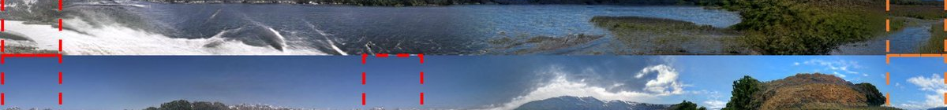
Infinite images from a patch-sized model
TAKEAWAY
THE BIG IDEA
Infinite-pixel synthesis becomes tractable once you stop tying generation to a fixed resolution.
HOW IT WORKS
WHAT IT UNLOCKS
Separate, then recombine
One framework, many powers
Separate global appearance, local structure via a
Spatial style fusion
coordinate-driven implicit function, and texture via
a padding-free generator. Patches come out
Multi-modal outpainting
independent yet perfectly consistent — tiling into
Arbitrary-length panoramas & inbetweening
any size, at constant memory, generated in parallel.
All from a model trained on tiny patches.
Fig. 5 · Arbitrary-length panorama synthesis and inbetweening — a single patch-trained model, unbounded output.
10 / 10

