Slide 1
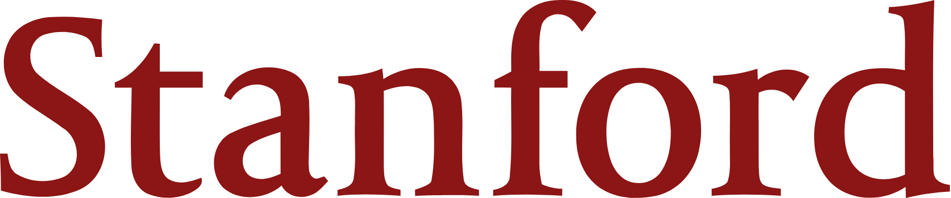

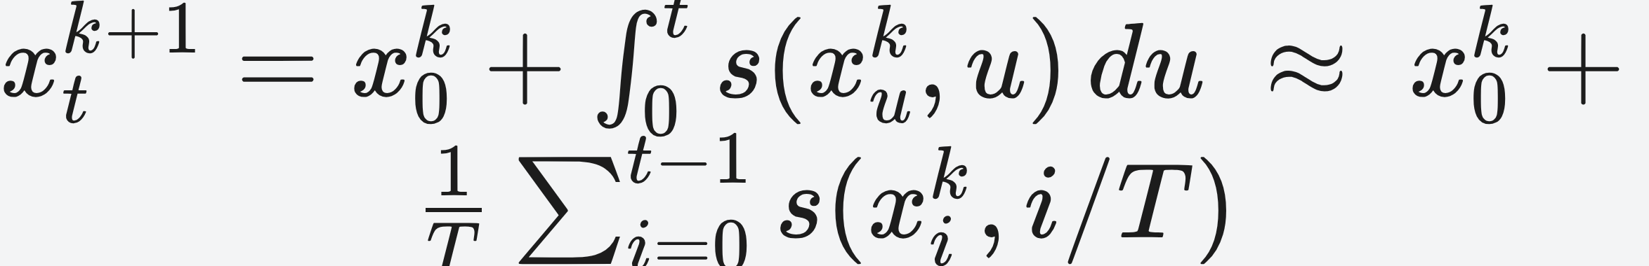
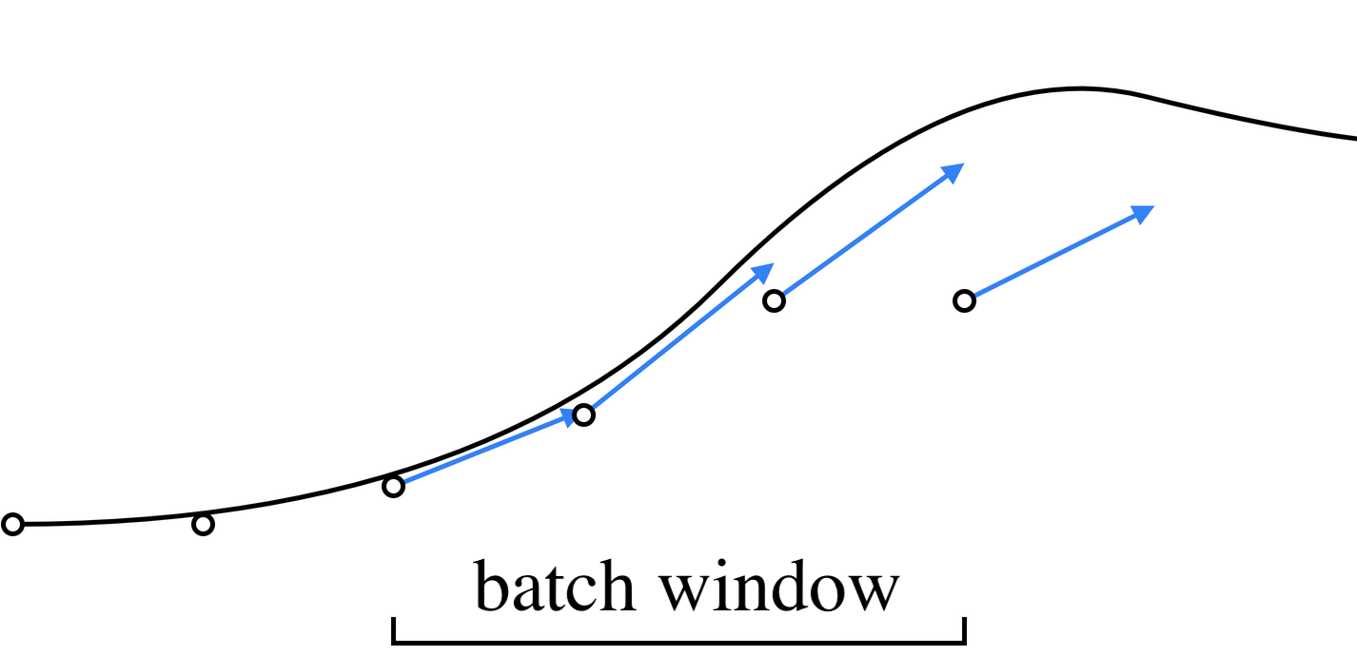
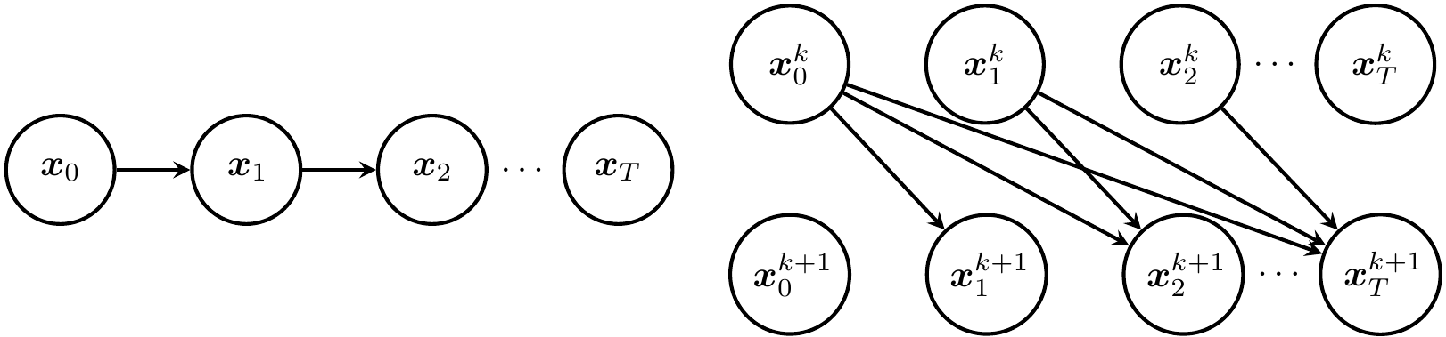
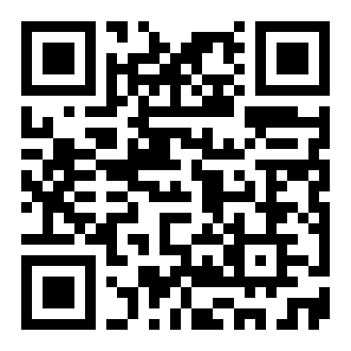

Parallel Sampling of Diffusion Models
Andy Shih¹, Suneel Belkhale¹, Stefano Ermon¹, Dorsa Sadigh¹, Nima Anari¹
¹ Stanford University
Problem
Method
Dataset / Benchmark
Ablation Study
Diffusion models generate high-quality samples but sample slowly — a single sample can require up to 1000 sequential denoising steps, far too slow for interactive use.
Reframe denoising as solving an ODE by Picard iteration: guess the entire trajectory, then refine every timestep in parallel.
Robotics diffusion policies scored by task reward over 200 episodes; image generation judged by CLIP score (COCO) and FID (LSUN).
Tolerance τ trades speed for fidelity on SD-v2 (200-step DDIM):
Robosuite Square
PushT
FrankaKitchen
TOLERANCE Τ
ITERS
CLIP
SPEEDUP
Iterate to a fixed point — empirically converging in far fewer iterations than there are denoising steps.
sequential
200
31.9
—
Fewer steps (DDIM, DPMSolver) buy speed only by paying with sample quality.
StableDiffusion-v2
LSUN Church
LSUN Bedroom
1e-1
15
31.9
4.0×
Process a sliding batch window of size p to fit GPU memory, advancing it once the leading timesteps converge.
5e-1
13
31.5
4.9×
Headline Numbers
SO WHAT → A relaxed tolerance preserves quality while delivering most of the speedup; gains come from parallelism, not fewer steps.
2–4×
14.6s
SD-v2 (from 50.0s)
Motivation
3.9×
LSUN Church, FID 12.8→12.9
sampling speedup, no quality loss
Instead of trading quality for speed by cutting steps, spend extra parallel compute to run all the steps in less wall-clock time.
Picard update: every timestep refined in parallel from the cumulative drift.
across every task & sampler
20×
fewer iters vs steps
Takeaway
Key Results
By reformulating denoising as parallel Picard iteration, ParaDiGMS trades extra compute for 2–4× lower sampling latency with no quality loss — and layers on top of DDIM and DPMSolver.
The bottleneck is single-sample latency, not throughput — denoising is inherently sequential, so this looks hard.
Setting
Seq.
Ours
Speedup
SD-v2 · DDPM
50.0s
14.6s
3.4×
SD-v2 · DPMSolver
10.3s
2.6s
4.0×
ParaDiGMS is complementary to fast samplers like DDIM and DPMSolver — the speedups compound.
Robosuite Square
37.0s
10.0s
3.7×
FIRST
PushT
32.3s
8.3s
3.9×
The first diffusion sampler to trade parallel compute for lower single-sample latency.
FrankaKitchen
112s
33.3s
3.4×
Trade compute for speed, not quality for speed — an orthogonal axis to fewer-step samplers.
ParaDiGMS computes the drift at multiple timesteps in parallel over a batch window of size p, then slides the window forward once the error falls below tolerance.
LSUN Church
24.0s
6.1s
3.9×
SD-v2 · DDIM
10.3s
2.6s
4.0×
A new axis for accelerating diffusion: spend compute, not quality.
1
Guess the entire denoising trajectory as an initial value.
2–4× faster sampling — no measurable quality loss
2
Update every timestep in parallel from the cumulative drift.
Scan to Read
SO WHAT → A consistent 2–4× latency reduction across robotics control and image generation, holding task reward, FID, and CLIP score unchanged — the parallel iterations to converge are up to 20× fewer than the sequential steps.
Sequential sampling (left) vs. Picard iterations (right), which add skip dependencies so information propagates down the chain in parallel.
3
Slide past converged timesteps and repeat until it stops changing. No retraining.
Paper
Code

