Slide 1





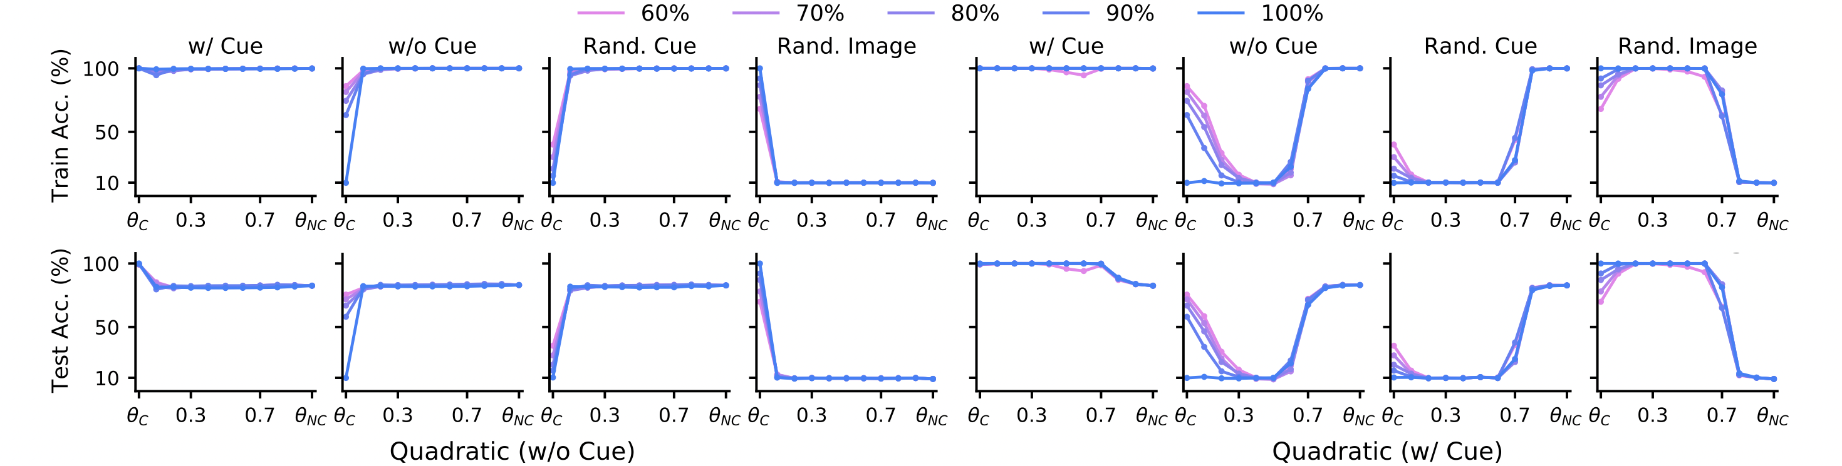


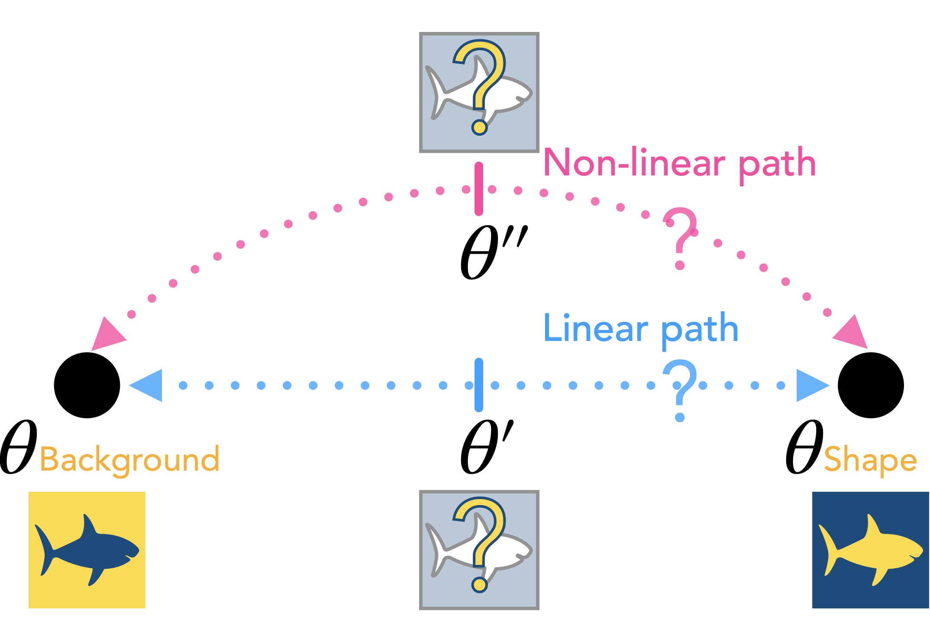
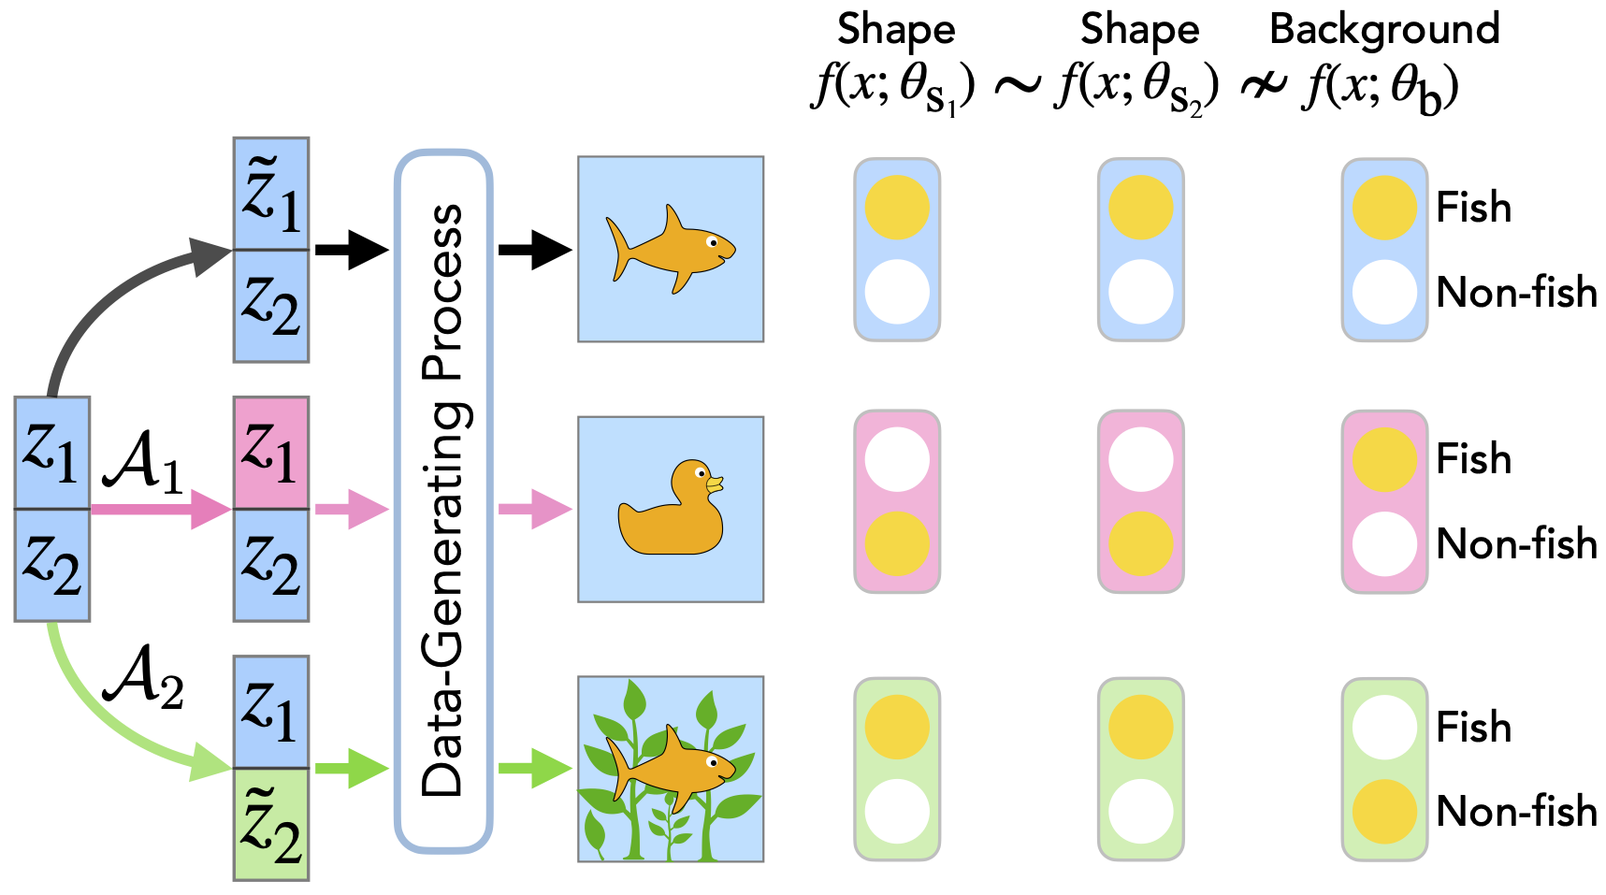
Mechanistic Mode Connectivity
Ekdeep Singh Lubana^{1,2,3}, Eric J. Bigelow², Robert P. Dick¹, David Krueger⁴, Hidenori Tanaka^{2,3}
¹ University of Michigan ² Harvard University ³ NTT Research, Inc. ⁴ University of Cambridge
Problem
Method
Key Results
Mode-connectivity theory shows a network’s low-loss minimizers are joined by simple paths — but ignores what mechanism each uses, so it cannot tell whether two solutions predict from the same input attributes.
Mechanistic similarity. Two models are similar if invariant to the same unit interventions on the data-generating latents (e.g. shape vs. background).
CIFAR-10 · 60% CUE
WITH CUE
RAND. CUE
Fine-tune
98.7%
17.5%
Connectivity theorem. A loss barrier on the linear path between two minimizers (even after permutation symmetries) implies they are mechanistically dissimilar.
CBFT (ours)
71.5%
73.4%
Prior connectivity work is mechanism-blind.
Motivation
Benchmarks. Evaluated on three synthetic cue-augmented datasets (CIFAR-10/100, Dominoes) with counterfactual splits that measure cue reliance.
Two models can reach low loss yet rely on different cues — background vs. shape.
Quadratic paths connect the two minimizers; linear paths cannot, even after permutation.
Fine-tuned models stay linearly connected to pretraining, so naive fine-tuning may never remove a spurious cue.
SO WHAT → +55.9 pts on Rand-Cue — a reliable signal of differing mechanisms.
CBFT: cross-entropy on cue-free data + a barrier loss (raises loss toward the cue-relying model) + an invariance loss .
Barrier loss chooses where to move; invariance loss chooses which mechanism to keep.
Headline Numbers
73.4%
74.1%
CBFT No-Cue acc.
CBFT accuracy · Randomized-Cue · CIFAR-10
8.8%
Rand-Image ≈ chance
vs. 17.5% for fine-tuning — a 4× gap, essentially cue-invariant
60–100%
cue proportion swept
Takeaway
Linear connectivity reveals whether two models share mechanisms — a practical lever to deliberately edit a model and strip its reliance on spurious cues.
Are mechanistically dissimilar minimizers (background- vs. shape-reliant) connected by simple low-loss paths — and can we exploit this to switch mechanisms?
Mechanistic similarity: models are compared by how their predictions respond to unit interventions on latent factors of the data-generating process.
Mode connectivity is not a geometric curiosity — it is a handle for robust, editable models.

