Slide 1

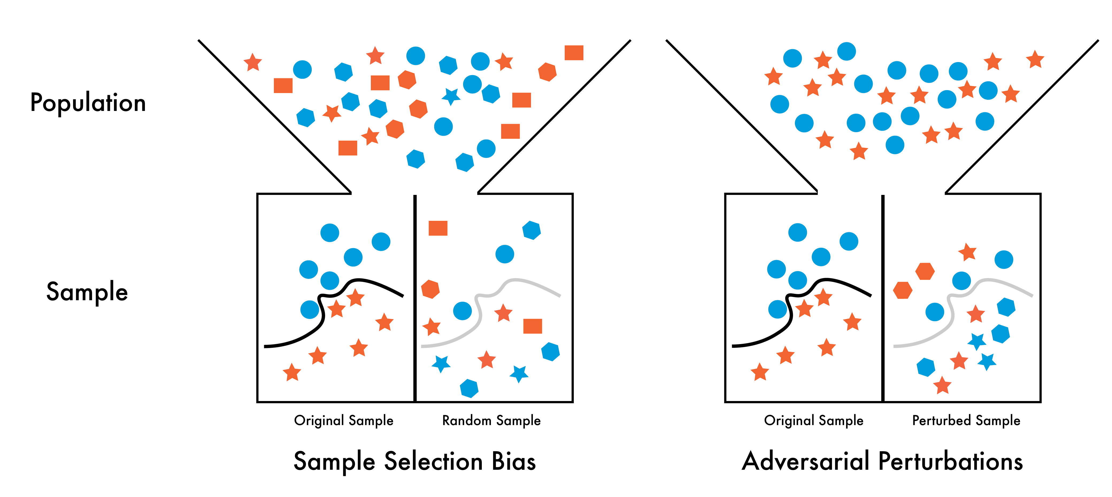
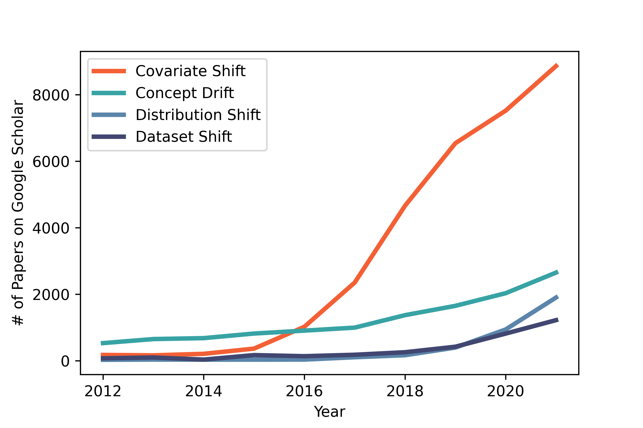
Identifying the Context Shift between Test Benchmarks and Production Data
arXiv 2022
Matthew Groh
MIT Media Lab
Problem
Method
Key Results
Machine-learning models reach human-level accuracy on static
benchmarks, then break on production data. The field calls this gap
distribution shift — a frame at once over-specified and under-
specified.
Context shift names the semantically meaningful upstream factors
behind distribution shift — sample selection bias, adversarial
perturbations, and non-stationarity.
DOMAIN
TEST
RESULT
FER (1 model, 7 sets)
SFEW → MultiPie
48.6% → 94.8%
ImageNet / CIFAR-10
faithful re-creation
−3 to −15%
1
›
2
›
3
Deepfake (DFDC)
real world-leader fakes
2% & 8%
Shift definitions compare two samples precisely, but say
nothing about the process that caused the mismatch.
Human intuition
Dynamic
benchmarking
Clarify limits
expert knowledge
surfaces features
models fail on
continual eval →
corroborated accuracy
state where
performance is known &
unknown
Random baseline is 14.2% — yet one FER model reads
anywhere from 48.6% to 94.8% depending only on which
benchmark you pick.
Motivation
Distribution shift is a symptom, not the disease — the cause lies
upstream in how data are created, collected, and curated.
SO WHAT → A single static benchmark badly predicts real-world performance — the gap is context, not chance.
SYMPTOM
Distribution shift measures that two datasets differ; context
shift explains why — the upstream cause you can act on.
Headline Numbers
48.6–94.8%
3–
15%
SOTA drop on re-created
ImageNet & CIFAR-10
Two context drivers made concrete: sample-selection bias (left) and
adversarial perturbation (right) reshape features and labels, so a
benchmark-tuned representation misclassifies production data.
one FER model's accuracy across
7 benchmarks
2% /
8%
detector confidence on real
world-leader deepfakes
random baseline is just 14.2% — the benchmark,
not the model, tells the story
128,154
DFDC videos from 960
consenting actors
Dataset / Benchmark
Takeaway
Three "model-organism" vision domains expose how implicit
benchmark assumptions cause real-world errors:
Reframe robustness around context shift — the semantically
meaningful data-generation factors behind distribution shift — and
close the benchmark-to-production gap by pairing human
intuition, dynamic benchmarking, and honest limitations.
SFEW
MMI
DISFA
FER2013
FERA
CK+
MultiPie
DFDC · 128,154 videos
DDI
Fitzpatrick 17k
The way forward: context-aware benchmarks — BREEDS,
WILDS, Dynabench — that model the data-generating process
instead of a single static snapshot.
The simplest fix available today: state plainly the contexts
a model was evaluated in — and the contexts where its
behavior is still unknown.
Google Scholar papers pairing "machine learning" with four shift terms,
2012–2021 — interest exploded, jargon stayed conflated.

