Slide 1






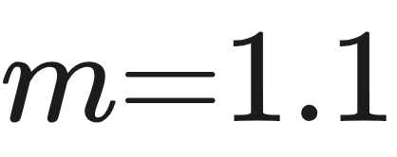
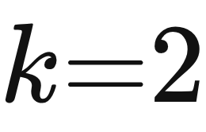
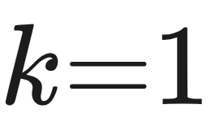
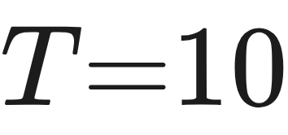

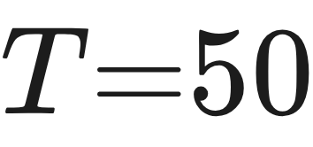

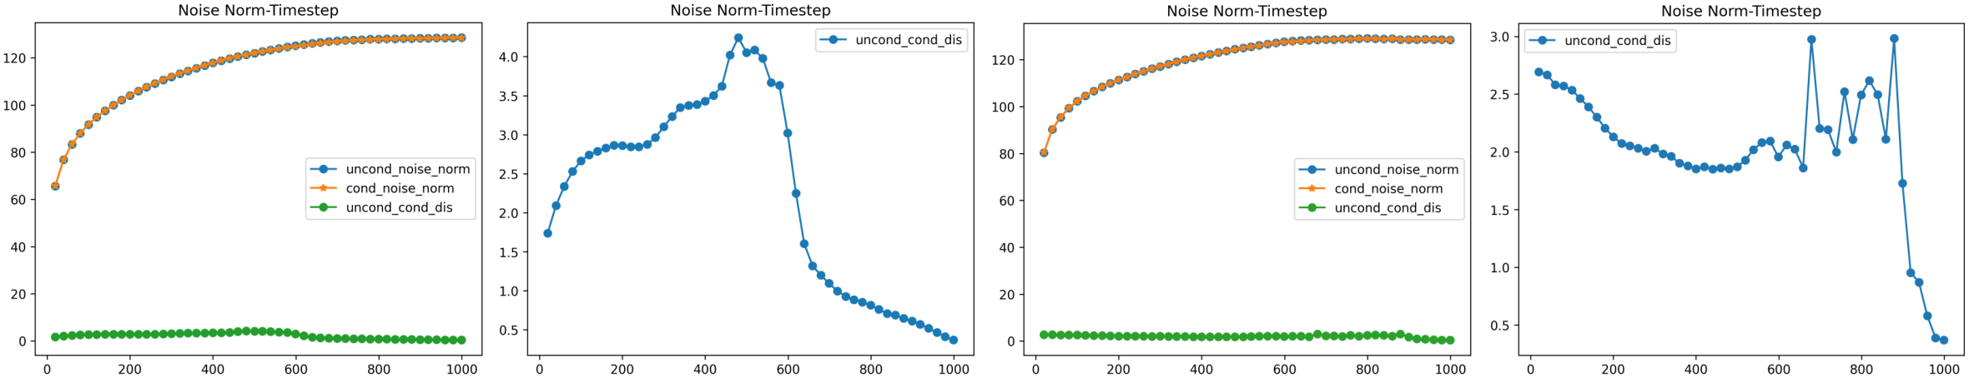
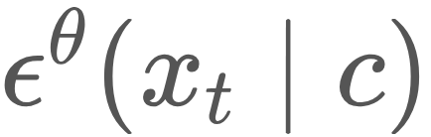
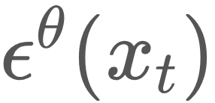
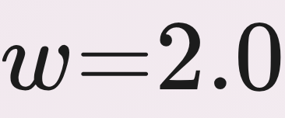
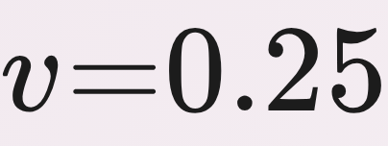
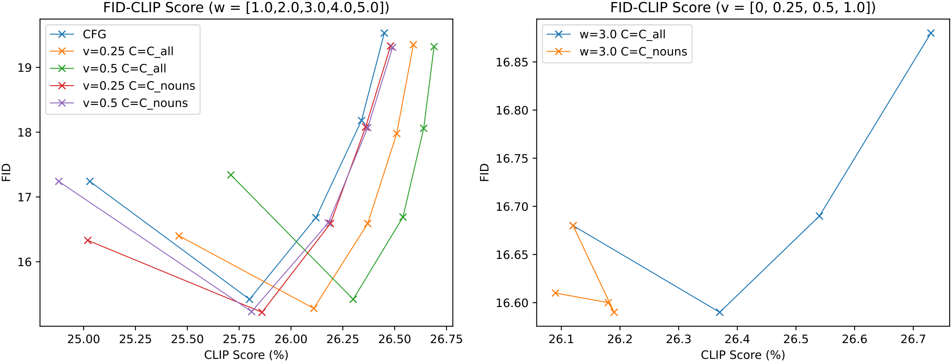







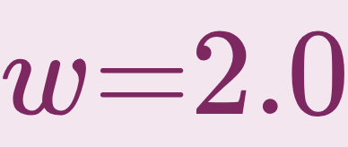
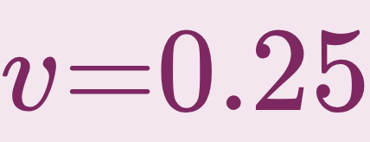
Inner Classifier-Free Guidance and Its Taylor Expansion for Diffusion Models
Shikun Sun¹², Longhui Wei³, Zhicai Wang⁴, Zixuan Wang¹², Junliang Xing¹², Jia Jia¹², Qi Tian³
¹Tsinghua University · ²BNRist · ³Huawei Inc. · ⁴University of Science and Technology of China
Paper
Problem
Method
Ablation Study
Classifier-free guidance (CFG) balances
diversity and fidelity in conditional diffusion
models, but it imposes no structure on the
condition space. When the condition is
continuous, CFG cannot exploit that
continuity.
Inner CFG (ICFG). Model the enhanced distribution as with .
Middle point : FID is U-shaped, best 15.42 at .
CFG is the first-order term; the term is new. The term reproduces CFG; the second-order term (via a middle point ) adds new information — no retraining.
Sampling steps: strong even at (FID 15.80), 15.28 at .
Robust across and the sampling budget.
For text-based models like Stable
Diffusion, a structured condition space
could sharpen the trade-off, yet CFG has
no way to reach it.
Headline Numbers
CFG treats a continuous condition as
an opaque label – can we use its
structure?
26.11
CLIP Score
(vs CFG
25.80)
15.28
24.69
U-ViT FID
@5k (CFG
34.23)
Figure 1. Score norms , and their distance over 50 CFG timesteps.
best MS-COCO FID at ,
Motivation
7.92
U-ViT FID
@80k (CFG
8.10)
Dataset / Benchmark
Key Results
The two dominant guidance routes,
external classifiers and classifier-free
guidance, both ignore the geometry of a
continuous condition space.
Text-to-image on the MS-COCO validation set; FID
(fidelity, ↓) and CLIP Score (alignment, ↑).
Takeaway
Run on pretrained Stable Diffusion, with a class-
conditional study on U-ViT and few-shot fine-tuning
on SD v1.5.
CFG is just the first-order Taylor term of
inner CFG. The second-order term buys a
better fidelity–diversity balance for free —
no retraining.
In Stable Diffusion the text encoder
induces a rich continuous space; if that
space has a "cone" structure,
guidance can be extended along it to
gain new, valuable information.
Guidance strength and second-order weight are swept across condition spaces and .
Figure 2. FID–CLIP trade-off across , , and condition space ; ICFG sits below CFG.
INSIGHT
MS-COCO val
FID ↓
CLIP Score ↑
Stable Diffusion
A well-defined "cone"-structured space
lets ICFG extend naturally to higher
orders.
Continuity is a resource CFG never
spends – the opening for a better trade-
off.
U-ViT
SD v1.5
FID 15.28 / CLIP 26.11 at , – beats CFG's 15.42 / 25.80 on both.
FID and CLIP Score reported for every setting.

