Slide 1




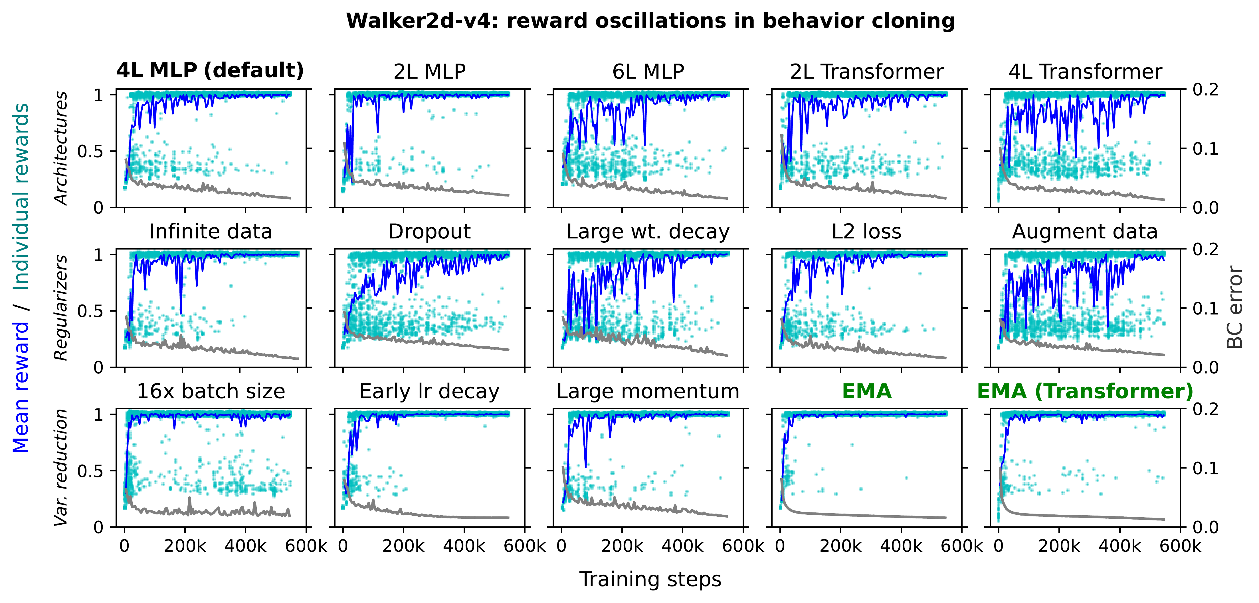
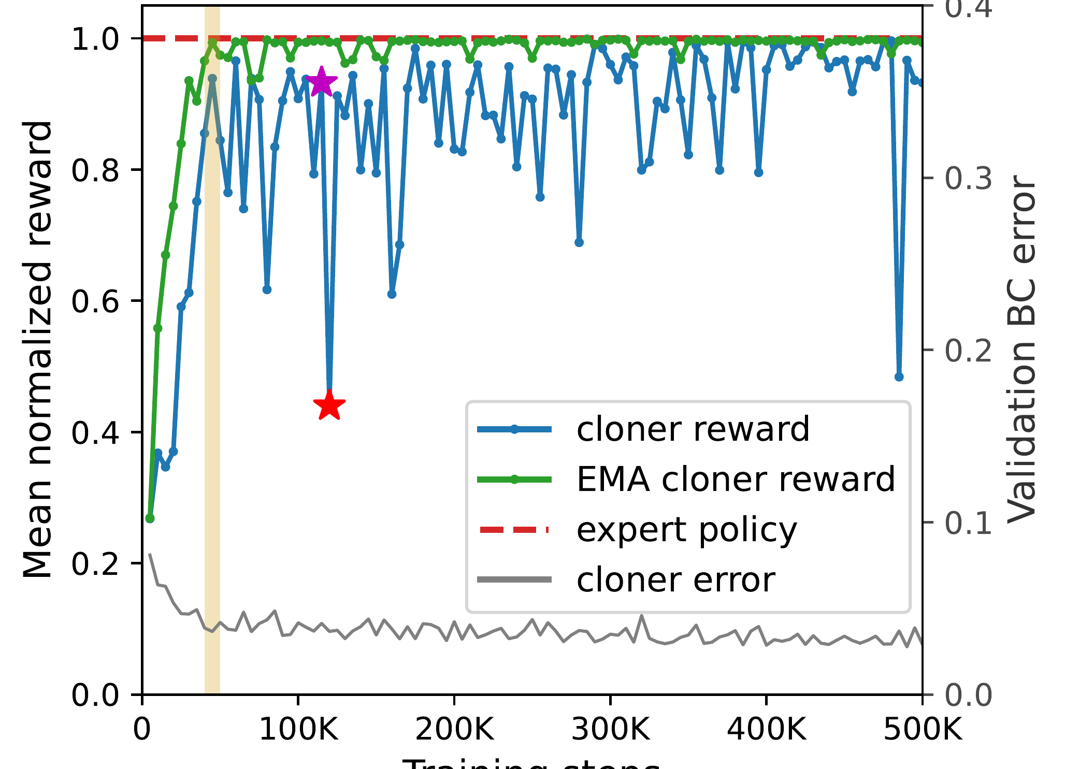
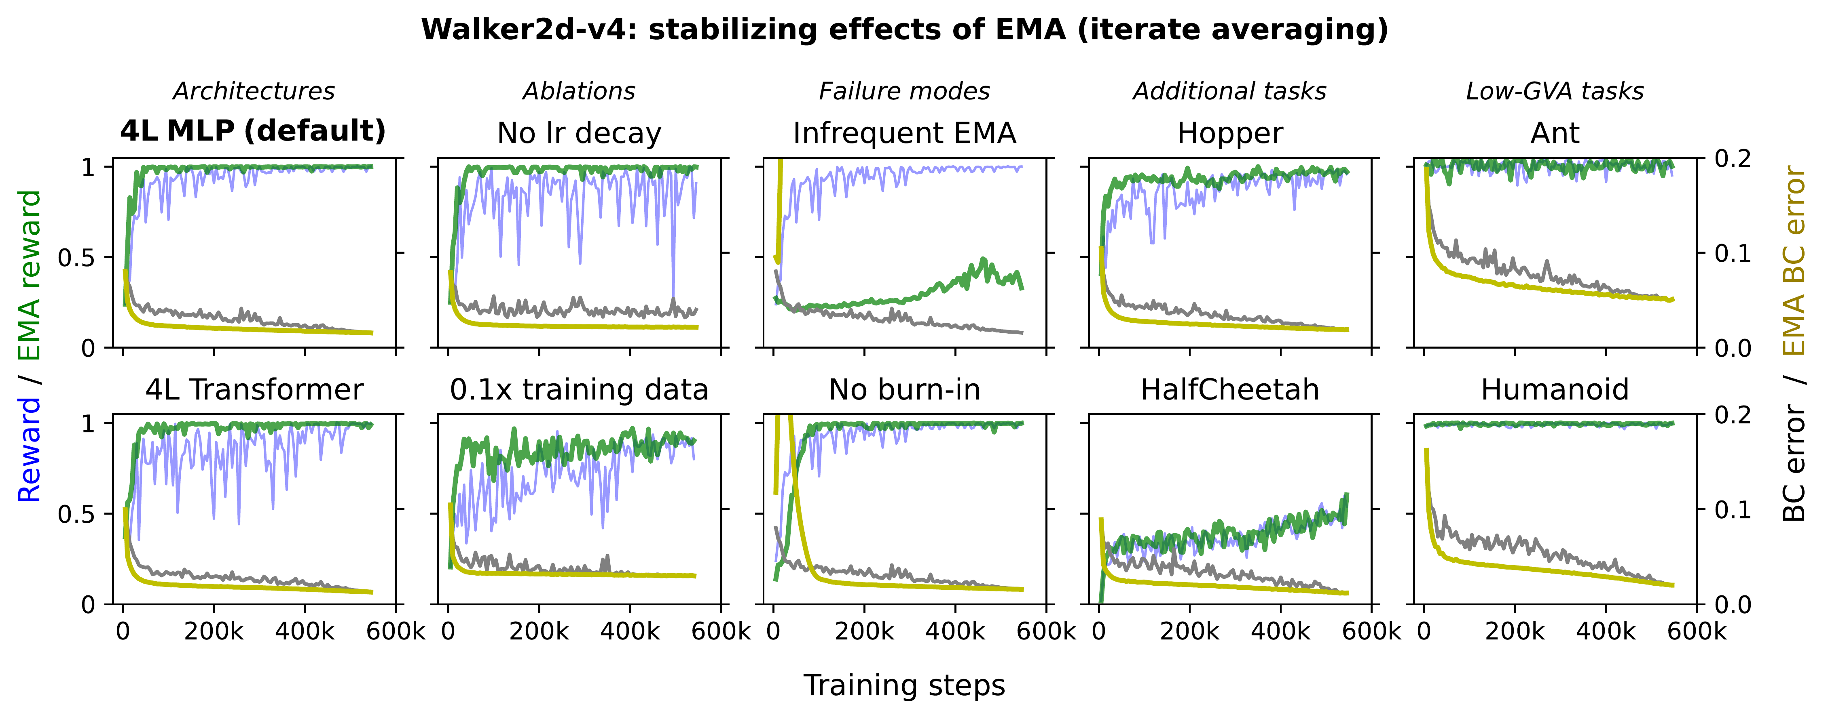
Butterfly Effects of SGD Noise: Error Amplification in Behavior Cloning and Autoregression
Adam Block¹, Dylan J. Foster², Akshay Krishnamurthy², Max Simchowitz¹, Cyril Zhang²
¹MIT ²Microsoft Research NYC
Problem
Method
Dataset / Benchmark
Ablation Study
Behavior-cloning deep policies with
minibatch SGD makes long-horizon rollout
reward oscillate violently across iterates
— while the single-step BC loss stays flat
and stable. Rolling out every checkpoint
is impractical, so any saved model carries
a real risk of poor deployed performance.
Disentangle statistical vs. algorithmic causes:
ablate the data difficulty and the oscillations remain
— the cause is gradient variance amplification
(GVA), SGD noise amplified through unstable
closed-loop rollouts.
Continuous control: BC from SAC experts over
horizon H = 1000 on MuJoCo — Walker2d-v4 plus
four more tasks.
Oscillations persist across dataset
sizes, architectures, scales, and
regularizers — only variance
reduction calms them.
Language: on TinyStories, train 270M-parameter
Transformers for language generation.
EMA is most effective updating every
iterate after a burn-in; skipping either
weakens the stabilization.
Test variance-reduction cures — LR decay, huge
batches, and iterate averaging. An EMA of the
weights updated every step stabilizes rollouts at
near-zero cost; a convex ‘cliff-loss’ vignette proves
the blow-up is real.
Walker2d-v4
Hopper
HalfCheetah
Ant
Humanoid
TinyStories LM
SO WHAT → LR decay and huge batches also help, at large compute cost.
Motivation
Key Results
Deep systems act inside feedback
loops, yet we train on surrogate
objectives that ignore the loop.
EMA needs no learning-rate or batch-size change;
in language modeling it further removes the need
for LR decay, reducing overfitting.
RAW SGD ITERATES
→
EMA ITERATES (OURS)
Headline Numbers
Reward swings step-to-step; any checkpoint is a gamble.
Rollouts stay near-expert; also lowest-perplexity LM.
278
1000
rollout horizon
H
Blame optimizer noise: the smooth
surrogate hides wild swings in the true
metric, not the training loss.
distinct
interventions
270M
LM params
EMA of the optimizer trajectory; rate with a burn-in
map when GVA appears and
what tames it
20
seeds averaged
Same fix, two domains: EMA tames the
butterfly effect in robot control and language
generation.
Takeaway
SGD noise is harmless for the one-step
loss, but feedback loops amplify it into
chaotic long-horizon failures (GVA). A
cheap EMA of the weights is a broadly
effective stabilizer — treat it like your
optimizer and scheduler, from robotic
control to language generation.
Oscillations persist across architectures and regularizers;
only variance-reduction (especially EMA) calms them.
EMA sharply damps GVA-induced reward oscillations across
architectures, ablations, dataset sizes, and tasks — no
change to the LR schedule or batch size.
SO WHAT → Statistical convergence is sufficient but not necessary for BC.
Averaging weights is a first-class
stabilizer.
Reward swings; BC loss stays flat; EMA damps
it.

