Slide 1
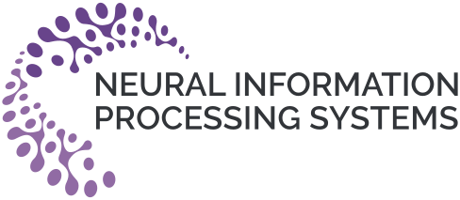


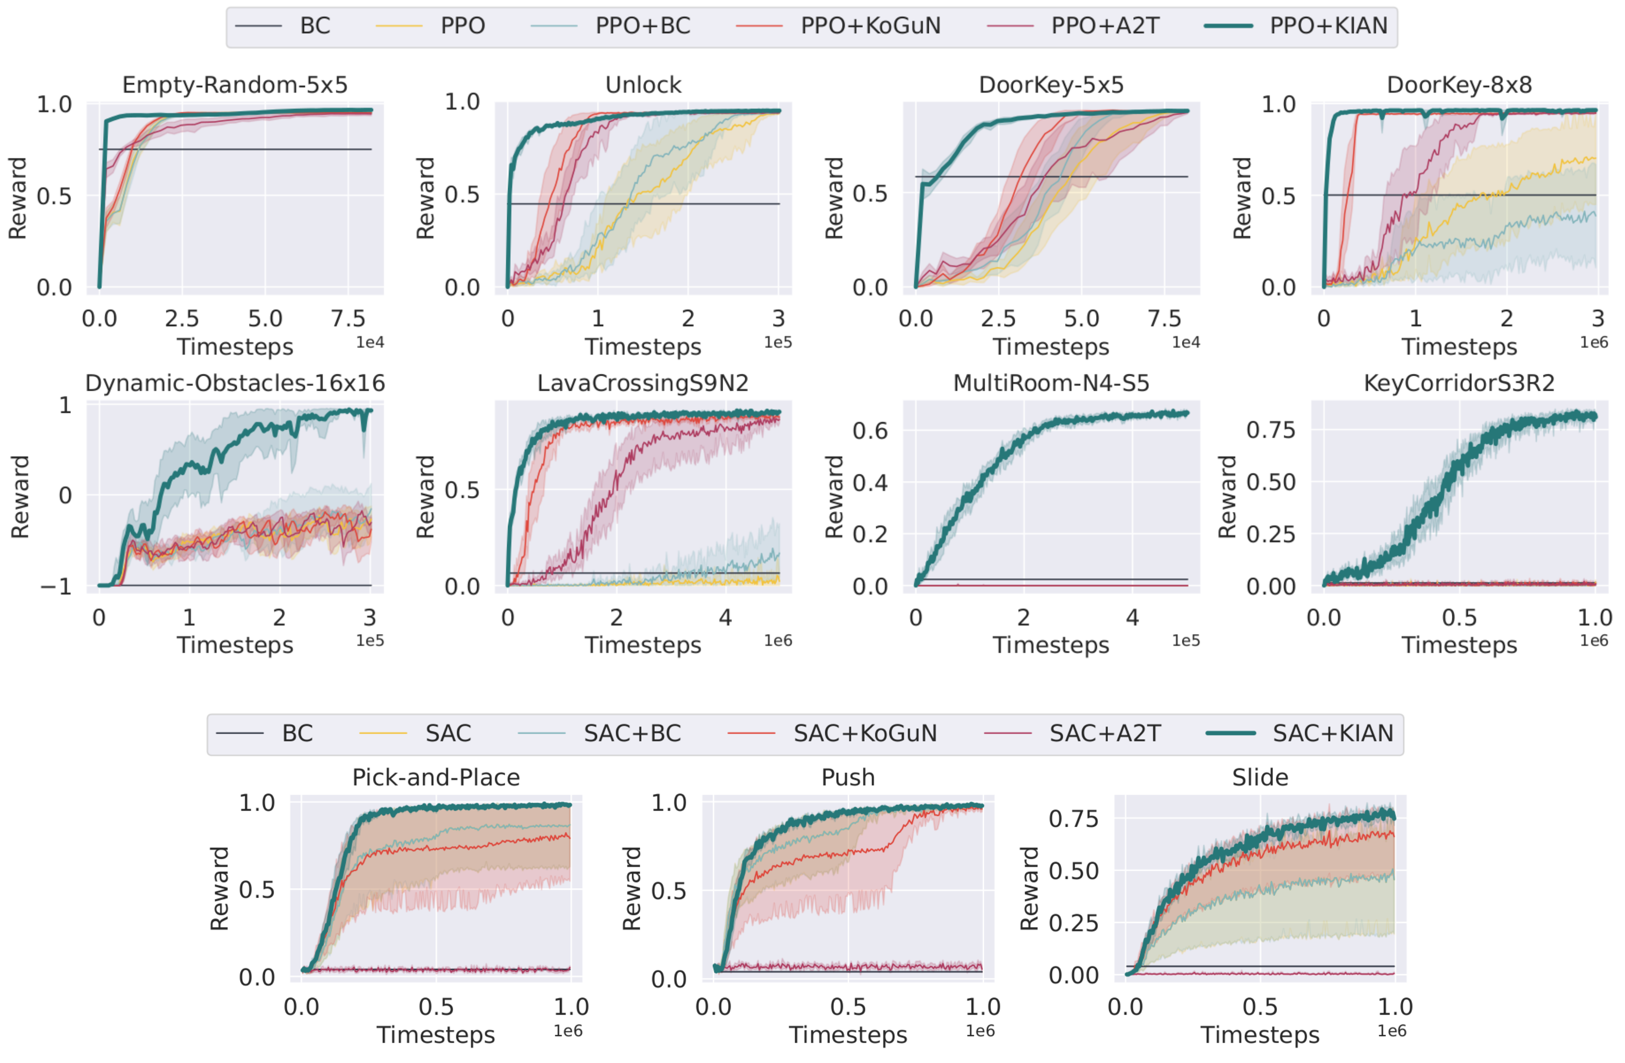
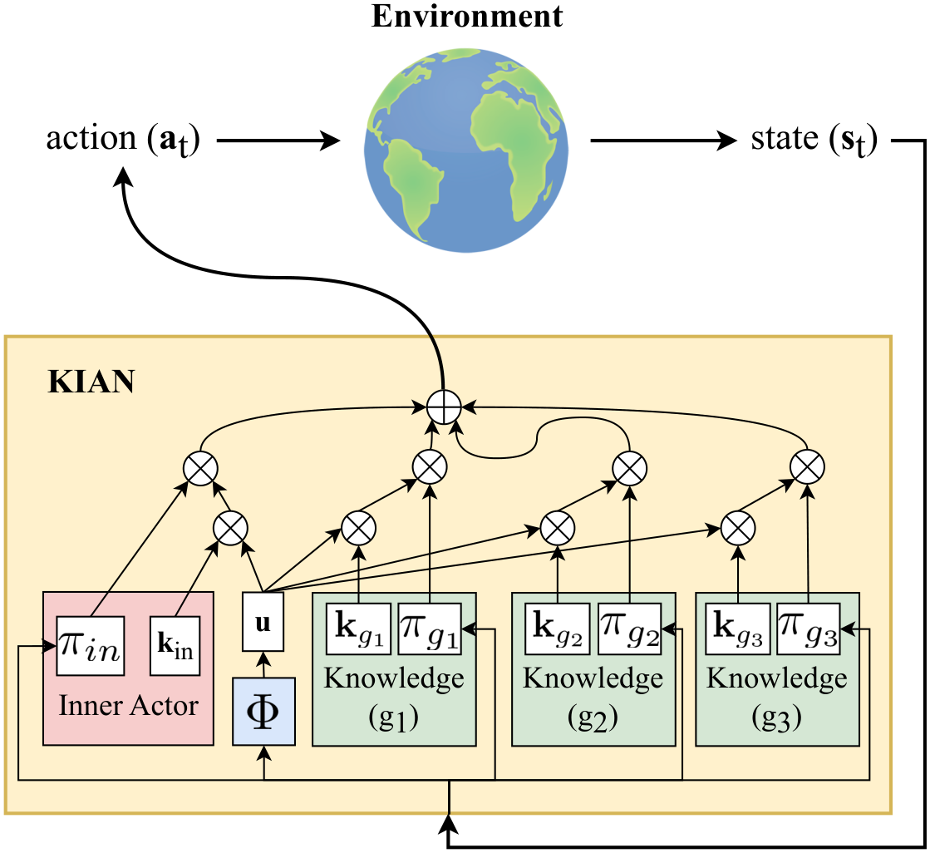
Flexible Attention-Based Multi-Policy Fusion for Efficient Deep Reinforcement Learning
Zih-Yun Chiu¹, Yi-Lin Tuan², William Yang Wang², Michael C. Yip¹
¹ University of California, San Diego ² University of California, Santa Barbara
Problem
Method
Key Results
Headline Numbers
RL agents are sample-inefficient;
injected knowledge policies stay rigid and
can't be recombined or replaced across
tasks.
KIAN = an inner actor (the agent’s own policy) + a
learnable key per knowledge policy + a state-
dependent query.
Zero-shot transfer
Best baseline
KIAN
0.93
0.72
Pick-and-Place
10× (vs 0.30)
Empty-Random 5×5 → 16×16
0.53
0.93
Zero-shot reward,
5×5 → 16×16 (vs
0.53 baseline)
1.00
DoorKey→Reach
(vs 0.80)
The fused policy is a weighted sum; keys are
unordered, so swap a policy by swapping its key —
no retraining.
Pick-and-Place, 10× goal range
0.30
0.72
10
DoorKey-8×8 → Reach (C2S)
0.80
1.00
seeds · 95% CI
HUMANS
vs
RL AGENTS
reuse & recombine freely
fixed order → retrain to edit
Only method to succeed in every environment
given a sub-optimal knowledge set — the
advantage grows as tasks get harder.
Ablation
Removing the entropy-imbalance fix
collapses KIAN onto one policy.
Motivation
Weights over the inner and knowledge keys.
Compositional & incremental: reused
keys learn tasks sequentially with fewer
samples.
Treat external policies as a modular,
reorderable set.
Prior fusion (KoGuN, A2T) fixes policy
order, forcing retraining.
SO WHAT → Modular knowledge keys pay off across transfer settings.
sample-efficient
generalizable
Takeaway
compositional
incremental
Encoding each policy as an independent
learnable key and fusing them by attention
makes external knowledge fully modular;
the entropy fix keeps exploration efficient.
Knowledge policies become plug-and-
play building blocks.
Contribution
1
KGRL — fuse an inner policy with
many knowledge policies.
Sample-efficiency learning curves across MiniGrid (top two
rows) and OpenAI-Robotics (bottom). KIAN (teal) reaches
high reward with far fewer samples on every task.
2
KIAN — attention rearranges, adds, or
replaces policies.
SO WHAT → Best zero-shot transfer in both simple→complex and complex→simple settings, with lower variance than every baseline (BC, RL, RL+BC, KoGuN, A2T). Methods that ignore entropy imbalance (A2T) barely learn in continuous control, while KIAN keeps improving.
Add, drop, or reorder knowledge
policies anytime — without
retraining the network.
3
Entropy imbalance — identified,
proven, and fixed.
KIAN architecture: inner actor + knowledge policies g₁–g₃
fused by embedding-based attention.

