Slide 1
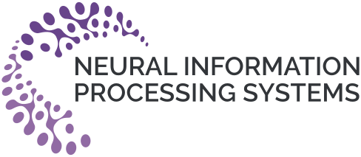



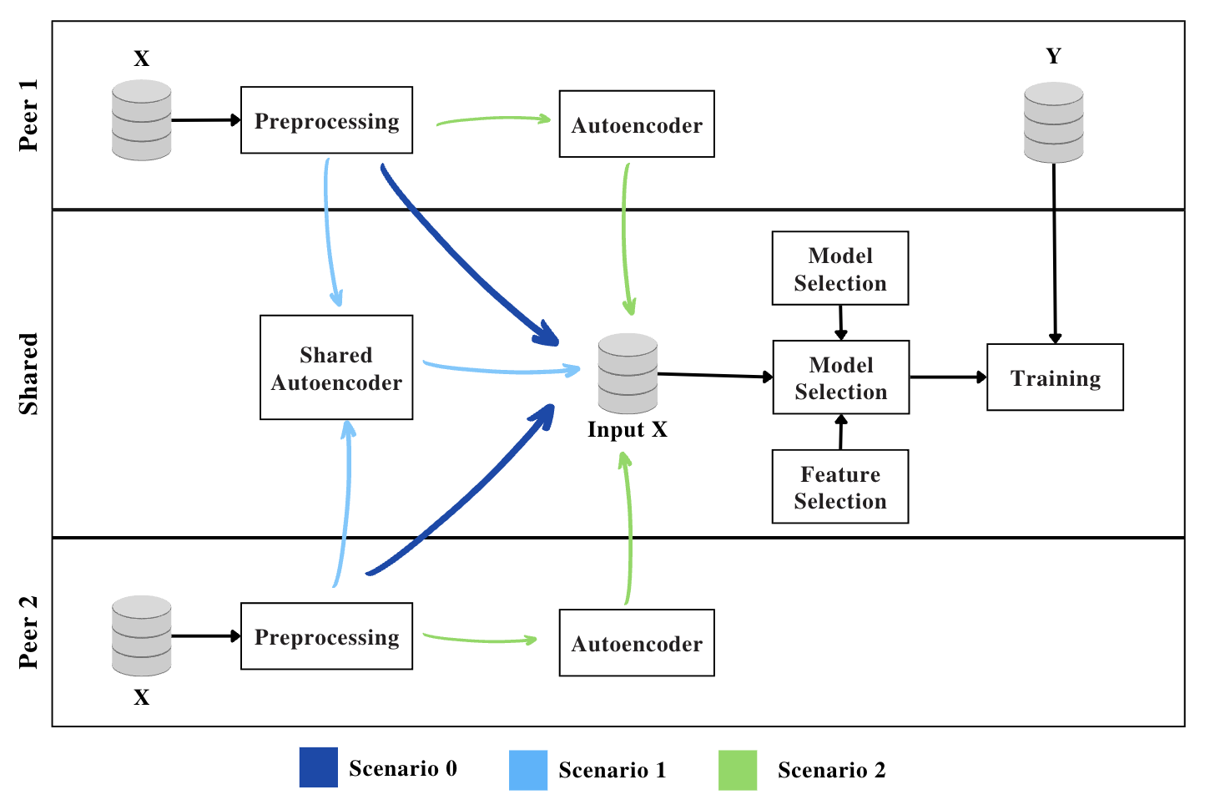
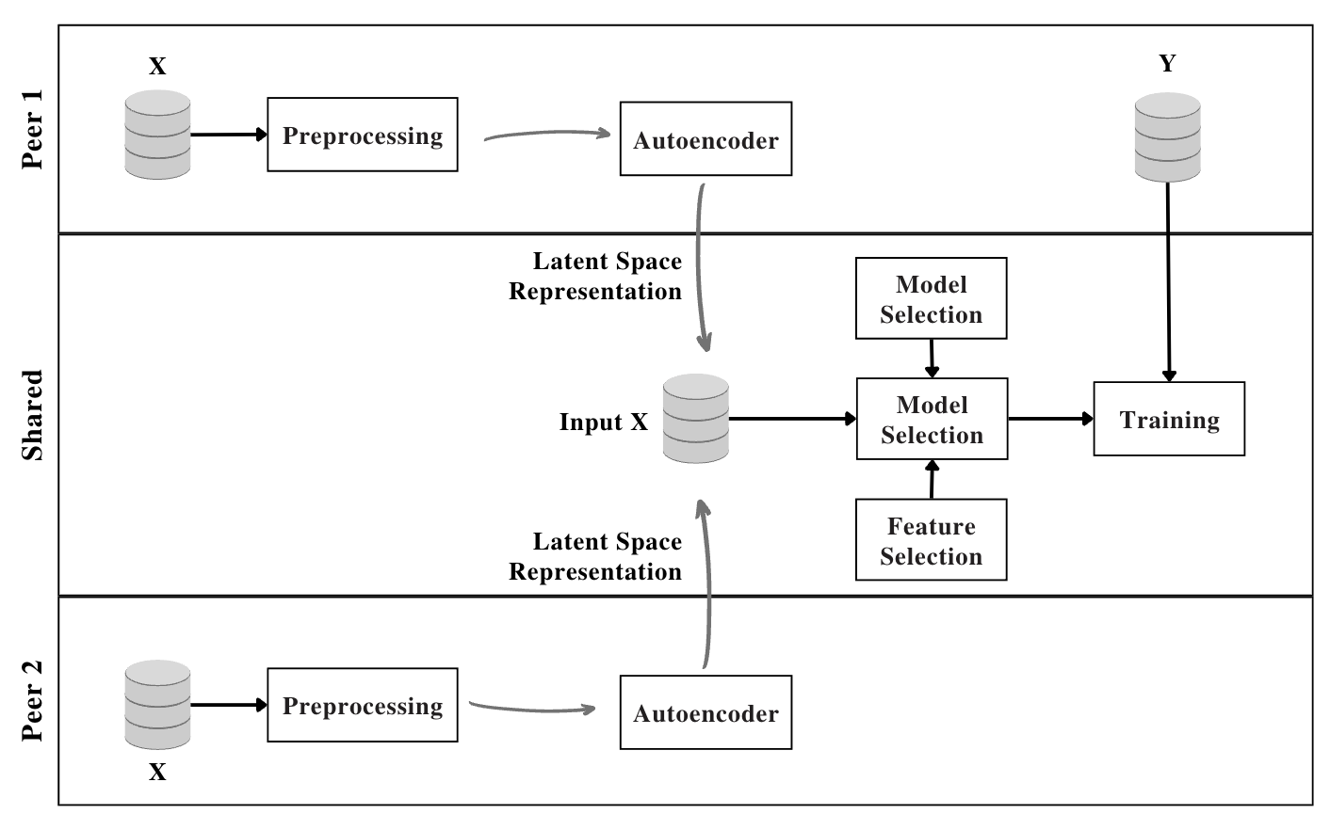
Privacy-Preserving Machine Learning for Collaborative Data Sharing via Auto-
encoder Latent Space Embeddings
Ana María Quintero Ossa¹, Jesús Solano², Hernán García², David Zarruk³, Alejandro Correa-Bahnsen², Carlos Valencia¹
¹ Los Andes University ² Rappi ³ Amazon
Problem
Method
Key Results
Two organizations often hold complementary variables about the same users. Combining them would sharpen a shared prediction, but privacy and IP law forbid exchanging raw sensitive features, so the collaboration is cancelled and its promised accuracy gain lost.
Each peer encodes its features with a fixed four-layer autoencoder and shares only the latent embedding.
Method
Metric
Raw features (S0)
90.29% R²
Peers join embeddings by a common ID and train one shared predictor; non-naive variants also predict the target.
Latent embeddings (S2)
89.33% R²
How can peers share their information and keep the predictive power of the original features, without ever exposing raw data?
Motivation
Encoder N→128→64→40→M, MAE loss; peers share only the latent code z.
Existing privacy tools each fall short. Homomorphic encryption is secure but hard to deploy; federated learning assumes peers hold the same features and cannot fuse complementary ones.
Differential privacy injects noise that degrades utility, and linear PCA drops nonlinear structure.
These protect data in transit, distort observations, or demand heavy maintenance, leaving room for a representation-learning encoder.
Federated Learning
Differential Privacy
Scenarios: S0 raw baseline, S1 shared autoencoder, S2 per-peer autoencoders.
Linear PCA
SO WHAT → House Pricing R² drops only 0.96 pp; across MNIST and Buzz encoded R² stays within 89–94%.
Ablation Study
Framework: peers share only latent embeddings, not raw data.
1
S0 Raw-data baseline, no privacy protection.
Headline Numbers
Takeaway
2
S1 / S2 Naive: single shared vs individual per-peer autoencoders.
< 10pp
89.33%
House Pricing R² (S2)
Peers collaborate by sharing autoencoder latent embeddings instead of raw data, keeping sensitive features private while losing under 10 pp of downstream performance.
downstream performance drop when raw features become shared latent embeddings
94.03%
Buzz R² (non-naive S3)
3
S3 / S4 Non-naive: multitask autoencoders that also predict the target.
5–11%
reconstruction error
NEXT
across all three benchmarks (House Pricing, MNIST, Buzz), while original features stay fully hidden
Making the encoder task-aware (non-naive) narrows the gap further; future work points to custom per-dataset encoders and explicit privacy-level measures.
SO WHAT → Non-naive variants win: on Buzz test R² rises 91.55% → 94.03% (S1→S3), and MNIST accuracy climbs 88% → 91%.
Shared autoencoders correctly estimate 96–98% of observations per feature, within a 5% MAPE reconstruction budget.

