Slide 1



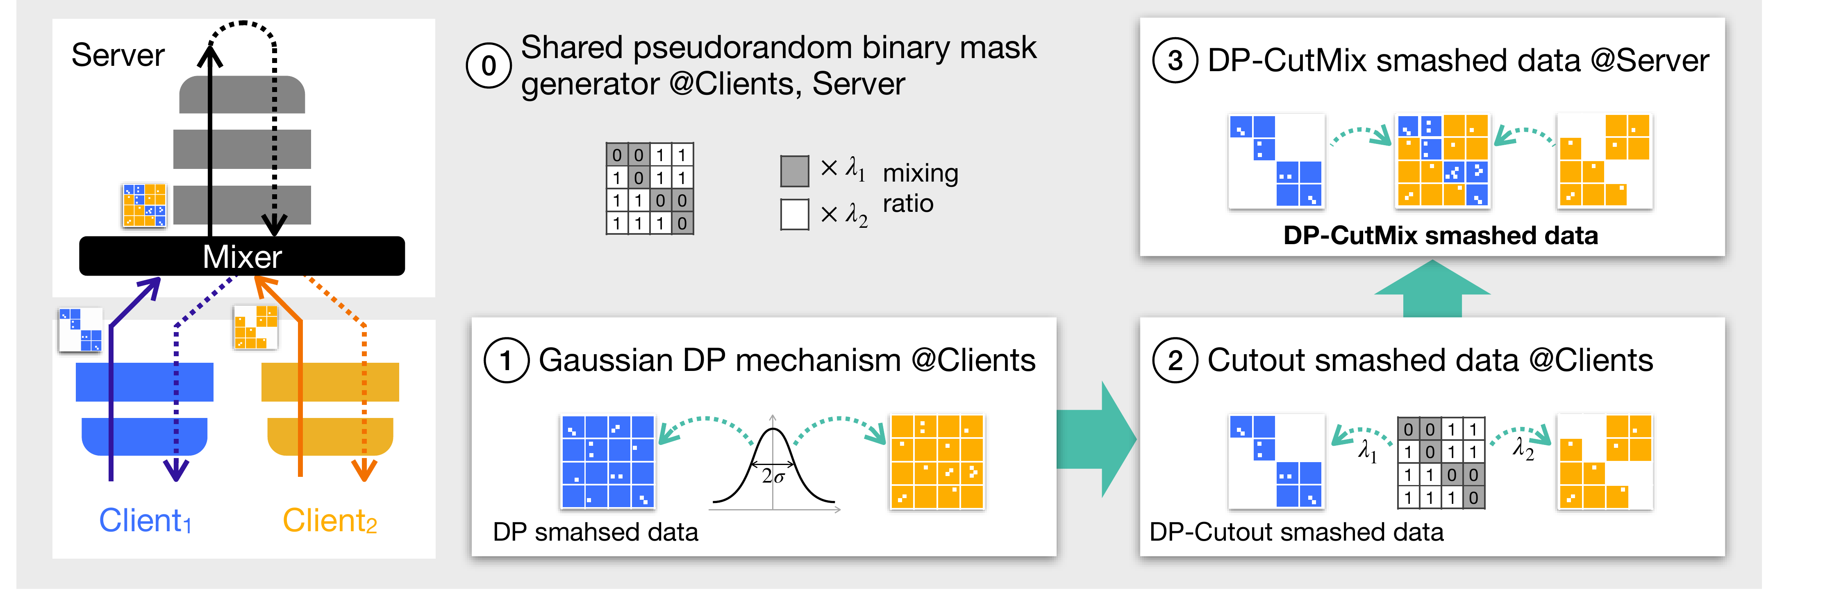
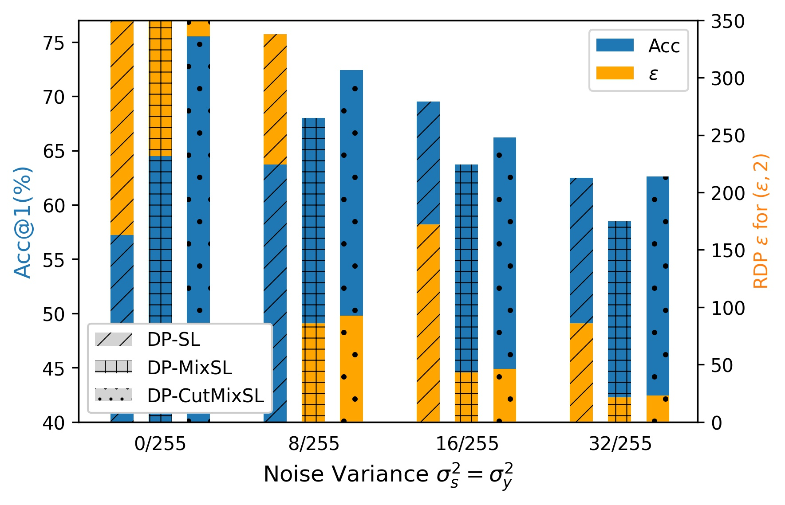
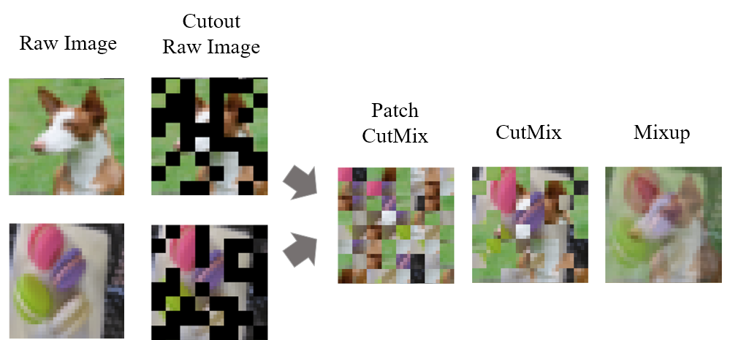
NeurIPS
Differentially Private CutMix for Split Learning with Vision Transformer
2022
Seungeun Oh¹, Sihun Baek¹, Hyelin Nam¹, Seong-Lyun Kim¹, Jihong Park², Praneeth Vepakomma³, Ramesh Raskar³, Mehdi Bennis⁴
¹ Yonsei University ² Deakin University ³ Massachusetts Institute of Technology ⁴ University of Oulu
Paper
Problem
Method
Dataset / Benchmark
Headline Numbers
In split learning with a Vision
Transformer, the cut-layer smashed
data barely differs from the raw input —
no pooling, no convolution — leaking
privacy and inflating cost.
A mixer shares a pseudorandom binary mask M_{i} (Dirichlet
ratios λ_{i}, Σλ_{i} = 1) to each client.
CIFAR-10
Fashion-MNIST
ViT-Tiny
PiT-Tiny
73.77%
71.26%
PiT-Tiny
top-1
VGG-16
|C| = 10 clients
cut after embedding
89.75%
F-MNIST
· ViT
Clients mask smashed data (Cutout) and add Gaussian
noise; the server sums complementary patches → DP-
CutMix, then propagates as in vanilla SL.
PiT-Tiny inserts a pooling layer, bridging pure ViT
and CNN; the cut-layer sits right after patch
embedding. Standalone, SL and SplitFed are
baselines. RDP computed at patch size N = 64,
sensitivity Δ = 0.2, uniform λ_{i} = 1/n, order α = 2.
Top-1 · CIFAR-10 ·
ViT-Tiny
+16.56 pp over plain SL
~8×
harder to
invert
No pooling, no convolution: a ViT's
smashed data barely distorts the
input, so it leaks like the raw image.
Ablation Study
DP-CutMixSL wins accuracy at
almost every noise level.
Motivation
Randomized inter-client CutMix provably tightens the Rényi-DP budget.
Key Results
ROBUST
ViT is displacing CNN in vision, so
privacy-preserving distributed training
must be rethought for pooling-free,
patch-level transformer architectures.
CIFAR-10 TOP-1 (|C|=10)
VIT-TINY
PIT-TINY
VGG-16
Recon. MSE: Cutout > Patch CutMix
> Mixup — 8× harder to invert.
SL
57.21
52.28
62.62
SplitFed
67.88
55.63
63.98
CutMixSL (ours)
73.77
71.26
67.53
Takeaway
Its cut-layer output barely distorts the
input, so regularizing smashed data
works as well as regularizing the raw
image — but leaks privacy.
DP-CutMixSL: a shared mask → Gaussian-DP Cutout at clients → the
server stitches surviving patches into DP-CutMix smashed data.
For Vision Transformers, DP-
CutMixSL breaks the privacy–
accuracy trade-off: mixing noisy
masked patches across clients
both tightens the DP guarantee
and improves accuracy.
Three ViT traits — low distortion,
noise-robust attention, and patch-level
operation — point to a single patch-
scale regularizer across clients.
Patch-level, global-attention ViT makes
patch CutMix work where it would hurt a
CNN — a privacy regularizer for the
transformer era, with the privacy gain
provably bounded by a Mixup
counterpart.
Global self-attention makes ViT
robust to noise on part of the image
— ideal for Cutout / CutMix-style
regularization, so masking whole
patches costs little accuracy.
Interpolation schemes on raw images vs. smashed data: patch-level
Cutout, Patch CutMix, CutMix, Mixup.
Accuracy & RDP ε vs. noise variance (CIFAR-10): DP-
CutMixSL leads accuracy at nearly every level, at a tighter
privacy budget than DP-SL.

