Slide 1



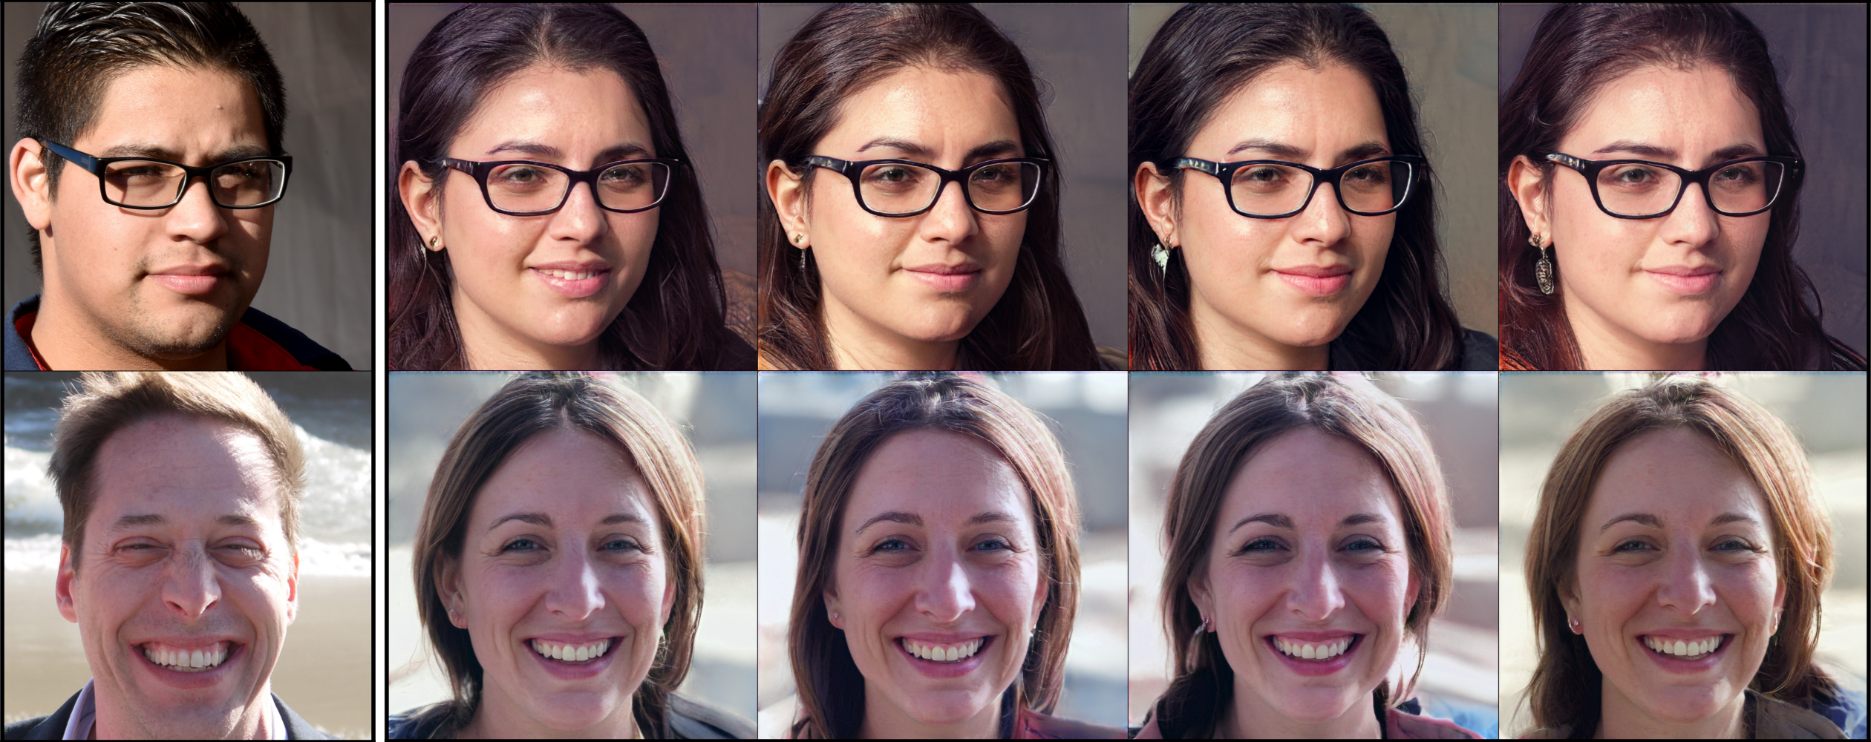
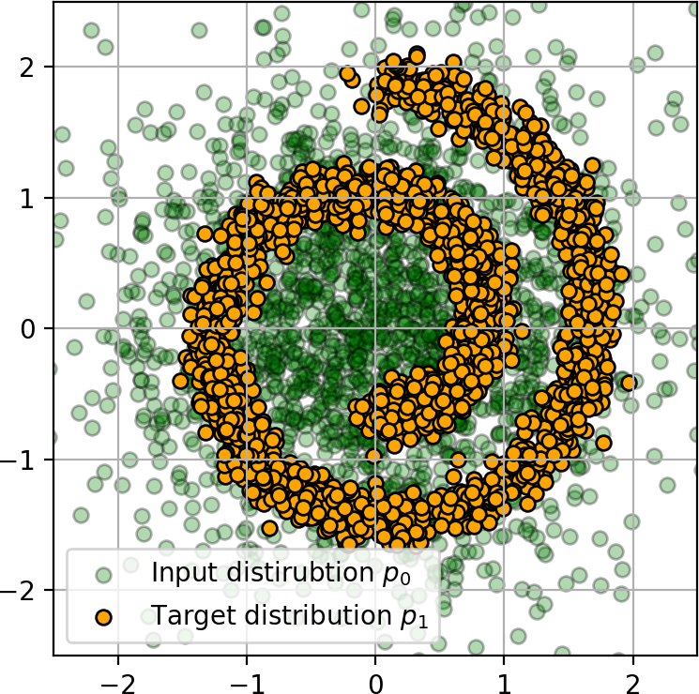
Light Schrödinger Bridge
Alexander Korotin^{1,2}, Nikita Gushchin¹, Evgeny Burnaev^{1,2}
¹Skolkovo Institute of Science and Technology · ²Artificial Intelligence Research Institute
Problem
Method
Key Results
Schrödinger Bridge (SB) solvers are heavy — stacks of neural
networks and complex, often adversarial optimization. No simple
baseline exists, the SB analogue of k-means or Sinkhorn to
reach for by default.
Minimize KL(π*‖π_{θ}) with the potential v_{θ} as an unnormalized
Gaussian mixture.
Setting
LightSB (ours)
Best baseline
One non-minimax, simulation-free objective — closed-form
plan & drift, plain SGD.
EOT/SB cBW²₂-UVP ↓
0.03–0.62%
1.04–18.05%
MSCI D=1000 · ED / time
1.27 / 146 s CPU
1.32 / 71 min V100
GAP
Users usually want only the endpoint plan π*(x₁|x₀).
Dataset / Benchmark
Closed-form plan; KL objective L(θ) minimized directly.
Tested on the Gushchin et al. (2023) EOT/SB benchmark
(ground-truth plans, D = 2–128, ϵ = 0.1/1/10) and the MSCI
single-cell dataset (PCA D = 50/100/1000).
Image translation on 1024×1024 FFHQ faces in the 512-dim
ALAE latent space.
Male → female translation in the ALAE latent space (D = 512).
EOT/SB benchmark
MSCI single-cell
FFHQ 1024²
ALAE latent
Headline Numbers
D = 2–1000
ϵ = 0.1–10
< 1 min
146
s
MSCI D=1000 on CPU (vs 71
min V100)
Motivation
to converge on 4 CPU cores (no
GPU), 512-dim latent image
translation
0.03%
best cBW²₂-UVP (baseline ≥
1.04%)
A user wanting EOT/SB between moderate-dimensional
distributions is forced into heavy neural solvers — min-max
objectives, iterative proportional fitting or process simulation
during training, and hours of GPU time plus fragile tuning.
vs tens of minutes to hours on a V100 GPU
1st
universal-approximator proof for
SBs
Takeaway
In most real tasks only the endpoints matter, so a solver that
returns the conditional plan directly and cheaply already covers
the dominant use case.
LightSB is essentially a Gaussian-mixture model for the
transport potential — simple, simulation-free, non-minimax,
and provably a universal approximator of SBs, yet it runs in
minutes on a CPU. It targets moderate-dimensional (or
latent) spaces and offers a natural default baseline for
EOT/SB.
A go-to, k-means-simple SB solver — cheap, tuning-free, CPU-
friendly — is what the field lacks.
The bridge process T_{θ} learned by LightSB on a 2D Gaussian → Swiss-roll
example.

