Slide 1


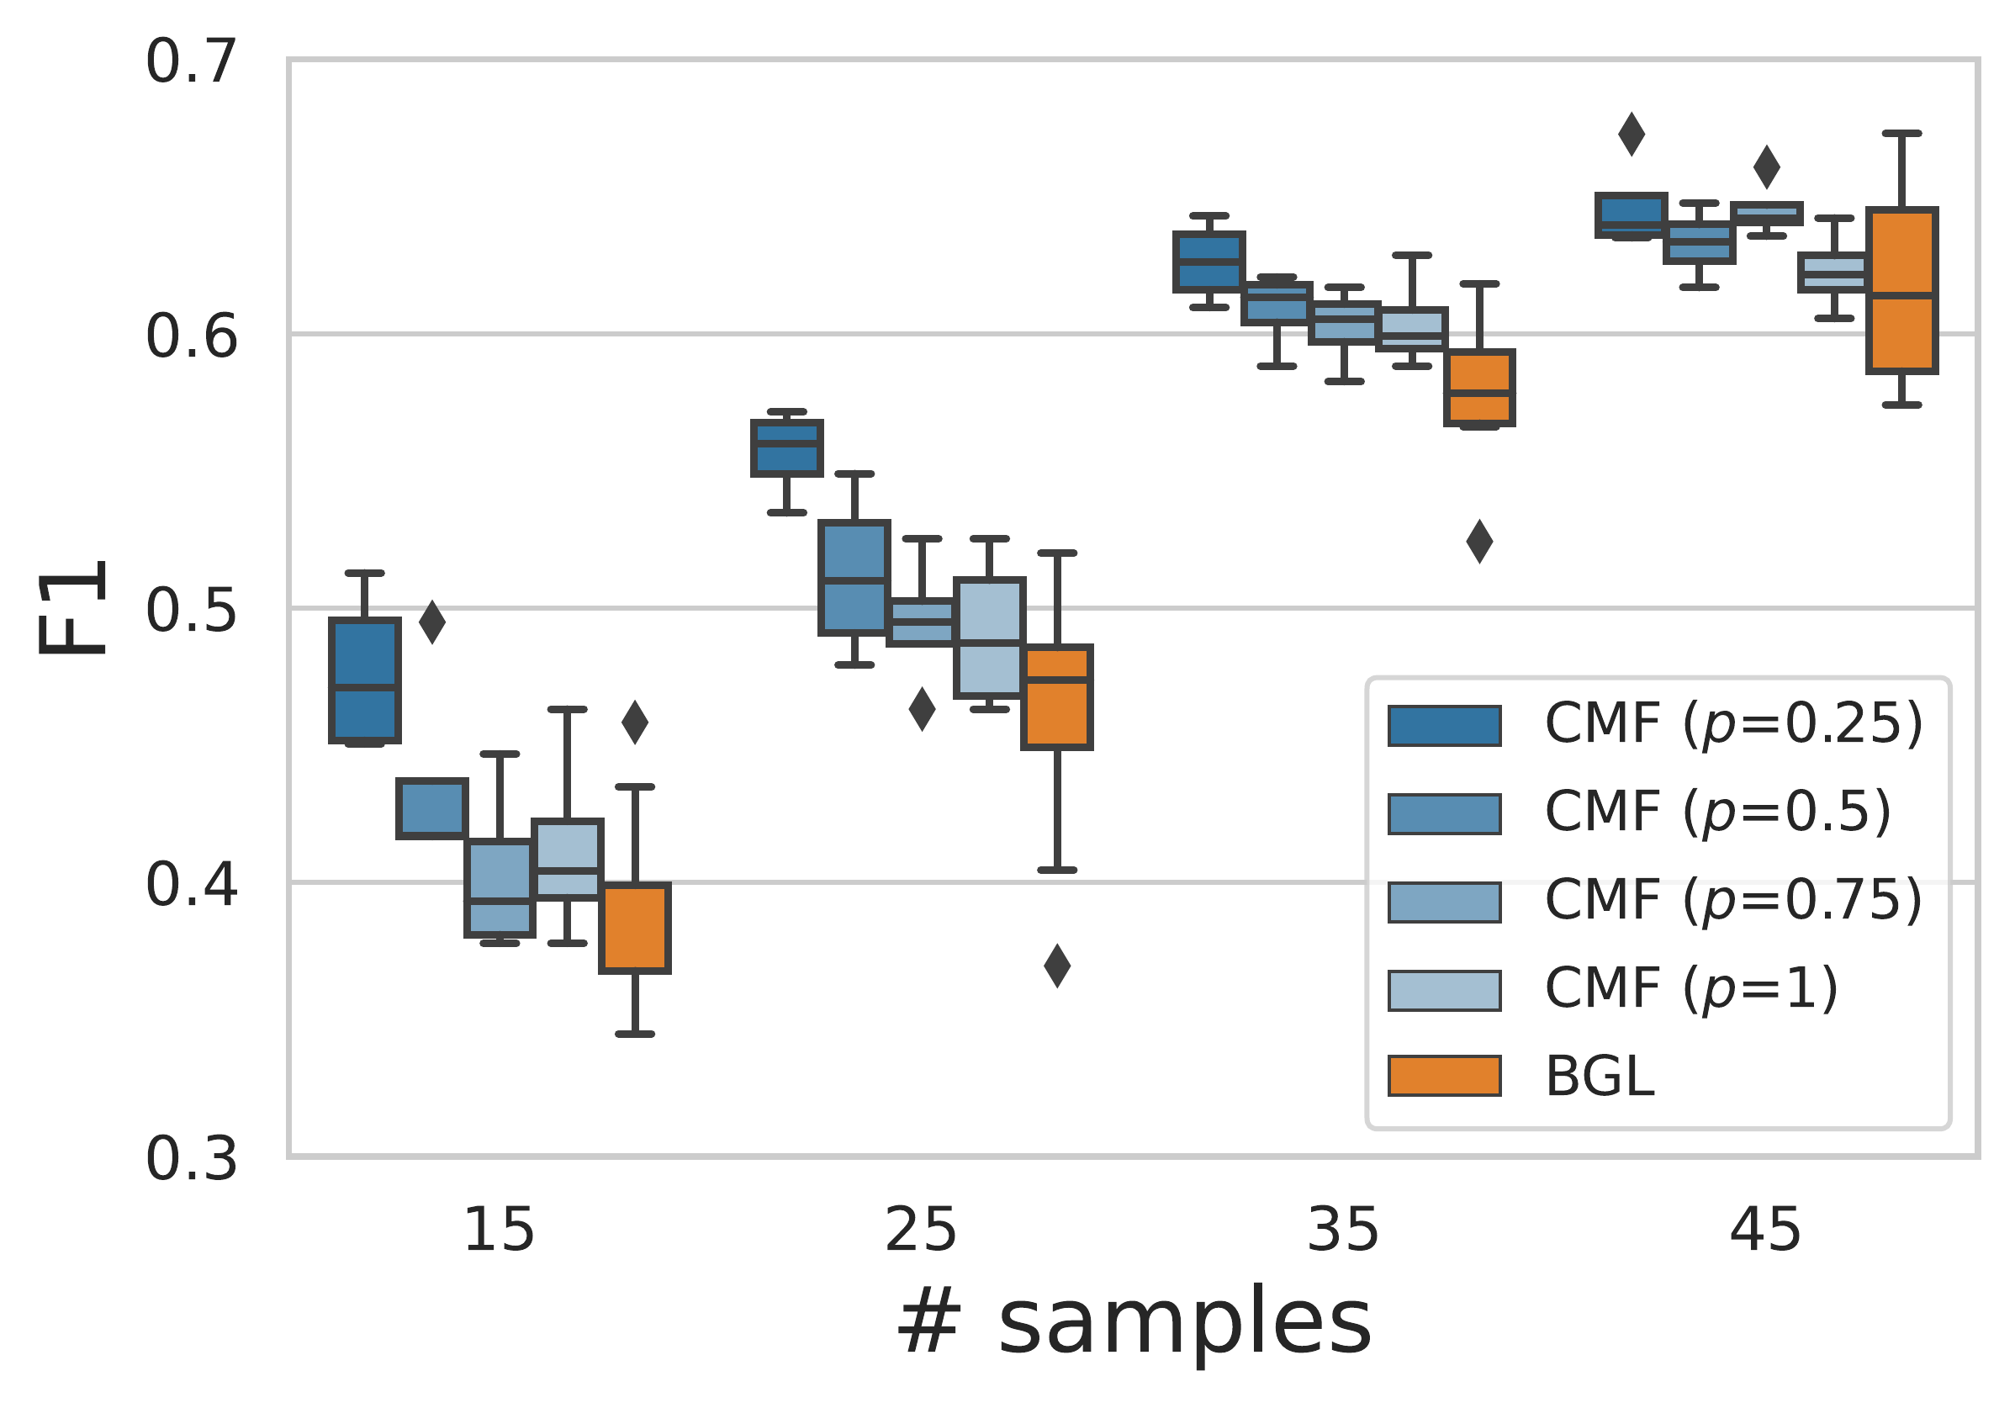
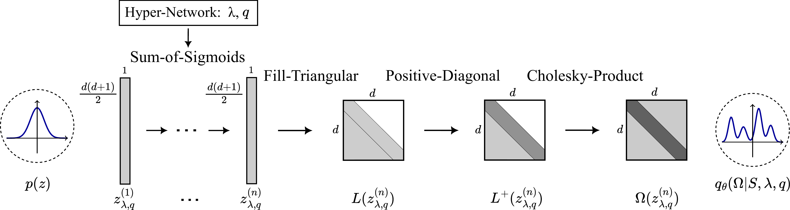
Conditional Matrix Flows for Gaussian Graphical Models
Marcello Massimo Negri¹, Fabricio Arend Torres¹, Volker Roth¹
¹ University of Basel
Problem
Method
Key Results
Gaussian Graphical Models recover conditional independence by sparsifying the precision matrix Ω — a zero entry means two variables are conditionally independent. The ideal sub-ℓ₁ (q<1) penalties are highly non-convex, so methods retreat to the convex ℓ₁ norm and pay with over-shrinkage.
SPD by construction: a base vector flows through Sum-of-Sigmoids → Fill-Triangular → Positive-Diagonal → Cholesky-product Ω=LL⊤.
A hypernetwork conditions on (λ, q) under a generalized-Normal prior — Lasso (q=1), Ridge (q=2), sub-ℓ₁ (q<1); log p(S|λ,q) is free and annealing T→0 gives the frequentist path.
In high dimensions (d>n) the sample covariance is singular — Ω cannot be inverted, and must be estimated under sparsity.
Motivation
Frequentist GLasso traces the whole ℓ₁ solution path over λ — but returns point estimates only, no posterior.
Bayesian GLasso gives a full posterior + marginal likelihood — but Gibbs samplers mix poorly and must be re-run for every λ.
Fig 4. F1 edge recovery vs. # samples: CMF (q={0.25,…,1}) vs. Bayesian GLasso.
Mean-field VI can't help — it assumes the very independence a GGM models; we need a family that respects dependence and flexes across λ and q.
Headline Numbers
Fig 1. Architecture of the Conditional Matrix Flow (CMF): light grey = unconstrained, dark grey = positive, white = zeros.
~350×
0.052
MSE vs. frequentist path
faster sampling vs. Gibbs (single GPU)
λ*=3.52
CMF selection (GLasso 3.36)
Contribution
Dataset / Benchmark
190
patients · 312 genes
≈2000 vs. 5.6 samples/s
FIRST
Synthetic d=15 (toy)
d=30, n∈{15,25,35,45}
10 ground-truth Ω
The first unified framework for the whole ℓ_{q} pseudo-norm family — no surrogate penalties.
190 patients
6 clinical + 312 genes
Takeaway
A matrix-variate normalizing flow over symmetric positive-definite matrices, conditioned on both λ and q.
Synthetic sparse precision matrices (Scikit-learn): toy d=15 for posteriors/paths, and d=30 edge recovery over 10 ground-truth Ω.
One conditional normalizing flow over positive-definite matrices unifies Bayesian and frequentist sparse GGM inference for every λ and every ℓ_{q} pseudo-norm — including the non-convex sub-ℓ₁ regime, where curbing over-shrinkage makes edge recovery win precisely where it is hardest.
One model gives the posterior for any (λ, q), the marginal likelihood for selection, and the frequentist path via annealing — the first to span the full ℓ_{q} family.
Real colorectal-cancer cohort — n=190 patients; the flow models only the query sub-blocks Ω₁₁, Ω₁₂, never the full matrix.

