Slide 1



NeurIPS 2023 · UNIVERSITY OF BASEL
Conditional Matrix Flows for
Gaussian Graphical Models
Code
Paper
One matrix normalizing flow for the whole family of sparse precision models.
Marcello Massimo Negri · Fabricio Arend Torres · Volker Roth
A SINGLE TRAINED FLOW GIVES
Bayesian posterior
Marginal likelihood
Frequentist path
for every λ and every l-q norm
for model selection over λ
via simulated annealing
Conditional Matrix Flows for Gaussian Graphical Models · NeurIPS 2023
01 / 08

Slide 2
THE PROBLEM
Sparse Precision Estimation Is Hard
A zero in the precision matrix means conditional independence, so a sparse precision matrix recovers the network.
1
Precision matrix Θ
2
The ideal: l₀ penalty
3
The retreat to l₁
‖Θ‖₀
Sub-l₁ norms (q < 1)
= 0
approximate l₀ well, but are
no edge
Counts the non-zero edges.
non-convex & hard to optimize.
So most methods fall back to
Exactly the sparsity we want,
the convex l₁ norm, which
Θᵢⱼ = 0 ⇒ i ⊥ j | rest
but the objective is
over-shrinks the estimate
combinatorial & intractable.
Sparse Θ = the conditional-
Worst when variables
independence network itself.
outnumber samples (d > n).
Conditional Matrix Flows for Gaussian Graphical Models · NeurIPS 2023
02 / 08

Slide 3
MOTIVATION
Two Camps, One Missing Piece
Frequentist GLasso
Bayesian GLasso
Variational inference
Traces the whole solution
Full posterior + marginal
Turns sampling into
path as λ varies.
likelihood for selection.
optimization.
But: point estimates only.
But: Gibbs mixes poorly,
But: mean-field assumes
restarts for every λ.
independence — what we seek.
THE GOAL
A variational family that respects dependence
and flexes across both λ and the norm q.
Conditional Matrix Flows for Gaussian Graphical Models · NeurIPS 2023
03 / 08

Slide 4
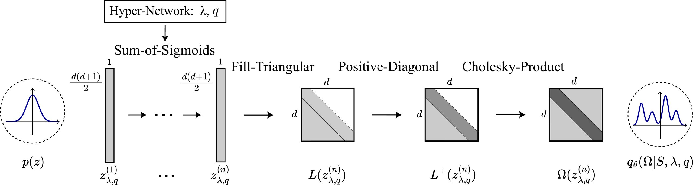
METHOD
The Conditional Matrix Flow (CMF)
Built on Cholesky
Any PD matrix = L Lᵀ,
so a d-dim precision
matrix needs only
d(d+1)/2 numbers.
The flow pipeline
Conditioning & training
One prior,
many norms
base vector → Sum-of-Sigmoids layers
Hypernetwork feeds in λ and q.
→ reshape to lower-triangular L
Loss = KL to the unnormalized
q = 2 · Ridge
→ softplus on the diagonal
posterior (generalized-Normal prior).
q = 1 · Lasso
→ Cholesky product L Lᵀ
Marginal likelihood falls out
Always a valid PD matrix, cheap Jacobian.
for free → model selection.
q < 1 · sub-l₁
Conditional Matrix Flows for Gaussian Graphical Models · NeurIPS 2023
04 / 08

Slide 5
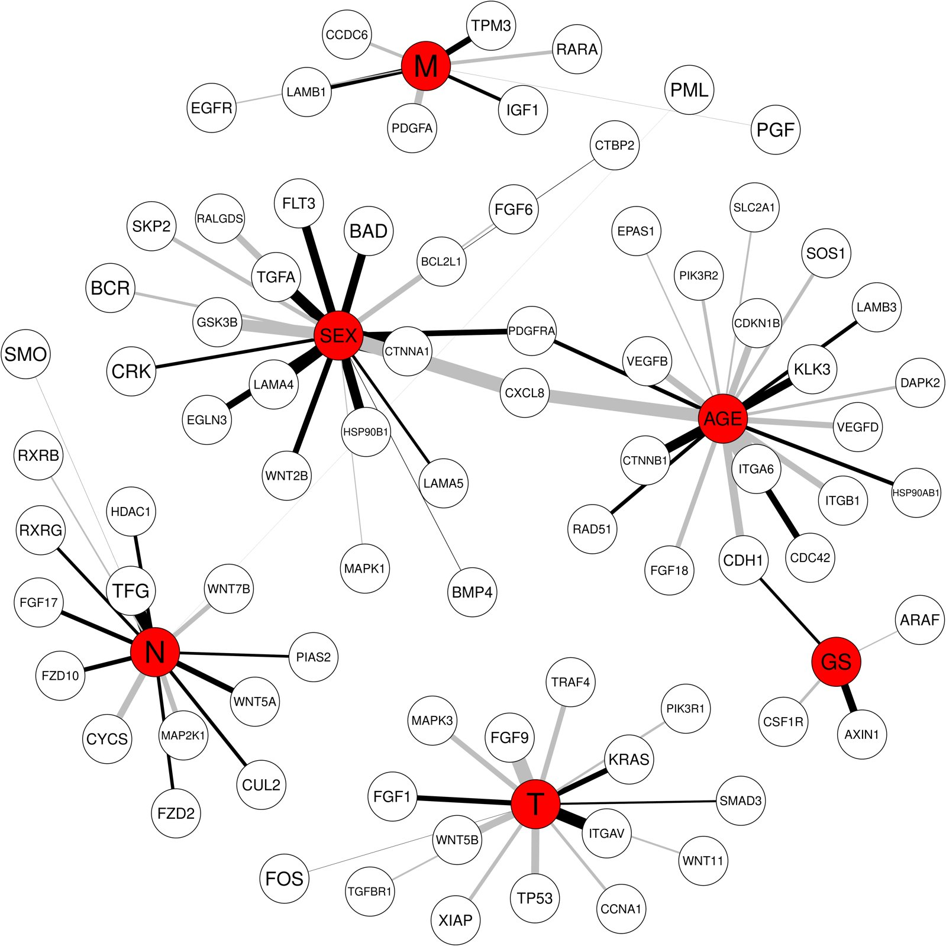
DATA & BENCHMARKS
From Synthetic Graphs to Real Cancer Data
The model is tested on two data types: controlled synthetic graphs and a real biomedical network.
1 · Synthetic (Scikit-learn)
2 · Real colorectal cancer
A 15×15 example to visualize
6 clinical variables and
posteriors and solution paths.
312 gene measurements.
d = 30, with n = 15, 25, 35, 45
190 fully-measured patients
samples for edge recovery.
(p53 status removed).
Averaged over 10 ground-truth
Infers only the relevant
precision matrices.
sub-blocks of Θ, not the
Inferred CMF network
full expensive matrix.
Few samples relative to dimension — the hard regime.
Smaller q yields sparser, cleaner clinical-gene structure.
Conditional Matrix Flows for Gaussian Graphical Models · NeurIPS 2023
05 / 08

Slide 6
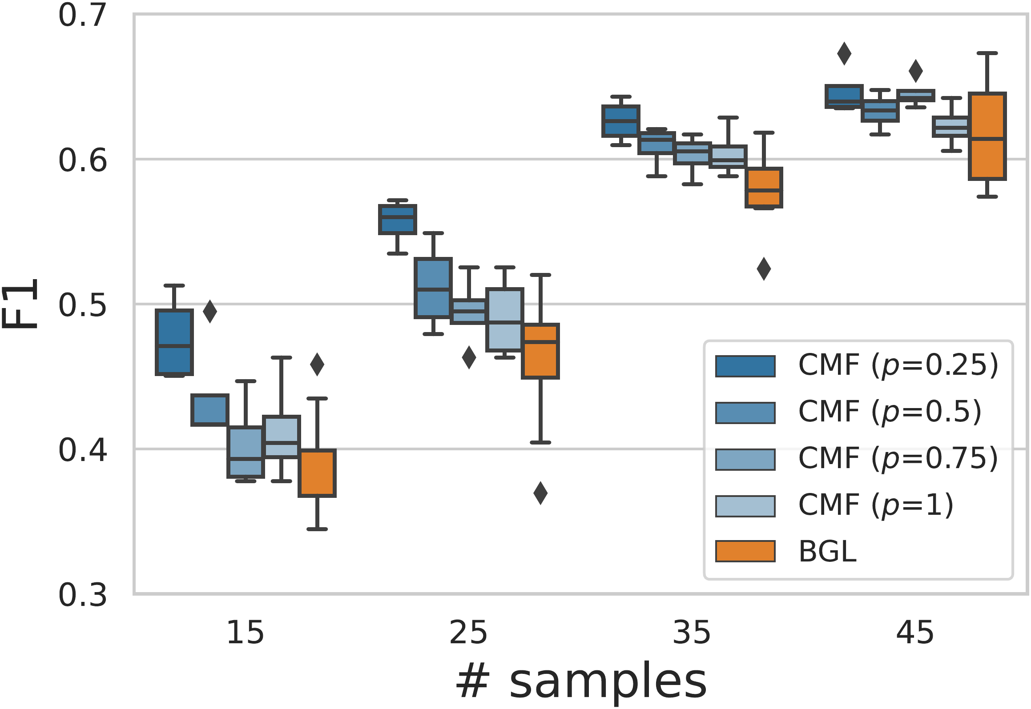
KEY RESULT
One Model Does the Work of Many
One trained flow reconstructs the frequentist path
Bayesian model selection picks
MSE = 0.052
λ = 3.52
agreeing with cross-validated GLasso λ = 3.36.
F1 edge recovery vs. samples
vs. frequentist competitors
Against surrogate l₀ penalties,
the CMF at q = 0.25 wins across
all sample sizes.
n = 15
most decisive margin
when samples are fewest
Scarce samples: sub-l₁ norms clearly beat BGL; the gain grows as q → 0.
Conditional Matrix Flows for Gaussian Graphical Models · NeurIPS 2023
06 / 08

Slide 7
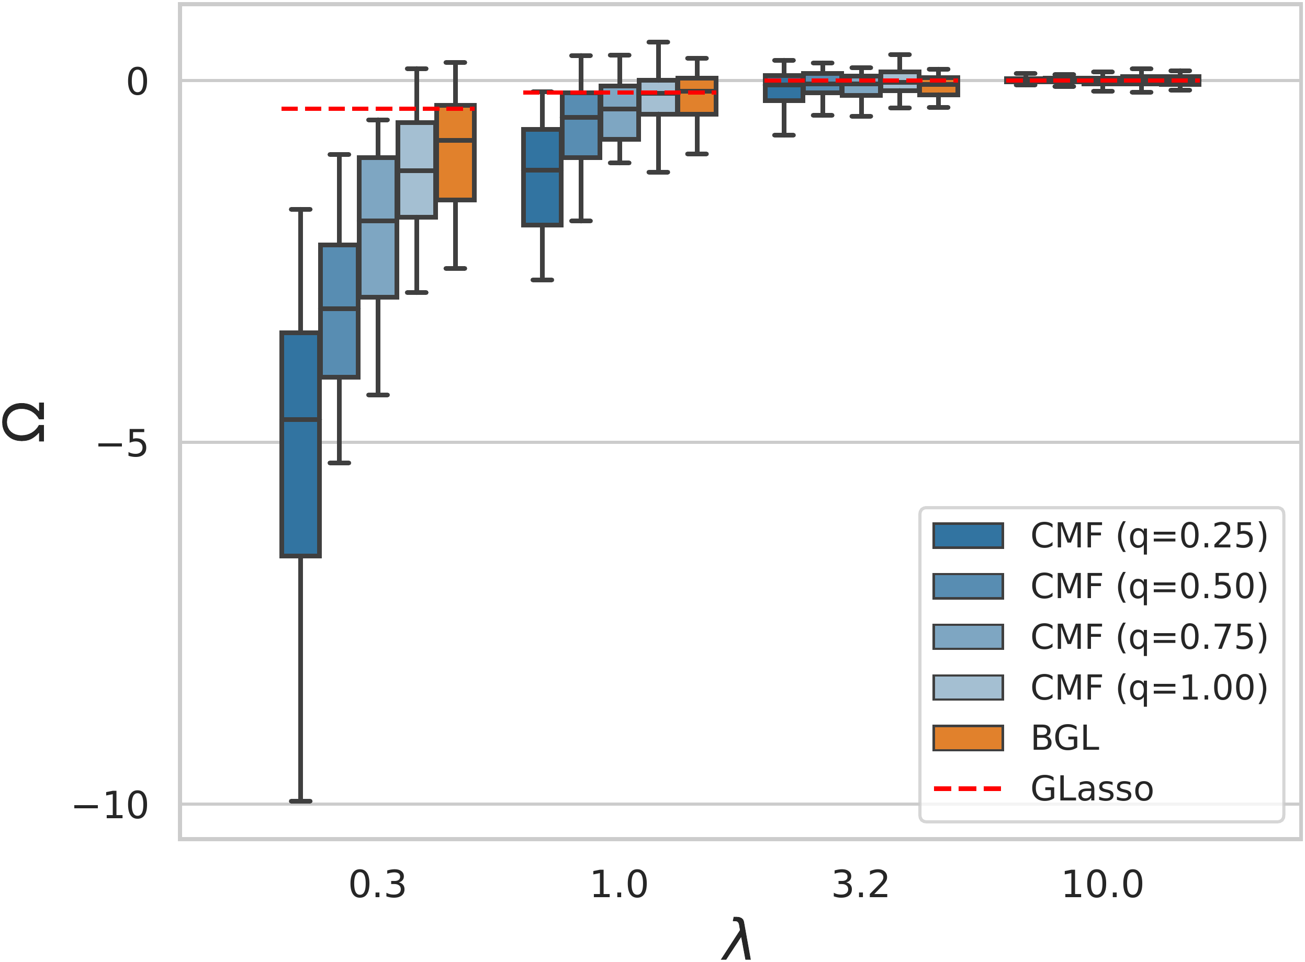
ABLATION STUDY
Two Knobs: the Norm q and the Temperature
The key study varies the pseudo-norm exponent q while holding everything else fixed.
Credible intervals across q
Keeping a true edge
At λ = 0.3, the 95% credible interval
excludes zero for q = 0.25, 0.5, 0.75.
The BGL at q = 1 still includes zero
— and would drop the edge.
Second knob: temperature
T = 1
→
T → 0
Bayesian (= BGL)
frequentist MAP path
Smaller q pulls the posterior median less toward zero.
One trained flow smoothly spans the whole family.
Conditional Matrix Flows for Gaussian Graphical Models · NeurIPS 2023
07 / 08

Slide 8
TAKEAWAY
One Flow Replaces a Toolbox
A single, well-designed normalizing flow
can replace an entire toolbox.
A clean unification
Why it matters
Built directly on positive-definite matrices,
Better edges
conditioned on both λ and the norm exponent q:
Bayesian posteriors
sub-l₁ fights over-shrinkage exactly
in the low-sample regime.
Marginal-likelihood model selection
100s× faster
The frequentist solution path
~2000 samples/s on one GPU vs.
... for every λ and every l-q norm, including the sub-l₁ region.
~5.5/s for the Gibbs sampler.
Conditional Matrix Flows for Gaussian Graphical Models · NeurIPS 2023 · arxiv.org/abs/2306.07255
08 / 08

