Slide 1





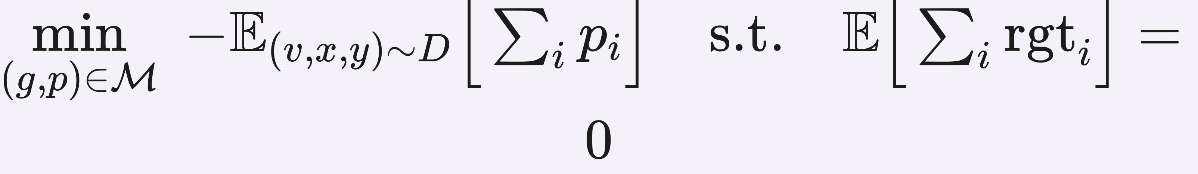
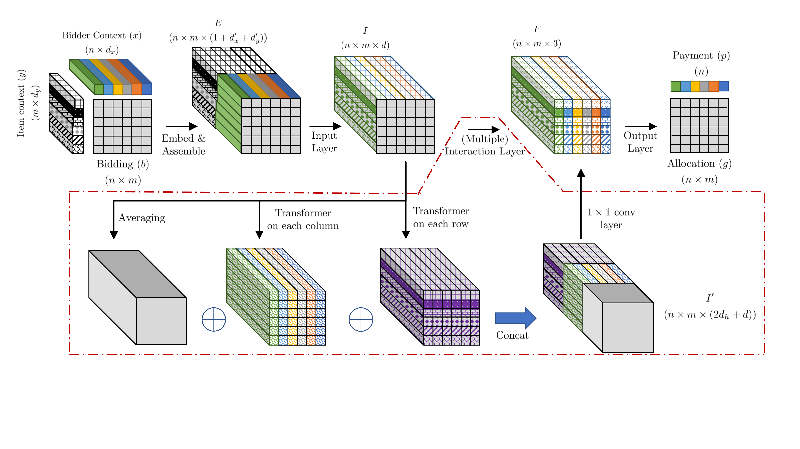
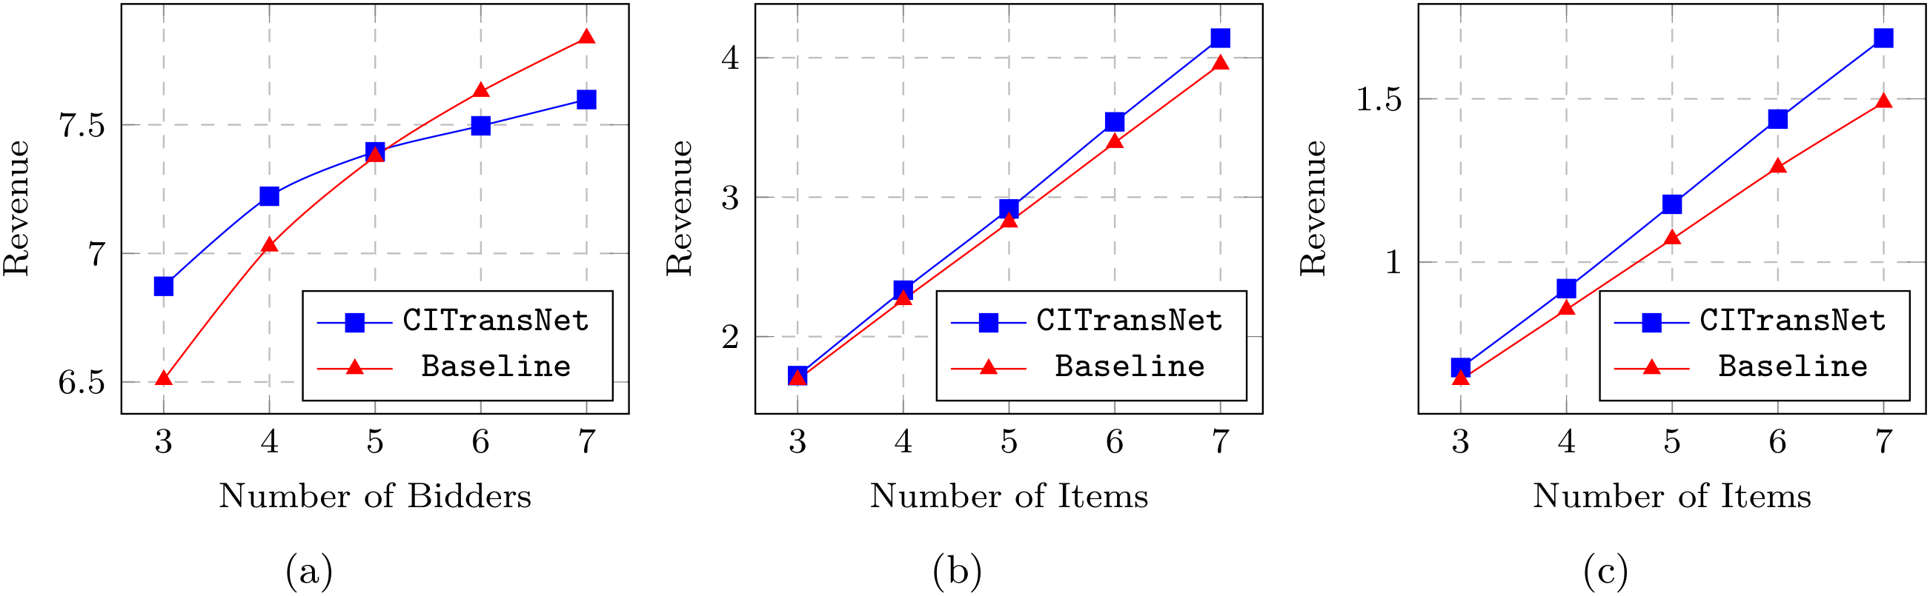


A Context-Integrated Transformer-Based Neural Network for Auction Design
Zhijian Duan¹, Jingwu Tang¹, Yutong Yin¹, Zhe Feng², Xiang Yan³, Manzil Zaheer⁴, Xiaotie Deng^{1†}
¹ Peking University ² Google Research ³ Shanghai Jiao Tong University ⁴ Google DeepMind
Problem
Method
Benchmark
Ablation Study
Designing an incentive-compatible auction that maximizes the seller's expected revenue is a central open problem.
Embed & assemble. Bidder- and item-contexts are embedded and stacked with the bids b into a per-bidder-item representation.
9 synthetic settings. Single-item A–C (Myerson-optimal) and multi-item D–I, up to 5×10.
Both context and the transformer layers are needed — removing either lowers revenue in every setting.
Interaction layers. Each mixes a global average with a transformer over every column and every row — modelling mutual influence while staying permutation-equivariant.
Discrete or continuous (R¹⁰) contexts; each result averaged over 5 runs.
Even the two-bidder, two-item case is still unsolved after four decades.
A–C single-item
D–I multi-item
Headline Numbers
Output layer. Emits allocation g and payment p; IR guaranteed by architecture, DSIC enforced as a regret constraint.
Motivation
Key Results
+9.9%
6 / 6
multi-item wins
Revenue gain, Setting G (2×5)
0.593
vs 0.594 optimal
Real markets (e.g. e-commerce ad slots) carry rich public context on bidders and items, and the auction size changes every round.
SETTING
ITEM-WISE MYERSON
CITRANSNET
5×10
A (single, opt 0.594)
—
0.593
largest auction
maximize expected revenue subject to zero expected regret (incentive compatibility / DSIC)
Prior neural designers (RegretNet, EquivariantNet) fix the auction scale or force symmetry, so they cannot exploit context.
E (3×10)
6.509
6.872
Takeaway
G (2×5, cont.)
1.071
1.177
Context yields near-optimal, asymmetric, incentive-compatible auctions that generalize to auctions larger than any seen in training.
Ignoring bidder/item identity, they also miss the asymmetric mechanisms that context demands.
Out-of-setting generalization: trained at one auction size, CITransNet keeps beating the Item-wise Myerson baseline as the number of bidders (a) or items (b, c) grows.
Scan to
Read
REQUIRES
Paper
arxiv.org/abs/2201.1
2489
An architecture that ingests features as context and handles a varying number of bidders and items, without forcing symmetry.
CITransNet embeds bidder- and item-contexts, assembles them with the bids, and passes them through transformer-based interaction layers (averaging ⊕ column-transformer ⊕ row-transformer) to produce the allocation and payment.
SO WHAT → Matches the Myerson optimum where known; wins where none exists.
Code
github.com/zjduan/C
ITransNet
Paper
Code

