Slide 1





ICML 2022
NEURAL AUCTION DESIGN
CITransNet
A Context-Integrated Transformer-Based Neural Network
for Auction Design
Peking University
Zhijian Duan · Jingwu Tang · Yutong Yin · Zhe Feng · Xiang Yan · Manzil Zaheer · Xiaotie Deng
Peking University · Google Research · Shanghai Jiao Tong University · Google DeepMind
REVENUE-MAXIMIZING
ASYMMETRIC
SIZE-GENERALIZING
Incentive-compatible
Not forced symmetric
Transfers across scales
Code
Paper
arXiv:2201.12489

Slide 2
02 · PROBLEM
2 / 10
A four-decade open problem
THE GOAL
Myerson, 1981
✓
Design one auction that
Single-item optimal auction — solved.
maximizes revenue
Multi-item, still open
and stays truthful.
?
Unsolved even for 2 bidders × 2 items.
Incentive-compatible (IC): no bidder
ever gains by lying about valuations.
PRIOR DEEP METHODS
Handle only a fixed number of
Revenue is the seller's expected
bidders and items, or force the
payment across the auction.
auction to be symmetric.

Slide 3
03 · MOTIVATION
3 / 10
Real auctions are richer
The simple settings prior work assumed do not match markets like e-commerce ads.
E-COMMERCE ADVERTISING
WHAT WE NEED
Many × Many
An architecture that
Many bidders compete for many ad slots.
▸ absorbs public
Public features
features as context
Each bidder and item carries descriptive context.
▸ handles varying
Varying size
auction sizes
A different number of participants every round.

Slide 4
04 · CONTRIBUTION
4 / 10
Two contributions
A framework + a network
01
02
A contextual learning
CITransNet, the network
framework
▸ Permutation-equivariant over
Extends the RegretNet framework to
both bids and contexts
the contextual setting: optimal design
▸ Not restricted to symmetric
as constrained optimization.
auctions
Sample-complexity bound proved
▸ Parameter count independent
of auction scale

Slide 5
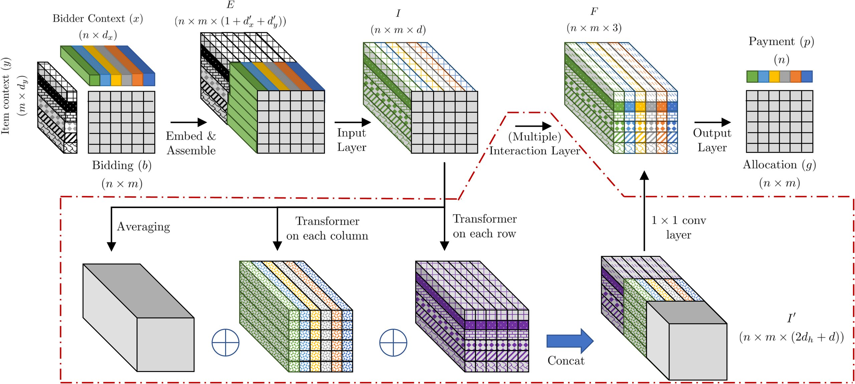
05 · METHOD
5 / 10
Inside CITransNet
THREE INPUTS
▸ Bidding profile b
▸ Bidder-contexts x
▸ Item-contexts y
OUTPUT LAYER
▸ Allocation probabilities
TRANSFORMER INTERACTION LAYERS
Figure 1 — CITransNet schematic
▸ Payments
Zero-regret enforced in training
Global average, row, and column transformers — permutation-equivariant.

Slide 6
06 · DATASET / BENCHMARK
6 / 10
Nine synthetic settings
EVALUATION
SANITY CHECK
THE HARD CASES
9
Single-item (3)
Multi-item (6)
A
B
C
D
E
F
G
H
I
synthetic
auction settings
Up to
Optimal solutions known
analytically from Myerson's
5 × 10
Every number is
theory — used to verify the
averaged over
learned mechanism is right.
bidders × items — the largest
5 runs
size studied in the literature.

Slide 7
07 · KEY RESULT
7 / 10
It works — in two parts
Known optima, then hard cases
PART 1 · SINGLE-ITEM
PART 2 · MULTI-ITEM
Recovers the known optimum
Beats the strong baseline
0.593
0.594
6/6
+10%
CITransNet revenue
Myerson-optimal
revenue gain, peak
wins vs Item-wise Myerson
Regret < 0.001 — genuinely near-optimal.
Also outperforms the context-integrated
Context-blind baselines fall short
versions of RegretNet and EquivariantNet,
where no analytical solution exists.
RegretNet & EquivariantNet miss the optimum —
integrating context is essential.

Slide 8
08 · ABLATION STUDY
8 / 10
What actually drives the gain?
SWAP THE LAYERS
THE FINDING
Keep the context, replace only
Both earn less revenue
CITransNet's transformer layers:
everywhere.
CIRegretNet
Transformer → RegretNet's
Across every multi-item setting — which
fully-connected layers
pins the improvement on the transformer.
CIEquivariantNet
AND GOING FURTHER
Transformer → EquivariantNet's
Removing context altogether
equivariant layers
hurts even the easy single-item
settings.

Slide 9
09 · HEADLINE NUMBERS
9 / 10
The numbers
A few numbers capture the impact — revenue is higher and regret stays tiny.
SINGLE-ITEM (A)
MULTI-ITEM · 3 × 10 (E)
CONTINUOUS CONTEXT (G)
0.593
6.872
1.177
vs optimal 0.594
vs Item-wise Myerson 6.509
vs 1.071 baseline
Essentially matches Myerson.
≈ +5.6%
≈ +9.9%
6 / 6
multi-item settings won
Regret ≤ 0.003 everywhere
against the strong Item-wise Myerson baseline
incentive compatibility essentially preserved

Slide 10
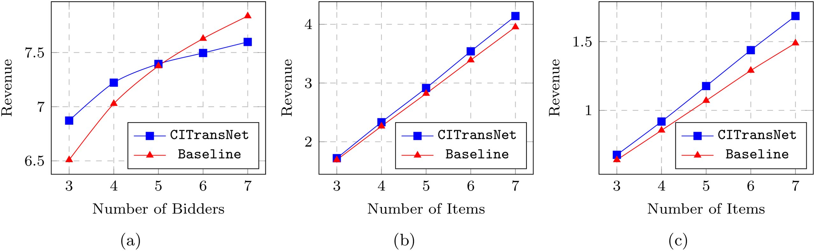
10 · TAKEAWAY
10 / 10
Context, as a
SIZE-INDEPENDENT
first-class input,
One trained model
transfers to unseen sizes
unlocks better
learned auctions.
CITransNet LEARNS MECHANISMS THAT ARE
Near-optimal · Asymmetric · Incentive-compatible
Figure 2 — out-of-setting generalization:
trained at one scale, evaluated at another.
CITransNet
github.com/zjduan/CITransNet
Context-Integrated Transformer for Auction Design · ICML 2022
arXiv:2201.12489

