Slide 1



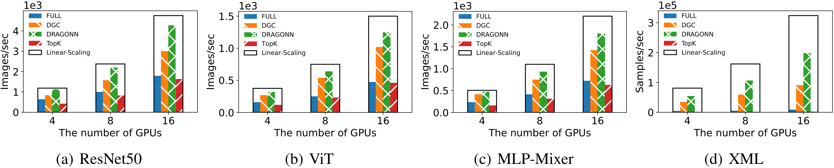
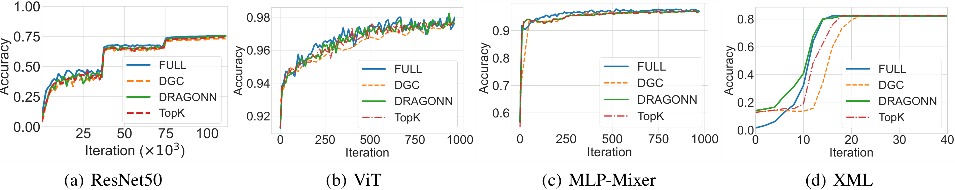
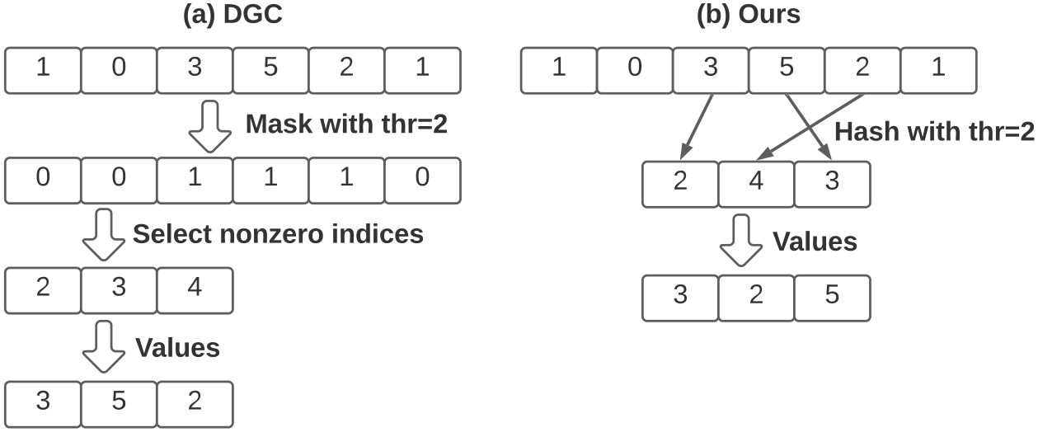
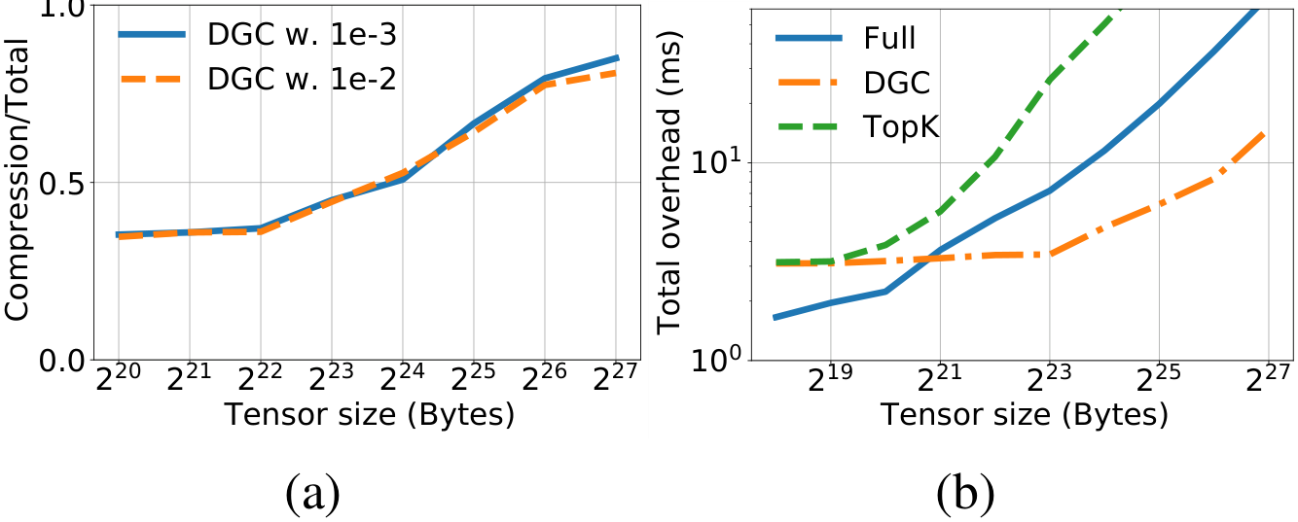
DRAGONN: Distributed Randomized Approximate
Gradients of Neural Networks
Zhuang Wang¹, Zhaozhuo Xu¹, Xinyu Crystal Wu¹, Anshumali Shrivastava¹ ², T. S. Eugene Ng¹
¹Rice University · ²ThirdAI Corp
Problem
Method
Key Results
In data-parallel distributed training, synchronizing gradients across
GPUs is the dominant efficiency cost. Gradient sparsification
(GS) transmits only a small subset of gradients to cut this traffic,
but the time spent compressing gradients has grown so large it
cancels the communication savings.
DRAGONN pre-allocates a compressed buffer and hashes
each above-threshold gradient's index directly into a slot, with
no prefix-sum scan — collisions simply overwrite, and empty
slots map to zero.
1.42×
2.15×
1.72×
3.52×
ResNet50
ViT
MLP-Mixer
XML
GPU writes are atomic, so many threads hash and write in
parallel with no ordering dependency between them.
Above 2²⁴ B tensors, compression overhead exceeds
communication; for small tensors GS can be slower than
sending everything. Compression is the new bottleneck.
Training speed vs #GPUs: DRAGONN tracks linear scaling.
direct hashing replaces exact nonzero-index selection
Motivation
SOTA methods like DGC extract approximate top-k gradients,
yet place them with exact parallel prefix sum — a sequential
O(log d) scan over the whole tensor.
Convergence unchanged: DRAGONN matches FULL's accuracy.
An exact–approximate mismatch: only an approximate set is
needed, so an exact selection algorithm is wasted overhead.
Headline Numbers
3.52×
70%
less compression time
7×
more memory accesses than the lower bound
DGC uses prefix sum; DRAGONN writes indices by direct hashing.
faster training vs DGC
35.9×
vs full sync
at equal convergence · up to 35.9×
=FULL
test accuracy
Dataset / Benchmark
Measured on 16 V100 GPUs at equal convergence.
Four models spanning vision + recommendation:
ResNet50/ImageNet, ViT & MLP-Mixer/Cifar10 (ImageNet-21k
pretrain), XML/Wiki10-31K.
Takeaway
Because gradient sparsification only ever needs approximate top-
k gradients, replacing exact parallel-prefix-sum selection with
direct randomized hashing removes the compression bottleneck
— now embarrassingly parallel.
Testbed: 16× V100-32GB (2×8 GPUs), 25 Gbps network;
memory-momentum error feedback preserves accuracy for all
GS methods.
ResNet50
ViT
MLP-Mixer
XML
16 V100 GPUs
25 Gbps
Tensor selection + sparse decoding make GS finally pay off
at scale — without hurting accuracy.
Compression overhead dominates total overhead as tensor size grows
(DGC / TopK vs Full).
Horovod / NCCL

