Slide 1



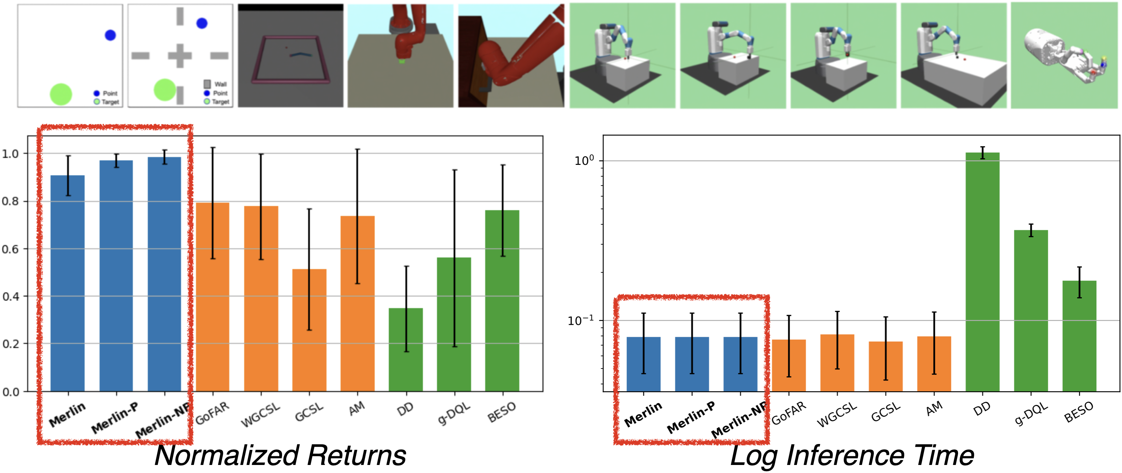
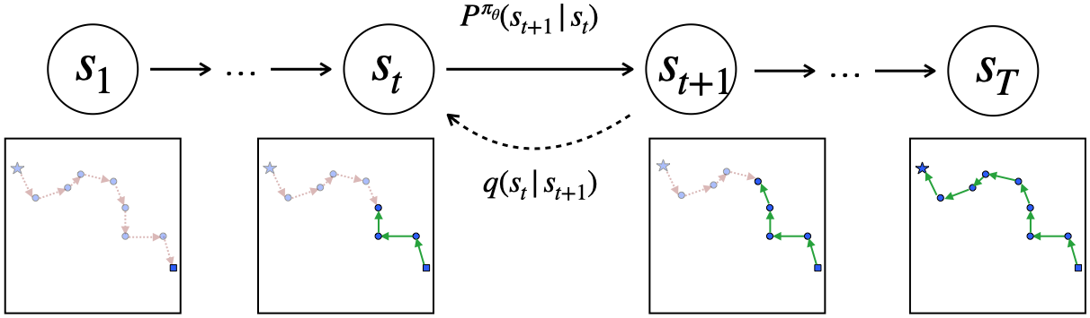
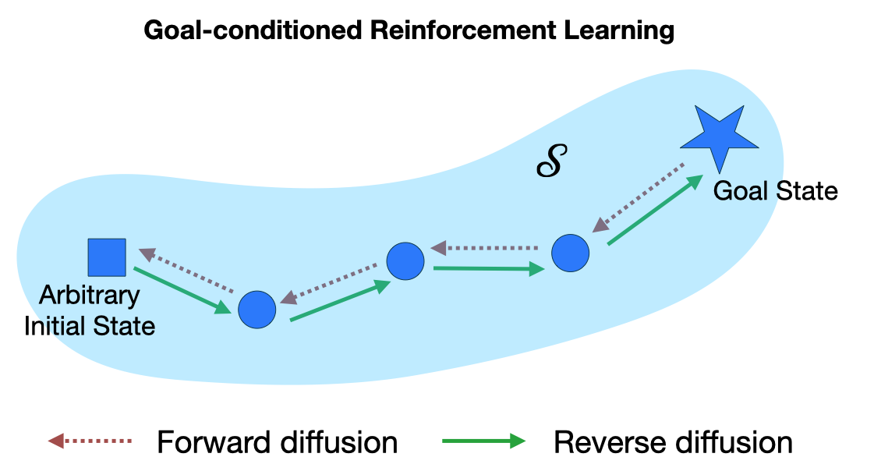
Learning to Reach Goals via Diffusion
Vineet Jain^{1,2} · Siamak Ravanbakhsh^{1,2}
¹McGill University ²Mila - Quebec AI Institute
Problem
Method
Key Results
Offline goal-conditioned RL must reach arbitrary goals from a
fixed dataset under sparse binary rewards. Most methods lean on
a learned value function, but here it is fragile: out-of-distribution
actions corrupt the estimates, and these errors compound over
time until the policy diverges.
Read an offline trajectory backwards from its goal; a forward
diffusion transform pushes states progressively away from the
goal, like adding noise.
Merlin-NP: best overall rank, ~10× faster.
Train a goal-conditioned policy to reverse the drift. At inference it
needs only a single denoising step per environment step.
No reliable value function ⇒ offline goal-reaching stays
unstable.
Three forward processes: a fixed rule (Merlin), a learned
parametric model (Merlin-P), and Merlin-NP, which stitches
nearest neighbors in a learned latent space.
Motivation
Diffusion models learn a target distribution without any value
function, by reversing a process that gradually turns clean data
into pure noise.
Returns (left) and log inference time (right): Merlin variants (blue) beat
baselines while running ~10× faster.
Goal-conditioned behavior cloning maximizes a lower bound on the goal log-likelihood, with no value function.
Cast goal states as that data distribution: build trajectories that
walk away from goals, then learn to reverse them, directly
analogous to learning the score.
Headline Numbers
~10×
1.7
avg rank, state (of 10)
Reversing a goal-departing walk sidesteps value estimation
entirely.
Faster end-to-end training & inference
than other diffusion-based reinforcement
learning methods
1.25
avg rank, pixel (of 10)
Forward (red) pushes states away from the goal (star); the learned
reverse policy (green) walks them back, shown on 2D navigation.
Just one denoising step per environment step, versus
many for prior diffusion policies
10
tasks · 10 seeds
Dataset / Benchmark
Takeaway
Benchmark of Yang et al. (2021): 10 control tasks, sparse
binary reward, trajectories capped at length T = 50, all averaged
over 10 seeds.
Reframing goal-conditioned RL as reverse diffusion turns goal-
reaching into simple, value-free behavior cloning that matches or
beats state of the art, far more efficiently.
Two regimes per task, expert and random, in both state and
pixel observation spaces.
SO WHAT
Diffusion in the state space, with one denoising step per
environment step, makes diffusion for RL both simple and
scalable.
PointReach
PointRooms
Reacher
SawyerReach
SawyerDoor
Reverse diffusion policy: walk away from the goal, then learn to reverse
the walk and reach it from any start.
FetchReach
FetchPush
FetchPick
FetchSlide
HandReach

