Slide 1





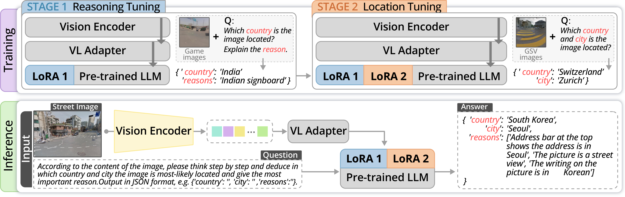
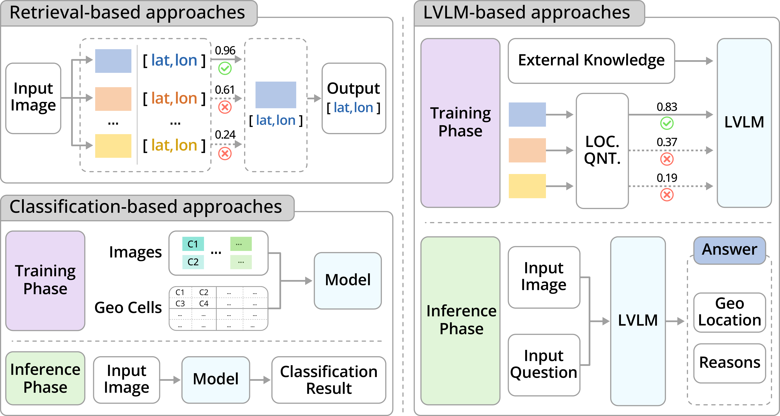
GeoReasoner: Geo-localization with Reasoning in Street Views using a Large Vision-Language
Model
Ling Li¹, Yu Ye², Yao Zhou³, Bingchuan Jiang⁴, Wei Zeng^{1,5}
¹ HKUST (Guangzhou) ² Tongji University ³ Independent Researcher ⁴ Information Engineering University ⁵ HKUST
Problem
Method
Key Results
Geo-localization models are black boxes that output a location
with no reasoning, and their training data is polluted with low-
quality images carrying no visual clues. Retrieval galleries are
costly to curate; classification ignores signboard text.
Built on Qwen-VL, fine-tuned in two stages with stacked LoRA
adapters (LoRA 1 + LoRA 2).
Method
Country F1
City F1
Reasoning tuning (3K game pairs) teaches country-level
reasoning; location tuning (70K GSV images) sharpens city-
level prediction. A locatability metric filters the data upstream.
Qwen-VL
0.7225
0.5270
StreetCLIP
0.8854
0.8543
DATA PROBLEM
+
REASONING PROBLEM
GeoReasoner
0.9033
0.8585
Tunnels, blank walls, generic vegetation — no locatable clues.
A coordinate is returned with no explanation to inspect.
+25.02% country · +38.61% city F1 over Qwen-VL
Ablation Study
Motivation
segment-area ratios × clue-relevance weights
Stage
Country F1
City F1
Large vision-language models excel at joint visual-textual
reasoning — a natural fit for interpretable geo-localization.
Qwen-VL baseline
0.7225
0.5270
+ Reasoning tuning
0.8215
0.5813
+ Location tuning
0.8766
0.8255
Online geo-games (GeoGuessr, Tuxun) hold rich human clues
no prior street-view dataset provides.
Full (both stages)
0.9033
0.8585
Location tuning drives city accuracy; reasoning tuning adds a further lift.
Headline Numbers
0.9033
0.8585
City F1
GeoReasoner's two-stage fine-tuning: reasoning tuning then location
tuning.
Country-level F1 (full GeoReasoner)
+38.61%
city vs Qwen-VL
+25.02% country and +38.61% city F1 over Qwen-VL
70K
images vs 1.1M
Dataset / Benchmark
On open Im2GPS, only 10K Flickr images rival models trained on millions.
130K+ geo-tagged GSV images from 72 cities / 48 countries,
filtered to 70K high-locatability images at threshold 0.4.
Takeaway
Curating high-locatability street views and injecting human
reasoning from geo-games lets a two-stage fine-tuned LVLM beat
prior models and explain its predictions — with a fraction of the
data. Data quality plus human reasoning knowledge substitutes for
sheer scale, pointing toward interpretable and resource-efficient
geo-localization. The locatability metric and borrowed geo-game
reasoning are the two keys.
3K reasoned text-image clue pairs mined from GeoGuessr &
Tuxun and cleaned with BERT-based NER; evaluated on 1K
held-out GSV plus Im2GPS / Im2GPS3k.
Three geo-localization paradigms: retrieval-based, classification-based,
and our LVLM-based approach with reasoning.
130K+
70K
3K
72
raw GSV
high-locatability
reasoned pairs
cities · 48 countries

