Slide 1
PHOT 301: Quantum Photonics
LECTURE 00
Michaël Barbier, Fall semester (2026-2027)

Slide 2
Course information
Instructor
Dr. Michaël Barbier
e-mail: michaelbarbier@iyte.edu.tr
Office: Z-5/B
Hours: Friday 9:00-17:00 (via appointment)
Teaching Assistants
Yağız Oyun
e-mail: yagizoyun@iyte.edu.tr
Office: Z-9/B
hours: TBA
Course Schedule
Thursday 13:30 – 15:15 Building F, lecture room D3
Thursday 15:30 – 17:15 Building F, lecture room D3

Slide 3
Contents of the Course
Wave function & Schrödinger’s equation
(Mathematical) Dirac notation
Bound states and scattering
Hydrogen atom, Multi-electron atoms
Molecules and materials
Electromagnetic-field, absorption/emission

Slide 4

Course materials
Course book
  D.J. Griffiths, Introduction to Quantum
  Mechanics, Pearson, 3rd edition
Supplementary material
  D.A.B. Miller, Quantum Mechanics for
  Scientists and Engineers, Cambridge
  C.C. Gerry and P.L. Knight, Introductory
  Quantum Optics, Cambridge, 2005

Slide 5
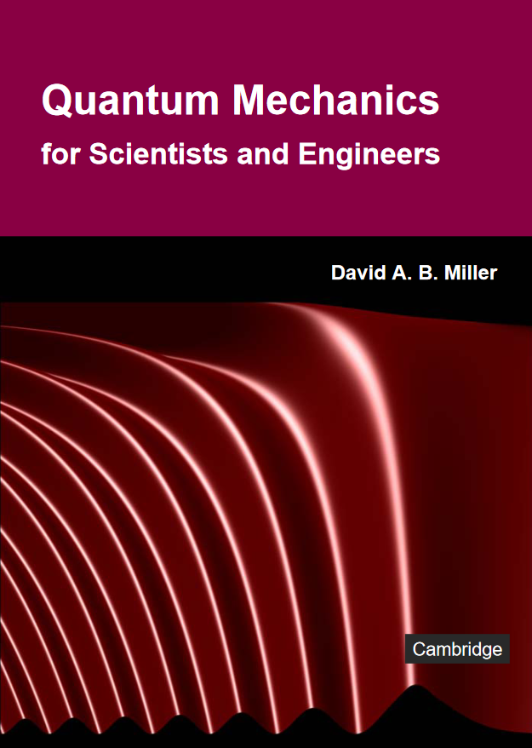
Course materials
Course book
  D.J. Griffiths, Introduction to Quantum
  Mechanics, Pearson
Supplementary material
  D.A.B. Miller, Quantum Mechanics for
  Scientists and Engineers, Cambridge
  C.C. Gerry and P.L. Knight, Introductory
  Quantum Optics, Cambridge, 2005

Slide 6
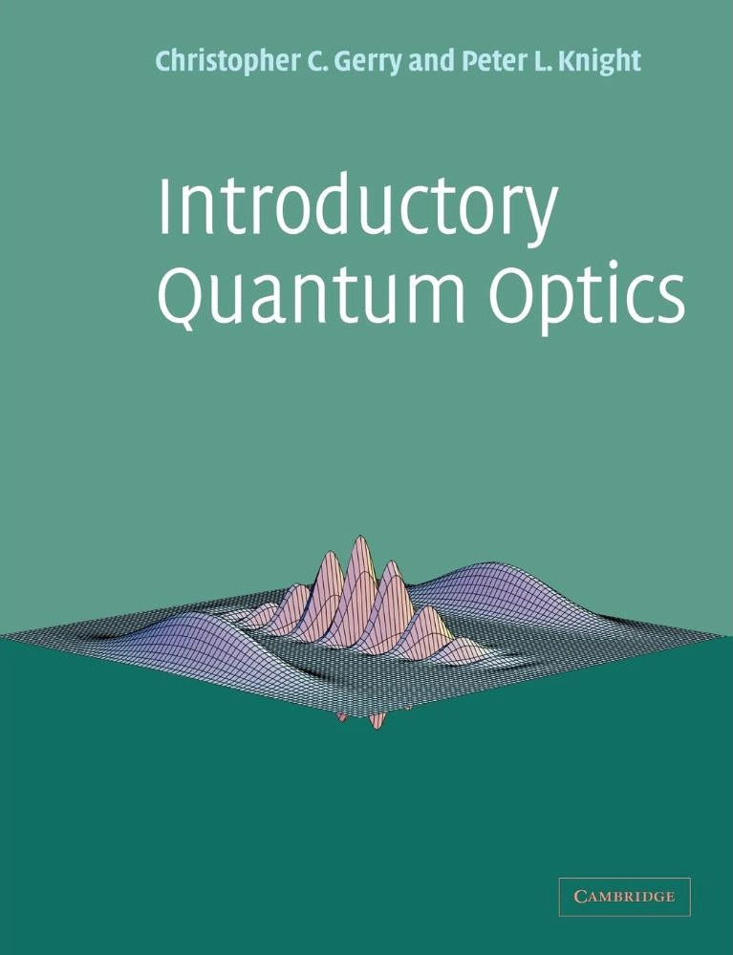
Course materials
Course book
  D.J. Griffiths, Introduction to Quantum
  Mechanics, Pearson
Supplementary material
  D.A.B. Miller, Quantum Mechanics for
  Scientists and Engineers, Cambridge
  C.C. Gerry and P.L. Knight, Introductory
  Quantum Optics, Cambridge, 2005

Slide 7
Course materials
Supplementary material
  David Miller’s webpage on quantum mechanics
  https://dabm.stanford.edu/teaching/quantum-mechanics/
  QuVis: Web site with quantum mechanics simulations
  QuTip: Python library quantum mechanical simulations
  Applet(s) by Paul Falstad for 1D quantum systems (other applets available on www.falstad.com/)

Slide 8
Overview of the course
week | Topic | Griffiths
Week 1 | Introduction & Required mathematical methods. Waves and Schrödinger's equation | Ch. 1
Week 2 | Probability, Uncertainty and Time evolution, Infinite Square well | Ch. 2
Week 3 | The Harmonic oscillator, Creation & Annihilation operators | Ch. 2
Week 4 | Free particle, 1D Bound states & Scattering/Transmission, Finite well | Ch. 2
Week 5 | Approximation methods in 1D | Ch. 3 & 7
Week 6 | Quiz 1 + Quantum mechanics formalism: Functions & operators | Ch. 3
Week 7 | Dirac formalism, Uncertainty | Ch. 3
Week 8 | Angular momentum and Hydrogen atom | Ch. 4
Week 9 | Spin | Ch. 4
Week 10 | Quiz 2 + Magnetic fields, The Pauli equation, Minimal Coupling, Zeeman Effect | Ch. 4
Week 11 | Identical particles | Ch. 5
Week 12 | Periodic structures, Band structure, Bloch functions | Ch. 5
Week 13 | Time-dependent perturbation | Ch. 7
Week 14 | Absorption, spontaneous emission, and stimulated emission | Ch. 7

Slide 9
Course syllabus and class workflow
Homeworks
Not graded, idea is to understand the topic better
You can submit solutions/ask questions, working together allowed
Quizzes (2)
2 x 20% = 40% of your grade, same style as the final but only 3 questions and you have 1 hour
Final Exam
60% of your grade, 7 theoretical open questions, Exercises are important, topics from the whole year

Slide 10
Course syllabus and class workflow
Quiz dates (tentative)
  Quiz 1: Wednesday 05.11.2025
  Quiz 2: Wednesday 03.12.2025
Final exam (all topics): date TBA

