Slide 1






$${\left|Ψ\left(x,t\right)\right|}^{2}$$
Position measurement
$$t=t_{0}$$
$$t=t_{1}$$
$$t=t_{2}$$
$$t=t_{3}$$
$$x$$

Slide 2



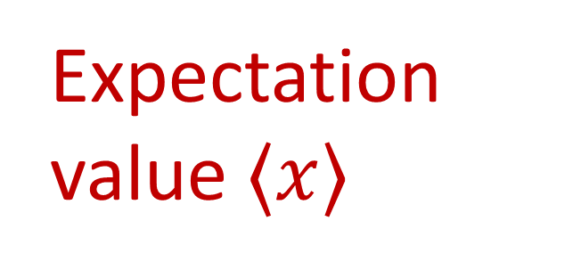
Expectation value $⟨x⟩$
$$⟨x⟩$$
$${\left|Ψ\left(x,t\right)\right|}^{2}$$
$$x$$

