Slide 1

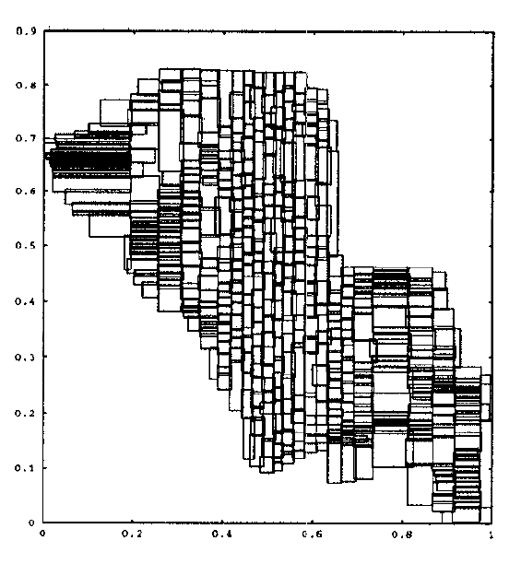
R-tree using STR
CS F211 Spring’23
Data Structures and Algorithms
GROUP 28
Ayush Gupta (2020B3A70838P)
Bhavishya Garg (2020B3A71425P)
Nitish Kumar Sahani (2020B1A70644P)
Ria Shekhawat (2020B4A71986P)
Suraj Phalod (2020B3A71959P)

Slide 2
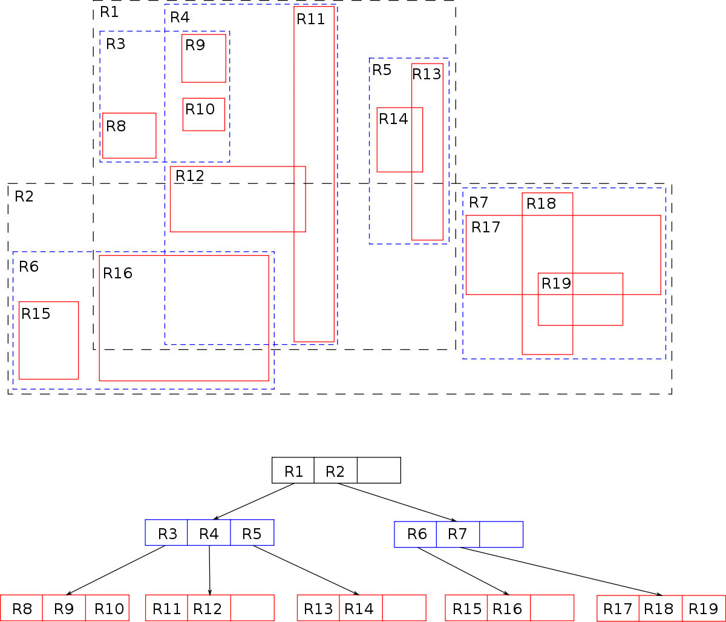
Introduction to R-Tree
A R-tree is a spatial data structure used for indexing multi-dimensional data in a way that supports efficient querying and retrieval of data based on their spatial proximity.
R-tree is a hierarchical data structure composed of a collection of nodes(Internal and Leaf Nodes) . It organizes data into a tree-like structure, where each node represents a region in the multi-dimensional space.
Each node in an R-tree has a minimum and maximum number of entries it can hold. The minimum and maximum entry limits help maintain the balance and performance of the tree.
Every entry in an R-tree corresponds to a bounding box that encloses the region occupied by the associated data object. The bounding box is defined by the minimum and maximum values of each dimension.

Slide 3
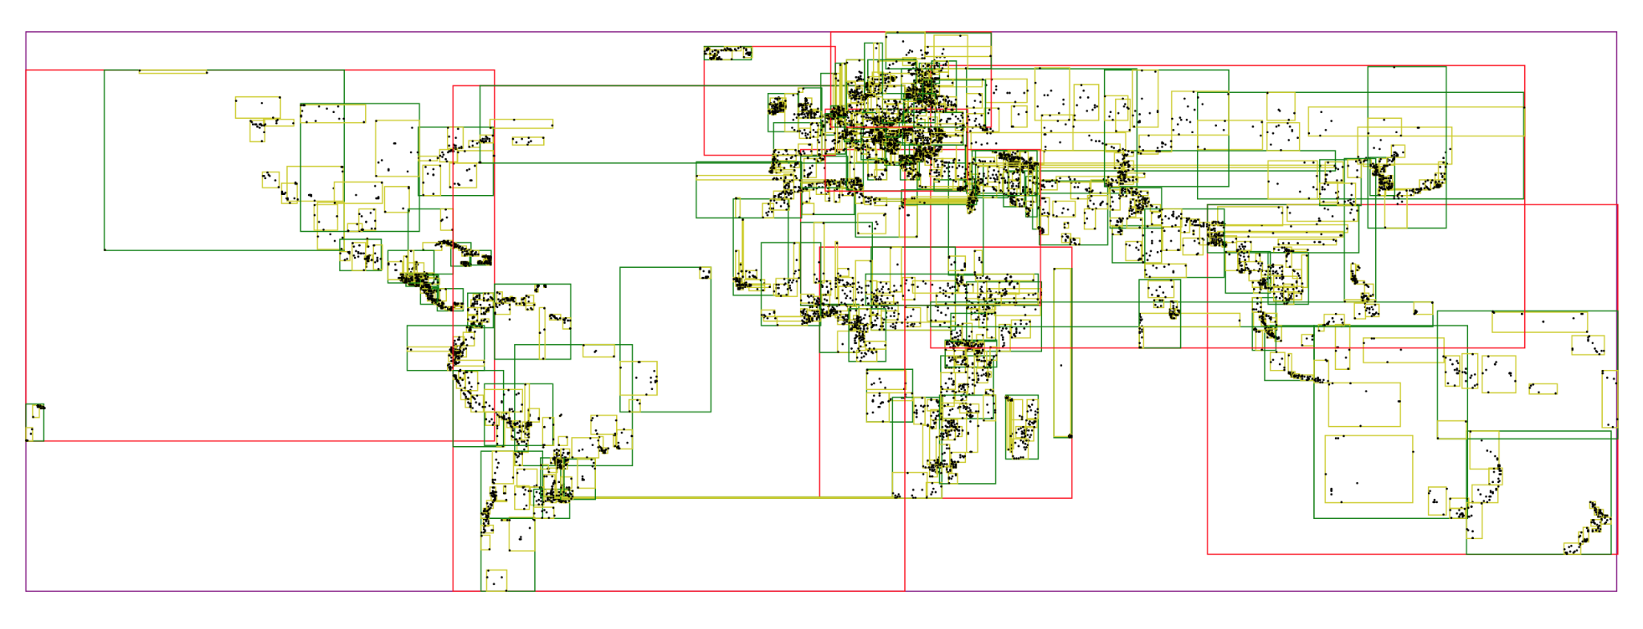
Need For R-Tree
Very often, objects represent multi dimensional spaces that aren't well represented by point locations such as census tracts, countries as they occupy regions of non-zero size. Therefore, a data structure is required that can work in multi-dimensions and also is quick with the entire indexing part. Hence R-trees are used
R-Trees are intended to store and retrieve things effectively depending on their geographical position or closeness. As a result, they are well-suited for applications such as:
Identifying all points that are within a specific distance of a given place
Searching for all things inside a certain area or region.
Identifying the closest neighbour to a given place.

Slide 4
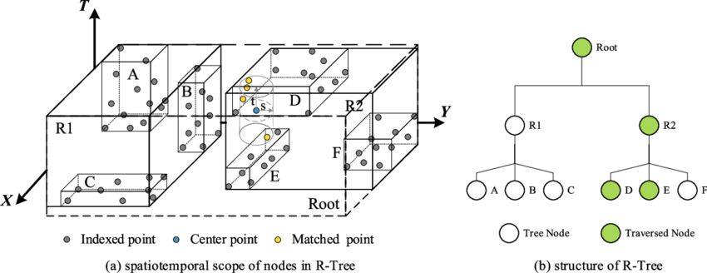
Why STR?
Building an R-tree by inserting one object at a time as specified by Guttman has several disadvantages, as mentioned in the paper:
(a) high load time,
(b) sub-optimal space utilization
(c) poor R-tree structure requiring the retrieval of an unduly large number of nodes in order to satisfy a query
The Sort-Tile-Recursive (STR) algorithm is a simple and efficient bulk-loading method for spatial or multidimensional data management using R-trees.
It is designed to maximize space utilization, and we fill the maximum leaves to capacity, as explained further. The overlap between nodes is much less than in a normal R-tree implementation.

Slide 5
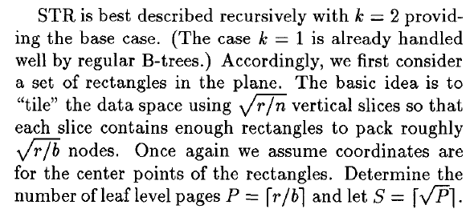
Implementation
Using STR Algorithm to draw R-tree
Given: 2-dimensional dataset
Dataset: (1,9),(2,20),(2,19),(3,20),(2,10),(8,5),(4,5),(3,4),(3,5),(2,4),(2,5),
(8,15),(8,14),(7,15),(9,14),(9,15),(9,16),(9,17),(12,17),(11,18),(1,20)
Here, the number of hyper-rectangles: r=21 , same as number of data points.
Maximum number of children of R-tree: b=4
Finding S: S=⌈√P⌉ , where P=⌈r/b⌉
So, P=6 and hence S= 3.

Slide 6
Sort the rectangles by x-coordinate and partition them into S vertical slices. A slice consists of a run of S.b consecutive rectangles from the sorted list.
Sorted in x-coordinate:
(1,9), (1,20), (2,4), (2,5), (2,10), (2,19), (2,20), (3,4), (3,5), (3,20), (4,5),
(7,15), (8,5), (8,14), (8,15), (9,14), (9,15), (9,16), (9,17), (11,18), (12,17)
Here, S.b= 12 . 1st slice has 12 rectangles:
(1,9), (1,20), (2,4), (2,5), (2,10), (2,19), (2,20), (3,4), (3,5), (3,20), (4,5), (7,15)
and 2nd slice has 9 rectangles:
(8,5), (8,14), (8,15), (9,14), (9,15), (9,16), (9,17), (11,18), (12,17)

Slide 7
Now sort the rectangles of each slice by y-coordinate and pack them into nodes by grouping them into runs of length b=4.
Slice1(sorted):(2, 4),(3, 4),(2, 5),(3, 5),(4,5),(1,9),(2,10),(7,15),(2,19),(1,20),(2,20),(3,20)
Slice2(sorted):(8,5),(8,14),(9,14),(8,15),(9,14),(9,16),(9,17),(12,17),(11,18)
Create leaf nodes and insert the data points into them. Each leaf node can hold a maximum of 4 entries:
Leaf Node 1: (2, 4),(3, 4),(4, 5),(3, 5)
Leaf Node 2: (2,5),(1,9),(2,10),(7,15)
Leaf Node 3: (8,5),(8,14),(9,14),(9,15)
Leaf Node 4: (8,15),(9,16),(9,17),(12,17)
Leaf Node 5: (2,19),(1,20),(2,20),(3,20)
Leaf Node 6: (11,18)

Slide 8
Promote the leaf nodes to the next level by creating intermediate-level nodes. Again heap sort is applied on the leaf node 1….6 and accordingly slicing is done and the appropriate leaf nodes are grouped to form the level 1 internal nodes.
Applying STR again:
r=6, b=4, P=⌈6/4⌉=2, S=⌈√P⌉=2.
Each intermediate(internal)-level node can hold a maximum of 4 entries (child nodes).
Level 1 (Internal Nodes):
Internal Node 1: Leaf Node 1, Leaf Node 2, Leaf Node 3, Leaf Node 4
Internal Node 2: Leaf Node 5, Leaf Node 6
Applying STR again:
r=2, b=4, P=⌈2/4⌉=1, S=⌈√P⌉=1.
Apply heap sort on the x-coordinates. Here, S.b=2, so we would have only 1 slice, We now heap sort this slice on the y-coordinates. Now use these coordinates to make the root node.
Level 2 (Root Node):
Internal Node 3: Internal Node 1, Internal Node 2

Slide 9
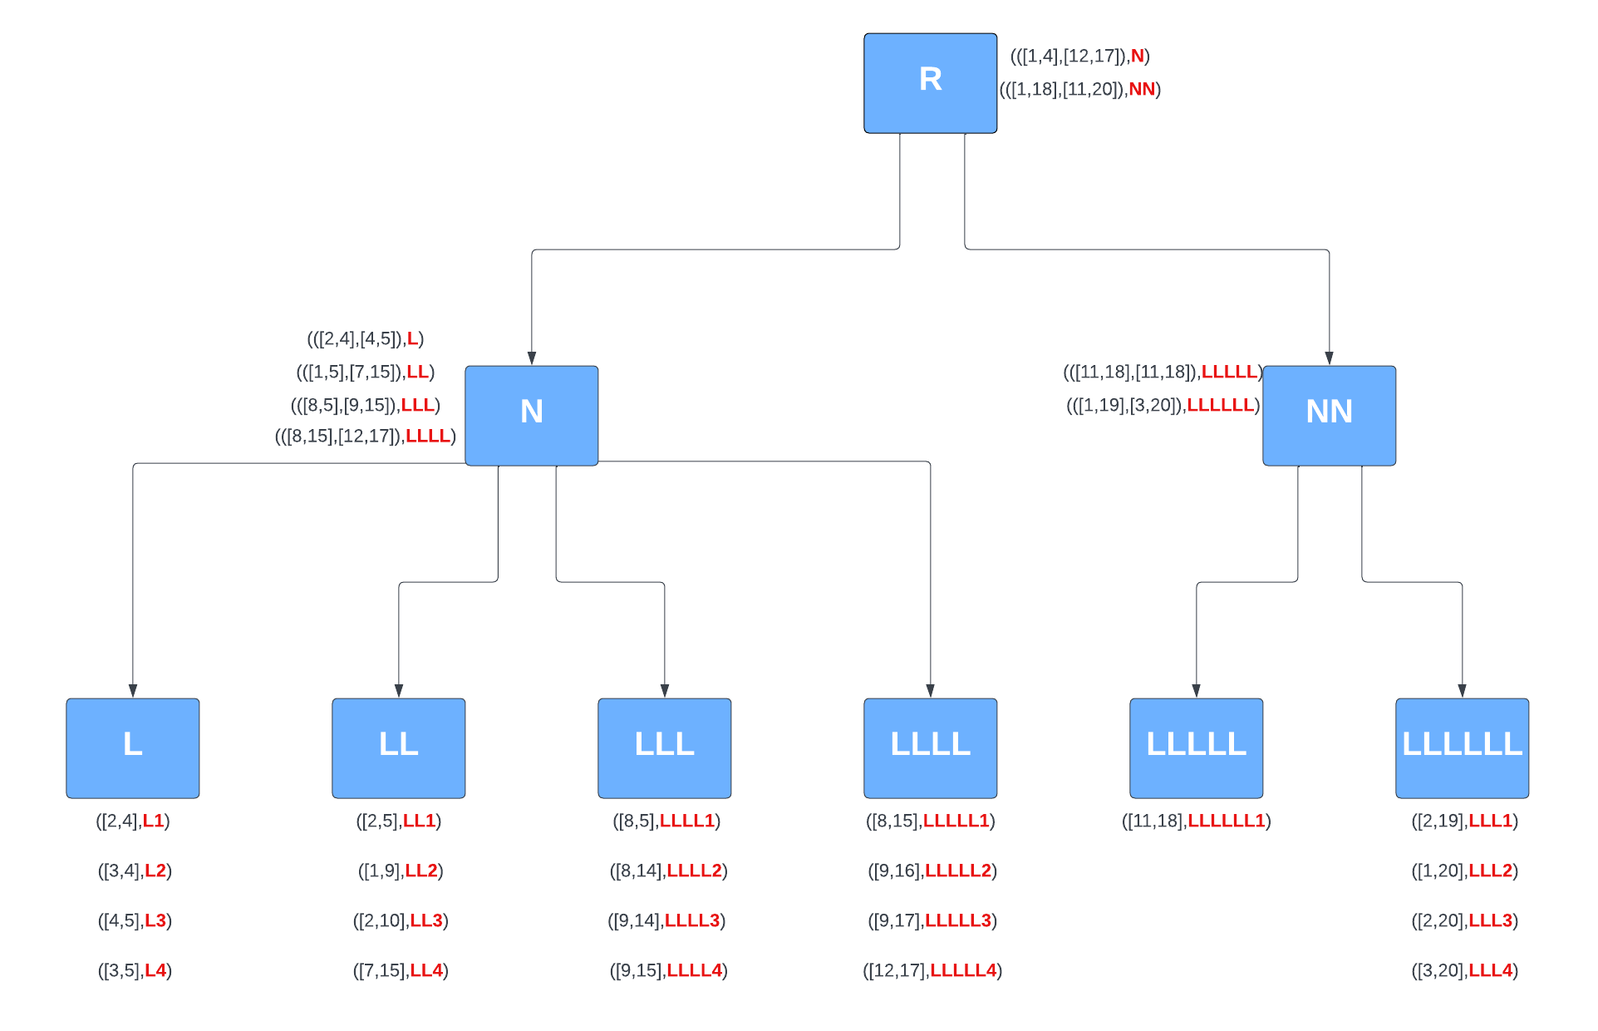
(([1,4],[12,20]),R)
Visualization

Slide 10
Heap Sort Method
Our program implements HeapSort using Heapify method of sorting. Build Max Heap and Heap Sort have not been used in our case, as Max Heapify has the least time complexity of O(n).
The worst case time complexity for Heap sort is O(N Logn) whereas it is O(n^2) in the case of QuickSort algorithm
Heapsort is space efficient as it uses O (1) extra space.
Heapsort tends to perform more consistently and efficiently on large data sets due to its guaranteed worst-case time complexity.
Something to also note here is that the final time complexity of the Heap Sort Algorithm is O (n Logn)

Slide 11
Structures Used

Slide 12
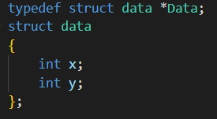
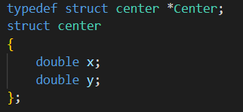
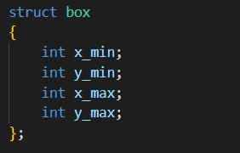
struct data
struct center
Struct box
Defines the format in which data should be stored in our program i.e. (x,y) :
x(int): stores the x-coordinate of 2D-data point
y(int): stores the y-coordinate of 2D-data point
Defines the format to store the centers of Minimum bounding rectangles(MBRs):
x(double): stores the x-coordinate of center of MBR
y(double): stores the y-coordinate of center of MBR
Defines the format to store the bottom left and top right of Minimum bounding rectangles(MBRs):
x_min(int): x-coordinate of bottom left coordinate
y_min(int): y-coordinate of bottom left coordinate
x_max(int): x-coordinate of top right coordinate
y_max(int): y-coordinate of top right coordinate

Slide 13
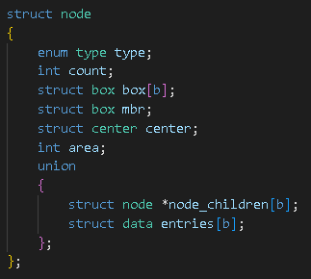
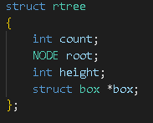
Struct node
struct rtree
Defines the structure to create node by
taking the enum type as leaf or internal node
count (int) - stores the total number of internal+external nodes in the tree
Stores the mbr of all the leaf nodes in the array box[b]
Also stores its own mbr in mbr
Stores the area of its mbr
The struct will be used to store its children in case of internal nodes or the data points if itself is a leaf
Defines the structure to store the R-Tree by
count(int): stores the total number of internal+external nodes in the tree
root(NODE): points to the root
int height(int): stores height of the tree

Slide 14
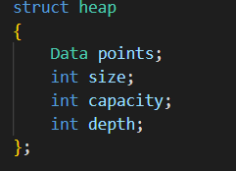
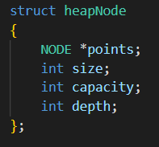
Struct heap
Struct heapNode
The given structure is used to create a heap in the function, for which
points of type Data is used to refer to the data points
apply heapsort on the data points at each level
Size of the heap is defined
Capacity of heap is also defined
The given structure is used to create a heap in the function, for which
*points refer to the pointer to the nodes
this is used to apply heapsort on the nodes at each level
Size of the heap is defined
Capacity of heap is also defined

Slide 15
Code

Slide 16
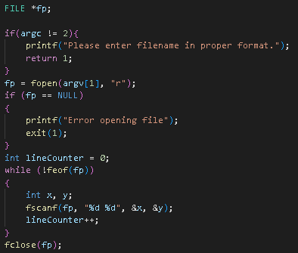

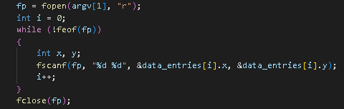
Reading The Data From File
Initialise data_size with the size of data and create a pointer of type struct data of size data_size, called data_entries to hold the data points.
Read the entire data file to find the number of data points and store the count in lineCounter
Read the file again and this time store the data points in data_entries array.

Slide 17

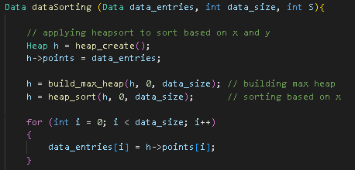
Implementing the STR (Sort Tile Recursive)
Call dataSorting() on the data_entries array.
The dataSorting() function sorts the data points according to STR approach using Heap Sort.
dataSorting() first sorts the data_entries array on the basis of x values.

Slide 18
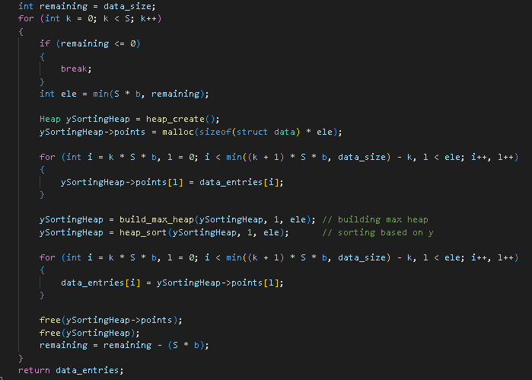
Implementing the STR (Sort Tile Recursive)
The data_entries array is then divided into splices of S.
Each Splice consists of S*b number of data points.
In our case of 21 datapoints,
S = ceil(sqtr(ceil (21/4))) = 3
S*b= 3*4 = 12
So the data is divided into two splices of 12 and 9 data points respectively.
Each splice is then sort on the basis of y values using Heap Sort.

Slide 19
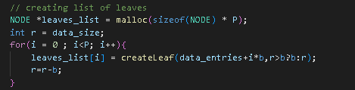
Implementing the STR (Sort Tile Recursive)
Then a leaves_list of size P is created.
In our case,
P = ceil (21/4) = 6
Then leaves are created by passing values from data_entries in multiples of 4 (last leaf may have less than 4 data entries)
Leaves formed are :
Leaf 1: (2, 4),(3, 4),(4, 5),(3, 5)
Leaf 2: (2,5),(1,9),(2,10),(7,15)
Leaf 3: (2,19),(1,20),(2,20),(3,20)
Leaf 4: (8,5),(8,14),(9,14),(9,15)
Leaf 5: (8,15),(9,16),(9,17),(12,17)
Leaf 6: (11,18)

Slide 20
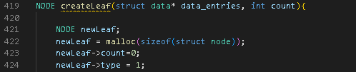
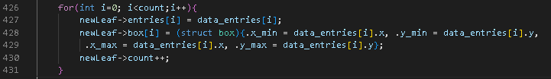

Implementing the STR (Sort Tile Recursive)
createLeaf() takes the data_entries and count, i.e. the number of data points to pack in one unit.
Then for every leaf, we store the data points in entries[] array and store the corresponding box of that entry in box[] and increment the count of that leaf.
Then for every leaf we will call:
findMBR() to find MBR of that leaf
findCenter() to find the center of MBR of that leaf
findArea() to find the area of MBR of that leaf
At the end, we will return the new leaf created.

Slide 21
Implementing the STR (Sort Tile Recursive)
We will then call the sorting() function on the leaveslist to sort the leaves again based on STR. The function sorting() used heap sort for sorting.
Here P = ceil(6/4)
Leaf 1: (2, 4),(3, 4),(4, 5),(3, 5)
Leaf 2: (2,5),(1,9),(2,10),(7,15)
Leaf 3: (2,19),(1,20),(2,20),(3,20)
Leaf 4: (8,5),(8,14),(9,14),(9,15)
Leaf 5: (8,15),(9,16),(9,17),(12,17)
Leaf 6: (11,18)
Leaf 1: (2, 4),(3, 4),(4, 5),(3, 5)
Leaf 2: (2,5),(1,9),(2,10),(7,15)
Leaf 3: (8,5),(8,14),(9,14),(9,15)
Leaf 4: (8,15),(9,16),(9,17),(12,17)
Leaf 5: (11,18)
Leaf 6: (2,19),(1,20),(2,20),(3,20)
Before applying STR
After applying STR

Slide 22

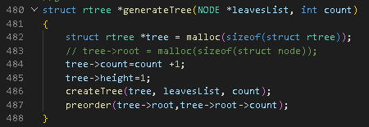
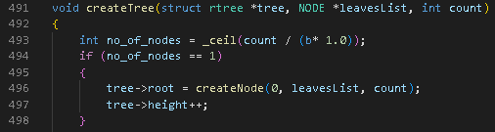
Implementing the STR (Sort Tile Recursive)
Next we will call the generateTree function to generate the R Tree using str recursively from bottom up.
Generate tree will:
Allocate memory to R Tree
Initialize count with 1
Initialize height with 1
Call the createTree() function
Print the preorder of tree using preorder()
createTree() will check if root needs to be created.
If no_of_nodes = 1 then the leavesList can be packed in one node only and we only need to create the root.
Else we need to create more level in the tree

Slide 23
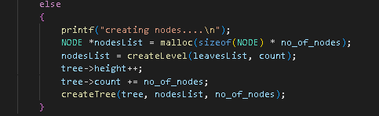
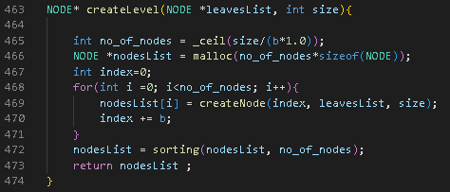
Implementing the STR (Sort Tile Recursive)
In case the no_of_nodes > 1, we need to create more levels.
We will call the createLevel to create upper levels and we will pass the leavesList and its size to function.
createLevel() with return the upper level nodes created and store them in nodesList.
Then we will recursively call the createTree() to build the tree recursively.
createLevel() will further pack the leavesList into groups of 4 and assign them to the new nodes created
The new nodes are stored in the nodesList.
We will then call the sorting() function on nodesList to sort the nodes based on STR.
We will then return the nodesList

Slide 24
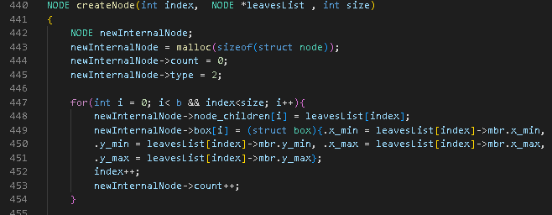
Implementing the STR (Sort Tile Recursive)
createNode() function creates new internal nodes.
It packs the leavesList in groups of 4 (the value of b) and assigns them to the new nodes created.
It also stores the corresponding MBRs of the leavesList in the box[] array of the new node.
It increments the count of the new node created.

Slide 25


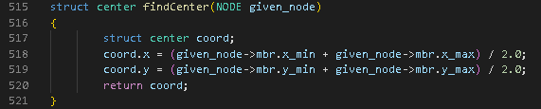
Implementing the STR (Sort Tile Recursive)
Functions are called to calculate and store the MBR, center and area of the nodes.
Function to find the area of nodes.
Function to find the center of nodes.

Slide 26
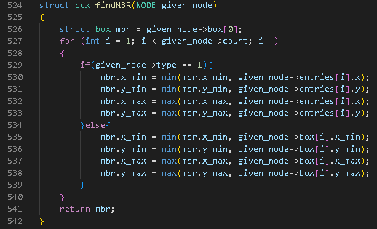
Calculating the MBR (Minimum Bounding Rectangle)
findMBR() calculates the mbr of node.
It compares the values of all the MBRs of the child nodes stored in the node and then take the minimum of x_min, minimum of y_min, maximum of x_max and maximum of y_max to calculate the MBR.

Slide 27
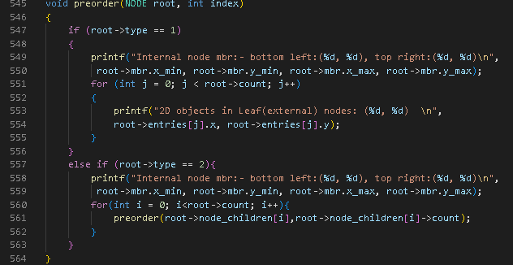
PreOrder Traversal
We visit the root of the tree and print its bottom left and top right coordinates.
We then visit the children of the root by again calling preorder().
If the child is a leaf we print the bottom right and top left coordinates and then print the 2D objects stored in them.
If the child is a node we print its bottom right and top left coordinates and then visit its children and repeat steps 3 and 4.

Slide 28
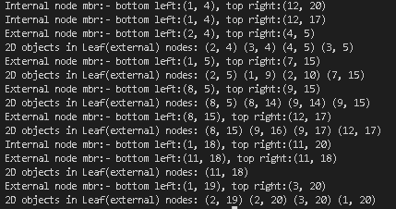
PreOrder Traversal Output

