Slide 1
BUILD WITH AI · CODE FOR COMMUNITIES
TRACK 3 · SMART HEALTH — AI-DRIVEN HEALTH CENTRE & SUPPLY CHAIN MANAGEMENT
Smart Health Centre
A real-time command centre for district health officials — and a 60-second daily report app for the PHC operator. Live on Google Cloud, in English, Hindi and Marathi.
Team ai-rangers · smart-health-20737125641.asia-south1.run.app · github.com/ai-rangers-team/Smart-Health-Center
Smart Health Centre
01

Slide 2
THE PROBLEM
A district runs 30+ health centres on paper registers and phone calls
Stock-outs surface too late
No live operational picture
Tools aren't built for the users
A medicine shortage is discovered when a patient is turned away — not two weeks earlier, when a transfer or reorder could still have prevented it.
Footfall, beds, staff attendance and diagnostics reach the district as monthly paperwork. Underperforming centres hide in the averages.
PHC staff work in Marathi and Hindi on low-end phones. Dashboards built for English-speaking analysts never get adopted at the last mile.
One centre's surplus is another centre's stock-out. The data to fix this exists — it just arrives a month late, on paper.
Smart Health Centre
02

Slide 3
THE SOLUTION
Report once. The district sees everything, instantly.
• PHC operator app — the whole daily report (patients, staff, stock, beds, tests) takes under a minute on a phone, in the operator's own language.
• District command centre — live status of every centre: AI morning briefing, stock-out forecasts, alerts, performance flags, transfer recommendations.
• Real-time, not batch — every save recomputes forecasts, scores and alerts; the dashboard updates in about a second.
Built around one principle
Algorithms decide. Gemini explains. Every alert and forecast is deterministic and auditable. Generative AI is the communication layer — never the gatekeeper of a health decision.
Operator reports
System recomputes
Firestore pushes live
Official acts early
60-second daily entry, or a photo of the restock invoice
Stock-out forecast, performance score, alerts — on every write
District dashboard updates in ~1s via real-time listeners
Reorder, transfer stock or intervene — days before the crisis
Smart Health Centre
03

Slide 4
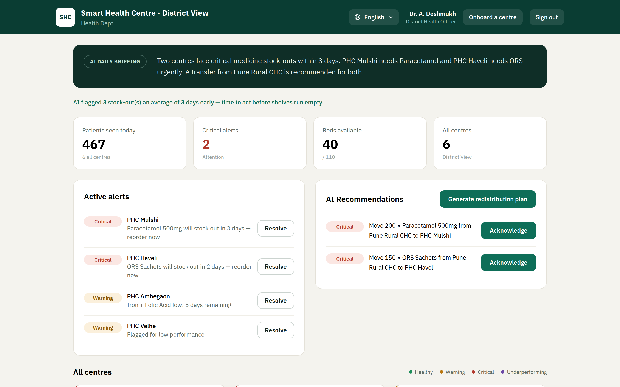
LIVE ON CLOUD RUN · REAL DATA
The district command centre
AI daily briefing, live alerts with days-to-stock-out, and transfer recommendations — one screen replaces a month of paperwork.
Smart Health Centre
04

Slide 5

INCLUSION BY DESIGN
The same intelligence, in the official's own language
English, Hindi and Marathi across the entire product — the AI writes its briefings and recommendations in the user's language, not just the labels.
Smart Health Centre
05

Slide 6
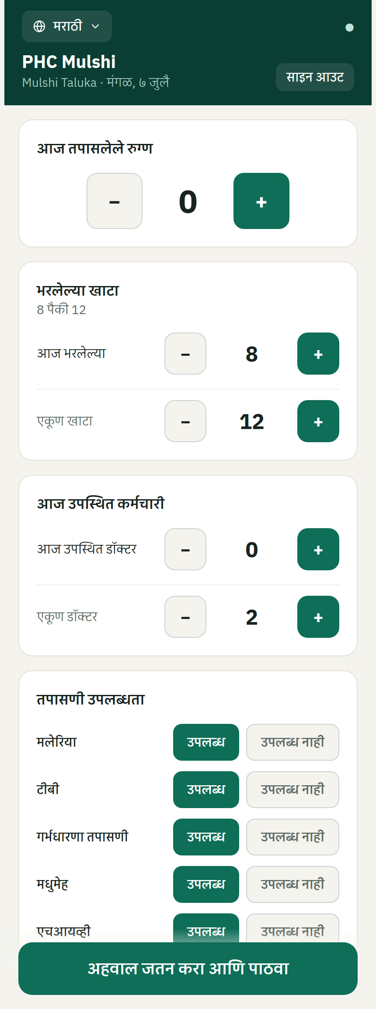
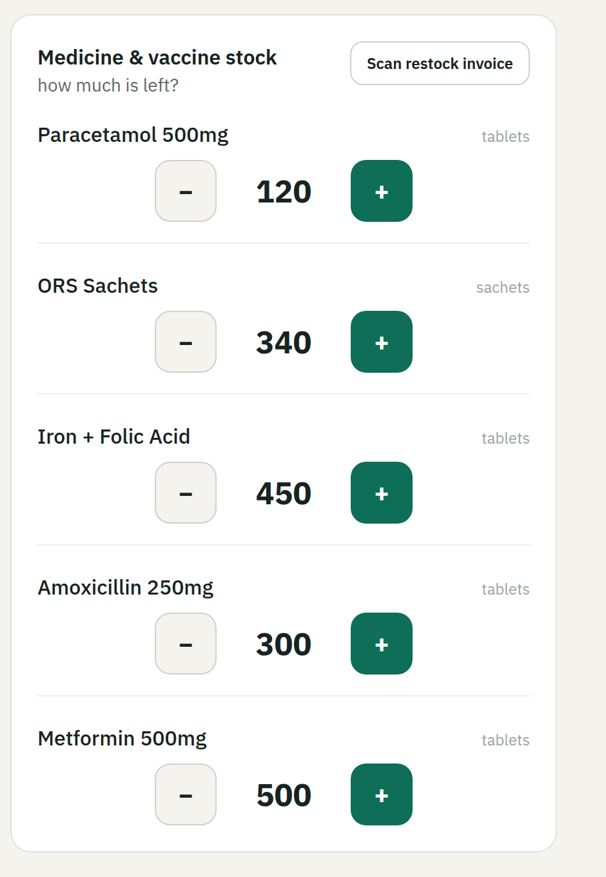
THE LAST MILE
A daily report that takes less time than a phone call
• Designed for village PHC staff — big tap targets, steppers instead of keyboards, works on low-end phones, installs as an app (PWA).
• Scan the restock invoice — when a delivery arrives, the operator photographs the invoice. Gemini reads it, matches line items to the centre's own medicine catalog, and pre-fills the quantities.
• AI proposes, a human confirms — extracted amounts land in a review screen, never straight into the database.
• Works in EN / HI / MR · Installable PWA · Gemini vision + structured output
Smart Health Centre
06

Slide 7
AI ARCHITECTURE
Algorithms decide. Gemini explains.
Health alerts must be reproducible and auditable. So the decision path is pure deterministic code — and Gemini makes it human.
Deterministic core — the decision path
Gemini 2.5 Flash — the communication layer
• Recency-weighted consumption forecasting (normalized EWMA) predicts every medicine's stock-out date.
• Composite performance score flags underperforming centres automatically.
• Redistribution engine matches surplus to deficit centres before stock-outs happen.
• New centres are safe from day one: thresholds from one question — expected patients per day.
• Morning district briefing from live data, in the official's language, with last-good fallback.
• Plain-language explanations of underperformance and transfer recommendations.
• Invoice OCR: photo or PDF to structured stock quantities, constrained to the centre's catalog.
• Never on the live write path — everything still works if Gemini is down or rate-limited.
Smart Health Centre
07

Slide 8
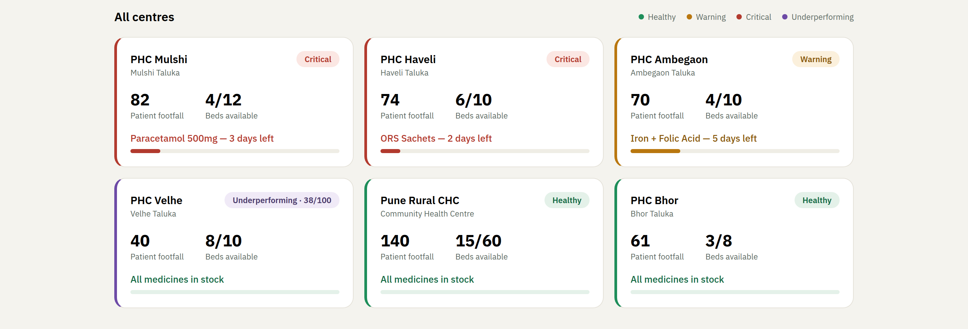
SUPPLY CHAIN INTELLIGENCE
From "we ran out" to "move 200 units by Friday"
3 days
7 / 14
~1 s
average early warning before a stock-out
day forecast bands for high and medium severity
from operator save to district dashboard update
Smart Health Centre
08

Slide 9
ENGINEERING
Not a prototype — a deployed, tested system
React 18 + Vite PWA
FastAPI on Cloud Run
Firestore + Firebase Auth
Gemini 2.5 Flash
Tailwind design system, offline persistence, Recharts
Python 3.12 · asia-south1 · rate-limited API
Real-time listeners · Google Sign-In · role claims
google-genai SDK · structured JSON output
• Security first: role-based access via Firebase custom claims — a district admin and a PHC operator see only what they should.
• 60 automated tests across forecasting, scoring, redistribution, alerting, auth and the invoice extractor.
• CI/CD on every merge: GitHub Actions deploys to Cloud Run with keyless Workload Identity Federation — no service-account keys anywhere.
• Resilient by design: cached last-good AI briefings, template fallbacks, deterministic writes even with Gemini fully unavailable.
Smart Health Centre
09

Slide 10
IMPACT & SCALE
Built for one district. Ready for a state.
Onboarding is one question
The model rolls up
Integration roadmap
A new PHC gets safe stock thresholds from “roughly how many patients a day?” — and an entire district onboards from a single CSV: 30–40 centres, operators provisioned automatically.
Centre to district today; district to state next. The same scoring, forecasting and redistribution logic works at every level of aggregation.
Designed to plug into e-Aushadhi (drug logistics), HMIS reporting and ABDM registries — replacing parallel data entry, not adding to it.
Every day of earlier warning is a queue of patients who did not get turned away. The marginal cost of adding a centre is one row in a CSV.
Smart Health Centre
10

Slide 11
Rural healthcare that runs on data, not paperwork.
Live today. Tested. Trilingual. Built on Google Cloud.
Live demo smart-health-20737125641.asia-south1.run.app
Source github.com/ai-rangers-team/Smart-Health-Center
Team ai-rangers — Rupesh · Rishi · Isha · Devik
Smart Health Centre
11

