Slide 1

Dead Ant
A Presentation for the term project in Search Based Software Engineering
North Carolina State University
Dept. of Computer Science

Slide 2
Outline
Introduction
Determining close
Comparisons
Dead Ant vs. Differential Evolution
Objective Scores
Mutation
Run times
Experiments
Spread
Introducing Dead Ant
Number of evaluations
Concluding Remarks
Questions
Future work
Real-world models
Standard Models
Models
Pseudo-code

Slide 3
Introducing DeadAnt
Introduction
Introducing Dead Ant
Pseudo-code
Determining close
Mutation
DeadAnt is a simple active learner.
Use less training, but allow machine to pick the examples to learn from [1]
It uses an unsupervised tabu search to decide if a potential solution deserves an evaluation.
If new solution is close to a bad solution, do not evaluate it.
It generates new candidates by directional mutation [2]
If a new candidate is close to a good candidate, mutate towards the better solution among the two.
Limits the population size by discarding bad solutions.

Slide 4
Dead Ant Pseudo-code
Introduction
Introducing Dead Ant
Pseudo-code
Determining close
Mutation
Build Initial Frontier with N candidates (ants). Mark everyone alive.
Repeat until stopping criterion is met (Set Lives = 100)
Generate a new ant.
If the ant is not close to anyone in frontier, add ant to the frontier.
If ant is close to an old ant that’s dead, discard the old ant, mark the new ant as dead.
If new ant is close to an old ant that’s alive, evaluate the ant and increase lives.
If the new ant dominates the old ant, mutate towards the new ant and kill the old ant.
If the old ant dominates the new ant, mutate towards the old ant and kill the new ant.
If the new ant and the old are mutually non-dominant, then add the new ant to the frontier.
All the live ants are the approximations to the Pareto frontier.

Slide 5
Determining ‘Close’?
Introduction
Introducing Dead Ant
Pseudo-code
Determining close
Mutation
We start with 2 arrays of with ‘K’ bins.
One stores the sum of the distances (for every new value)
The other stores the number of distances in each bin.
Note: In a beginning all distances go to the first bin
After the number of values in the bin reached a certain value, we obtain the mean of the distances in the bin.
Now for every new value that comes, if the distance less than the mean of a bin, we move to then next bin.
If a new distance propagates beyond the 4th bin, we say they’re close.

Slide 6
Mutation Policy
Introduction
Introducing Dead Ant
Pseudo-code
Determining close
Mutation
Dead ant builds upon the directional mutation policy suggested in GALE [1].
For two solutions A and B, mutate towards the better solution based on the distance between the A and B.
The mutation distance is constrained by a fixed parameter γ = 1.5
In Dead Ant, the new solution is obtained by mutating with a randomly chosen constraint.
The maximum extent of mutation is still limited by γ = 1.5
Furthermore, in DA we generate 100 mutants using the above policy and pick the one which is farthest from the bad solution.

Slide 7
DA vs. DE
Comparisons
Dead Ant vs. Differential Evolution
Property | DeadAnt | Differential Evolution
Initial Placement | Random | Random
Selection | Random/Extrapolation | Next in list
Domination | Label better solution as ‘Alive’, worse solution as ‘Dead’ | Replace the dominated solution
Not Better | Delete one, label the other as ‘dead’ | Delete and discard
New candidates | Random/ Extrapolate | Extrapolation
Active Learning | YES | NO
Frontier Size | Varying | Varying

Slide 8
Models
Models
Standard
Real world
Real-world Models
XOMO (Decisions 23, Objectives 4)
POM3* (Decisions 9, Objectives 4)
Standard Models
Schaffer (Decisions 1, Objectives 2)
Kursawe (Decisions 3, Objectives 2)
Fonseca (Decisions 3, Objectives 2)
DTLZ7 (Decisions 20, Objectives 20)
ZDT1 (Decisions 30, Objectives 2)
ZDT3 (Decisions 30, Objectives 2)

Slide 9
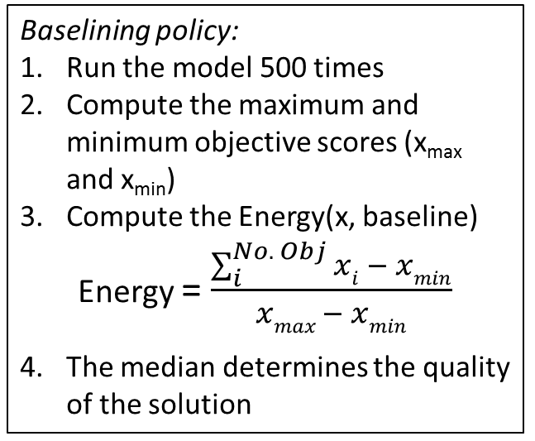
Experiments
Experiments
Energy
Spread
Run times
Number of evaluations
Energy
Scott Knott test for 25 repeated runs
Spread
Determines the spread of solutions of on the Pareto frontier (less is better)
Scott Knott test for 25 repeated runs
Run times
Averaged over 25 runs
Number of Evaluations
Scott Knott for 25 runs
Baselining policy:
Run the model 500 times
Compute the maximum and minimum objective scores (x_{max} and x_{min})
Compute the Energy(x, baseline)
Energy = $\frac{\sum_{i}^{No. Obj}{xi} − xmin}{xmax − xmin}$
The median determines the quality of the solution
Energy
> 0 : Loss in quality from baseline
= 0 : No improvement
< 0 : Improvement from baseline

Slide 10
Experiments
Energy
Spread
Run times
Number of evaluations
Energy
Experiment | Dead Ant |  | Differential Evolution
 | Median | IQR | Median | IQR
XOMO | 0.00 | 0.0001 | 0.17 | 0.093
DTLZ7 | 0.06 | 0.05 | -1.63 | 0.3
ZDT1 | 0.51 | 0.41 | -1.48 | 0.27
ZDT3 | 0.13 | 0.05 | -1.19 | 0.3
FONSECA | 0.14 | 0.1 | 0.47 | 0.59
KURSAWE | 0.2 | 0.09 | -1.39 | 0.04
SCHAFFER | 0.00 | 0.0001 | 0.01 | 0.001

Slide 11
Experiments
Energy
Spread
Run times
Number of evaluations
Spread
Experiment | Dead Ant |  | Differential Evolution
 | Median | IQR | Median | IQR
XOMO | 0.80 | 0.07 | 0.86 | 0.09
DTLZ7 | 0.58 | 0.004 | 0.65 | 0.004
ZDT1 | 0.54 | 0.01 | 0.59 | 0.01
ZDT3 | 0.52 | 0.01 | 0.58 | 0.007
FONSECA | 1.03 | 0.45 | 1.48 | 0.29
KURSAWE | 0.48 | 0.04 | 0.49 | 0.04
SCHAFFER | 1.04 | 0.34 | 0.65 | 0.1

Slide 12
Experiments
Energy
Spread
Run Times
Number of evaluations
Runtimes
Experiment | Dead Ant | Differential Evolution
 | Average (sec) | Average (sec)
XOMO | 37.66 | 91.20
DTLZ7 | 26.63 | 26.25
ZDT1 | 35.03 | 34.21
ZDT3 | 49.26 | 23.23
FONSECA | 1.97 | 1.26
KURSAWE | 2.14 | 1.63
SCHAFFER | 0.80 | 0.61

Slide 13
Experiments
Energy
Spread
Run Times
Number of evaluations
Runtimes

Slide 14
Experiments
Energy
Spread
Run Times
Number of evaluations
Number of evaluations
Experiment | Dead Ant |  | Differential Evolution
 | Median | IQR | Median | IQR
XOMO | 361 | 2 | 1700 | 258
DTLZ7 | 133 | 10 | 157 | 56
ZDT1 | 404 | 16 | 806.5 | 64
ZDT3 | 402 | 12 | 836 | 50
FONSECA | 142 | 14 | 148 | 52
KURSAWE | 141 | 4 | 246 | 56
SCHAFFER | 114 | 8 | 148 | 67

Slide 15
Experiments
Energy
Spread
Run Times
Number of evaluations
Number of evaluations

Slide 16
Concluding Remarks
Concluding Remarks
Future work
DeadAnt
Active learner
Evaluates only the most useful candidates
Works well on large Real-world models
Finds reasonable solutions on standard models
Future work
Reduce number of nearest neighbor comparisons by discarding some dead ants from the cache

Slide 17

Questions

