Slide 1
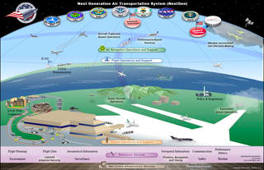
NASA INNOVATIVE ADVANCED CONCEPTS (NIAC): NNH15ZOA0001N. PHASE I Verifying Safety of NextGen Models: A Rational Approach
WHY
Air spaces gets more crowded
Safety concerns become more critical.
Need better reasoning about how pilots navigate crowded skies.
Principle of rationality: experts know that only a few actions are most relevant
Our hypothesis: (1) these few choices mark out a small space; (2) in that small space, formal verification tools can thoroughly explore a model
pretty
Understanding Huge Models
(application to aerospace models)
WHAT
JPF= Java Pathfinder = model exploration tool.
GALE= optimizers. Like a smart pilot controlling a craft.
Step1: Run GALE to find rational decisions.
Step2: Run JPF for a few steps, constrained to regions found by GALE.
Step3: Unleash JPF on regions accepted by Step2.
If JPF finds counter-examples, use GALE to find mitigation strategies
Step 4: run GALE with the constraint that it should strive to avoid counter-example states.
HOW
Case studies using recent work at NASA Ames models: modeling of pilots in the Brahms multi-agent framework for NAS and the NextGen Air Transportation Systems
WHO
PI Prof Tim Menzies CS NC State, tjmenzie@ncsu.edu
Dr. Neha Rungta, NASA Ames, neha.s.rungta@nasa.gov
Menzies = co-author of the GALE heuristic optimizer. Rungta = experienced modeler of pilot systems

