Slide 1
Montreux Jazz Festival i* Exercise
Based on Osterwalder Ph.D. Thesis
Jennifer Horkoff

Slide 2
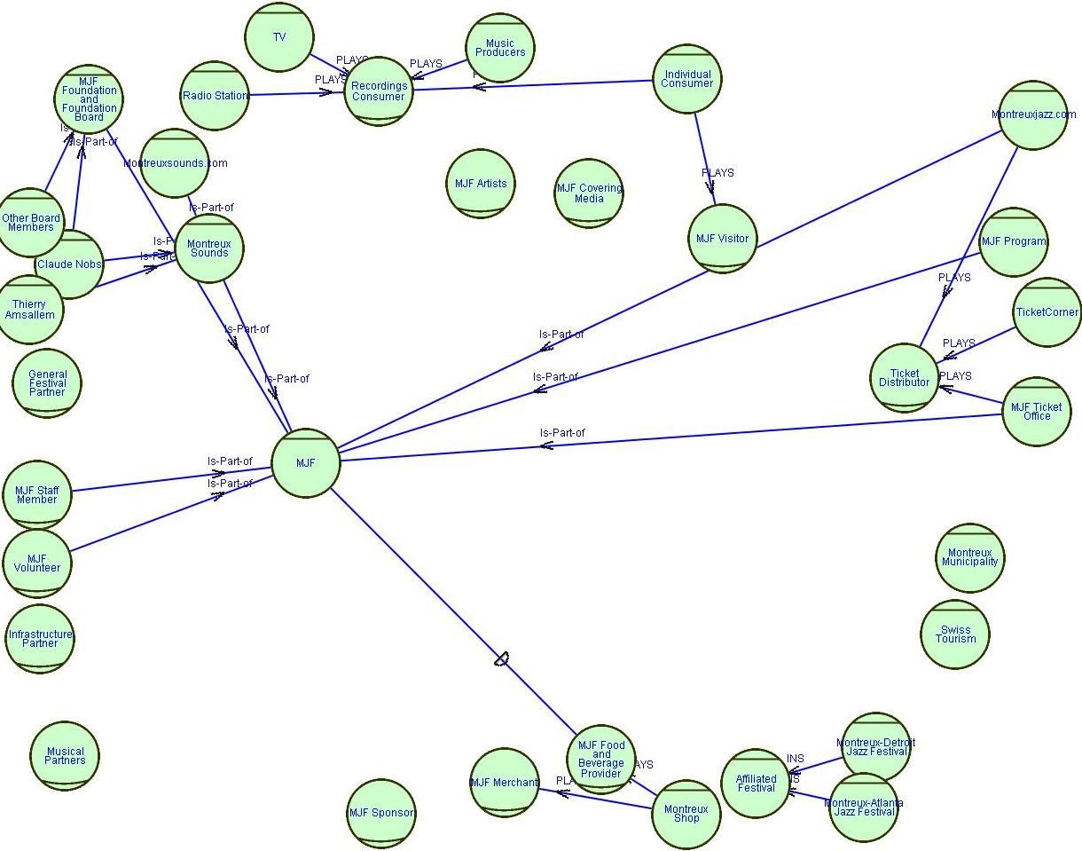
SD: All Actors

Slide 3
All Actors Questions/Comments
Actors spread out in strange ways because of addition of later elements
What is or is not part of the MJF? For example are the MJF Merchants part of the MJF? They are part of the festival but not usually part of the decision making process or management of the festival, and they have an independence from the festival as they may exist all year round.
How do you show that one agent controls another, the MJF Foundation and Foundation Board controls the MJF. It is part of it, but it is not part of the MJF the same way that a staff member is.

Slide 4
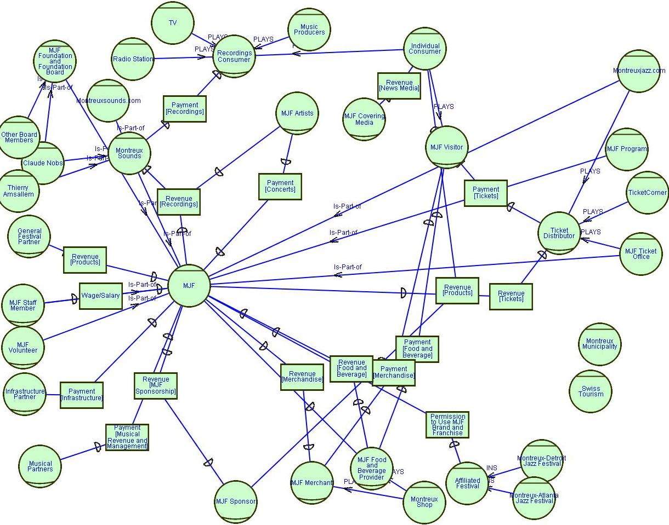
SD: Add Financial Resources

Slide 5
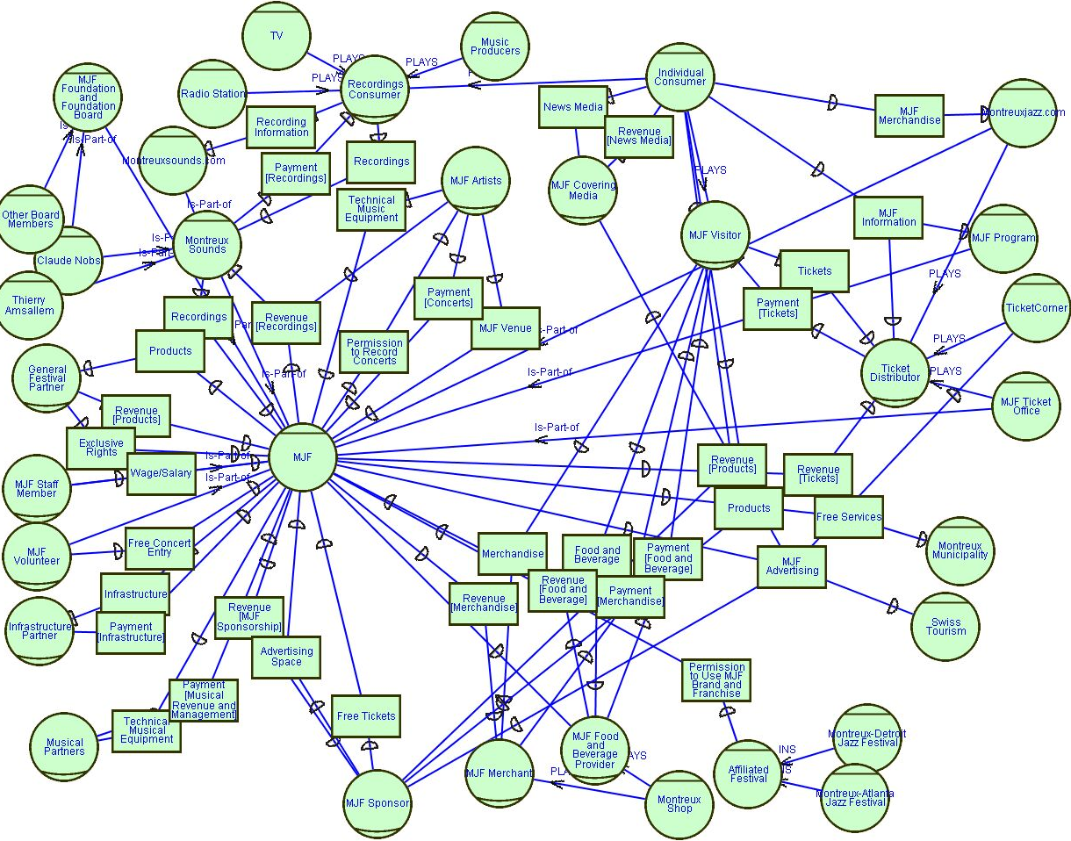
SD: All Resources

Slide 6
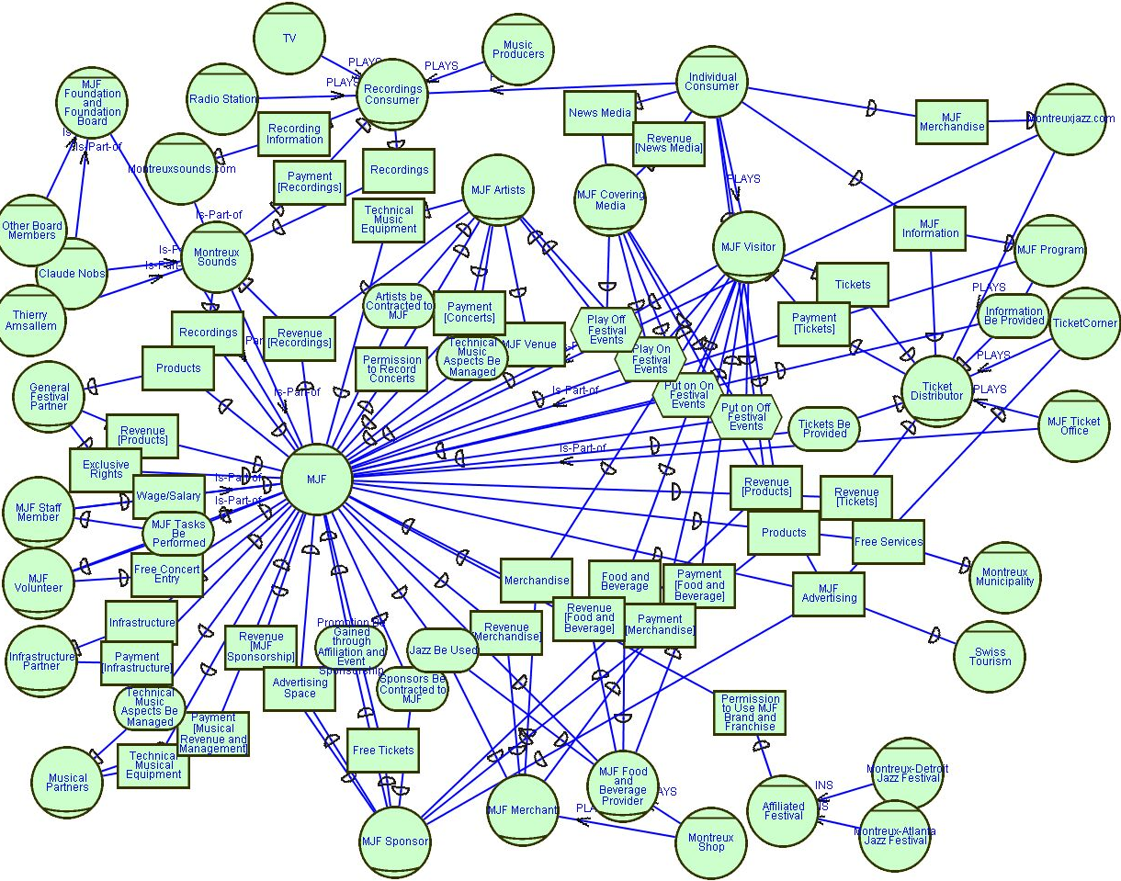
SD: Everything But Softgoals

Slide 7
Everything but Softgoals Questions/Comments
Should “events” like concerts, boat trips, and train trips be tasks or resources, or should it be a goal like “Concert Be Performed”. Here I have made them tasks as the MJF Visitor depends on the MJF to perform a specific task of putting on a concert or a trip in a certain way.
What about the signing of contracts? Is that a goal, resource or a task? I have it as a goal as the MJF wants the artist to sign a contract, but it could also be task, “Sign Contract”, or a resource “Signed Contract”.

Slide 8
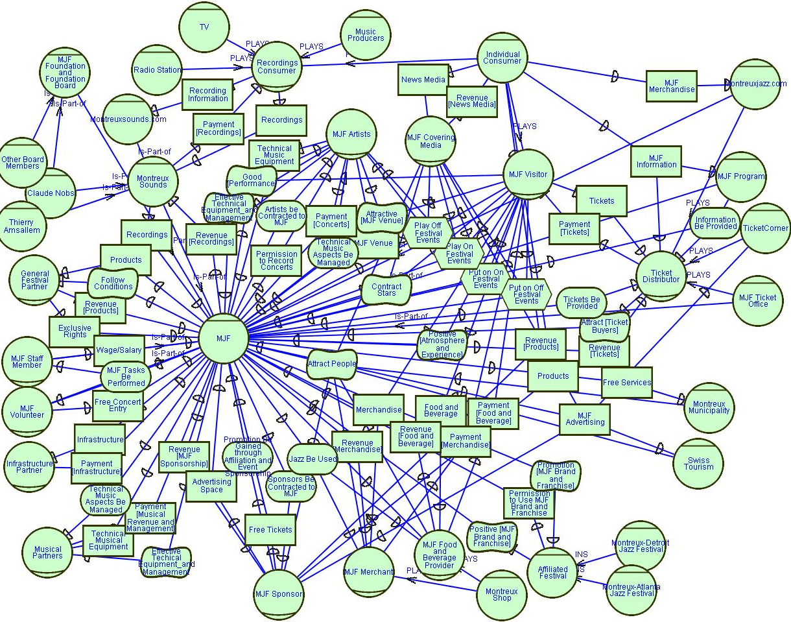
SD: Big Picture

Slide 9
Big Picture Questions/Comments
The Affiliated Festivals depend on the MJF for use of it’s brand and franchise and for a positive brand and franchise, but why does the MJF want to franchise it’s name? From what I understand it receives no direct profit from the franchises. My guess here is that it wants promotion of it’s brand and franchise by letting others use it.
We are obviously now running into some scalability problems, as most of the links are very difficult to trace.

Slide 10
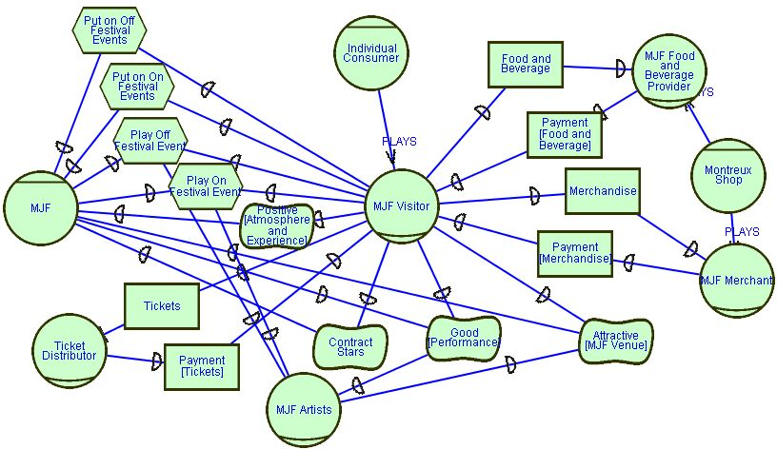
SD: MJF Visitor
Only the elements and actors involved in dependencies or plays relationships with the MJF Visitor are shown

Slide 11
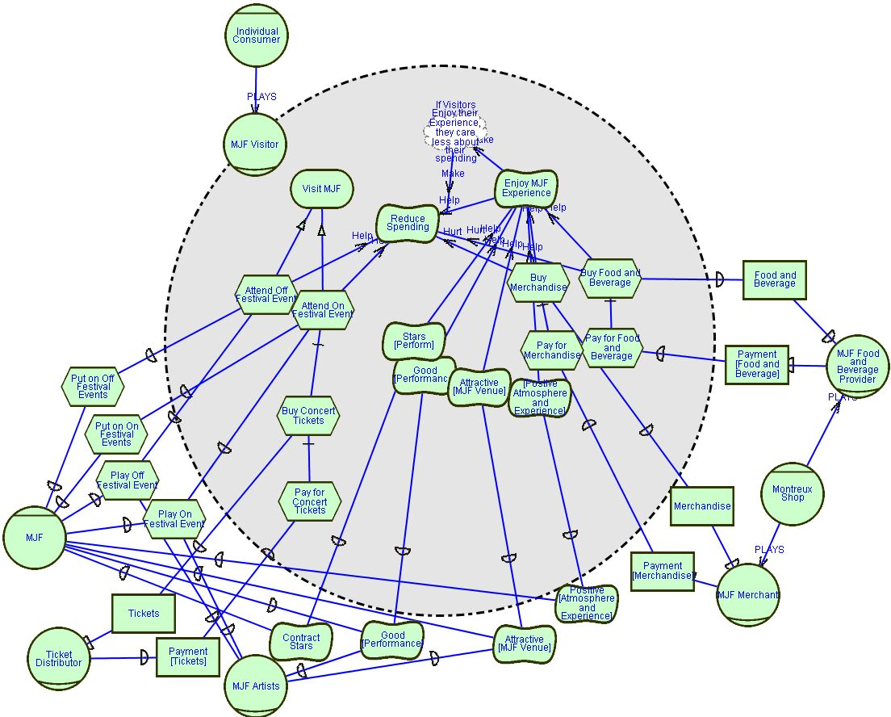
SR: MJF Visitor
The main elements of the Visitor are to visit the MJF and to enjoy the experience

Slide 12
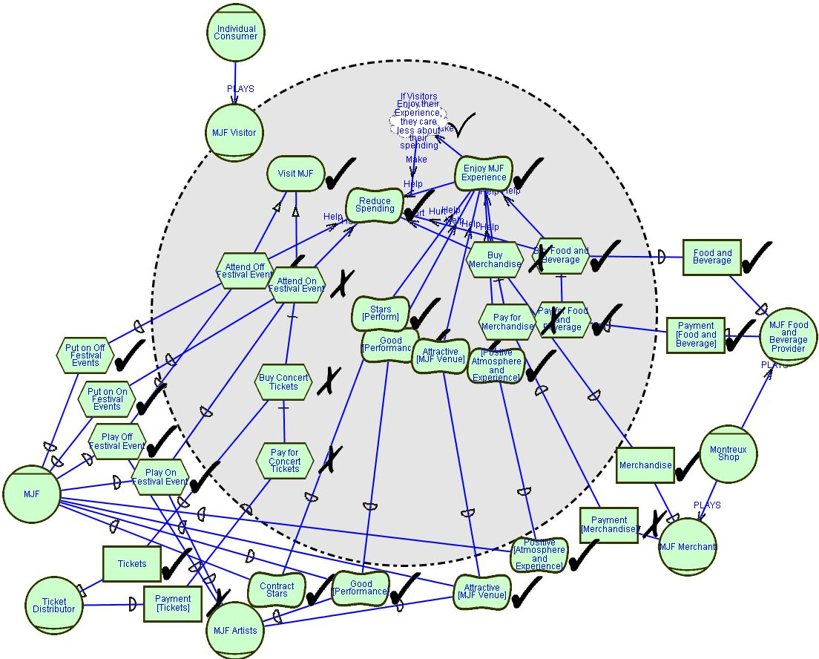
SR: MJF Visitor Evaluation
Leaf Nodes (starting points in the evaluation procedure) are labeled with red circles.
This particular visitor only attends Off Festival Events and Purchases Food and Beverages but not Merchandise

Slide 13

SR: MJF Visitor Evaluation
This particular visitor attends On Festival Events and Purchases Merchandise but not Food and Beverages

Slide 14
SR: MJF Visitor Evaluation Comments and Questions
The previous evaluation examples show some of the potential evaluation problems of actor multiplicity and the lack of ability to show this multiplicity. In reality there are many MJF Visitors and each will chose a combination of attending Off Festival Events and On Festival Events as well as purchasing Food and Beverage and/or Merchandise. When only one MJF Visitor is shown then only one possibility is demonstrated. For example, the first evaluation shows a Visitor who doesn’t go to On Festival Events. Because of this the Payment [Tickets] resource for the MJF is denied, as the Visitor does not buy official tickets. In reality this resource may not be denied because there are other MJF Visitors not shown who do buy tickets. But how many of them are there? So is Payment [Tickets] then satisficed or partially satisfied? In the first and second evaluation the same issues appear with Payment [Food and Beverage] and Payment [Merchandise].

Slide 15
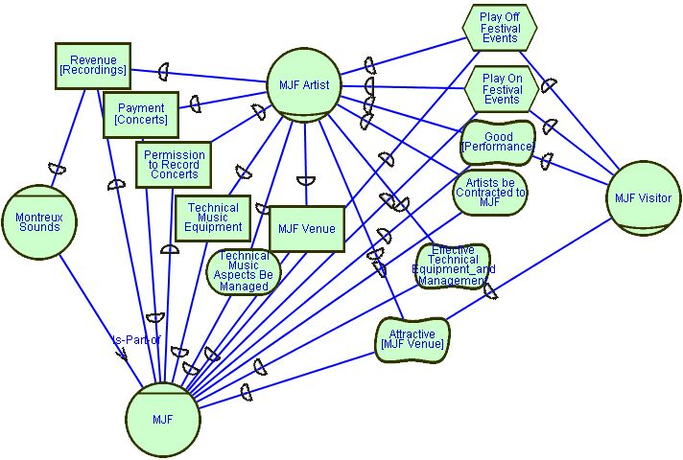
SD: MJF Artist
All the elements here were in the previous Big Picture SD Model
Any actor or element not involved in a dependency relationship with the MJF Artist was removed for clarity

Slide 16
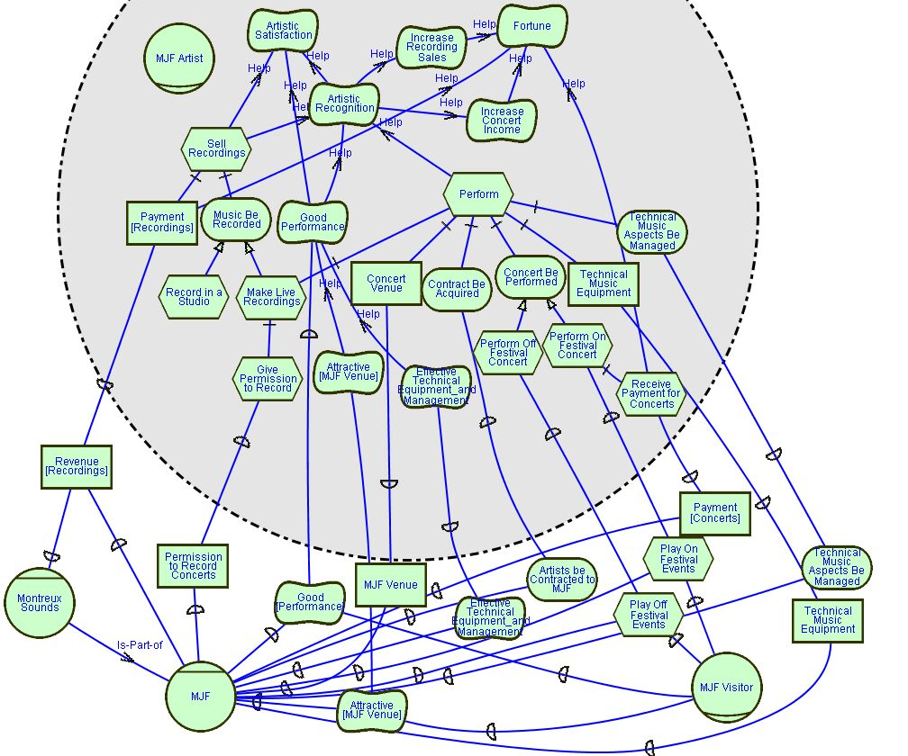
SR: MJF Artist
The main softgoals of the MJF artist are Artistic Satisfaction, Fortune and Artistic Recognition.
To satisfy these elements Artists Sell Recordings and Perform.
I’m assuming artists don’t get paid for Off Festival Events.

Slide 17
SR: MJF Artist Questions
Should resources appear inside of an actor? For example I have Payment Recordings and Technical Music Equipment. Should these resources themselves be decomposition elements of Sell Recordings and Perform or should it instead be tasks that describe the acquisition of these resources like Receive Recording Payments and Acquire Technical Music Equipment? Which way is correct and why?
Good Performance is not a decomposition element of Perform because of problems with the evaluation in this case. Although it seem logical that wanting to have a Good Performance is part of performing, if Good Performance is denied then by the and evaluation rule for decomposition Perform is also denied. This is not allowing for the possibility of a bad performance, or in other words, it is still possible to perform and make money, even if the performance is not good.

Slide 18
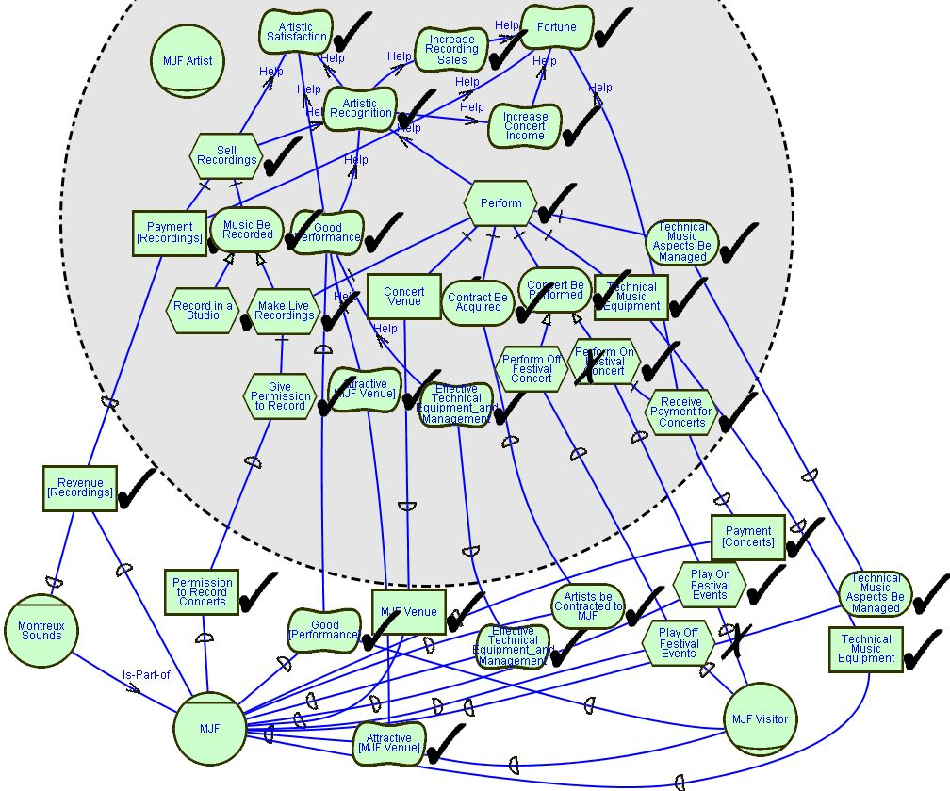
SR: MJF Artist Evaluation
Assuming that the leaf nodes labeled satisficed are satisficed the top level softgoals of Fortune, Artistic Recognition and Artistic Satisfaction are satisficed
The same issues with multiplicity and choice occur here as well, Play Off Festival Events is probably not really denied

Slide 19
SR: MJF
Because of the massive size of the complete SR model for the MJF I am presenting it piece by piece. The pieces I have chosen focus on the relationship between the MJF and a few actors at a time. In each piece I have deleted actors and elements that do not seem to be relevant to the actors being considered.
In order to create these diagrams I first made one really big SR Model. The other approach would have been to create each model with only a few actors in it one at a time and possible piece them all together at the end for a larger view. There are pros and cons to each method that can be summarized:
Create One Big Model then Divide it up into Readable Pieces | Create Many Smaller Models then put them together into one Big Model
New Changes Discovered only have to be made once for the one Model | New Changes have to be possibly applied back to each previously completed model (this is really annoying, especially when each picture needs to be imported into ppt or word)
It is easy to create smaller views by deleting irrelevant elements | Creating each smaller model by itself takes more time
Creating the large model takes a long time | Creating each smaller model takes far less time, but there are many of them, with possibly repeated elements
OME is incredibly slow for large models | OME is ok for small to medium models
The large model is very hard to read in order to be divided and created | The small models are easier to read

Slide 20
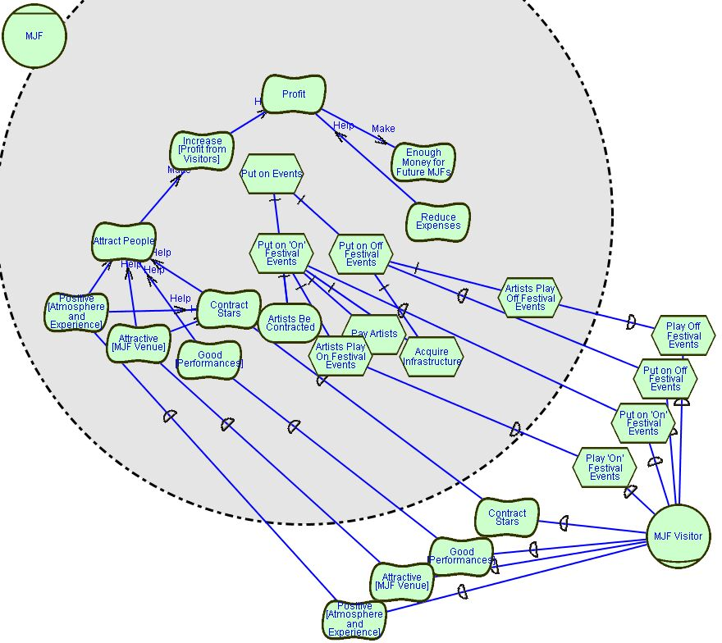
SR: MJF and Visitor
The main softgoal of the MJF is profit.
It needs to Attract Visitors in order to profit.
Many elements allow the MJF to Attract Visitors.

Slide 21
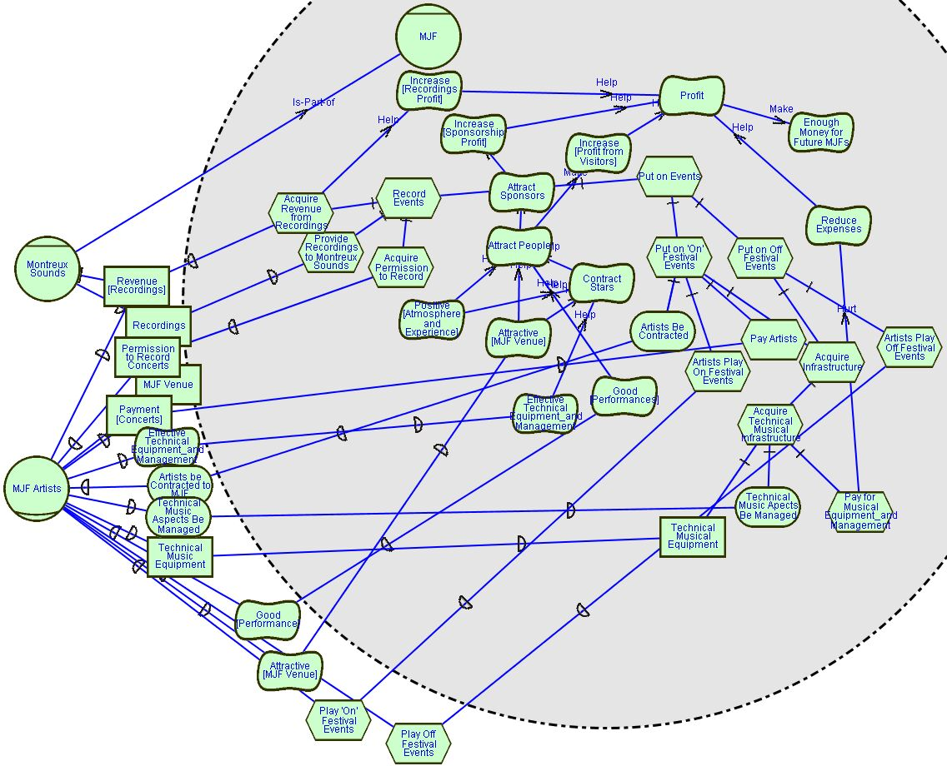
SR: MFJ and Artist

Slide 22
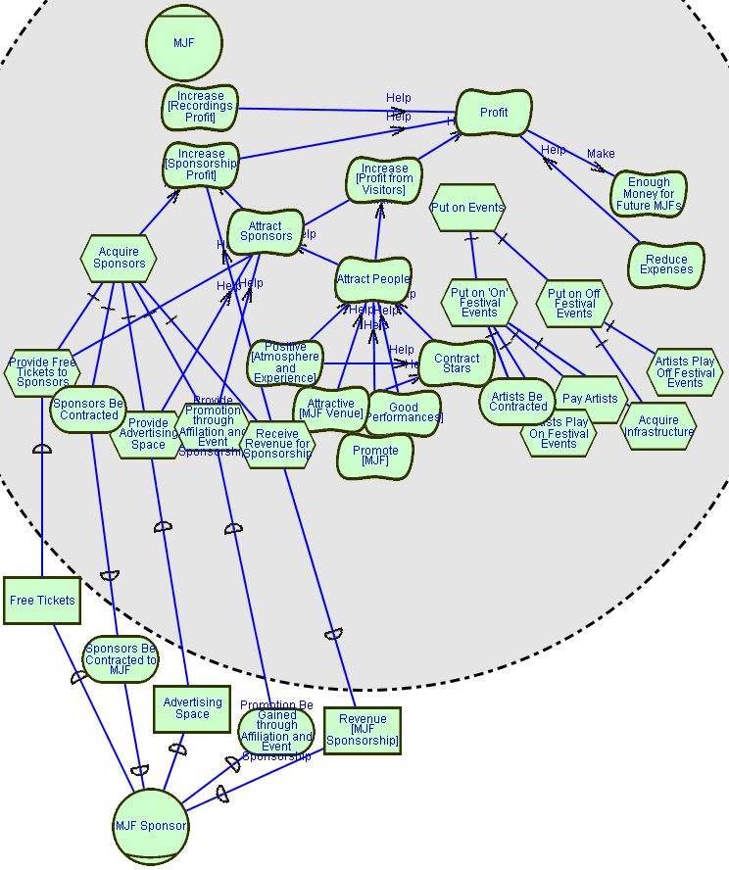
SR: MJF and Sponsor
This model brings up another point that elements need to be moved around and adjusted each time in order for them to be read. In this case I forgot to move the hurt link from Provide Free Tickets to Sponsors to Increase [Profit from Visitors], so it’s covered by Attract Sponsors. It would be nice if elements were “smart” enough to know not to cover each other, that would be tricky though.

Slide 23
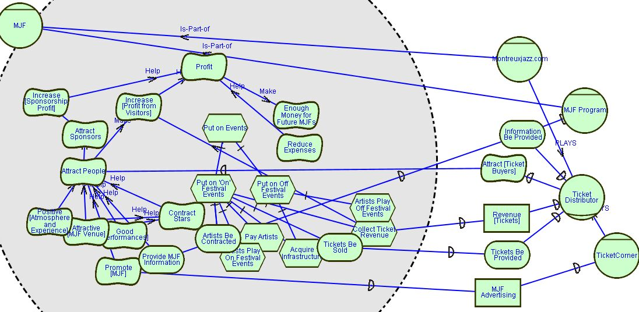
SR: MJF and Ticket Distributors

Slide 24
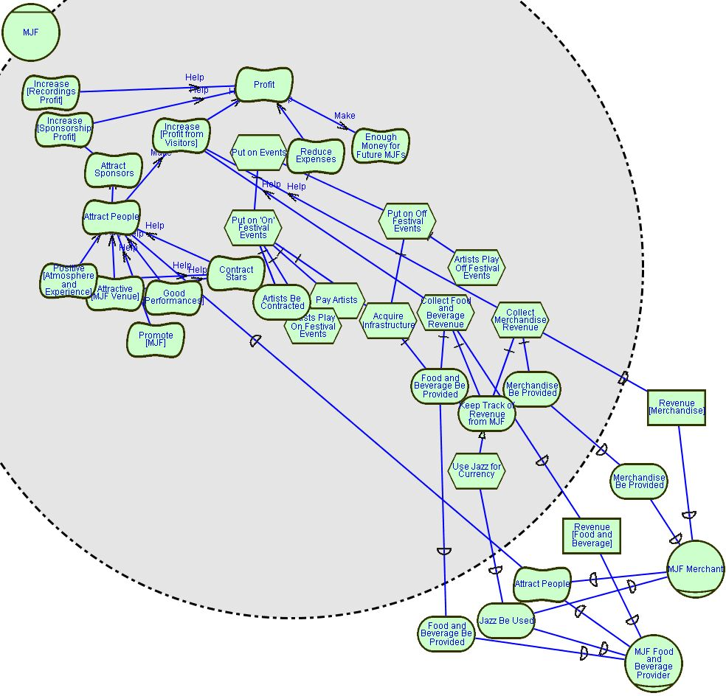
SR: MJF, FB and Merchants

Slide 25
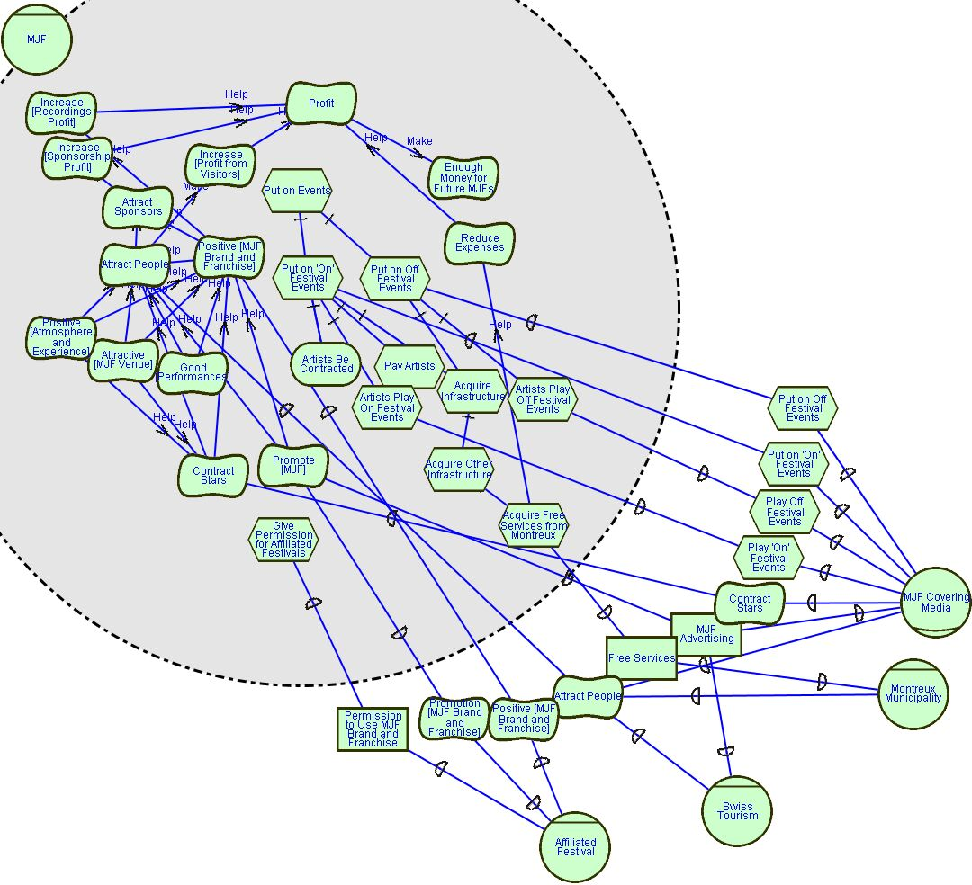
SR: MJF, Media, Montreux, Tourism and Affiliated Festivals
It looks like an error to have the Media and MJF both depend on Play Off and On Festival Events, but both the Media and MJF actually depend on the MJF Artist for this task, but it is not shown in this model. That is one of the effects of breaking a model up into readable pieces, sometime the things missing may cause confusion or apparent errors.

Slide 26
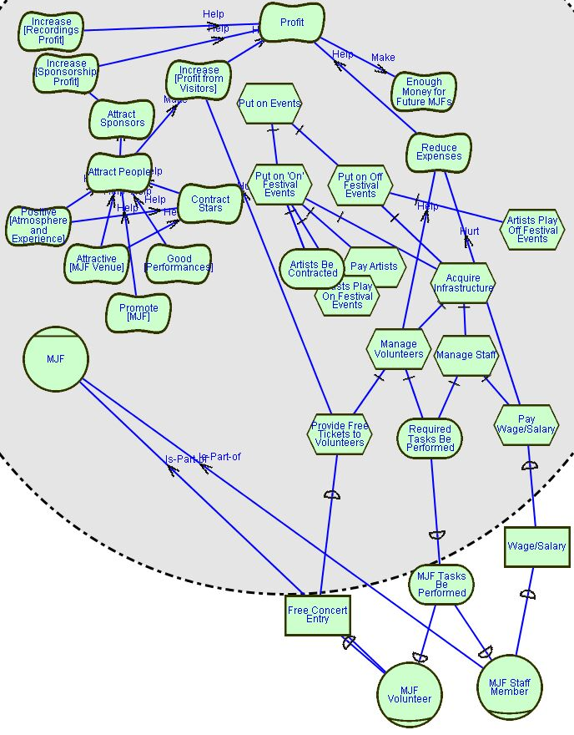
SR: MJF, Staff and Volunteers
Required Tasks be Performed is extremely general, but as the Case Study did not go into too much detail on the duties of the volunteers and staff and as the model is already detailed, I have not decomposed this goal. Examples of “tasks” would be to take tickets at venues, clean venues, provide directions, etc.

Slide 27
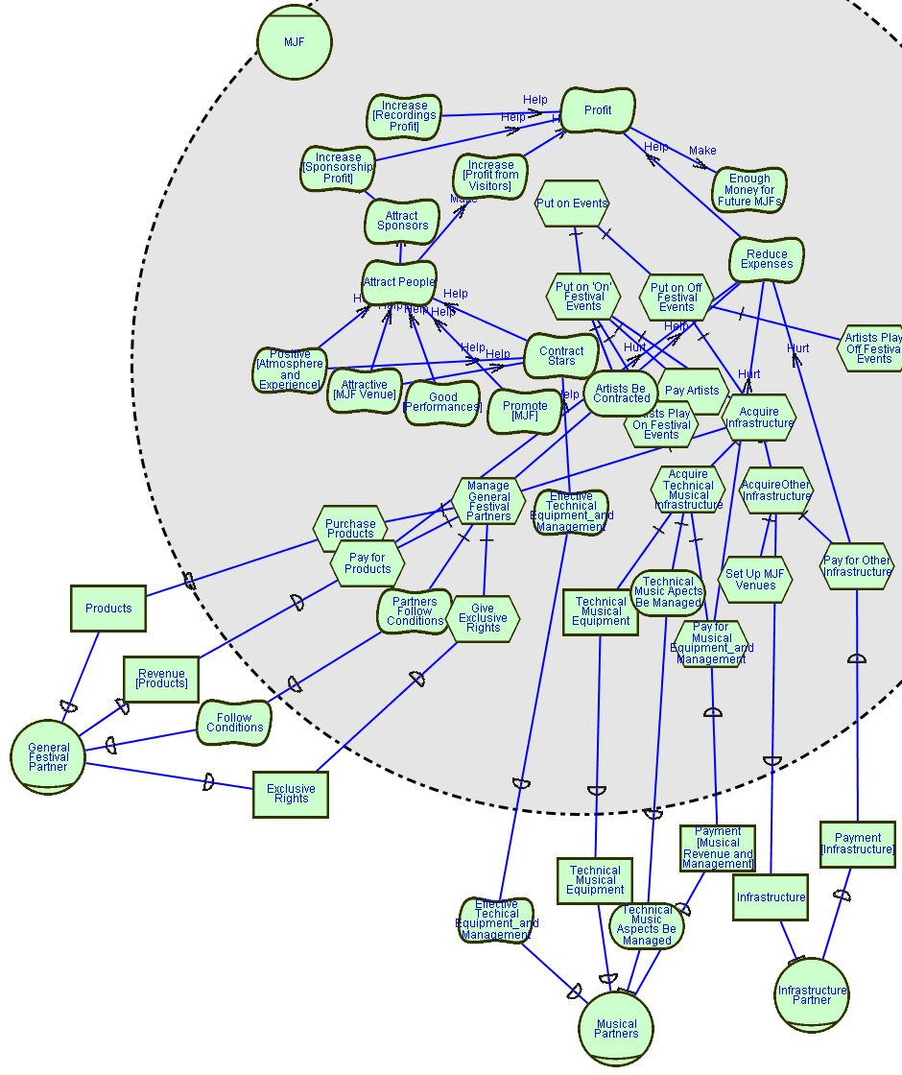
SR: MJF and Partners
“Other” Infrastructure is again very vague, but by this I mean physical stages, maybe chairs, fences, tents, etc. Again the Case Study does not give a lot of detail about these things.
It is also not extremely clear what sorts of products General Festival Partners provide, or why the MJF would want to give them exclusive rights, presumably the MJF gets some sort of discount for providing them exclusive rights, perhaps this is included in the “Conditions” mentioned in the Case Study

Slide 28
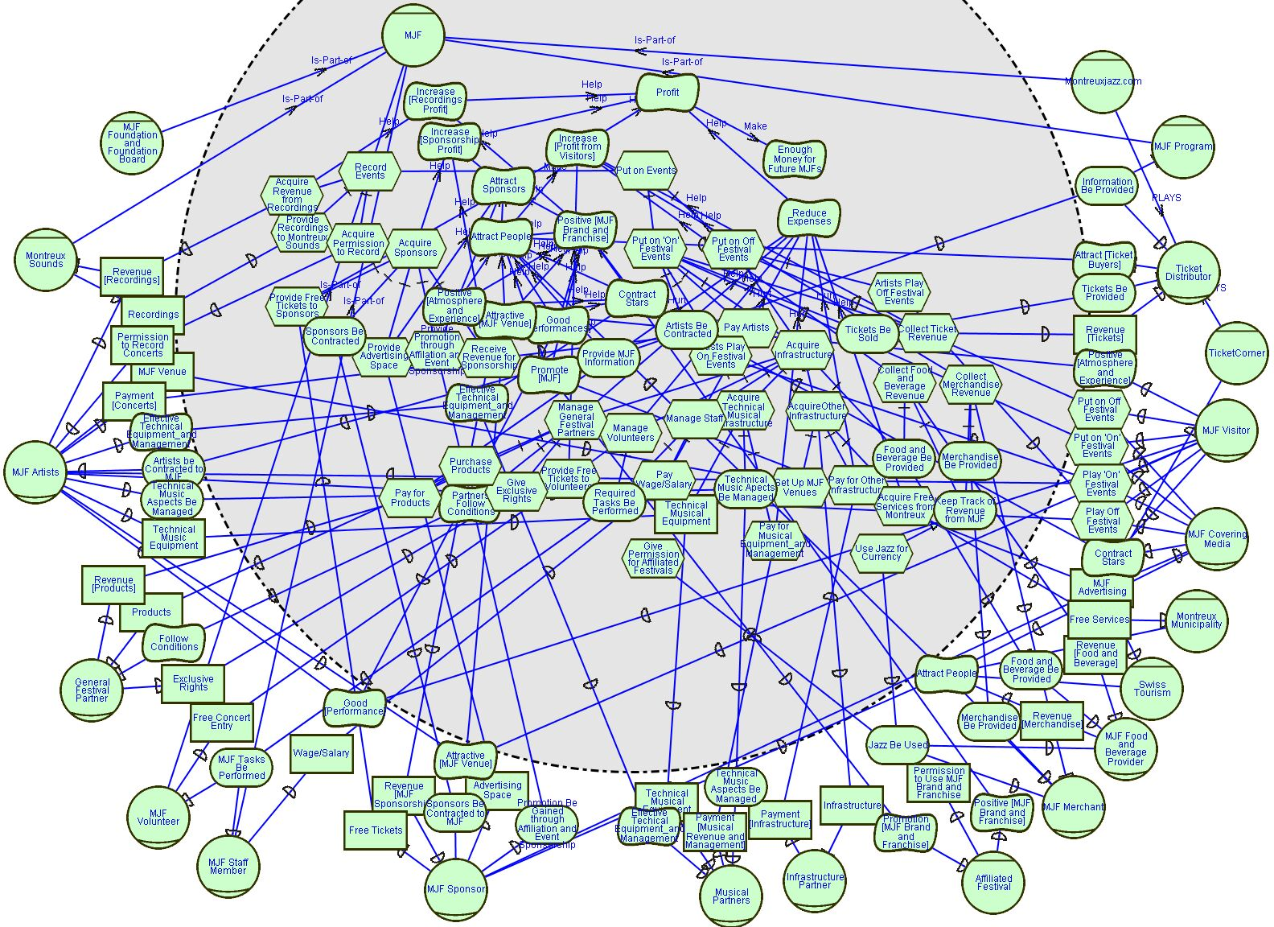
SR: MJF

