Slide 1

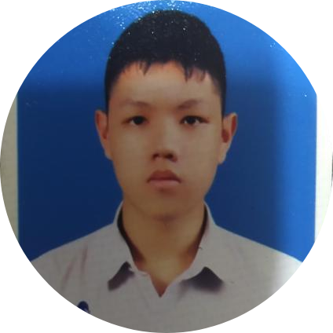

AI-shiteru
From Thailand
Film
Tham
Prem
Notes:
Hello we are from Ai-shiteru from Thailand Today we will present our project JOBTISTIC

Slide 2
J O B T I S T I C

Slide 3

Introduction
1:59
Normal: Austistic Children
Source: Centers for Disease Control and Prevention
Notes:
From the statistic 1 in 59 children are found with autistic problem.

Slide 4
Introduction
80%
Unemployed
Source: Centers for Disease Control and Prevention
Notes:
80% of autistic people around the world are unemployed

Slide 5

Introduction
≈300000
Autistic people in Thailand
Source: Department of Empowerment of Persons with Disabilities
Notes:
and around 300000 autistic people living in Thailand

Slide 6
Introduction
≈200
Autistic people in Thailand who have work and income to support themselves
Source: Department of Empowerment of Persons with Disabilities
Notes:
But only a small number of them are actually have a work.

Slide 7



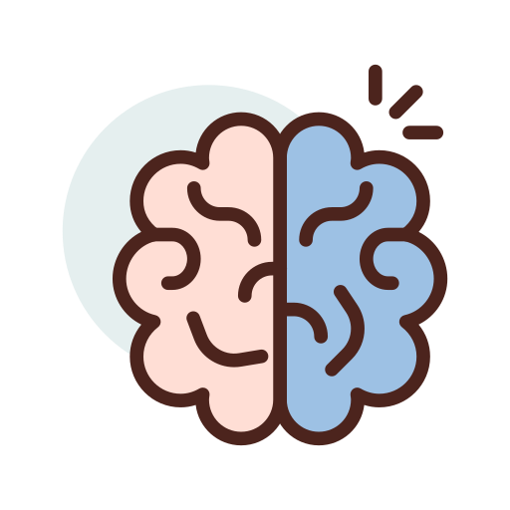

Strong point
Less distracted by social interactions
Detail and Accuracy
Powerful memory
Obsessive approach when it is needed
Notes:
People with autism are actually capable of holding regular, full-time jobs just like normal people. In fact, autistic employees might perform better than their peers with these traits.

Slide 8







Introduction
Photographer
Writer
Work and earn money
Help Family
Happy
Artist
Barista
Notes:
With appropriate job and right support these autistic people can have a regular income to support themselves and their families to have a better life quality.

Slide 9
Can we help them?
Yes
Notes:
Yes definitely

Slide 10
AI
How?
Artificial Intelligence
Notes:
So that when AI come in to help them determined their career choices that is best suits their interest and ability

Slide 11







Tools and equipment
Machine Learning Studio
Azure bot service
Microsoft Azure
Azure app service
Computer
Web application
Azure Datacenter

Slide 12
Process of Solution
Notes:
Our app have 4 processing step, first recommend system second third lastly

Slide 13
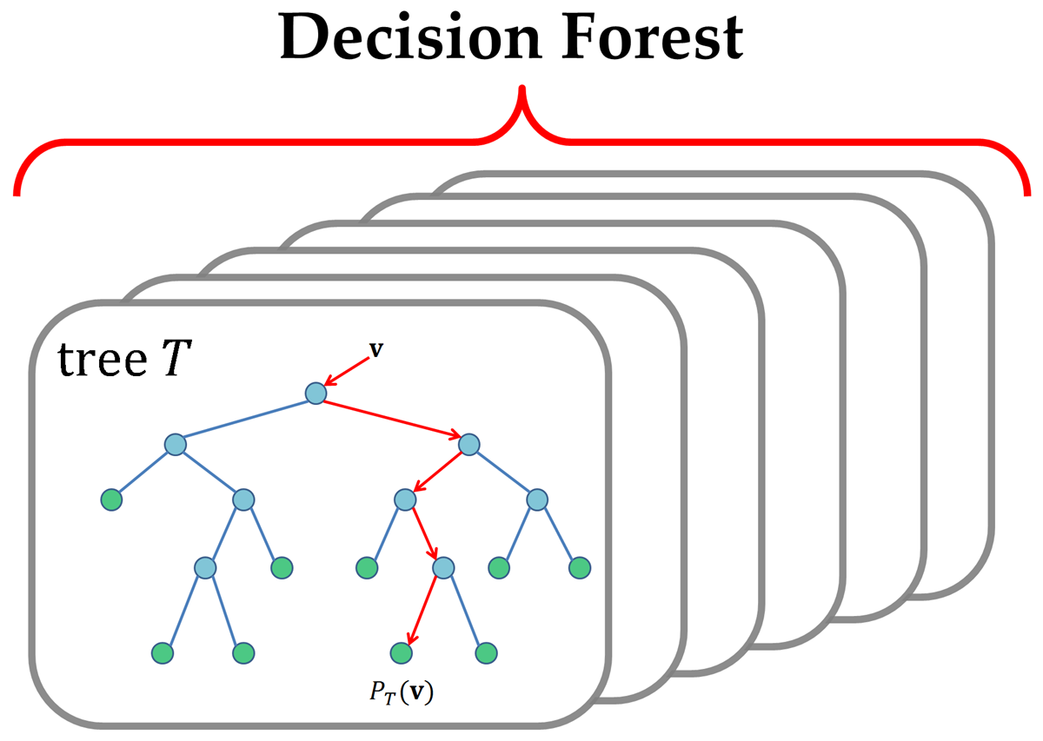
Process - Recommend System Example
We will find an interesting career through the data collected by the recommended system using Multiclass Decision Forest in Azure's Machine ​ Learning.
Question 1
A) B) C)
Question 2
A) B) C)
Question 3
A) B) C)
…
Photographer
Writer
Artist
Barista
Barista
Notes:
To make better understanding of the system we will use the barista career for the example , start with recommend system with the AI help, it will recommend your job from the answer that you chose then through the decision forest will get you the suitable job next

Slide 14


Process – Barista Online Course Example
After getting a suitable job of your interests, you will be continuing to online study.
Barista
Barista online courses
Notes:
the user will have to go through barista online course to learn the basic about career and If you don’t like Barista you can change the job by using AI or decide by yourself
then after that

Slide 15


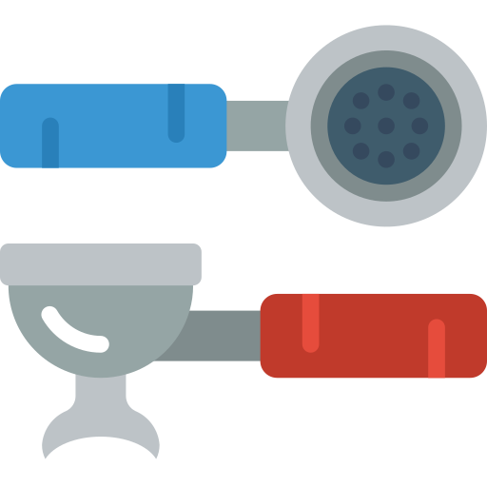
Process – Barista Virtual Workshop Example
Experimenting on the virtual workshop by simulating a virtual game that is like a real working process and it is available through any platform to get you ready.
Virtual Workshop
Barista virtual workshop
Notes:
The User will be experimenting on their own with the virtual workshop

Slide 16


Process – Barista Certification Example
Passing a test to get certificates that can guarantee that you are ready to apply to the job through our contracted company.
Certificate
Our contracted company
Notes:
last Passing a test will get you a certificates that can guarantee that you are ready to apply to the job through our contracted company.

Slide 17
Process – Barista Example Summarize
AI help to recommend your job from answer for this example is Barista, but you can try to decide other job by yourself
Learn online course how to make coffee from a barista. If you don’t like Barista you can change the job by using AI or decide by yourself
Learn online course how to make coffee from a barista. If you don’t like Barista you can change the job by using AI or decide by yourself
Notes:
And this is summarize of barista app process

Slide 18

Benefits
After complete the exam ,you will get the certificate that says you are able to work.
Increase your chances of getting accept into work.
Once an autistic person has a job, they can become self-sufficient and lighten the family burden.
Notes:
And The profit gain from using this app is that you will get the certificate that says you are able to work. Increasing your chances of getting accept into work. And can become self-sufficient and lighten the family burden.

Slide 19
Referrences
https://www.posttoday.com/social/local/74952
https://www.siamhealth.net/public_html/Disease/neuro/psy/austism/autism.htm
https://www.autismparentingmagazine.com/best-autism-jobs-and-careers/
https://edition.cnn.com/2018/04/26/health/autism-prevalence-cdc/index.html
Notes:
This is our Referrences

Slide 20
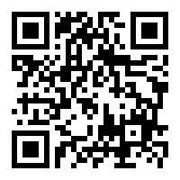
THANK YOU https://fxlmer.wixsite.com/ms-apac-ai-2020
Notes:
Thank you for attention
For more information you can visit our website
And Please feel free to ask

